Slide 1
Introduction to the Analytical Mindset
ACCTG 320
Accounting Systems and Analytics
Class 01 | Autumn | 2026

Slide 2
Agenda
Introductions
Course Overview & Expectations (Syllabus)
The Analytical Mindset (interactive activities)
Conclusion and look ahead
**time permitting, login and orientation to foster remote labs

Slide 3




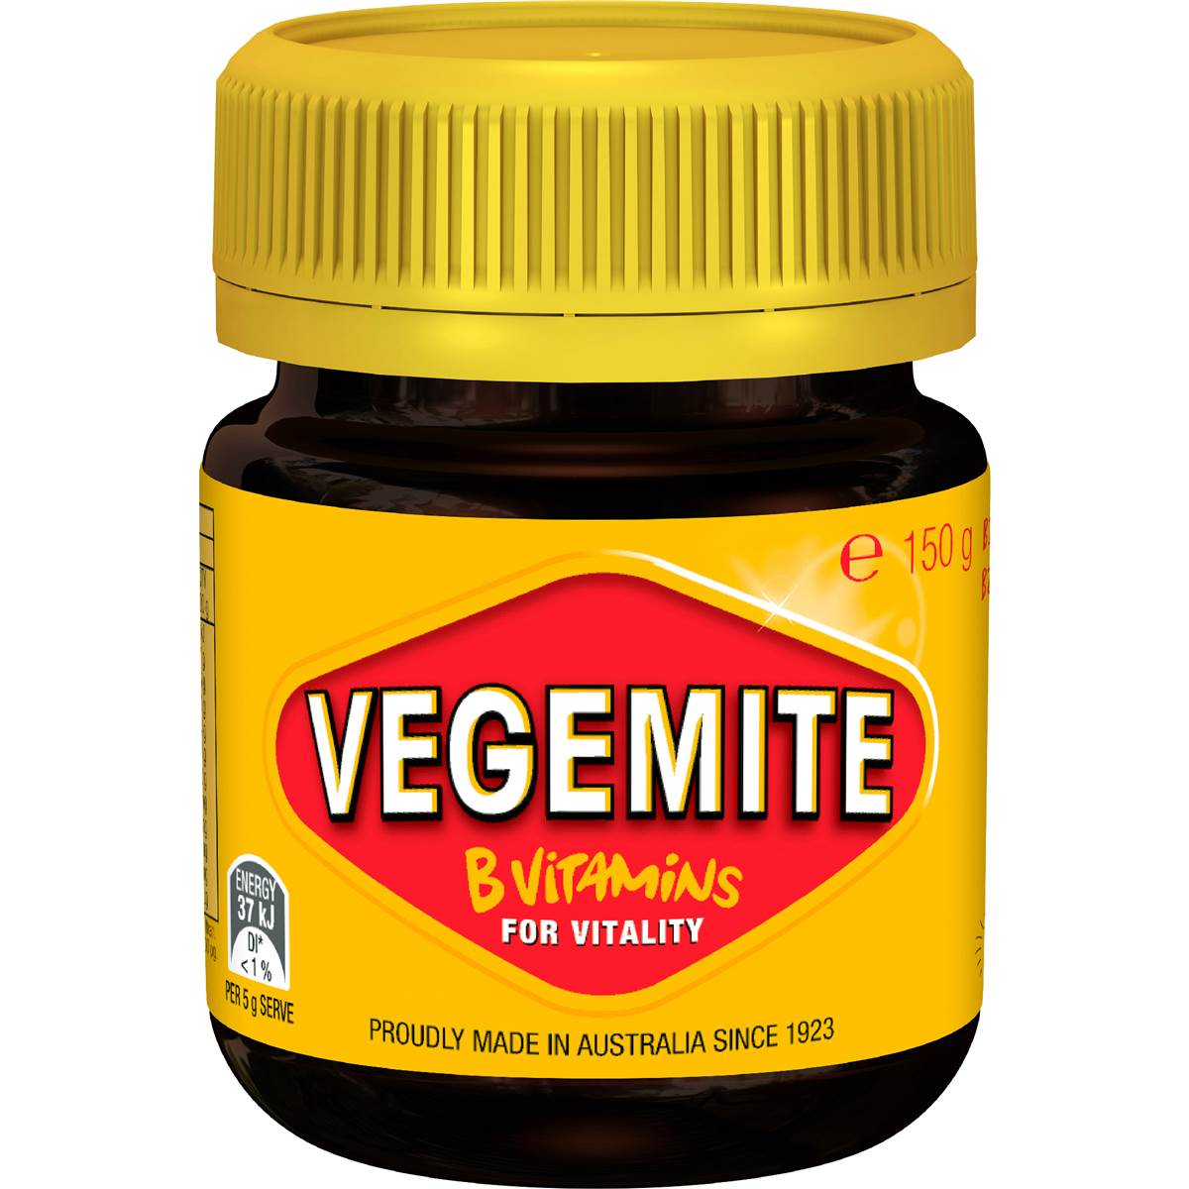





My Background

Slide 4
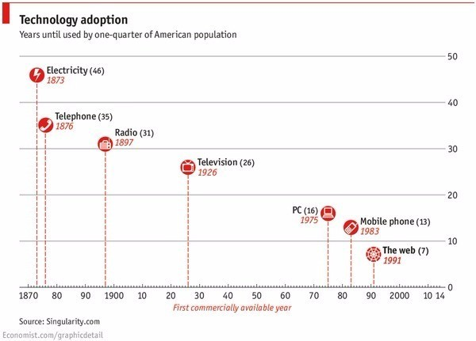
“The new people to thrive are the adaptive ones”
Lior Frenkel, December 2016

Slide 5
“The new people to thrive are the adaptive ones”
Lior Frenkel, December 2016
Go back just around 20 years and:
No smartphones
No Facebook, YouTube, or Instagram
No online job boards or LinkedIn
No Lyft, Uber, or Google Maps
No WhatsApp or Zoom
No AirBnb or Netflix
No Cloud or IoT
No blockchain or cryptocurrencies
No Chat GPT
And technology is accelerating…

Slide 6
Agenda
Introductions
Course Overview & Expectations (Syllabus)
The Analytical Mindset (interactive activities)
Conclusion and look ahead

Slide 7
Syllabus
Syllabus · ACCTG 320 · Autumn 2026 (Section A)
Syllabus · ACCTG 320 · Autumn 2026 (Section B)

Slide 8
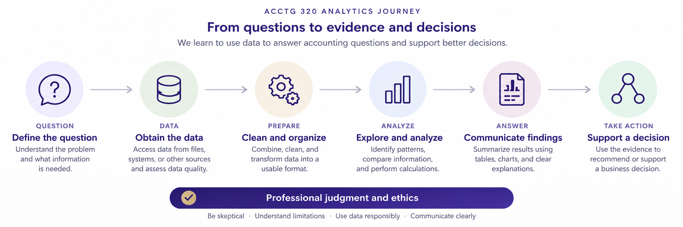

Slide 9
Generative AI usage
Let’s collect your thoughts on Gen AI usage in this course
First: I’ll provide some articles; you tell me what you think went wrong
Second: General Polls (PollEverywhere).

Slide 10
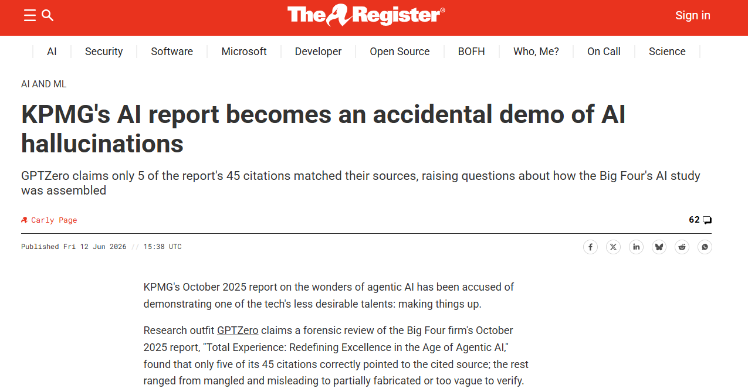

Slide 11
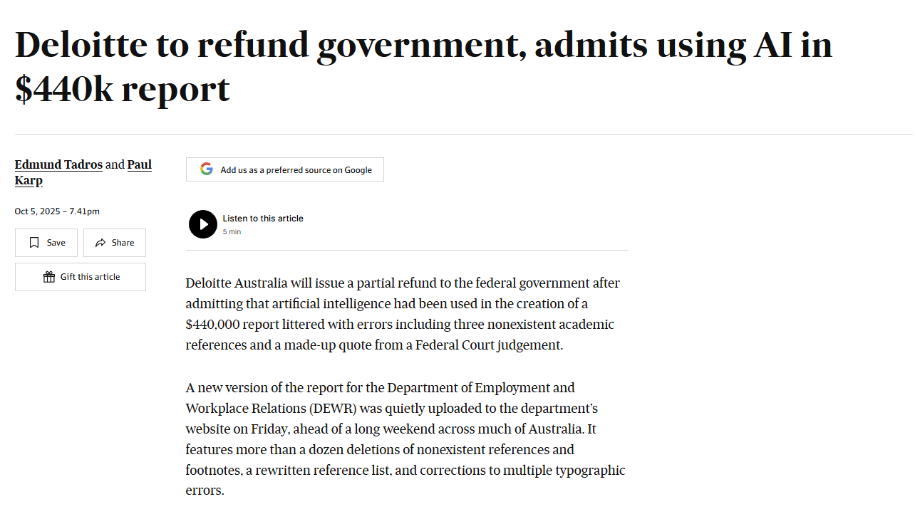

Slide 12
What do you think went wrong?

Slide 13
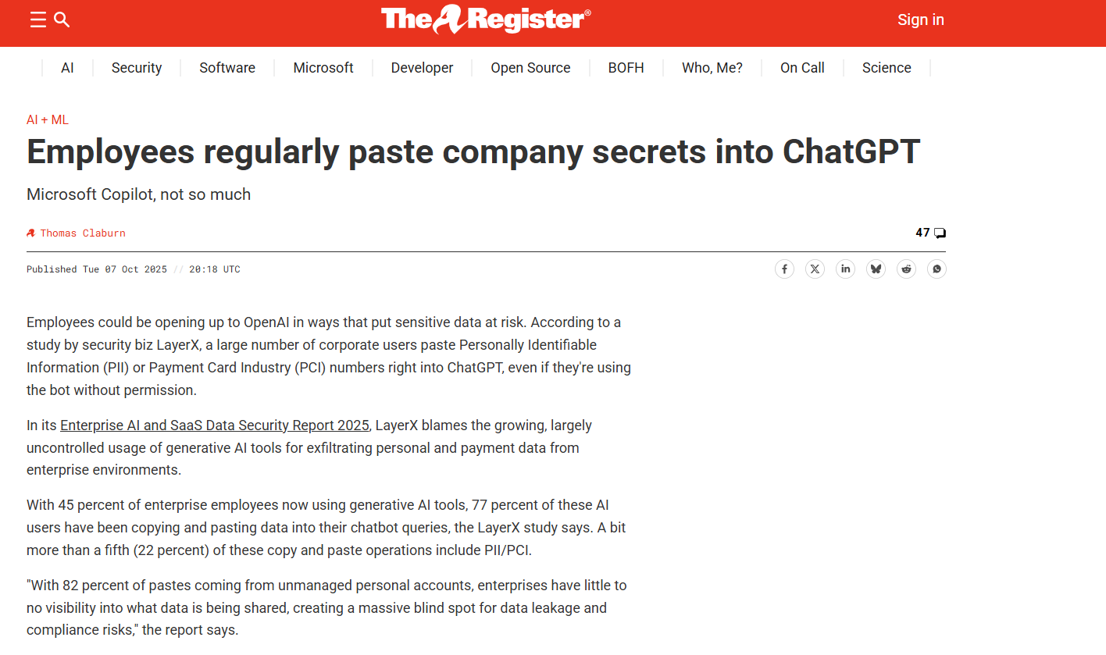

Slide 14
Why is this a problem?

Slide 15
Generative AI usage
You remain responsible for what you submit or recommend (Deloitte and KPMG news events)
Having access to a document does not establish permission to upload it (e.g., paste secrets article).
  In professional practice: Access to client or employer information does not give you permission to share it with an AI tool.

Slide 16
PollEverywhere Polls
Be prepared to answer “Appropriate”, “Inappropriate”, or “Depends” for two Gen-AI use cases.

Slide 17
Summary: AI assisted work you can explain
1. Define the task and check the rules for AI assistance.
2. Share only information you have permission to provide.
3. Test the output against evidence and your own reasoning.
4. Revise the result and record any required disclosure.

Slide 18
Expectations for the year
Learn data analytics technology and build skills through practice.
Contact me early if you feel lost/overwhelmed.
Use professional skepticism when reviewing analytics (including AI) output.
Be attentive and engaged.
Own the reasoning, evidence and final work you submit.

Slide 19
Agenda
Introductions
Course Overview & Expectations (Syllabus)
The Analytical Mindset (interactive activities)
Conclusion and look ahead

Slide 21
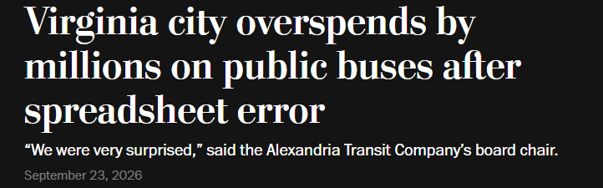
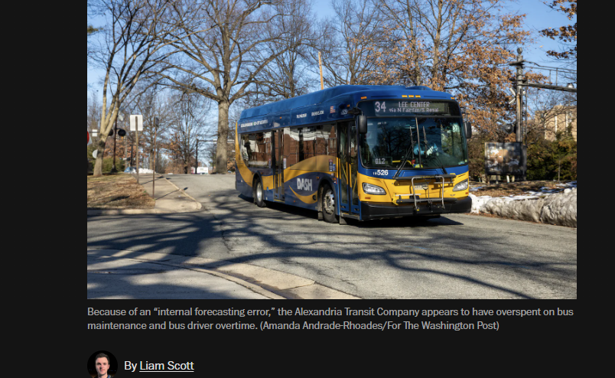
Alexandria Transit: A $3.2 Million Spreadsheet Error
(Based on Washington Post | September 23, 2026 |Sources: Original article

Slide 22
Alexandria Transit: A $3.2 Million Spreadsheet Error
What happened?
Alexandria Transit Company (DASH) ended fiscal 2026 about $3.7 million over budget.
A $3.2 million spreadsheet forecasting error overstated available funding and helped conceal the shortfall until after year-end.
The deficit was roughly 10% of the transit system's operating budget.
Why this matters for accounting analytics
Analytics depends on reliable inputs. A simple data or spreadsheet error can propagate into forecasts, budgets, reports, and ultimately business decisions.

Slide 23
Alexandria Transit: A $3.2 Million Spreadsheet Error
Discussion points:
How could an organization make decisions for months using an incorrect spreadsheet?

Slide 24
Alexandria Transit: A $3.2 Million Spreadsheet Error
Discussion points:
How could an organization make decisions for months using an incorrect spreadsheet?
What processes/checks/procedures (or controls) could have helped detect the problem earlier?

Slide 25
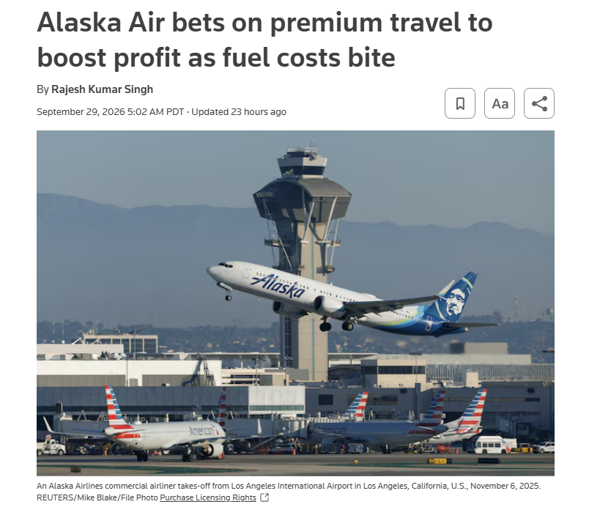
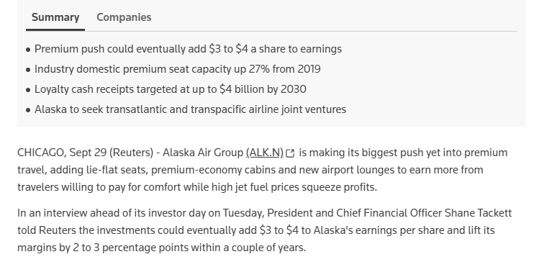
Alaska Air: Analytics as Decision Support
(Based on Reuters | September 29, 2026 |Sources: Reuters article

Slide 26
Alaska Air: Analytics as Decision Support
What happened?
Alaska Air is expanding premium cabins, lounges, and other higher-value offerings as it builds its international network.
Management estimates the strategy could eventually add $3–$4 to earnings per share and improve margins by 2–3 percentage points.
At the same time, volatile fuel costs materially affect profitability and forecasts.
Why this matters for accounting analytics
Accounting analytics is not limited to detecting errors or fraud. It supports forward-looking business decisions involving customers, pricing, capacity, costs, investment, profitability, and uncertainty.

Slide 27
Alaska Air: Analytics as Decision Support
Discussion points:
What data would Alaska need to decide whether adding premium seats creates value?

Slide 28
Alaska Air: Analytics as Decision Support
Discussion points:
What data would Alaska need to decide whether adding premium seats creates value?
What are the relevant revenues, costs, constraints, and alternative uses of aircraft space?

Slide 29
Alaska Air: Analytics as Decision Support
Discussion points:
What data would Alaska need to decide whether adding premium seats creates value?
What are the relevant revenues, costs, constraints, and alternative uses of aircraft space?
What would make you comfortable to use a descriptive analytics result ('what are premium customers doing?’) to make an operational decision (‘we should add more premium seats')?

Slide 31
Agenda
Introductions
Course Overview & Expectations (Syllabus)
The Analytical Mindset (interactive activities)
Conclusion and look ahead

Slide 32
Questions and next steps
Questions?
Next topic: We will discuss data quality issues
I look forward to your questions and taking the next steps on Monday!
Thank you!

Slide 33
Foster Remote Labs (time permitting)
https://fprod-hcs.foster.uw.edu
Sign in using UW netid and password.
Familiarize yourself with the remote environment and identify storage location.
Open a file, save a copy and confirm where it went (goodbye.txt; hello_world.txt).
Your laptop and the remote computer have different file locations.

