Slide 1
Introduction to the Analytical Mindset
ACCTG 522
Data Analytics for Professional Accountants
MPAcc Class of 2027
Class 01 | Autumn | 2026

Slide 2
Agenda
Review (Introduction; Gen AI; PollEverywhere)
Course Overview & Expectations (Syllabus)
The Analytical Mindset
  Definition
  From data to responsible decisions
  Exercises (questioning data recursively)
Foster Remote Labs set-up

Slide 3




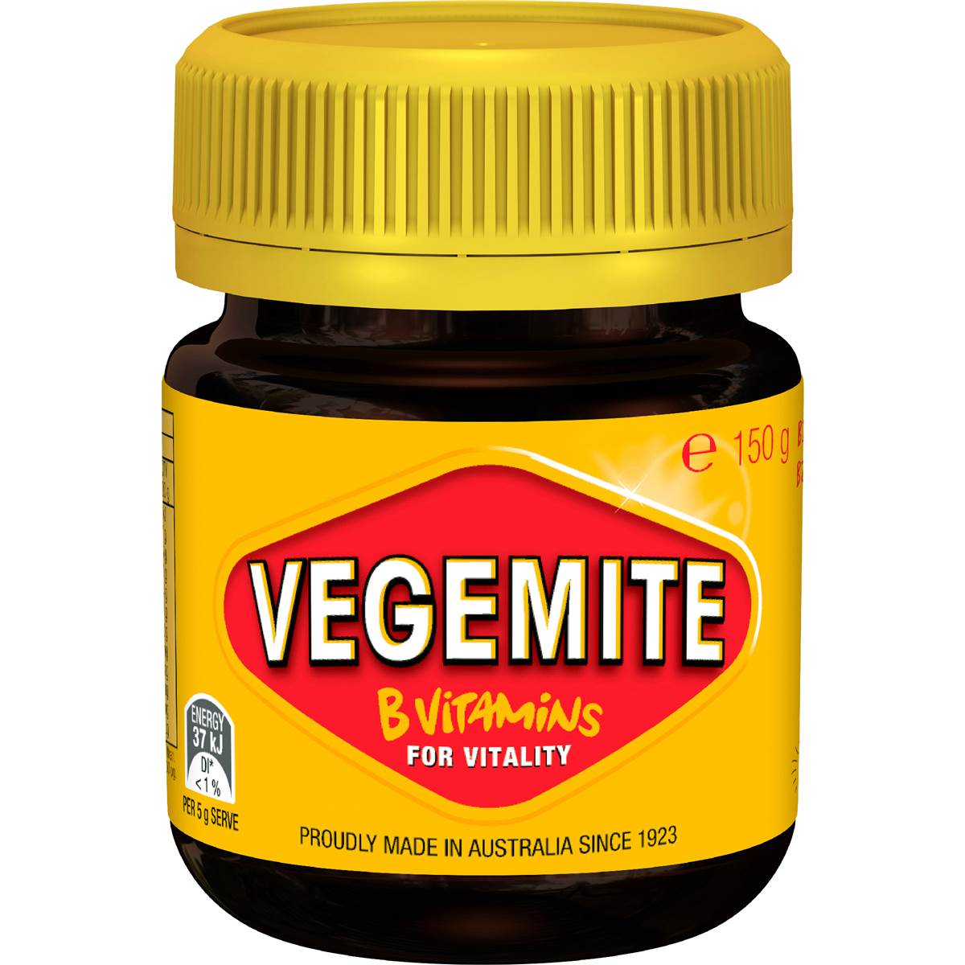





My Background

Slide 4
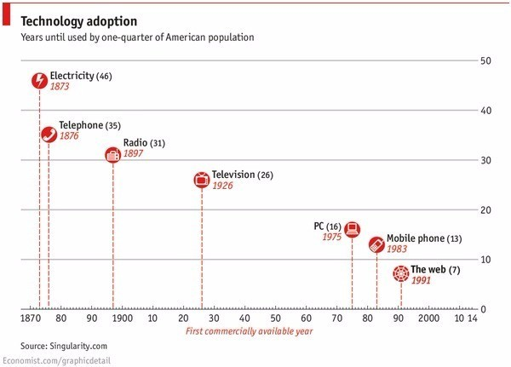
“The new people to thrive are the adaptive ones”
Lior Frenkel, December 2016

Slide 5
“The new people to thrive are the adaptive ones”
Lior Frenkel, December 2016
Go back just around 20 years and:
No smartphones
No Facebook, YouTube, or Instagram
No online job boards or LinkedIn
No Lyft, Uber, or Google Maps
No WhatsApp or Zoom
No AirBnb or Netflix
No Cloud or IoT
No blockchain or cryptocurrencies
No Chat GPT
And technology is accelerating…

Slide 6
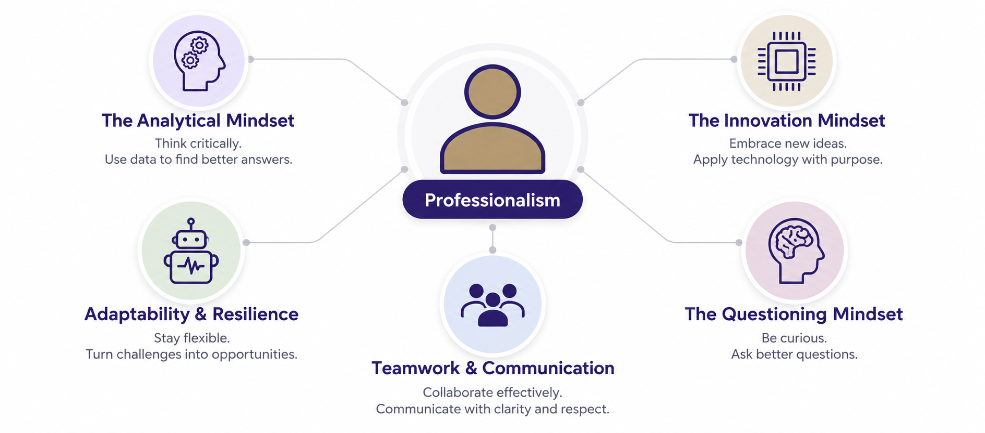
MPAcc mindsets
Which mindset matters when an AI answer sounds convincing?

Slide 7
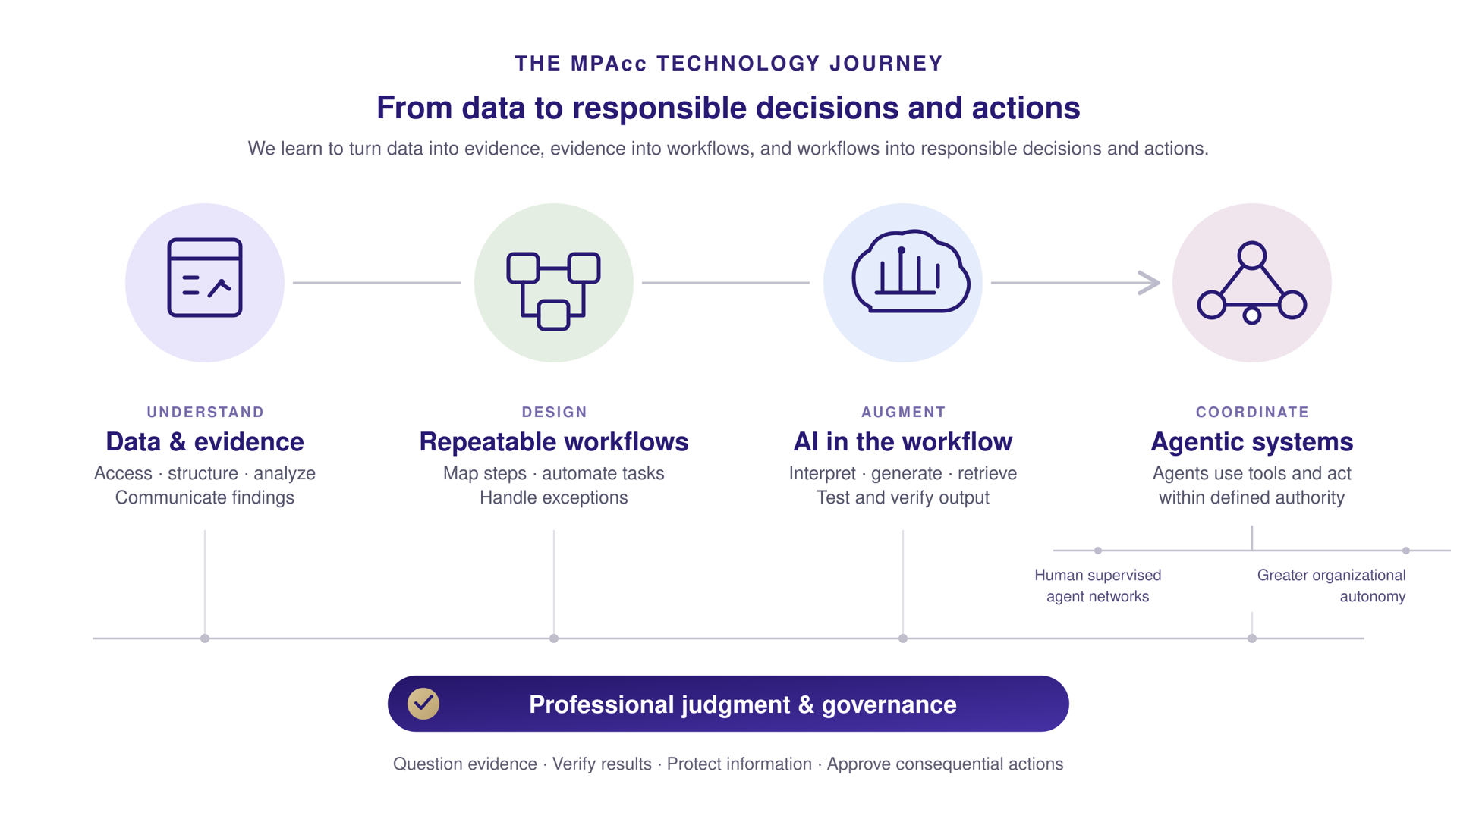

Slide 8
Generative AI usage
You remain responsible for what you submit or recommend (recall: Deloitte and KPMG news events)
Having access to a document does not establish permission to upload it.
  In professional practice: Access to client or employer information does not give you permission to share it with an AI tool.

Slide 9
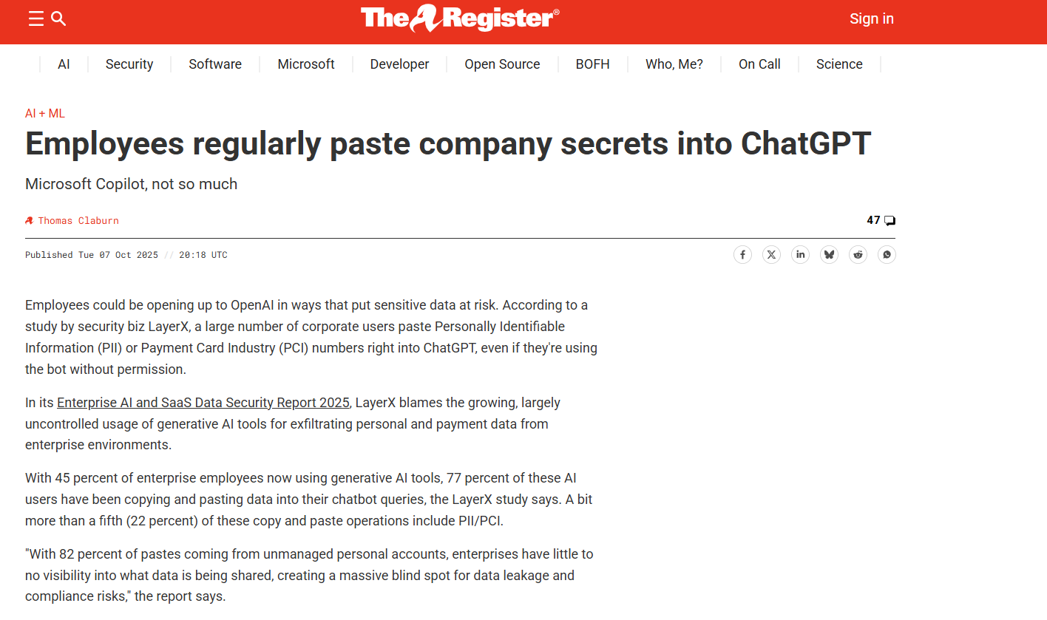

Slide 10
PollEverywhere Recap
Be prepared to answer “Appropriate”, “Inappropriate”, or “Depends” for two Gen-AI use cases.

Slide 11
Summary: AI assisted work you can explain
1. Define the task and check the rules for AI assistance.
2. Share only information you have permission to provide.
3. Test the output against evidence and your own reasoning.
4. Revise the result and record any required disclosure.

Slide 12
Agenda
Review (Gen AI; PollEverywhere)
Course Overview & Expectations (Syllabus)
The Analytical Mindset
  Definition
  From data to responsible decisions
  Exercises (questioning data recursively)
Foster Remote Labs set-up

Slide 13
Syllabus
Syllabus · ACCTG 522 · Autumn 2026

Slide 14
Common final project
MPAcc Common Final Project · Autumn 2026

Slide 15
Expectations for the year
Experiment with technology and build skills through practice.
Use professional skepticism when reviewing AI output.
Follow assignment rules and protect information.
Own the reasoning, evidence and final work you submit.

Slide 16
Agenda
Review (Gen AI; PollEverywhere)
Course Overview & Expectations (Syllabus)
The Analytical Mindset
  Definition
  From data to responsible decisions
  Exercises (questioning data recursively)
Foster Remote Labs set-up

Slide 17
MPAcc mindsets
What can analytics tell us?

Slide 18
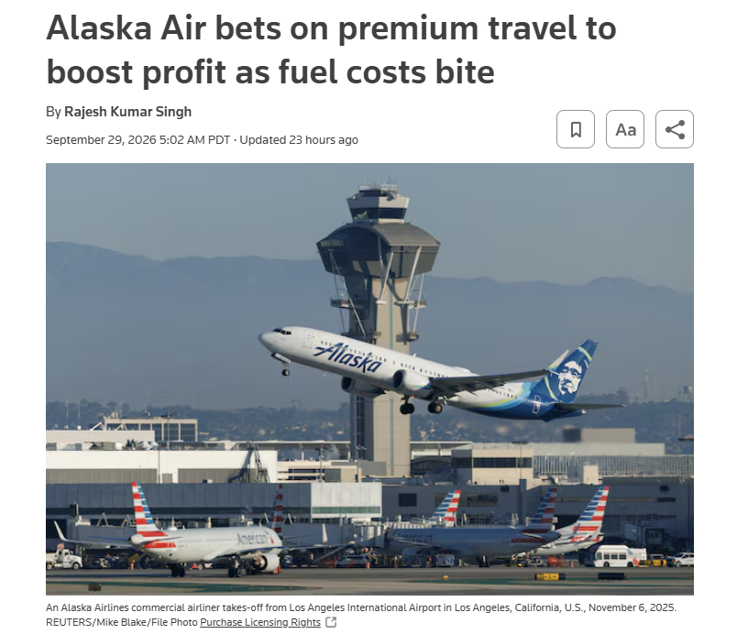
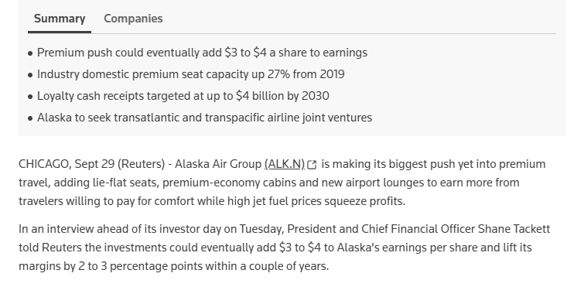
Alaska Air: Analytics as Decision Support
(Based on Reuters | September 29, 2026 |Sources: Reuters article

Slide 19
Alaska Air: Analytics as Decision Support
What happened?
Alaska Air is expanding premium cabins, lounges, and other higher-value offerings as it builds its international network.
Management estimates the strategy could eventually add $3–$4 to earnings per share and improve margins by 2–3 percentage points.
At the same time, volatile fuel costs materially affect profitability and forecasts.
Why this matters for accounting analytics
Accounting analytics is not limited to detecting errors or fraud. It supports forward-looking business decisions involving customers, pricing, capacity, costs, investment, profitability, and uncertainty.

Slide 20
Alaska Air: Analytics as Decision Support
Discussion points:
What data would Alaska need to decide whether adding premium seats creates value?

Slide 21
Alaska Air: Analytics as Decision Support
Discussion points:
What data would Alaska need to decide whether adding premium seats creates value?
What are the relevant revenues, costs, constraints, and alternative uses of aircraft space?

Slide 22
Alaska Air: Analytics as Decision Support
Discussion points:
What data would Alaska need to decide whether adding premium seats creates value?
What are the relevant revenues, costs, constraints, and alternative uses of aircraft space?
How would you distinguish descriptive analytics ('what are premium customers doing?') from a decision ('should we add more premium seats?')?

Slide 24
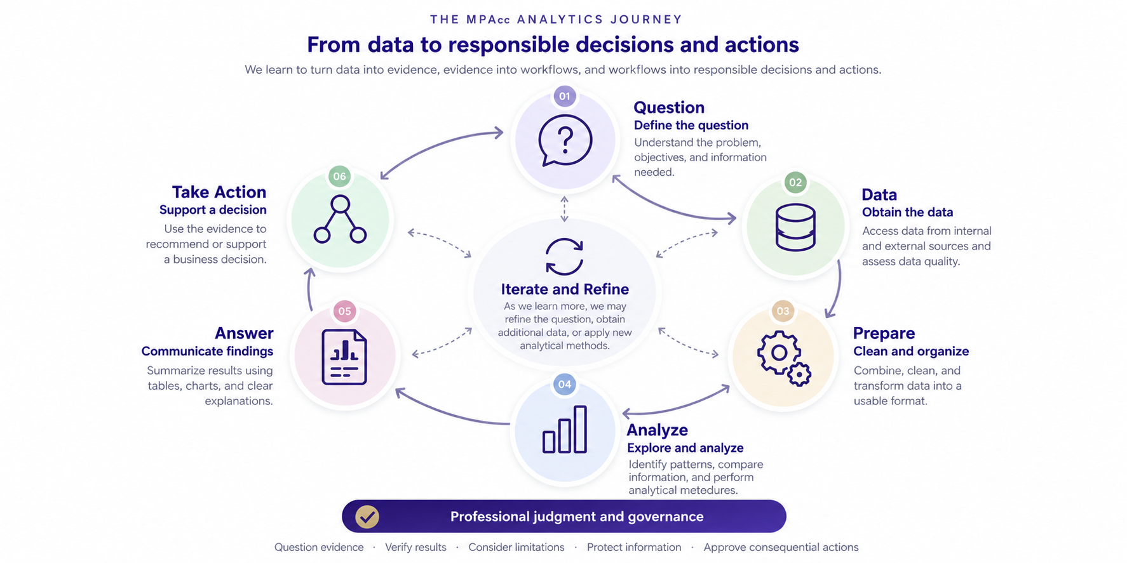

Slide 25
Why think of the link between data and question recursively?
We will work through scenarios where:
We have a question and expectation about data.
We access the data and identify unexpected data fields
We must/can revise our question

Slide 26
Initial question
Are employees circumventing the company's purchasing approval controls?
Expected data: employee, PO, vendor, amount, approver, approval date/time, invoice, payment.
Actual data: purchase order, vendor, amount, date. Approval data are absent and employee identifiers are incomplete.
Revised question?

Slide 27
Initial question
Are employees circumventing the company's purchasing approval controls?
Expected data: employee, PO, vendor, amount, approver, approval date/time, invoice, payment.
Revised question?
Are there purchasing patterns that indicate transactions that should be examined for possible control circumvention?
Actual data: purchase order, vendor, amount, date. Approval data are absent and employee identifiers are incomplete.

Slide 28
Why be recursive in the analytic process
Constraint: the available data cannot support the original conclusion. Narrow the question to one the evidence can credibly answer. A later (preliminary) finding, such as many purchases just below an approval threshold, may trigger another recursion to obtain better approval or employee data.

Slide 29
Initial question
Did sales decline in the Northwest region this year?
Expected data: monthly sales totals by region.
Actual data:
Revised question?

Slide 30
Initial question
Did sales decline in the Northwest region this year?
Expected data: monthly sales totals by region.
Actual data: transaction-level data with date, customer, salesperson, product, location, quantity, price, discount, and return indicator.
Revised question?

Slide 31
Initial question
Did sales decline in the Northwest region this year?
Expected data: monthly sales totals by region.
Actual data: transaction-level data with date, customer, salesperson, product, location, quantity, price, discount, and return indicator.
Revised question?
What is driving the change in Northwest sales?

Slide 32
Why be recursive in the analytic process
Opportunity: richer data make a more informative question possible. Instead of stopping at what happened, decompose the change into possible drivers such as volume, price, product mix, customer mix, discounting, and returns.

Slide 33
Initial question
Has the company's financial condition deteriorated or improved?
Expected data: balance sheet, income statement.
Actual data: Initial evidence may include financial statements and ratios. SEC filings can add several years of MD&A, risk factors, footnotes, comment letters, XBRL facts, and other external financial data.
Revised question?

Slide 34
Initial question
Has the company's financial condition deteriorated or improved?
Expected data: balance sheet, income statement.
Actual data: Initial evidence may include financial statements and ratios. SEC filings can add several years of MD&A, risk factors, footnotes, comment letters, XBRL facts, and other external financial data.
Revised question?
Are changes in management's disclosures consistent with the deterioration/improvement observed in the financial statements?

Slide 35
Why be recursive in the analytic process
Discovery: combining structured financial data with narrative disclosures can create new questions. Agreement across sources may corroborate a concern; disagreement can itself become evidence that warrants additional investigation.

Slide 36
Summary
Why be recursive in the analytic process
Example: QUESTION → DATA → QUESTION
  Constraints (sparse data)
  Opportunities (rich data)
  Discovery (multiple rich data sources)

Slide 37
Agenda
Review (Gen AI; PollEverywhere)
Course Overview & Expectations (Syllabus)
The Analytical Mindset
  Definition
  From data to responsible decisions
  Exercises (questioning data recursively)
Foster Remote Labs set-up

Slide 38
Where the MPAcc tools fit
Canvas: course instructions, assignment rules and resource links.
Poll Everywhere: participation and discussion during class.
Foster Remote Labs: the shared environment for course software.
Git and GitHub: a consistent way to obtain course files.
EYARC Live: an online content delivery platform.

Slide 39
Foster Remote Labs
https://fprod-hcs.foster.uw.edu
Sign in using UW netid and password.
Familiarize yourself with the remote environment and identify storage location.
Open a file, save a copy and confirm where it went (goodbye.txt; hello_world.txt).
Your laptop and the remote computer have different file locations.

Slide 40
Questions and next steps
Questions?
Next topic: We will begin our ETL process module (extensive; practical and conceptual)
I look forward to your questions and taking the next steps on Monday!
Thank you!

