Slide 1
The economics of Auditing
Advanced Cases in Assurance Services (ACCTG 521)
Class 2 | MPAcc class of 2025

Slide 2
Agenda
Welcome and administration
Information and uncertainty
Economics of disclosure (information)
Qualitative analysis: Analysis of Private Company Disclosure
Review
Information Verification
Economics of auditing (information verification)
Quantitative audit fee analysis

Slide 3
Why do we expect firms to disclose or not disclose information? What kinds of financial information do private firms disclose voluntarily?
Review

Slide 4
Agenda
Welcome and administration
Information and uncertainty
Economics of disclosure (information)
Qualitative analysis: Analysis of Private Company Disclosure
Review
Information Verification
Economics of auditing (information verification)
Quantitative audit fee analysis

Slide 5
Information Verification: Demand for auditing and assurance

Slide 6
Explain with examples
Consequence: Groups 1, 2 & 3
Complexity: Groups 4, 5 & 6
Conflicts of interest: Groups 7 & 8
Remoteness: Groups 9 & 10

Slide 7
Economics of Audit Fees
If we think of auditing as an economic good, in a competitive market, then audit fees are a result of supply and demand factors
Demand ↑ when information verification is more valuable
Supply ↓ when audit requires more effort

Slide 8
Economics of audit fees discussion

Slide 9
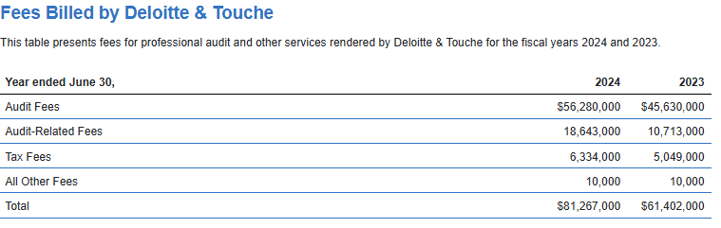


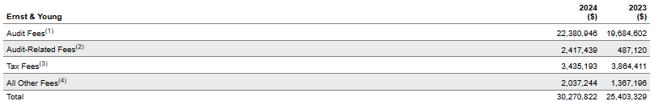

Slide 10
Reason why firms pay higher audit fee
How to measure it
Size of the company
A company’s total assets

Slide 11
Lab
Quantitative audit fee analysis
(lab and presentation)

Slide 12
Team activity
Labs demonstration and extension to test hypotheses:
Larger firms pay more audit fees
An incremental reason a firm would pay more
1 min presentations at end of class (approx. 3:05pm).
Be prepared to have one team member share their screen (front of room).

Slide 13
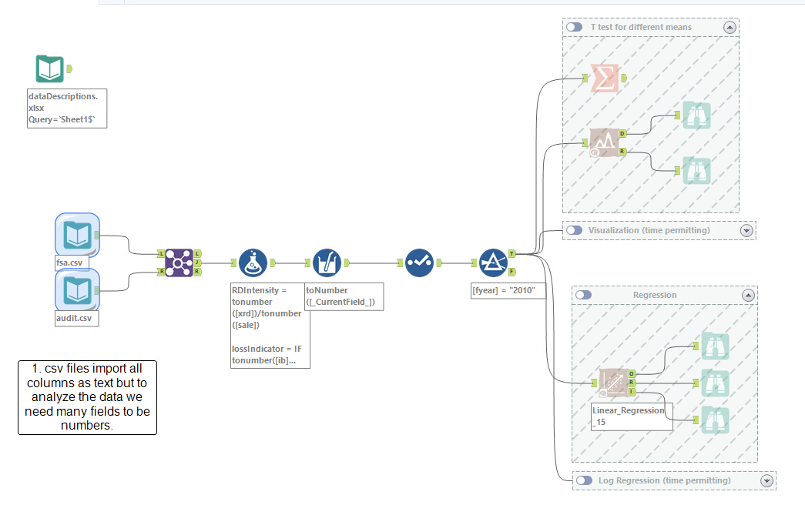

Slide 14
Takeaways
Conflicting incentives for firms to disclose and withhold information
Conflicting incentives for firms to undertake audits (or information verification)
Factors that influence demand for audit and therefore audit fee include:
Agency conflicts
Information asymmetry
Risk of intentional manipulation
Risk of unintentional errors

Slide 15
THANK YOU

