Slide 1
Advanced Analytics and Final Project Workshop
Data Analytics for Professional Accountants (ACCTG 522)
Class 17 | MPAcc Class of 2026

Slide 2
Agenda
Welcome!
Review: Final Project
Thoughts on eVal integrations
Final Project Checklist
Advanced Alteryx Workflows:
Core v. Advanced v. Expert Certification Tools
Using Macros
Final Project Workshop:
Teams to work on the Final Project Checklist
Finalize any requests

Slide 3
1. Information collection and processing
2. Forecasting
3. Fundamental Valuation
4. Decisions
improves
necessary
for
informs
Information collection and processing:
Screening enhancements: What are the limitations of the current screening tools? Do you want to screen on custom metrics? (e.g., accruals quality, sentiment)
Account-level refinements: What are the limitations of the current data aggregators groupings? Do you want more disaggregated data for risk assessments and forecasts? (e.g., multiple revenue streams and COS aggregated into single line items)
XBRL tagging often includes company specific tags referenced by the company’s ticker.
Footnote analysis can also be possible with XBRL tags
10-K Text Analytics:
Sentiment analysis (usually MD&A)
Risk section analysis
Keyword searches
LLM interpretations/summaries.

Slide 4
1. Information collection and processing
2. Forecasting
3. Fundamental Valuation
4. Decisions
improves
necessary
for
informs
Forecasting
More advanced analytics such as time-series estimates / forecasts (regression-based, ARIMA, ML models), cointegration or comovement analysis.
Formal forecasting models (e.g., revenue driver models: Same store sales, revenue per sq ft etc).

Slide 5
1. Information collection and processing
2. Forecasting
3. Fundamental Valuation
4. Decisions
improves
necessary
for
informs
Fundamental Valuation
Advanced scenario analysis supported by macros / automation, allowing for changes in multiple forecasting dimensions used in the valuation model to estimate scenarios and sensitivity.
Advanced analytics aimed at estimated risks and growth parameters.

Slide 6
1. Information collection and processing
2. Forecasting
3. Fundamental Valuation
4. Decisions
improves
necessary
for
informs
Decisions / Recommendations
Support recommendations with additional analytics supported risk analysis.
Support decisions with beta / market comovement analysis and potential for slippage.
Support decisions with other red-flag and future-looking issues that could affect short and long differently (i.e., not just the overall market changes).

Slide 7
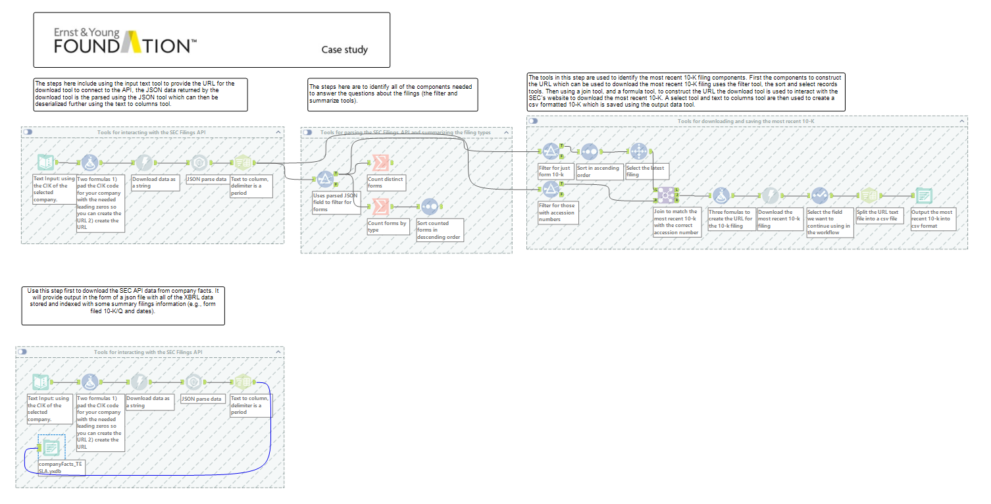
.\datasets.io\ACCTG522\EDGAR_Explorer

Slide 8
Agenda
Welcome!
Review: Final Project
Thoughts on eVal integrations
Final Project Checklist
Advanced Alteryx Workflows:
Core v. Advanced v. Expert Certification Tools
Using Macros
Final Project Workshop:
Teams to work on the Final Project Checklist
Finalize any requests

Slide 9
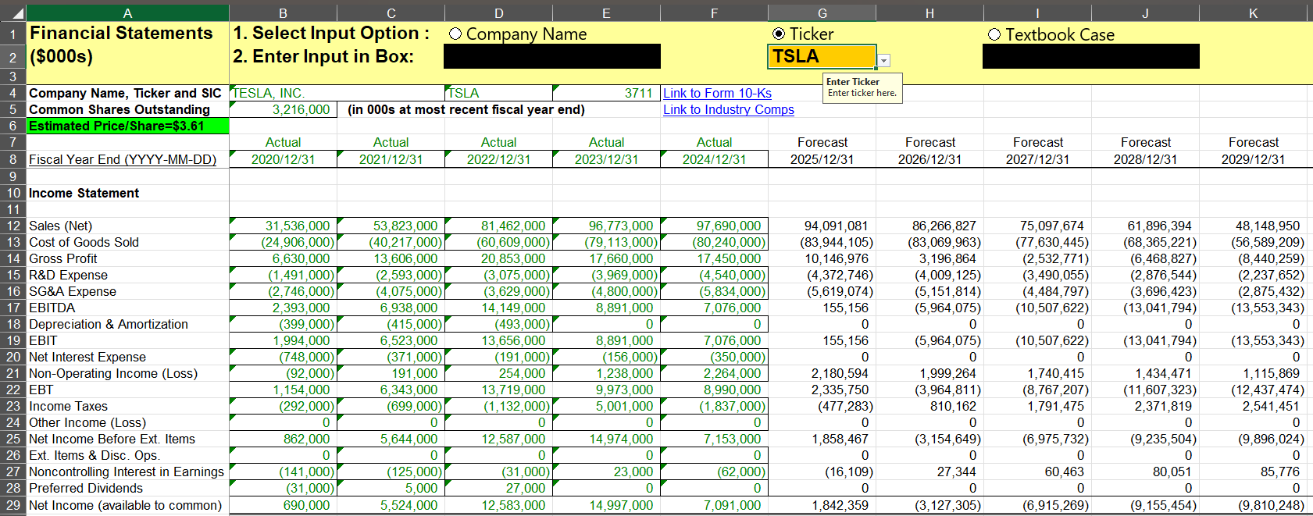
Thoughts on eVal Integration

Slide 10
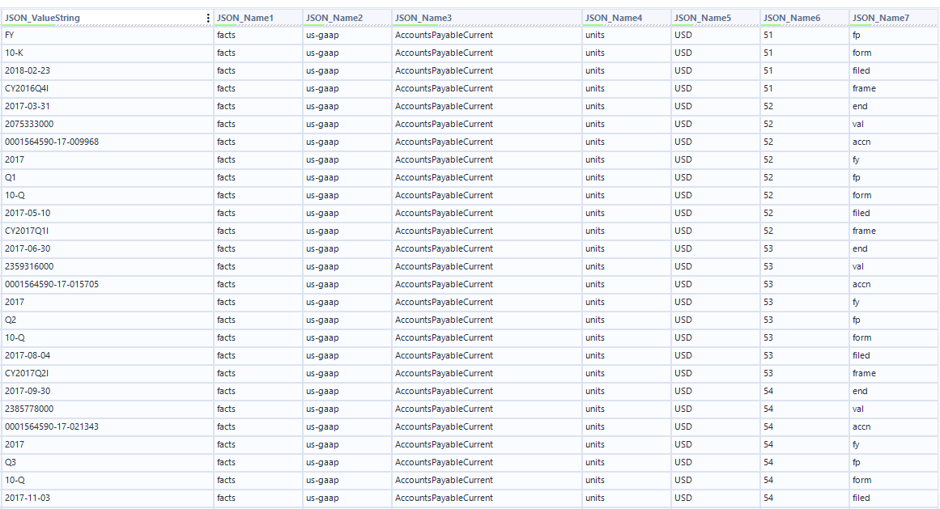
XBRL Data

Slide 11
Agenda
Welcome!
Review: Final Project
Thoughts on eVal integrations
Final Project Checklist
Advanced Alteryx Workflows:
Core v. Advanced v. Expert Certification Tools
Using Macros
Final Project Workshop:
Teams to work on the Final Project Checklist
Finalize any requests (see form)

Slide 12
Checklist
For each item you wish to enhance with data:
Where can I get the data? Is it free? Do I have an API key? Are there restrictions on the data?
Is the ETL easy or difficult to get into eVal? What kind of workflow do I need to use? Will the transpose be easy or difficult?

Slide 13
Checklist
Task | Access to Data? | ETL Comments
Replace eVal historical with EDGAR | EDGAR Explorer / SEC API | Data needs extraction using CFRAME and will need to be transposed to be pasted to eVal Financial Statements Tab
Replace eVal forecasts with Predictive tools based forecasts | Workflow to be developed in Alteryx | Leverages data above, need to better understand predictive tools.

Slide 14
Agenda
Welcome!
Review: Final Project
Thoughts on eVal integrations
Final Project Checklist
Advanced Alteryx Workflows:
Core v. Advanced v. Expert Certification Tools
Using Macros
Final Project Workshop:
Teams to work on the Final Project Checklist
Finalize any requests

Slide 15
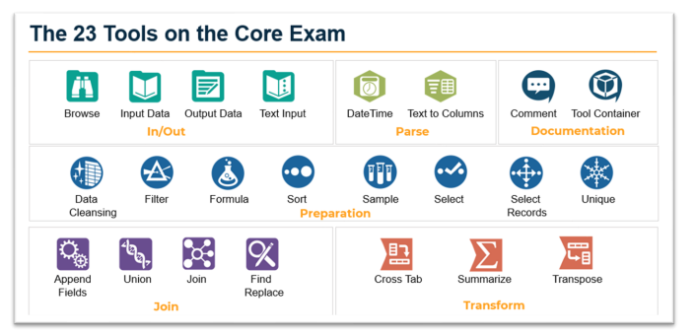
Core Certification Tools
https://alteryx-academy-certifications.s3.us-east-1.amazonaws.com/Alteryx_Core_exam_prep_guide_2025.pdf

Slide 16
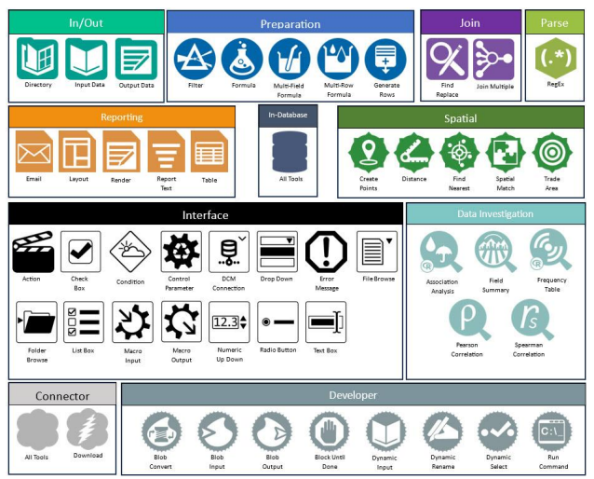
Advanced Certification Tools
https://alteryx-academy-certifications.s3.us-east-1.amazonaws.com/Alteryx_Advanced_exam_prep_guide_2025.pdf

Slide 17
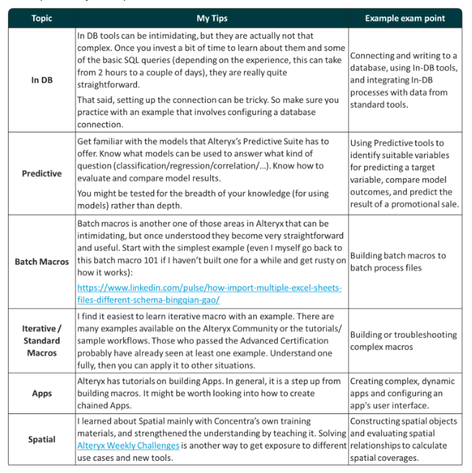
Description of Expert Tools
**Note: Not available until 2026.
https://www.linkedin.com/pulse/alteryx-expert-certification-exam-prep-guide-top-tips-bingqian-gao/

Slide 18
Agenda
Welcome!
Review: Final Project
Thoughts on eVal integrations
Final Project Checklist
Advanced Alteryx Workflows:
Core v. Advanced v. Expert Certification Tools
Using Macros
Final Project Workshop:
Teams to work on the Final Project Checklist
Finalize any requests

Slide 19
Standard Macro
A workflow can be converted to a standard macro (select all tools, right click → convert to macro…)
Example from our last case
**If you want to consider Iterative or Batch Macros let me know.

Slide 20
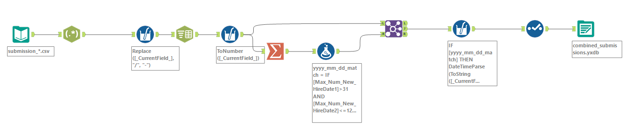

Slide 21
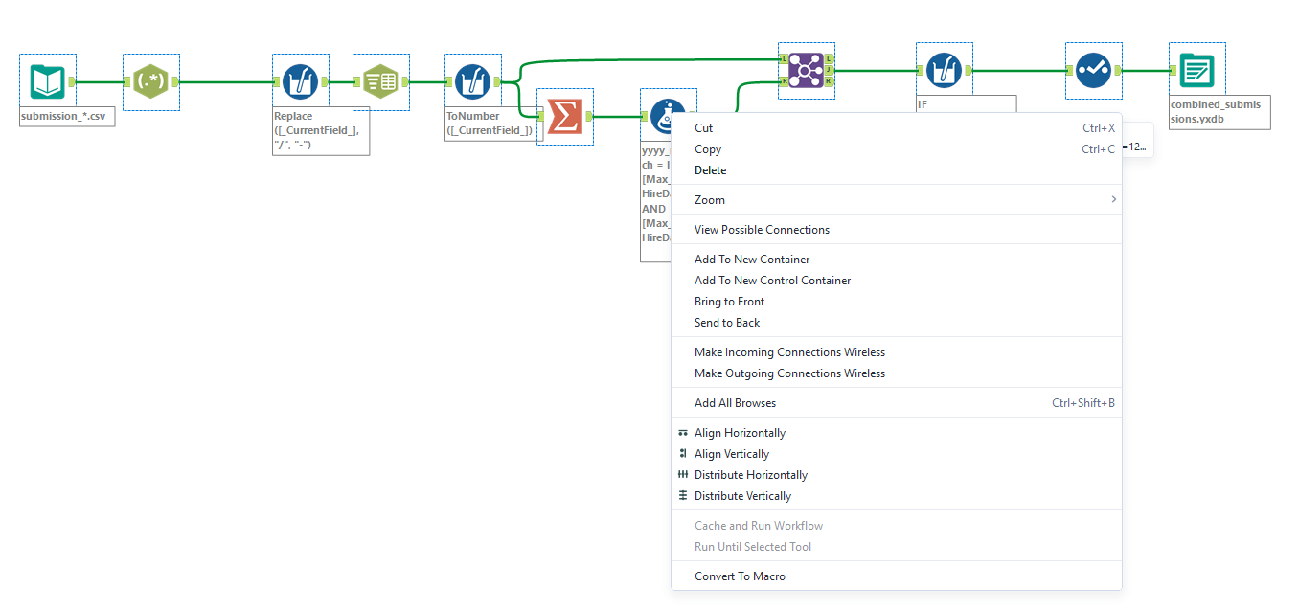

Slide 22
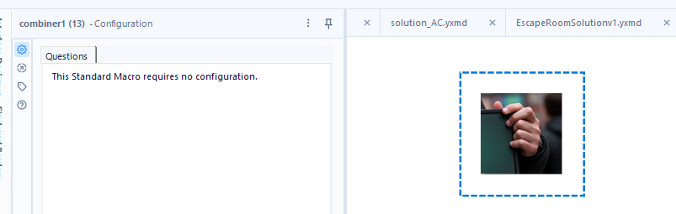
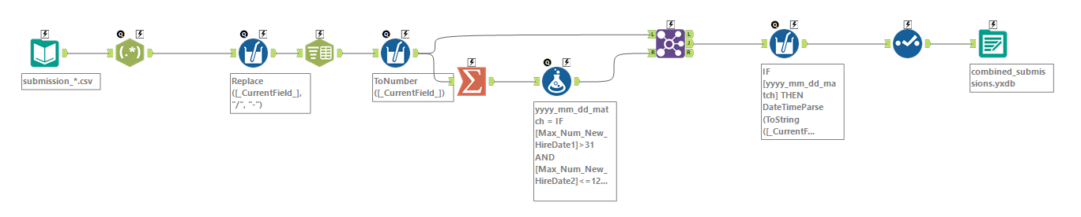

Slide 24
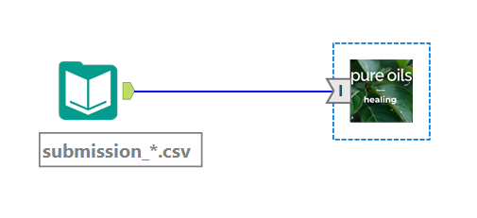
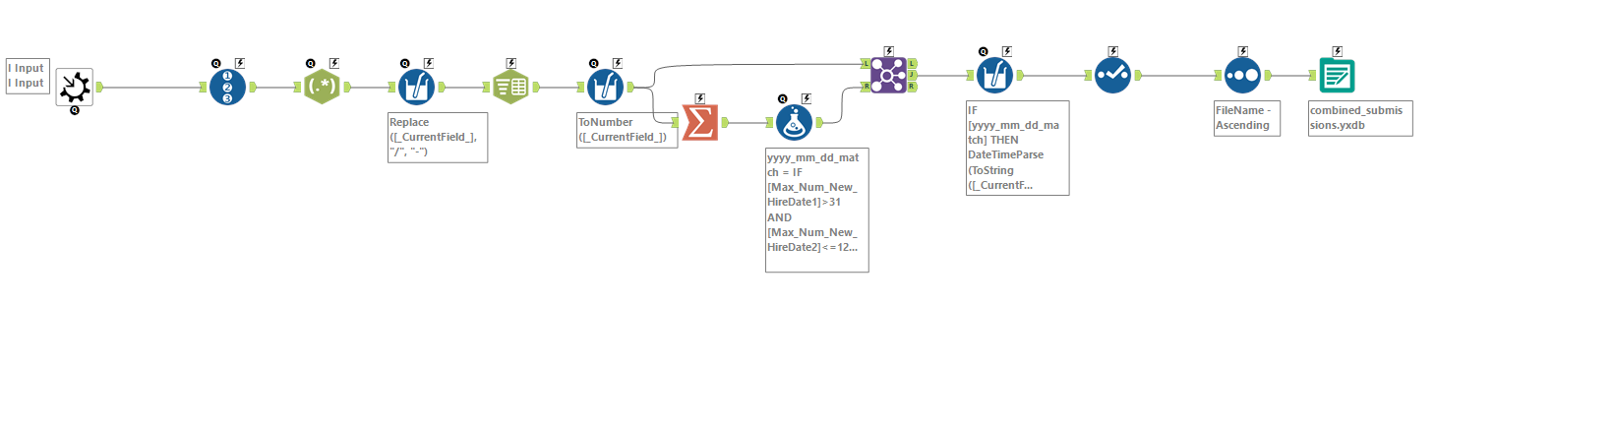

Slide 25
Agenda
Welcome!
Review: Final Project
Thoughts on eVal integrations
Final Project Checklist
Advanced Alteryx Workflows:
Core v. Advanced v. Expert Certification Tools
Using Macros
Final Project Workshop:
Teams to work on the Final Project Checklist
Finalize any requests

Slide 26

Thank you!

