Slide 1
AI Assisted Audit Analysis 2
Advanced Cases in Assurance Services (ACCTG 521)
Class 12 | MPAcc class of 2026

Slide 2
Agenda
Review: Mindbridge AI
Overview: Individual Deliverable
Labs (in new discussion teams)
Mindbridge University Case C (complete A, B after).
Time for Memo Submission.

Slide 3


Slide 4
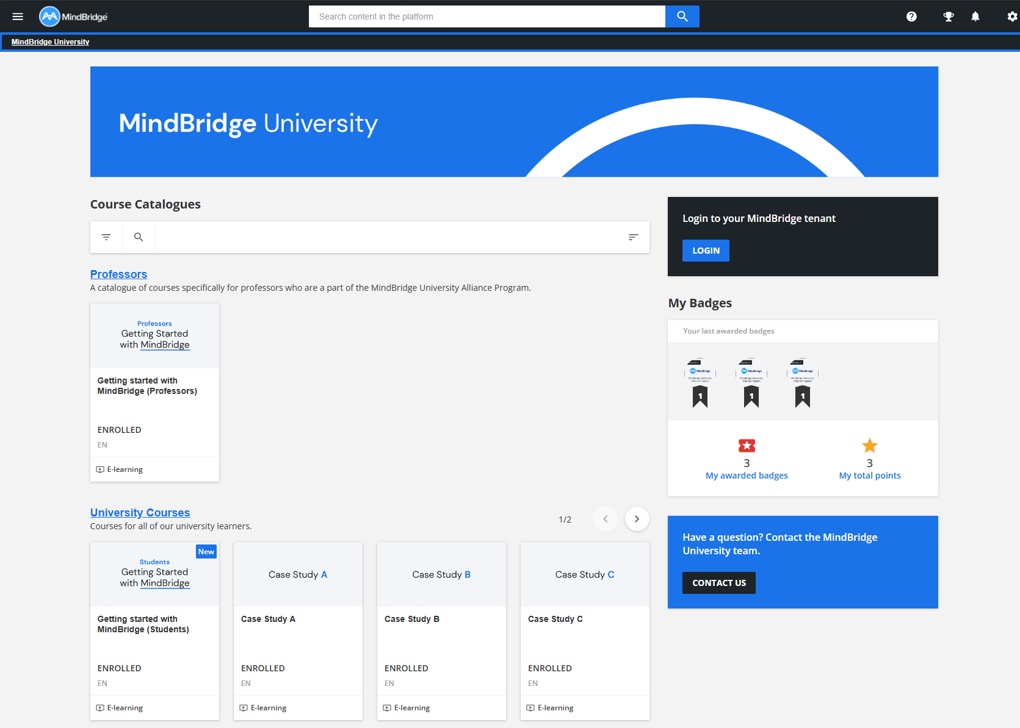
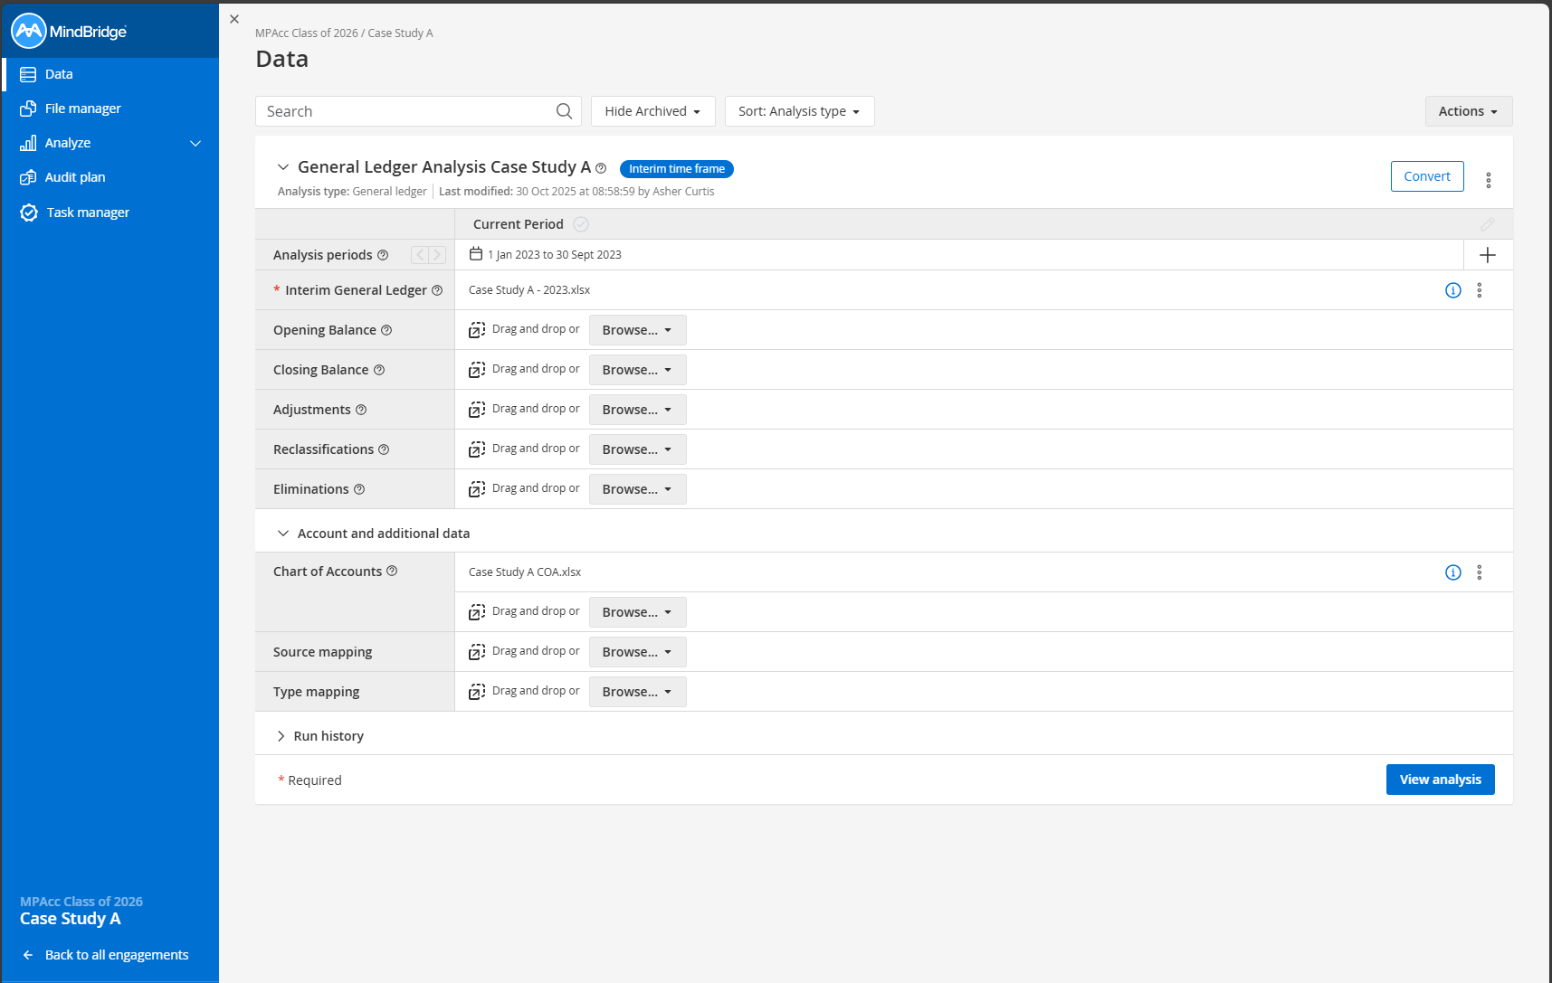
https://uwashington.mindbridge.ai
Mindbridge AI Platform (the software platform where you load the data and perform the audit).
https://university.mindbridge.ai Mindbridge University Platform (where you get the data and case material).

Slide 5
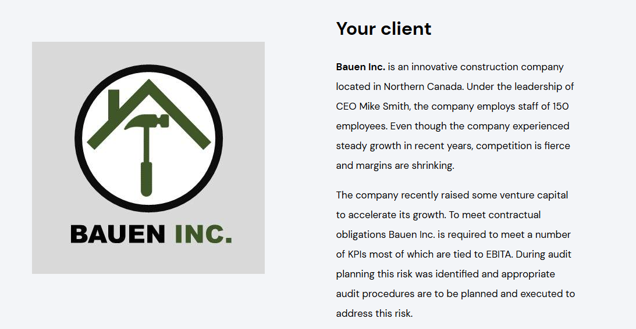
Case Study C:

Slide 6
Agenda
Review: Mindbridge AI
Overview: Individual Deliverable
Labs (in new discussion teams)
Mindbridge University Case C (complete A, B after).
Time for Memo Submission.

Slide 7
Outline of individual deliverables
Due: Nov 6th
On Mindbridge University: Case Completions (Cases A, B, and C + optional final project).
On Canvas: Short memo outlining potential benefits of this tool.

Slide 8
Memo requirements
Short ½ to 1 page memo outlining:
An assessment of Mindbridge as an AI assistant focused on the results of Case C, include:
How does Mindbridge identify risk and give an example (include a screenshot of a visual you used in the appendix).
What transactions Mindbridge helped you identify in your audit plan and why you selected these transactions (screen shot your audit plan transactions and add them to the appendix).
Your assessment of how well a tool like Mindbridge could help smaller organizations without an internal audit function (e.g., the PSU Hotels example).

Slide 9
Agenda
Review: Mindbridge AI
Overview: Individual Deliverable
Labs (in new discussion teams)
Mindbridge University Case C (complete A, B after).
Time for Memo Submission.

Slide 10
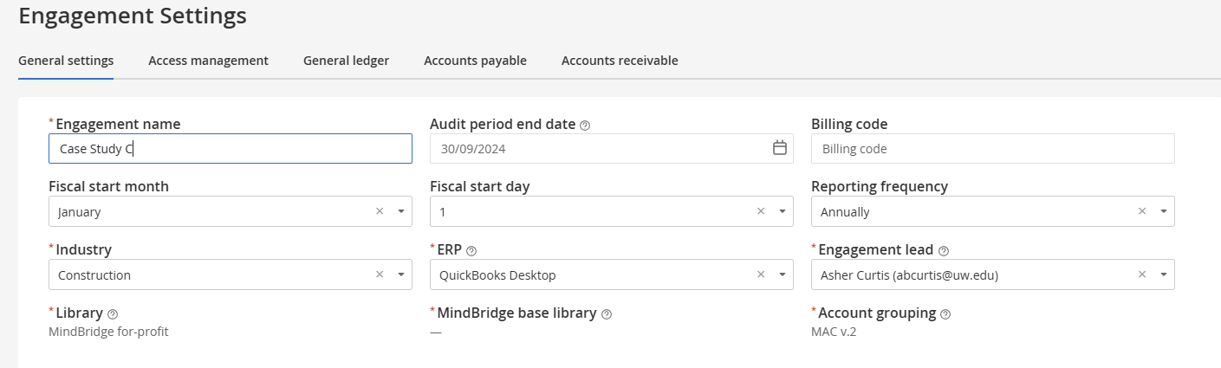
Set-up Helpers

Slide 11
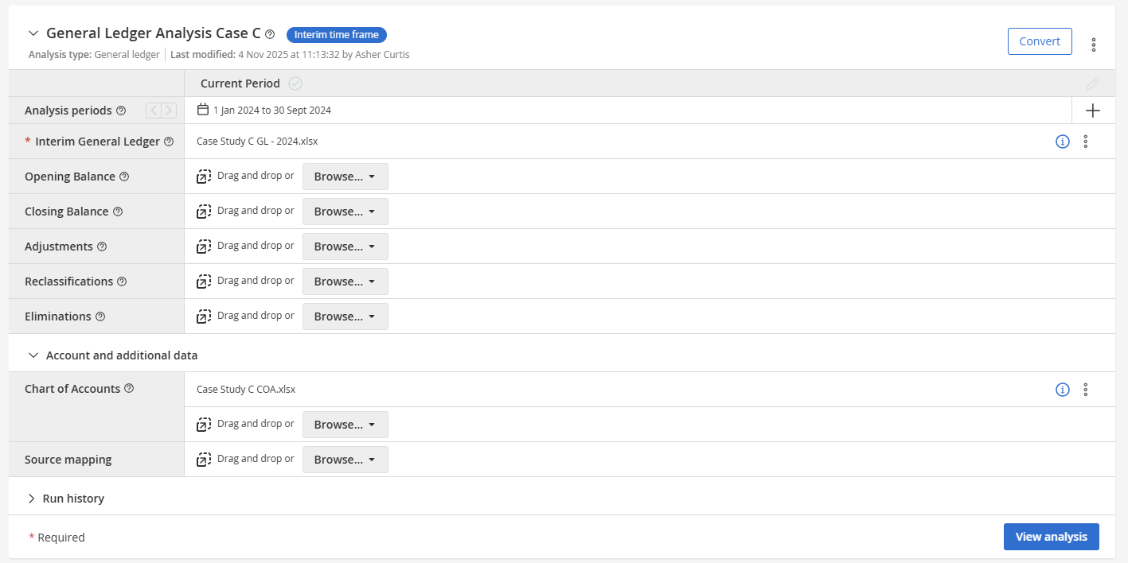

Slide 12
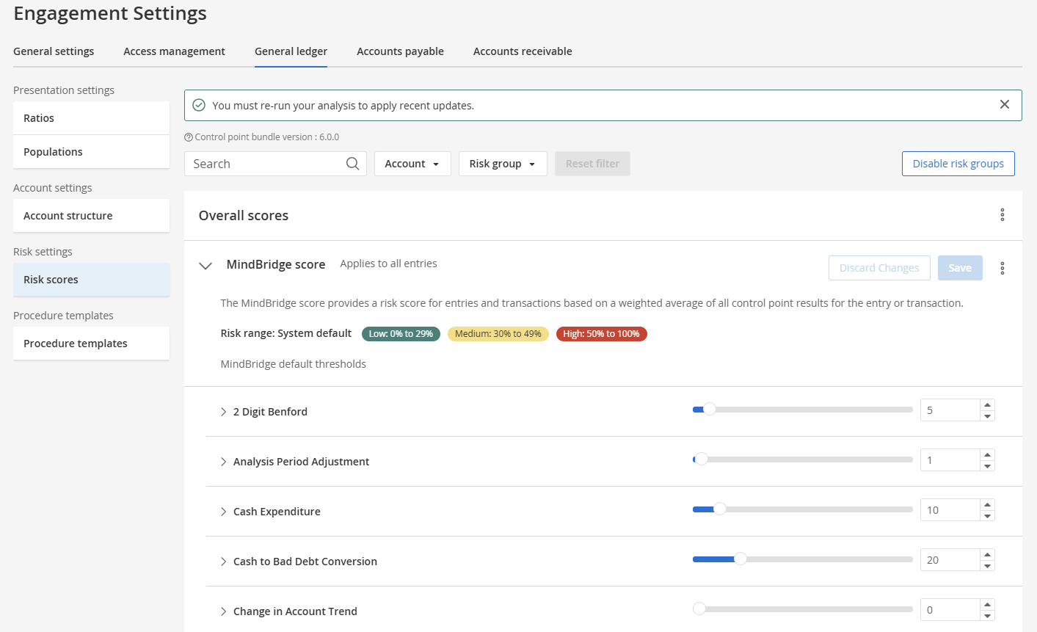

Slide 13

Thank you!

