Slide 1
The ETL process: Relational Databases
ACCTG 522
Data Analytics for Professional Accountants
MPAcc Class of 2027
Class 04 | Autumn | 2026

Slide 2
Agenda
Review
Relational Databases Overview
Class Exercises on Joins
  PowerBI relationships
  SQL based approaches
Conclusion & Look Ahead

Slide 3
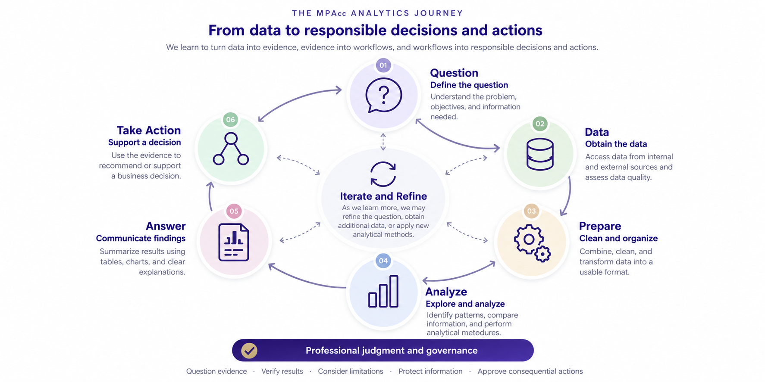

Slide 4
Review
Our key takeaway: We need to get comfortable with complex data extraction and transformations.
APIs automate a data extraction process (compare to copy and pasting info from the 10-K).
Understanding how to transform automated extraction mechanisms gives us a powerful set of data analytic ETL tools.

Slide 5
Agenda
Review
Relational Databases Overview
Class Exercises on Joins
  PowerBI relationships
  SQL based approaches
Conclusion & Look Ahead

Slide 6
Joining data
Joining data is a fundamental step in the ETL process, as in most cases, developing insight will require data from different databases.
Joining data can sometimes be referred to as merging data, blending data, or combining data.

Slide 7
How do joins work?
Two important features:
Join type
Cardinality

Slide 8
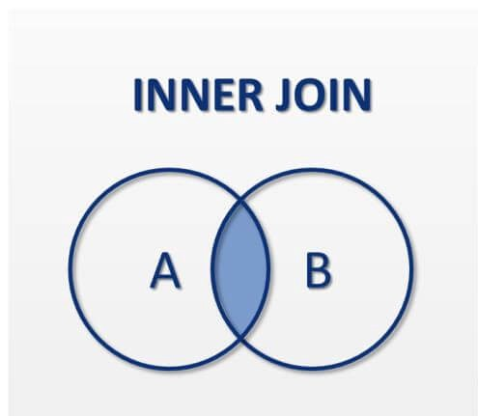
Keys in A
APPL, … A data, …
NVIDIA, … A data, …
MSFT, … A data, …
Keys in B
APPL, … B data, …
MSFT, … B data, …
Output keys in both A and B
APPL, … A data, … , … B data, …
MSFT, … A data, … , … B data, …

Slide 9
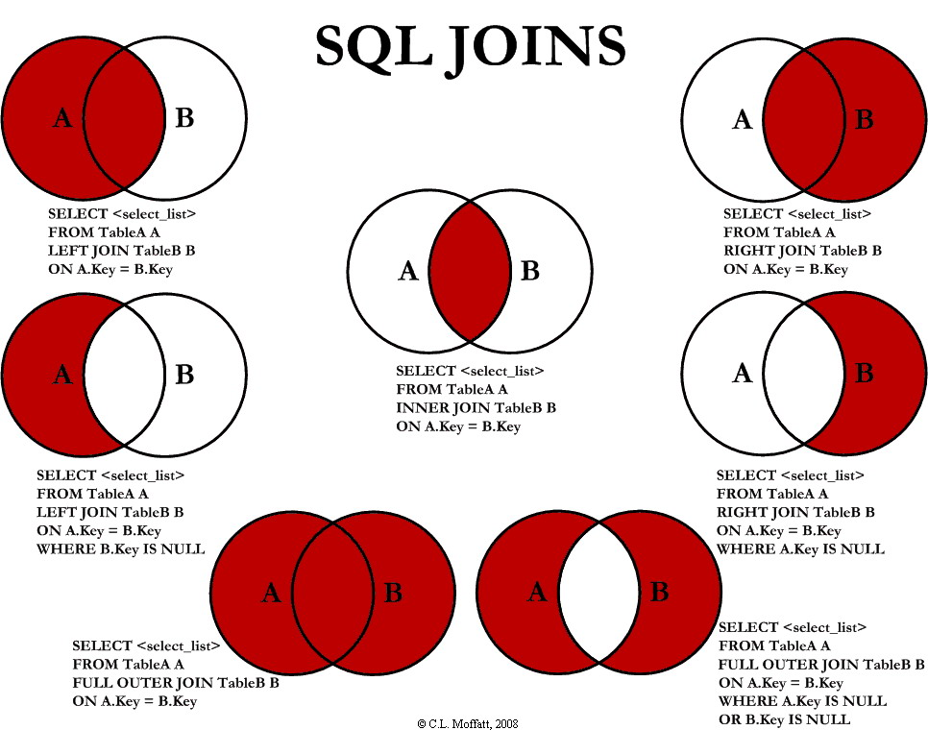

Slide 10
Cardinality
How many keys in Dataset A are expected to match to Dataset B?
1:1
1:Many
Many:Many

Slide 11
What can go wrong?
Incorrect joins are a data quality issue, incorrect joins can:
  crash (or really slow down) our programs!
  have us lose important data.
  Have us generate incorrect conclusions/insight from our analysis.

Slide 12
Agenda
Review
Relational Databases Overview
Class Exercises on Joins
  PowerBI relationships
  SQL based approaches
Conclusion & Look Ahead

Slide 13
How do Power BI relationships work?
Relationships connect tables through common identifiers without combining them into one large table.
Keys connect tables.
One lookup record can match many (journal) lines.
3. Relationships allow filters and visuals to use fields across tables.

Slide 14
How do Power BI relationships work?
ChartOfAccounts
JELineItems
1
GLAccountNumber
JENumber
GLAccountName
*
GLAccountNumber
BusinessUnitID
*
Amount
BusinessUnits
1
BusinessUnitID
BusinessUnit
* = many 1 = one

Slide 15
Relationships versus joins: when should we use each?
Alteryx Join / Power Query Merge / Excel lookups
Power BI Relationship
Combines columns into an output table
Keeps tables separate
Join type determines which rows are retained
Cardinality and filter direction govern interaction
Produces a transformed dataset
Supports a connected analytical model
Useful for preparing flat datasets and exception testing
Useful for interactive analysis across tables

Slide 16
Agenda
Review
Relational Databases Overview
Class Exercises on Joins
  PowerBI relationships
  SQL based approaches
Conclusion & Look Ahead

Slide 17
Introduction to SQL: Asking Questions of Relational Data
SQL (Structured Query Language) lets us retrieve, combine, filter, and summarize data stored in relational tables.

Slide 18
Introduction to SQL: Case 4 as an example
Why use SQL in Case 4?
• Retrieve only the journal-entry fields we need
• Match line items to preparer records
• Identify exceptions where no match exists
• Repeat the same query consistently
Example: Find journal lines with no matching preparer:
SELECT j.JENumber, j.BusinessUnitID, j.PreparerID
FROM JELineItems AS j
LEFT JOIN Preparers AS p
ON j.BusinessUnitID = p.BusinessUnitID
AND j.PreparerID = p.PreparerID
WHERE p.PreparerID IS NULL;
Key idea: SQL specifies the question; the database performs the matching and returns the results.
Discussion: Why do we need both BusinessUnitID and PreparerID in the join?

Slide 19
Agenda
Review
Relational Databases Overview
Class Exercises on Joins
  PowerBI relationships
  SQL based approaches
Conclusion & Look Ahead

Slide 21
Summary
Today's key takeaway: Understanding how data are connected is essential to producing reliable analytical evidence.
Tools like Power BI make relational data useful. Relationships, transformations, and visualizations allow us to explore data without always combining everything into one table.
SQL allows us to query relational data. We can select, filter, join, and aggregate records to answer accounting and business questions.

Slide 22
Next steps
Next topic: The ETL process: Introduction to Transforming Data
A Core Data Analytic Skill, transforming data using formulas to create the data we want
Develops data skills with Regular Expressions
We will use a combination of python and colabs / vscode
Thank you!

