Slide 1
Blockchain Audits
Advanced Cases in Assurance Services (ACCTG 521)
Class 18 | MPAcc Class of 2026

Slide 2
Agenda
Review/Admin
Auditing Blockchain: Brief Overview
Deliverable
Lab:
Manually extract and reconcile blockchain.
Use the Blockchain Analyzer tool.

Slide 3
Review/Admin

Slide 4
Agenda
Review/Admin
Auditing Blockchain: Brief Overview
Deliverable
Lab:
Manually extract and reconcile blockchain.
Use the Blockchain Analyzer tool.

Slide 5
Auditing Blockchain: Brief Overview

Slide 6
The Blockchain is an “immutable public ledger”
The ledger is cryptographically sealed:
Transactions are recorded into blocks and blocks are linked into a chain of blocks using cryptographic hashes.
Each transaction hash a hash, like a digital fingerprint.
This process makes the blockchain near impossible to alter the history of the ledger, instead, you can generally only add to it.
Often considered as leading to a trusted ledger, the truth, or a trustless environment (so why do we need to audit crypto??)

Slide 7
“Trust” is misleading in the world of blockchain
Inside the blockchain
Integrating in the real world… risks are still present
Trust the math/code
Trust, but verify
Many perceive that because blockchain transactions are considered immutable and based on cryptography (the math), there are no additional risks; however, this is not the case. For example, the math can validate the existence of a digital asset and imply ownership but ownership can be compromised if the private key is stolen, lost or otherwise misappropriated.

Slide 8
Agenda
Review/Admin
Auditing Blockchain: Brief Overview
Deliverable
Lab:
Manually extract and reconcile blockchain.
Use the Blockchain Analyzer tool.

Slide 9
Deliverable

Slide 10
Deliverable
As a 1 page memo, please answer the following (based on Part 5 Section 3 of the Case):
Testing for completeness and existence. Required: Evaluate the completeness and existence assertions for the client. In evaluating these assertions, you need to check if the given transactions exist and add up to the same end balance in the wallet. You also need to look for any unusual items (something suspicious or potentially risky).
Describe the anatomy of a blockchain (bitcoin) transaction using an accompanying screenshot of a selected transaction from those provided.
To assess completeness and existence, which of the analyzer tabs did you use? Take a screenshot and Explain why and any findings.
How does this tool help in a blockchain audit relative to manual sampling?
**See example memo template (optional).

Slide 11
Agenda
Review/Admin
Auditing Blockchain: Brief Overview
Deliverable
Lab:
Manually extract and reconcile blockchain.
Use the Blockchain Analyzer tool.

Slide 12
Lab* *(no need for remote today)

Slide 13

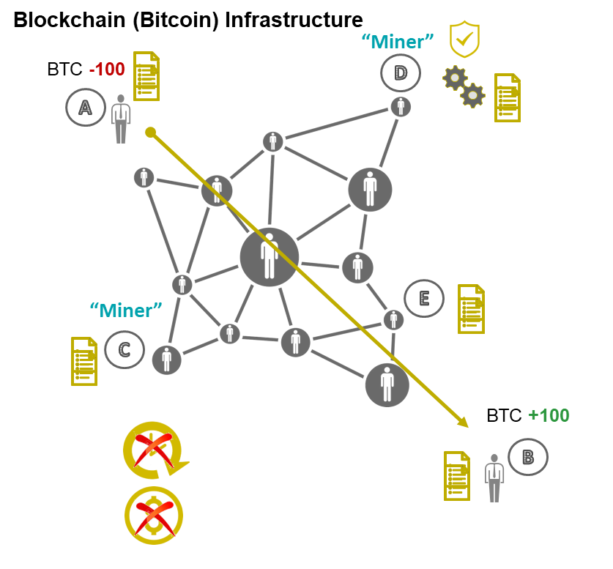
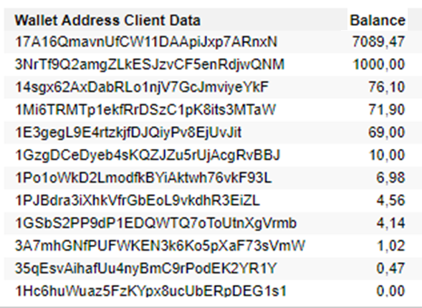
Rather than relying on a central entity to verify transactions, blockchains are
managed and secured autonomously by a peer-to-peer network.
Bitcoin
Client Data
F
“Blockchain.com”
Wallet data
Transaction data
Access verification data
Auditor
Reconcile a blockexplorer’s data with client records.

Slide 14
Audit using a third-party
Your client has provided you with a table of their cyptocurrency transactions (Bitcoin) that occurred on March 1, 2018 for their wallet at the address: 17A16QmavnUfCW11DAApiJxp7ARnxN5pGX
Transaction ID | Block | DD.MM.YYY Time | Value | Running Balance | Sent/ Received
5a60cf5712521d0dc57c0cb56f493126c6d7967b78ee6cc9ac28c7b77bffb2c7 | 511417 | 01.03.2018 04:54 | 0.09761362 | 273.938403 | Received
3c25b98df1d2ce6a7cce227f4300e28c93141ad98cdf4f4d8f07955b79f7abf1 | 511418 | 01.03.2018 05:02 | -0.04125702 | 273.9001168 | Sent
3a69317f65e4ef0c73a242c9c4ae125a7c27e0f23397be7652e65d409a156ea1 | 511418 | 01.03.2018 05:02 | 0.0271139 | 273.9413739 | Received
66a8dd8135d7655207b17ee5a0279ab0184987105b8c51cb79233d3d0835dbf9 | 511418 | 01.03.2018 05:02 | -0.01465857 | 273.91426 | Sent
C22e31c0010acadf1c9457593379b496b0f0a65d25df3bdea19b7453bf67cc68 | 511418 | 01.03.2018 05:02 | 0.01877822 | 273.9289185 | Received
3bb36c8afe021b031b4bac846f56e4b17ba25e5cc208ea8a450a97535c29a86b | 511419 | 01.03.2018 05:04 | 0.00042844 | 273.9005453 | Received
4c5ff27fa0c0e20d3d55dd94f065c9258208e339c0b02c403c8c3c6587781db6 | 511420 | 01.03.2018 05:28 | 0.05636806 | 273.9177608 | Received
7cad2ead30accb9f4f0dbd4511f755589e4efd42fb44e9d6daaf231d49c46fb3 | 511420 | 01.03.2018 05:28 | -0.09210298 | 273.8613927 | Sent
F533bbf1e47ed31a14a5a4ce80907d0aa28b271147fb6e098e92d5b1e732e774 | 511420 | 01.03.2018 05:28 | 0.00587873 | 273.9534957 | Received
96b536a276c1add2e511837a20f67dc1bfa547e004397a4e4743406349ed2f0d | 511420 | 01.03.2018 05:28 | 0.07450548 | 273.947617 | Received
Notes:
Faculty note: Ten transactions are provided (estimated 10 minutes to complete). You can ask for students to research less transactions as desired based on permitted time.

Slide 15
Audit using a third-party
Tools often referred to as block explorers are commonly used to access and analyze information from a public blockchain. These tools display the contents of a public blockchain and allow users to examine the details of individual blocks (e.g., all transactions included in a block), individual transactions (e.g., the transaction amount, the sender’s public address, the receiver’s public address) and information about specific public addresses (e.g., balance as of the point in time that the information is accessed, details of all transactions).

Slide 16
Audit using a third-party
Required
Blockchair is a block explorer. Using this block explorer, the transaction ID and wallet address, check to see if each transaction exists and if the value of each transaction differs from the client data.
What are your findings?
What are your perspectives (and or/concerns) about using a tool like this to audit these types of transactions?
*In small teams you will need to explore the transaction data and reconcile with the info in the excel sheet. (Alternative explorer: mempool - Bitcoin Explorer)

Slide 17
Anatomy of a bitcoin transaction
Since each transaction spends Unspent Transaction Outputs (UTXOs) and because a UTXO can only be spent once, the full value of the included UTXOs must be spent or given to a miner as a transaction fee. Few people will have UTXOs that exactly match the amount they want to pay, so most transactions include a change output.
Change outputs are regular outputs which spend the surplus satoshis from the UTXOs back to the spender. They can reuse the same P2PKH pubkey hash or P2SH script hash as was used in the UTXO, but for the reasons described in the next subsection, it is highly recommended that change outputs be sent to a new P2PKH or P2SH address.

Slide 18
Audit using a third-party
Perspectives (Q3):
Inefficient / time consuming
Risky – reliance on a third party
Insufficient – can we get running balances?

Slide 19
Auditing Digital Assets: Using an audit node on the blockchain

Slide 20
Rather than relying on a central entity to verify transactions, blockchains are
managed and secured autonomously by a peer-to-peer network.
Bitcoin
Client Data
Live feed
F
“Audit node”
Wallet data
Transaction data
Access verification data
Auditor
Reconcile live data with client records.

Slide 21
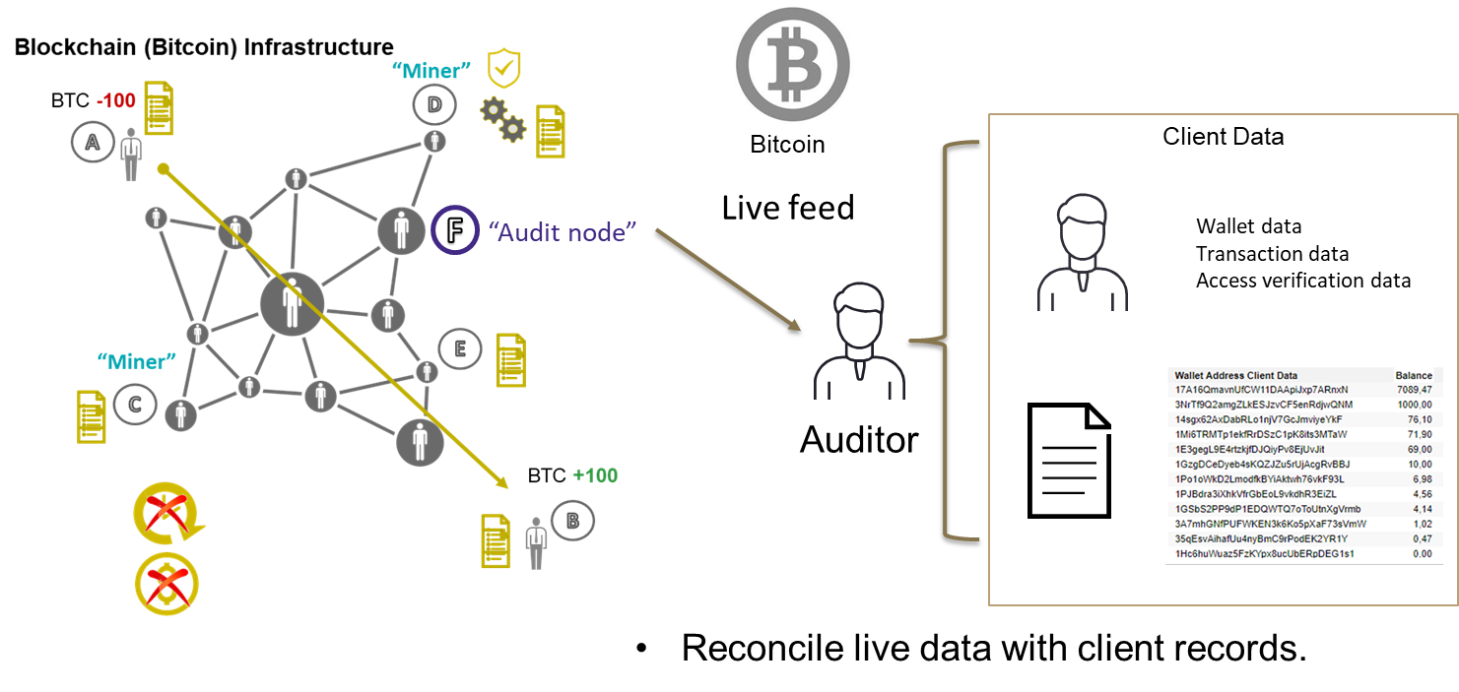
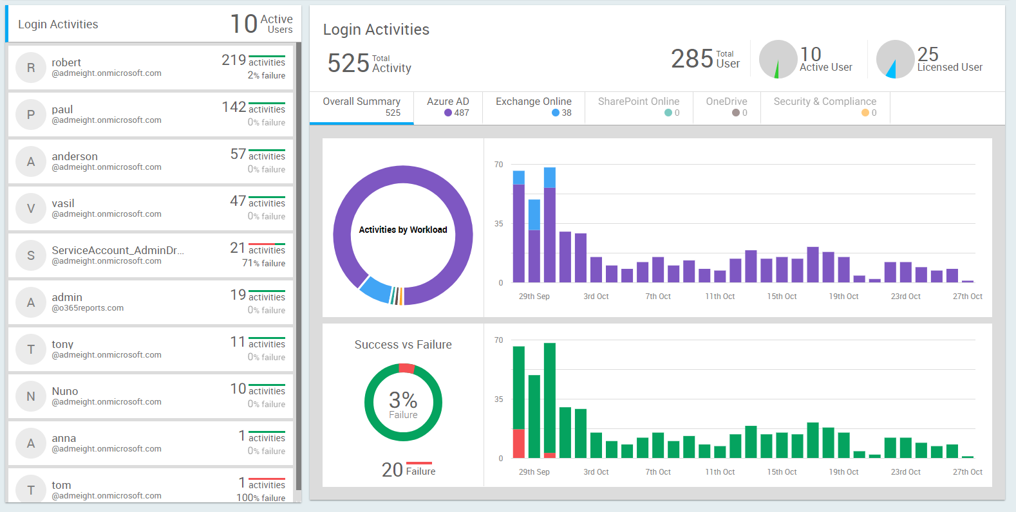
Rather than relying on a central entity to verify transactions, blockchains are
managed and secured autonomously by a peer-to-peer network.

Slide 22

Thank you!

