Slide 1
Intro to Extracting, Transforming and Loading Data
ACCTG 522
Class 2

Slide 2
Welcome!
Class Agenda
Review and ETL Overview
ETL Cases in the FSB Remote Labs
Conclusion and look ahead

Slide 3
Review: ETL Overview

Slide 4
The Analytical Mindset
The Analytical Mindset is defined as the ability to work with data to apply appropriate analytics and interpret and share insight with stakeholders.

Slide 5

Why do we care about Data Quality?
Analytics quality (and insight) is driven by data quality.
Garbage in = Garbage Out !
This Photo by Unknown Author is licensed under CC BY-ND

Slide 6
Why do we care about Extract, Transform & Load (ETL)?
The Extract, Transform & Load or ETL Process is the first task required to complete the analytical process.
In most cases, data required for the analytical process is stored in a database and must be extracted from that database and loaded into analytics software.

Slide 7
Why do we care about Extract, Transform & Load (ETL)?
In most cases, the data will also have to be transformed, or modified to apply analytics tools
this can include calculating additional variables (like multiplying price and quantity to get sales),
cleaning the data due to differences in formatting,
preparing and joining datasets,
and transposing or pivoting the data.

Slide 8
Identifying data issues
Revision.
There are 9 data quality issues with the file:
Identify the issues and why
Propose how they could be solved

Slide 9
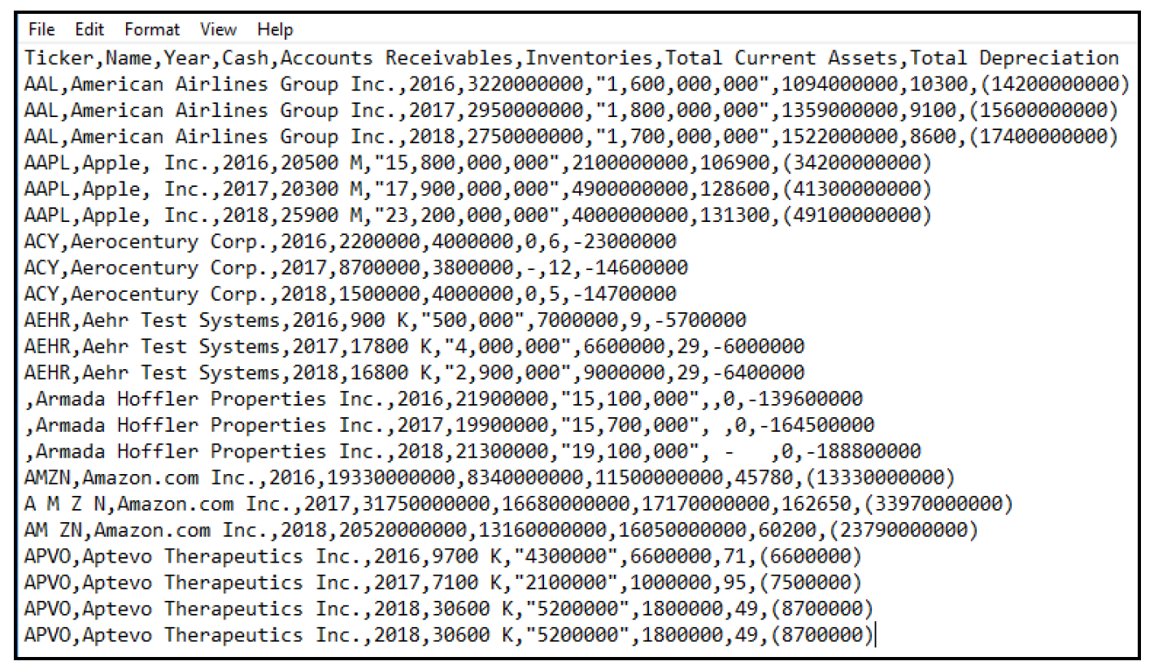

Slide 10
Notes:
Apple has a comma in its name, Apple, Inc., but the name does not have a text qualifier.
Armada Hoffler Properties Inc. is missing the ticker symbol.
The ticker for Amazon.com Inc. (AMZN) has spaces in some instances, but not in others.
Aptevo Therapeutics Inc. has a duplicate row of information.
For the Cash category:
Apple, Inc.’s cash is listed in millions using a number, followed by a space and an M.
Aehr Test Systems’ cash is listed in thousands using a number, followed by a space and a K.
Aptevo Therapeutics Inc.’s cash is listed in thousands using a number, followed by a space and a K.
For Accounts Receivables, some amounts are shown as text and include commas in the number (commas within a text qualifier are appropriate, but this is important to note for purposes of loading the data).
For Inventories, null values are displayed in various forms as text, including a zero, a blank, a hyphen (-), a hyphen with spaces or a space.
For Total Current Assets, none of the amounts are listed in millions.
For Depreciation, some numbers use parentheses for credits (or negatives) and others use a minus sign.

Slide 11
ETL Cases in the FSB Remote Labs

Slide 12
Revision – Data Quality
Open discussion (2 mins with classmate)
One lesson from the formatting exercise we undertook was that we need to be careful with converting string variables to numbers – what went wrong?

Slide 13
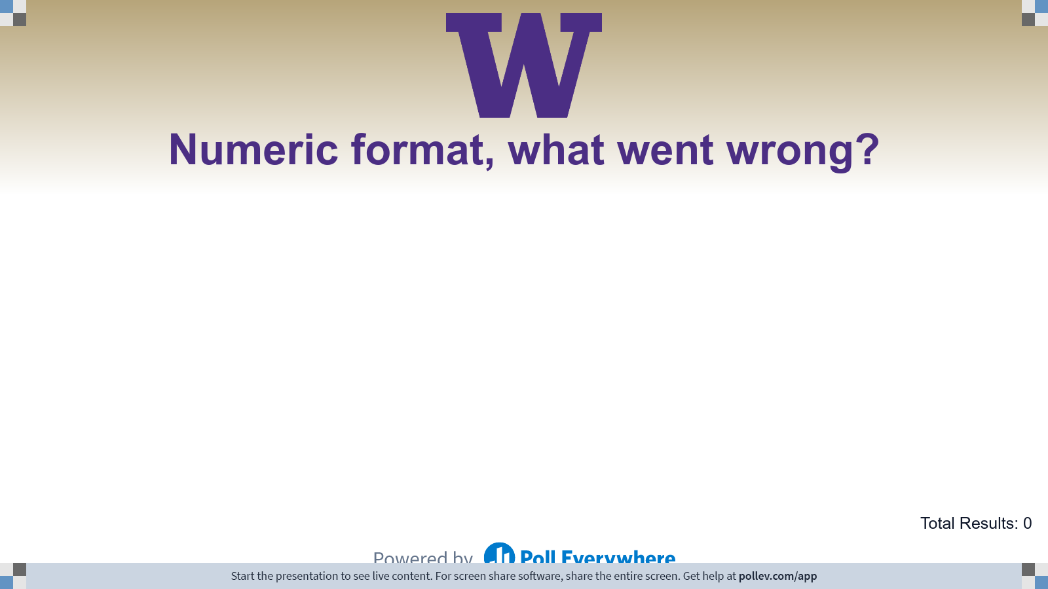
Notes:
Poll Title: Do not modify the notes in this section to avoid tampering with the Poll Everywhere activity. More info at polleverywhere.com/support Numeric format, what went wrong? https://www.polleverywhere.com/free_text_polls/r2W3O8apKA9FaBriBMSHa

Slide 14
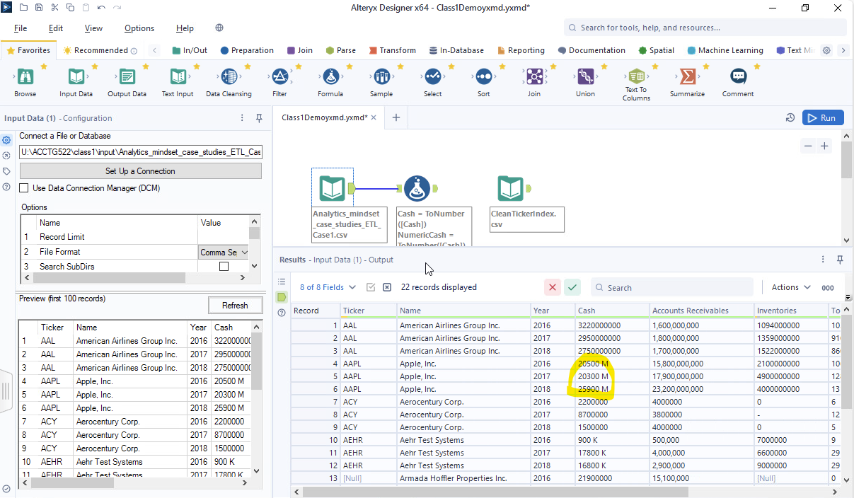
Revision – Data Quality

Slide 15
Alternative – Data Quality
“Clean ticker file”
Join by Company Name

Slide 16
ETL Cases
Our first ETL case “Text Extraction and Unique Identifiers” we will:
Prepare data for a join by “Location-PlantID”
The information is in “EmployeeCode”

Slide 17
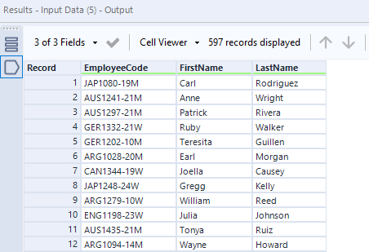
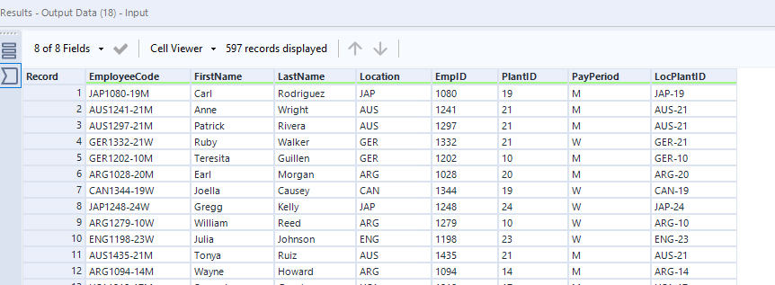
5 new output fields

Slide 18
ETL Cases
Our second ETL case “Advanced ETL Text Extraction and Unique Identifiers” we will:
Prepare data for a join by “Location-PlantID”
The information is in “EmployeeCode”
But this time, clean the “EmployeeCode” as it is messy!

Slide 19
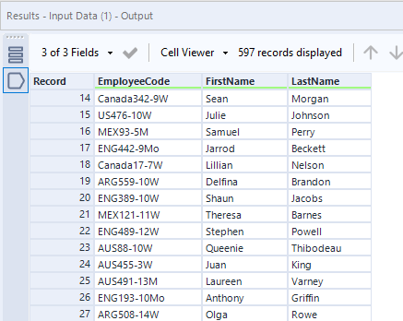
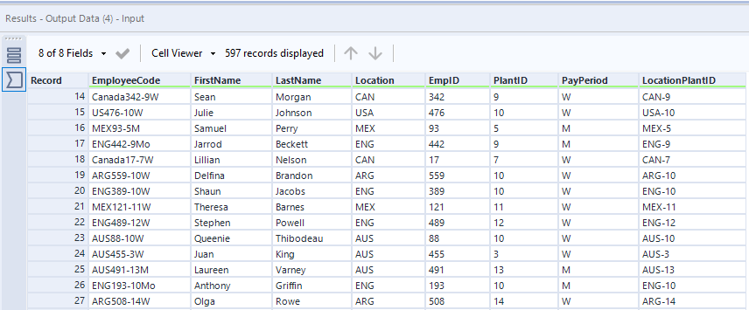
5 new output fields again

Slide 20
Why Alteryx?
Alteryx is cutting-edge software that is excellent for the ETL process.
Working with cutting-edge software allows you to:
Become adaptable and resilient to new software.
Impress recruiters with practical discussions of cutting-edge software.

Slide 21
To FSB remote labs
We will use Alteryx on the FSB remote labs to solve both cases.
I recommend saving screenshots of your work in Alteryx (I’ve added blank slides if you want to save them in this ppt document, ctrl+m adds more slides)

Slide 22





The Tools We will use:
Input Data Tool | Alteryx Help
Text To Columns Tool | Alteryx Help
Formula Tool | Alteryx Help
RegEx Tool | Alteryx Help
Output Data Tool | Alteryx Help

Slide 23
Lab Agenda
Solve ETL Case 2
Discussion of ETL strategy for messy ETL Case 3 (find the inconsistencies)
Solve ETL Case 3

Slide 24
Discuss your Case 1 strategy to get from the input to the output
5 new output fields

Slide 27
Discuss your Case 2 strategy to get from the input to the output
Make a note of the inconsistencies in the input file
5 new output fields again

Slide 31
Extra RegEx examples
Dates:
Invoice Date: 03/15/2025
Payment Due: 04/14/2025
Invoices:
INV-100234
INV-567890
Reference: INV-456

Slide 32
Extra RegEx examples
Firm Identifiers:
CIK: 0000320193
Ticker: TSLA
Ticker: AAPL
Matching dollar amounts and accounts:
Total: $12,450.00
Late Fee: $25
Refund: ($1,200)

Slide 33
Extra RegEx examples
Phone numbers, email, credit card numbers:
206-123-4567
real_person@example.com
Potential fraud detected: 4532-9876-1234-5678

Slide 34
ETL Cases, Continued
Today we will examine “Joining Data”:
Joining data is another fundamental step in the ETL process, as in most cases, developing insight will require data from different databases.
Joining data can sometimes be referred to as merging data, blending data, or combining data.

Slide 35
Why is joining data important?
Joining data is part of the transforming step in ETL.
Incorrect joins are a data quality issue, incorrect joins can:
crash (or really slow down) our programs!
have us lose important data.
Have us generate incorrect conclusions/insight from our analysis.

Slide 36
Joining using unique keys
In all cases we will use unique keys to join the data.
All the unique keys are described in the case
One of them was tricky, can you remember which one?

Slide 37
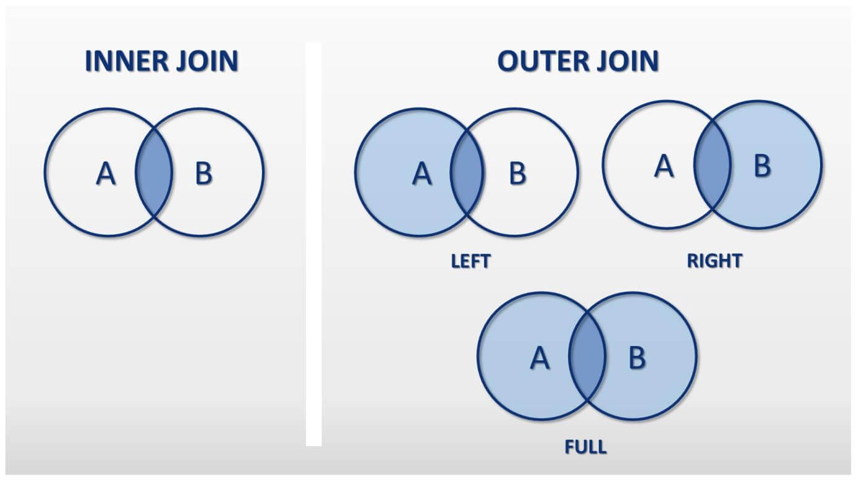

Slide 38
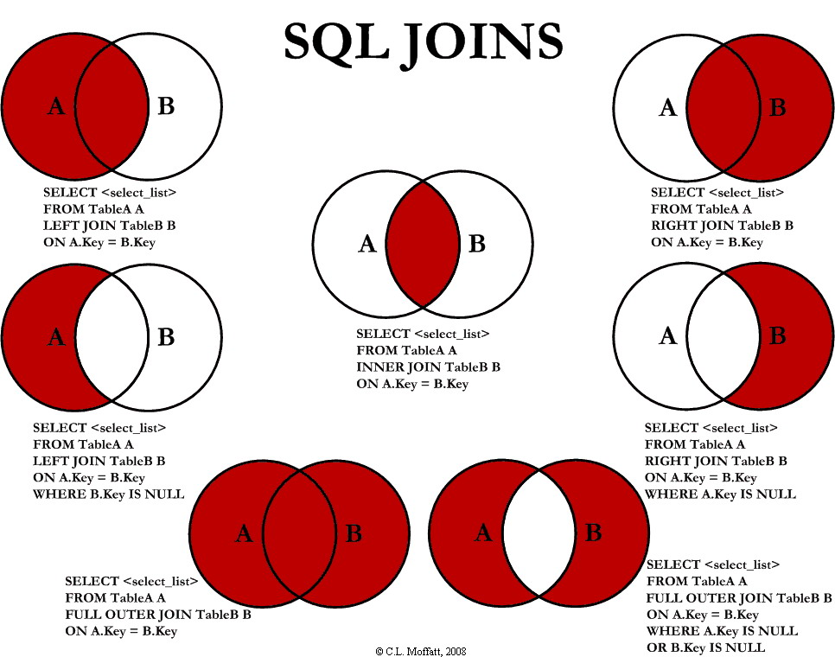

Slide 39
Joining using unique keys
In all joins we will use “one to many” matches.
Joining the large information source (“JELineItems”) to the smaller set of information in the other data sheets.

Slide 40
Why join across multiple software?
Because joining data is so fundamental, we want to work towards becoming software agnostic.
Working with cutting-edge software allows you to:
Become adaptable and resilient to new software.
Impress recruiters with practical discussions of cutting-edge software.

Slide 41
The tools we will use:

Slide 42
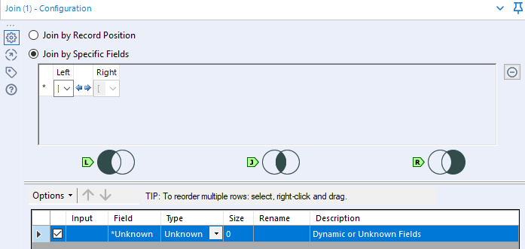

Alteryx Joins:

Slide 43
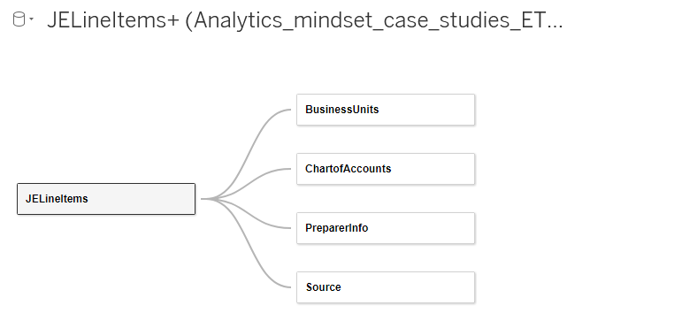
Tableau Relationships

Slide 44
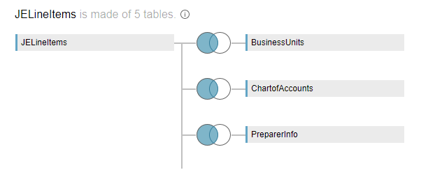
Tableau Joins

Slide 45
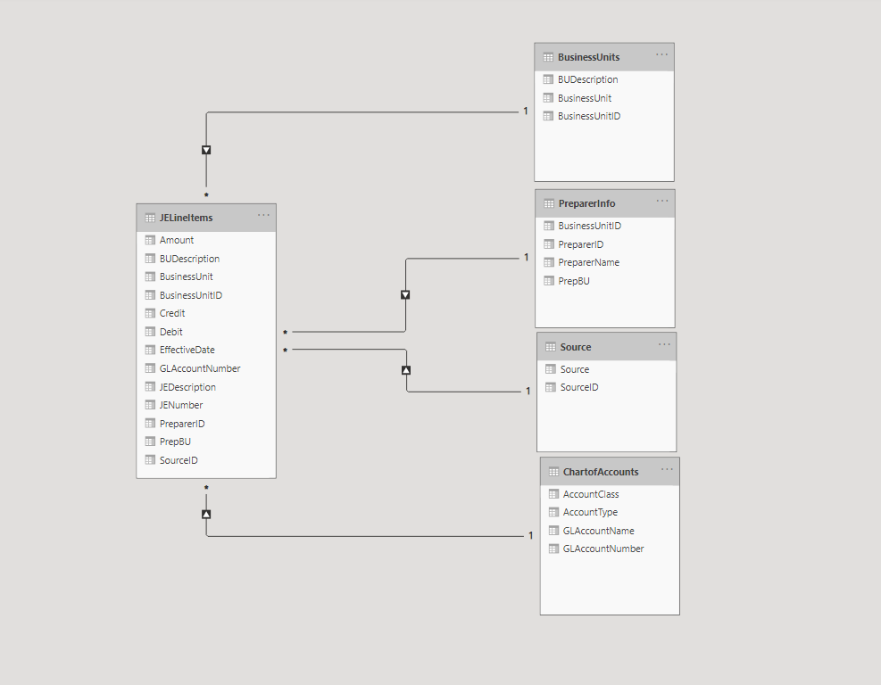
Power BI Data Relationships

Slide 46
To FSB remote labs
We will begin in Alteryx.
Again I recommend saving screenshots of your work in Alteryx (I’ve added blank slides if you want to save them in this ppt document, ctrl+m adds more slides)

Slide 47
Lab Agenda
Case Demonstration in Alteryx
Then in Tableau (time permitting)
Then in Power BI (time permitting)

Slide 50
Conclusion and look-ahead
ETL is the first step in the analytical process – we cannot undertake data analytics without data!
ETL is especially important when the data needs to be cleaned or transformed for use in analytics.

Slide 51
Conclusion and look-ahead
Wednesday:
Cases: Enron Emails Case – RegEx Heavy

Slide 52

Thank you and Congratulations!

