Slide 1
A Grounded Q&A Assistant
for Intelligence Analysts
CIS 5300 Final Project
Vincent Lin, Risha Kumar, Chih Yu Tsai, Asher Ellis
December 18, 2025

Slide 2
The Problem
Intelligence analysts must sift through many documents to find information
Today’s options:
  Manual reading: Accurate but slow, tedious
  LLM summaries: Fast but may hallucinate
What's missing: Fast, trustworthy answers with clear provenance
Goal: Build system that retrieves docs, generates answers, cites sources

Slide 3
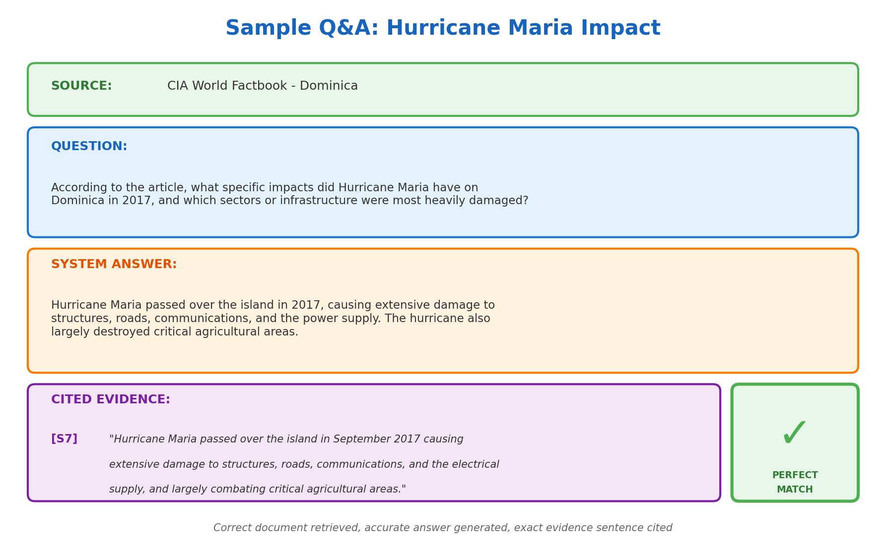
Sample Q&A
Successful example: correct document retrieved, accurate answer, correct sentence cited
Notes:
Given a question and a document corpus, build a system that:
1. Retrieves the correct source document corpus
2. Generates a 2-4 sentence answer grounded in that document
3. Cites the specific sentences that support the answer
4. Refuses when evidence is insufficient or contradictory
Here’s an example of what it should look like – this was actually taken from our final results

Slide 4
Dataset
Document Corpus (787 docs)
QA Dataset (30 questions)
CNN/DailyMail articles (300)
Russia-Ukraine conflict reporting (217)
CIA World Factbook entries (257)
Documents stored with sentence boundaries
Sentence IDs: S1, S2, S3...
24 train / 3 dev / 3 test
Each entry includes:
- Question text
- Gold answer
- Source document ID
- Evidence sentence IDs
Edge cases: unanswerable questions, numeric precision queries

Slide 5
Evaluation Metrics
Retrieval & Citation
Answer Quality
Recall@1: Correct doc ranked first?
Recall@5: Correct doc in top 5?
Citation Precision: Fraction of cited sentences that are correct
Citation Recall: Fraction of gold sentences that were cited
Citation F1: Harmonic mean
LLM-as-Judge: Llama 3.1 8B scores answers 1-5 using rubric
Evidence Score: Word overlap between gold and predicted citations (less strict then SID matching)
Combined Score:
0.5 × (Answer/5) + 0.5 × Evidence
Rewards both answer quality and proper grounding

Slide 6
Simple Baseline: BM25 Retrieval
Classic lexical retrieval using term frequency and document length
Implementation:
  Tokenization: NLTK word_tokenize + lowercase
  Ranking: BM25Okapi scores all 787 documents
  Retrieve top-5 documents
Results: Recall@1 = 54.2%, Recall@5 = 62.5%, Citation F1 = 0.241

Slide 7
Strong Baseline: LLM-Only
Direct LLM generation without document retrieval
Implementation:
  Model: Llama 3.1 8B via Groq API
  No retrieval, no document access, no citations
Results: Answer Score = 2.58/5, Combined = 0.30 (no evidence!)

Slide 8
Extension 1: Retrieval-Augmented Generation
Combine BM25 retrieval with LLM generation
Pipeline:
  BM25 retrieves top-5 documents
  Pass top document to LLM as context
  LLM generates 2-4 sentence answer
  Word-overlap extracts top-3 evidence sentences
Results: Answer improves 2.58 → 3.12 (+21%), Combined 0.30 → 0.48

Slide 9
Extension 2: Cross-Encoder Reranking
Problem: BM25 misses semantically similar content
Solution: Reranking with cross-encoder
Implementation:
  BM25 retrieves top-30 candidates (expanded from top-5)
  Cross-encoder (ms-marco-MiniLM-L-6-v2) scores each pair
  Re-sort by scores, select top-5
Results: Recall@1 jumps 54% → 79% (+46%), 6 more correct docs at rank 1

Slide 10
Extension 3: LLM-Based Citation Extraction
Problem: Word-overlap misses semantically similar matches
  E.g., "casualties" in question vs "killed" in document
Solution: LLM identifies supporting sentences
• Prompt LLM with question, answer, and numbered sentences
• LLM returns sentence IDs that support the answer
• Semantic matching instead of lexical matching
Results: Citation F1 jumps 0.29 → 0.58 (+98%)

Slide 11
Extension 4: Hybrid Retrieval
Combine lexical and semantic signals
BM25 scores (lexical matching) + dense embeddings (all-MiniLM-L6-v2) for semantic similarity
Combined score: α × BM25 + (1-α) × Semantic, with α = 0.5
Results: Recall@1 hits 83.3%, Recall@5 hits 95.8% (best retrieval)

Slide 12
Extension 5: Document Chunking
Problem: Long documents dilute relevant content
Solution: Break documents into overlapping chunks
Implementation:
  8-sentence windows with 2-sentence overlap
  Each chunk scored independently -> best chunk used for answer generation
Results: Recall@5 reaches 100% - correct doc always in top 5

Slide 13
Extension 6: Answer Verification
Problem: Generated answers may not be supported by retrieved doc
Solution: Verify answer against source, retry if needed
Implementation:
  Generate answer from top chunk
  LLM verifies: Is this answer supported by the document?
  If NOT_SUPPORTED: try next chunk (up to 3 attempts)
  Return best verified answer
Results: Best overall - Citation F1 = 0.63, Answer = 3.88/5, Combined = 0.71

Slide 14
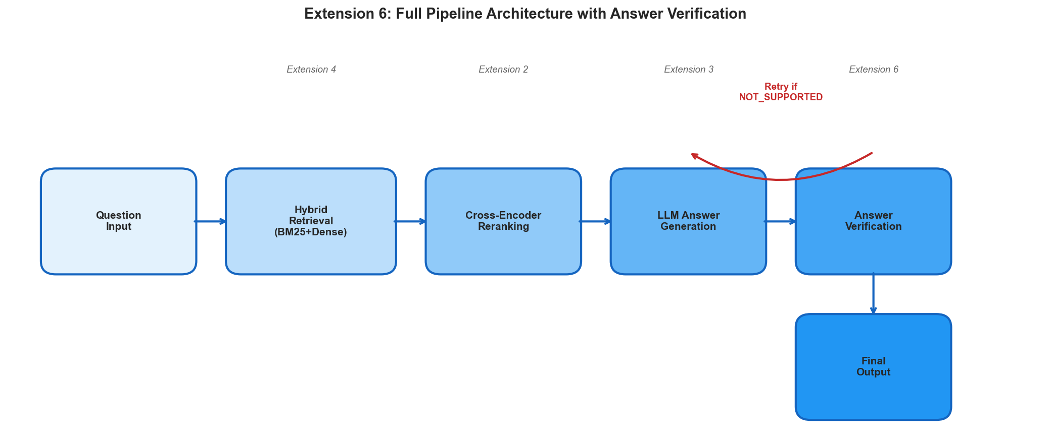
Final Architecture
Extension 6 pipeline: Hybrid retrieval → Reranking → Generation → Verification with retry

Slide 15
Results: Train Set (24 questions)
Model | R@1 | R@5 | Cite F1 | Answer | Combined
Simple (BM25) | 54.2% | 62.5% | 0.241 | -- | --
Strong (LLM) | 0% | 0% | 0% | 2.58 | 0.30
Ext 1 (RAG) | 54.2% | 62.5% | 0.241 | 3.12 | 0.48
Ext 2 (Rerank) | 79.2% | 91.7% | 0.291 | 3.75 | 0.58
Ext 3 (LLM Cite) | 79.2% | 91.7% | 0.576 | 3.83 | 0.70
Ext 4 (Hybrid) | 83.3% | 95.8% | 0.528 | 3.79 | 0.65
Ext 5 (Chunk) | 75.0% | 100% | 0.616 | 3.67 | 0.69
Ext 6 (Verify) | 75.0% | 100% | 0.632 | 3.88 | 0.71

Slide 16
Key Improvements
Retrieval: 54% → 79% Recall@1 (+46% from reranking)
Citation: 0.24 → 0.63 F1 (+163% from LLM extraction)
Answer Quality: 2.58 → 3.88 (+50% from grounding)
Combined Score: 0.30 → 0.71 (+137%)
Grounding Analysis: Extension 6 achieves 100% answer grounding
  Every answer verified against source document
  Retry mechanism catches initially unsupported claims

Slide 17
Error Analysis
1. Retrieval Failures (6/24 questions)
  Similar documents confuse the retriever
  Example: Multiple Russia-Ukraine articles from same time period
2. Citation Misalignment
• LLM cites semantically related but not gold sentences
3. Unanswerable Questions
• System sometimes attempts answer when should refuse
• Verification helps but doesn't fully solve this

Slide 18
Conclusions
What we built:
  End-to-end document-grounded QA with sentence-level citations
  Six extensions progressively improving each pipeline stage
Results (train set):
• Recall@1: 54% → 79% | Citation F1: 0.24 → 0.63
• Combined Score: 0.30 → 0.71
What we learned:
• Neural methods outperform lexical but are less interpretable
• "Hallucination-free RAG" is harder than it looks
• Each pipeline stage has failure modes that cascade

Slide 19
Questions?
github.com/asherellis/cis5300_project

