Slide 1
RAG-Based QA Assistant for Intelligence Analysis
Milestone 3 Presentation Draft
Asher Ellis, Vincent Lin, Chih Yu Tsai, Risha Kumar

Slide 2
What problem are we solving?
Analysts face a trade-off: manual reading (accurate but slow) vs LLM summaries (fast but may hallucinate).
Need a fast, trustworthy answers that show exactly where each claim came from.
Goal: deliver concise, defensible answers with sentence-level citations from documents that intelligence analysts may access and need answers from.
Notes:
Intelligence analysts need to synthesize information quickly but accurately. They require reliable traceability for where you got your information from. Current LLMs are fast but can hallucinate, while manual reading is accurate but too slow and tedious. Our project aims to bridge this gap.

Slide 3
Why is this exciting?
Real world problem: There's been an explosion of data for intelligence analysts, and a growing challenge of how to sift through it all.
Technical challenge: information retrieval and question-answering is surprisingly complex!
Covers several key tasks + concepts in NLP:
  RAG (Retrieval-Augmented Generation)
  LLM-as-judge
  Evaluation of generation quality (faithfulness, grounding)

Slide 4
Relevance to class
Retrieval:
BM25 lexical matching
Tokenization (NLTK word_tokenize)
Generation:
LLM text generation
Prompt engineering and instruction-following
Evaluation
Precision, recall, F1
LLM-as-judge

Slide 5
Our task
Input: a natural-language question + corpus (open-source materials).
Output: 2–4 sentence paraphrased answer + inline citations to exact sentence IDs.
System should refuse when evidence is insufficient or contradictory (e.g. print 'insufficient evidence').
Notes:
Unlike some QA tasks, intelligence analysis requires reliable traceability for where you got your information from. Here, we require sentence-level citations. The refusal mechanism aims to prevent hallucination when documents don't contain relevant information.

Slide 6
Our Model at a High-Level
Document ingestion: Load documents with sentence boundaries preserved
Retrieval: BM25 lexical matching to retrieve top-k relevant documents
Answer generation: LLM (llama-3.1-8b-instant) produces 2-4 sentence answer from top-ranked document
Citation extraction: Word-overlap matching to identify evidence sentences
Post-checks: Evidence thresholds; refusal if insufficient evidence
Notes:
This is our Extension 1 implementation - a RAG system combining BM25 retrieval with LLM answer generation. We'll descriibe each component in the following slides.

Slide 7
Corpus & QA dataset
Corpus:
1005 documents from CNN/DailyMail, Russia-Ukraine conflict articles, CIA World Factbook
Mix of news articles, government reports, and reference materials
Documents stored with sentence boundaries preserved (sentence IDs: S1, S2, S3...)
Dataset:
24 train / 3 dev / 3 test examples
Each JSONL entry: question, gold answer, evidence Sentence IDs, and 1–5 rubric
Examples include edge cases: unanswerable, numeric-precision queries, multi-source syntheses
Notes:
Our corpus is diverse to test retrieval across different document types. The dataset was carefully annotated with gold answers and citations for strong evaluation.

Slide 8
Ingest Data
PDFs → text extraction, preserving sentence boundaries and metadata
Store metadata: title, date, source type (govt/think tank/news), doc_id
Sentence IDs: S1, S2, S3, … assigned to each sentence
Extracting snippets: Concatenate the top k sentences with highest overlapped with question with truncation
Output of load_documents:
  doc_texts (string of texts for BM25 index)
  doc_ids
  doc_structures (meta-data)

Slide 9
Evaluation Overview
Three dimensions:
Retrieval accuracy: Recall@1, Recall@5 (whether gold document is in top-k)
Citation accuracy: Precision, Recall, F1 based on exact sentence ID matching
Answer quality: LLM-as-judge (1-5 rubric)
Primary combined score: c_i = λ * a_i + (1−λ) * e_i, where a_i ∈ [0,1] (rubric score normalized) and e_i ∈ [0,1] (evidence score - gold vs predicted word overlap).
Special-case: unanswerable questions get c_i = 1 if grader gives perfect refusal (Ai=5), else 0.

Slide 10
Simple Baseline: (BM25 Retrieval)
BM25 Lexical Matching
Lexical matching: captures queries with numbers, proper nouns, and exact term matches
Tokenization: lowercase, alphanumeric filtering via NLTK
Ranking: BM25Okapi scores → retrieve top-5 documents by query word overlap
Why BM25? Fast, interpretable, widely used
Answer Construction
Extract snippet from top-ranked document
Sentence IDs selected by top overlap with query
Citations: Sentence IDs with top word overlap (e.g., cnn_dailymail__123_S7)
Performance (train set): Recall@1: 58.33%, Recall@5: 66.67%, Citation F1: 0.2224
Notes:
BM25 - lets us retrieve top-5 documents by lexical match, then use the top-ranked document for answer generation. This provides a lower bound demonstrating that retrieval alone is insufficient for high-quality answers, but establishes baseline performance for retrieval and citation metrics

Slide 11
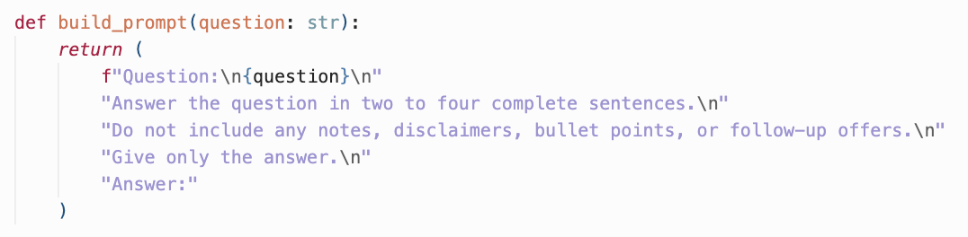
Strong Baseline (LLM Generation)
Answer Generation:
LLM generates short paraphrased answer (2–4 sentences)
Model: llama-3.1-8b-instant via Groq API
No retrieval or document access
Prompt:
Performance (train set, 24 questions): Answer Score: 2.58/5, Evidence Score: 0.0833 (very low due to no citations), Combined Score: 0.30
Notes:
The strong baseline demonstrates LLM generation capabilities but shows the importance of document grounding. Without retrieval or citations, the model cannot provide accountable, traceable answers even when it generates (seemingly) coherent text.

Slide 12
Edge Cases
Unanswerable questions or missing info → require correct refusal to avoid hallucination.
Numeric precision requests (percentages, counts, dates) — demand exact evidence from sources.
Contradictory sources — system should surface disagreements or refuse to synthesize unjustifiably.
Notes:
Explain evaluation for edge cases: unanswerable examples get perfect score only when model refuses correctly.
Discuss potential future like multi-source synthesis with provenance weighting maybe?

Slide 13
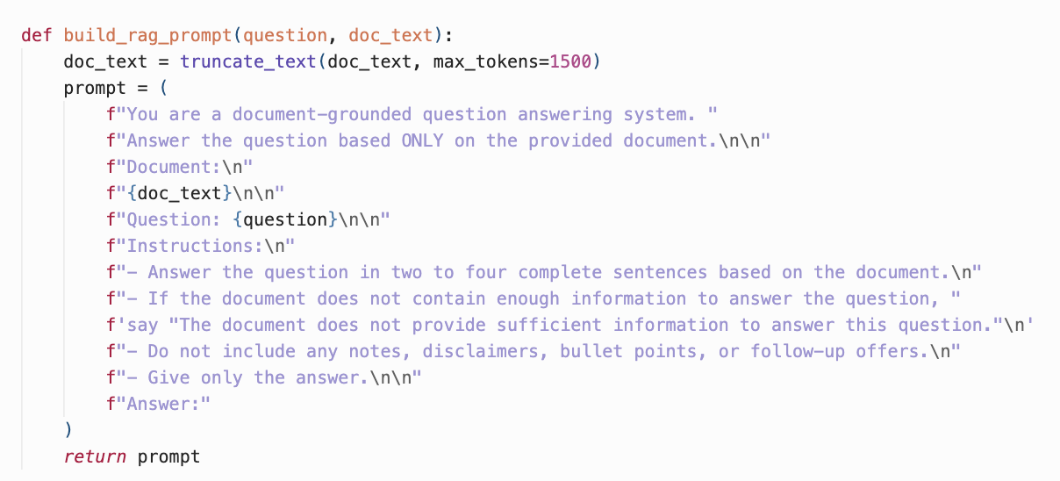
Extension 1 (RAG)
Combine both baselines into a single RAG QA pipeline
Retrieval: BM25 retrieves top-5 documents
Answer generation: Top-ranked document truncated and passed to LLM as context → LLM (llama-3.1-8b-instant) generates 2-4 sentence answer from document
Citation extraction: Word-overlap matching extracts top-3 evidence sentences
Refusal: LLM refuses if document lacks sufficient information
Prompt:
Notes:
…

Slide 14
Extension 1 (RAG)
Combine both baselines into a single RAG QA pipeline
Retrieval: BM25 retrieves top-5 documents
Answer generation: Top-ranked document truncated and passed to LLM as context → LLM (llama-3.1-8b-instant) generates 2-4 sentence answer from document
Citation extraction: Word-overlap matching extracts top-3 evidence sentences
Refusal: LLM refuses if document lacks sufficient information
Results (train set):
Retrieval:
  Recall@1: 58.33%, Recall@5: 66.67%
  Citation
    F1: 0.2224 (identical to simple baseline)
    Precision: 0.3030
    Recall: 0.2307
Answer Score: 3.25/5 (26% improvement), Evidence Score: 0.3230 (+288% improvement), Combined Score: 0.4865 (+62% improvement)
→ Document grounding significantly improves answer quality
Notes:
…

Slide 15
Example
Question: How did Russian officials publicly respond to accusations of default, and what rationale did they use to argue that the responsibility for non-payment lay outside Moscow's control?
Gold Answer: Russian officials rejected the idea that the country was in default and argued that they had sufficient funds to make the payments. [...] This response was meant to shift blame outward and maintain the image of financial solvency.
System Output (Extension 1):
  Retrieval: BM25 retrieves doc `russia-ukraine-conflict_2022-06-27T14_23_05Z` (score: 62.51, rank 1)
  Generated answer: "Russian officials publicly responded to accusations of default by denying that the country was in default, with Vladimir Putin's spokesperson, Dmitry Peskov, calling the claims "absolutely unjustified". He further stated that it was "not our problem" that sanctions had prevented intermediaries from transferring the payments, implying that the responsibility for non-payment lay outside Moscow's control due to external sanctions."
  Citations: Evidence sentences S19, S5, S7 (gold: S9, S11, S17)
Evaluation: Answer Score 5/5 (perfect), Evidence Score 0.21, Combined Score 0.61
Notes:
Walk through retrieval → rerank → select sentence → generate final answer with citation.
Show how the system would refuse if ICJ doc was not in corpus.
This example shows Extension 1 working. The LLM generates a good answer (5/5) that captures all key points, showing the value of combining retrieval + generation. However, the evidence score (0.21) is low because the predicted citations (S19, S5, S7) differ from the gold standard (S9, S11, S17). So, word-overlap citation extraction can identify relevant sentences, but it may not always match the exact "best" sentences for citation. The combined score (0.61) reflects the mixed picture of strong answer quality and poor citation precision. It also reveals a limitation of the word-overlap citation method: it can identify semantically related sentences but doesn't always select the exact sentences that directly answer the question.

Slide 16
Future Extensions*
Retrieval:
Hybrid lexical + semantic retrieval: Combine BM25 with dense embeddings (sentence-transformers) to broaden match criteria and nuance
Cross-encoder reranking: Rerank BM25 top-20 with BERT cross-encoder for better precision
Query expansion: Expand queries with synonyms before retrieval
Answer Generation:
Multi-document synthesis: Use top 3-5 documents, synthesize information across sources
Passage summarization: Summarize passages before answer generation (rather than truncating)
Citation Improvements:
LLM-based citation extraction: LLM identifies relevant sentences semantically (from retrieved docs) rather than word overlap
Architectural:
Retrieve chunks instead of full documents → more granular retrieval.
*will likely do 2-4 extensions, not all.

