Slide 1
RecipeAPI
Built with Python Flask, SQLite, and some HTML/CSS
Alex Sheriff

Slide 2
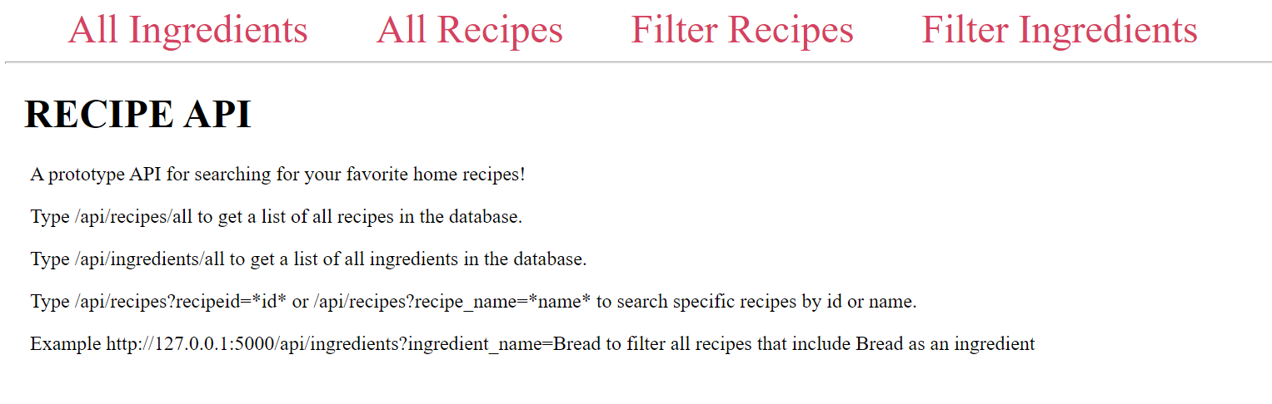
What is RecipeAPI?
A place where I can view recipes, and see what kind of recipe I can make based on certain ingredients.

Slide 3
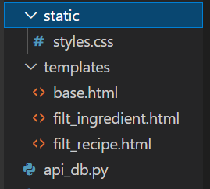

MVC Design
Model - recipes.db (our database)
View - The webpage itself, built via the 3 html and 1 css file.
Control - api_db.py - Handles what to do with the data when a user interacts with the webpage.

Slide 4
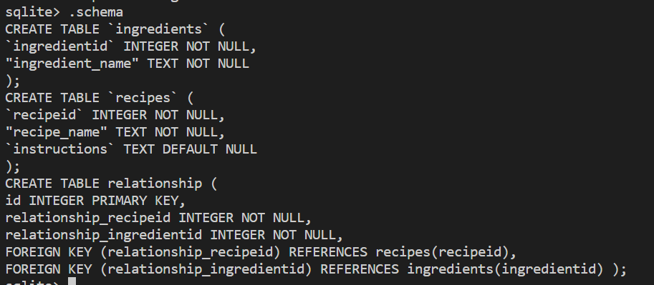
Recipes.db Schema

Slide 5
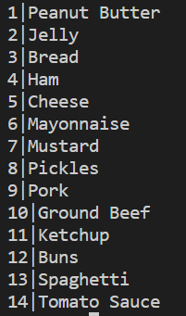

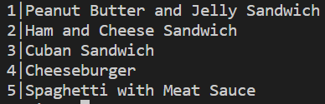
Recipes.db Visualized
Ingredient Table
Relationship Table
Recipes Table

Slide 6
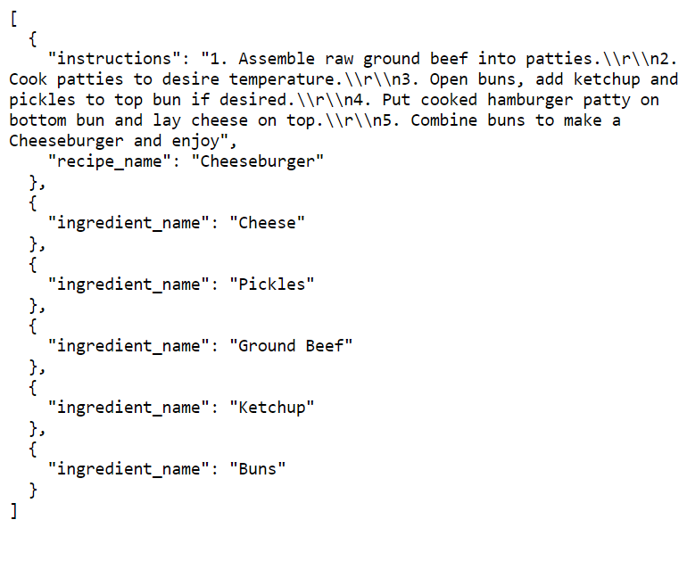
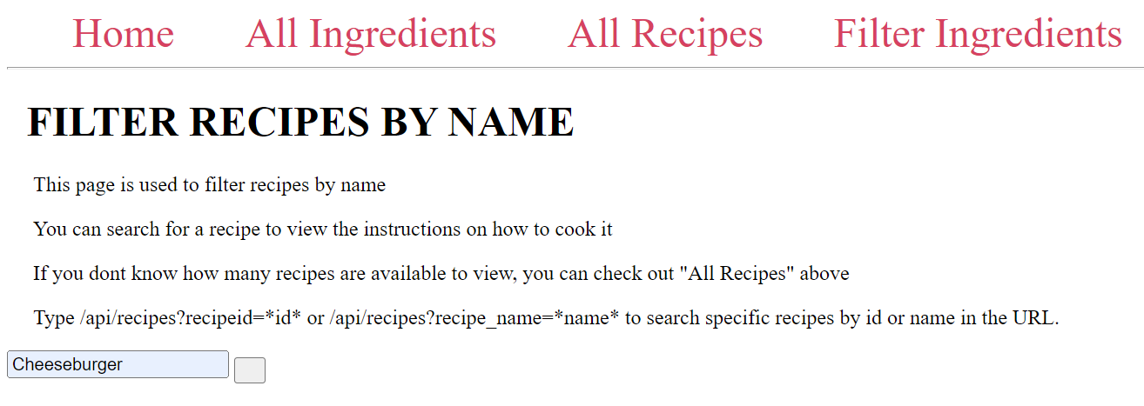
Search for Recipes
When you search for a recipe, the page will redirect you to that recipe with instruction, name, and the ingredients required to make it. You could search directly in the URL if desired.

Slide 7
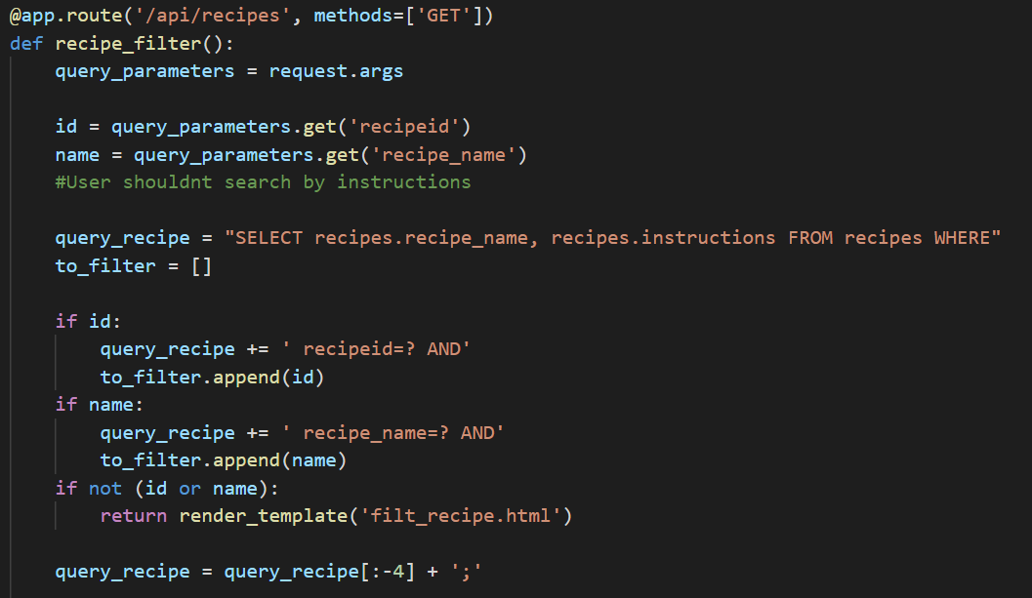
Code Searching for Recipes pt 1
This code handles retrieving the recipe name and instruction itself.

Slide 8
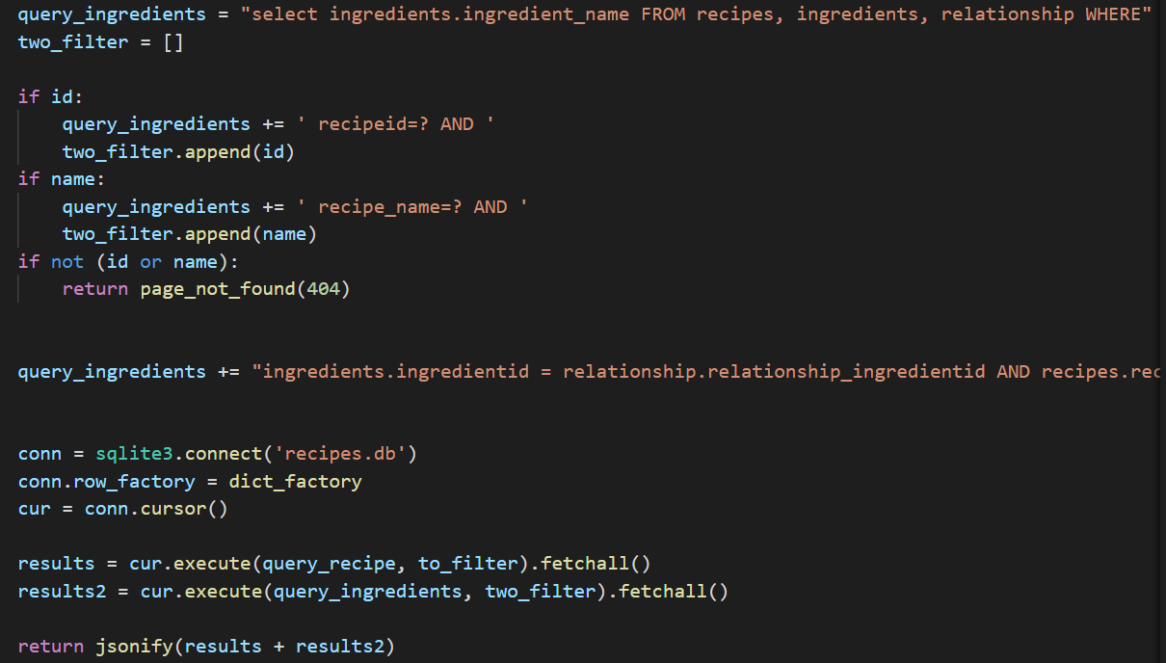
Code Searching for Recipes pt2
The second part of the function. It retrieves the ingredients by the name of the recipe.

Slide 9
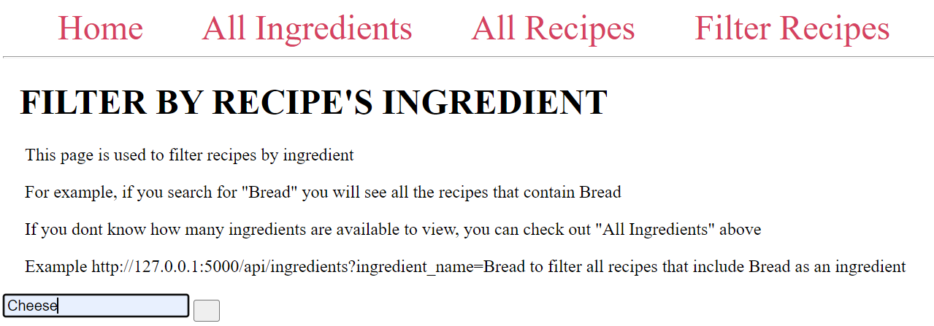
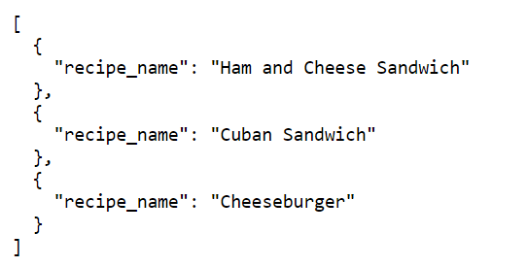
Filter for Recipes By Ingredient
If you want to make a recipe with a specific ingredient, you can filter for recipes by ingredient.

Slide 10
Functions that like to be added in the future
Login system so Users can add their own recipes as well as follow other users recipes
Filtering recipes by multiple ingredients
Adding ingredient amounts to appear (outside of instructions obviously)
Having all results appear on the webpage itself

Slide 11
DEMO & QUESTIONS

