Slide 1


Slide 2


Git is a distributed, non-linear version control system
Version control is a system that records changes to a file or set of files over time so that you can recall specific versions later. Distributed version control allows multiple copies to exist on multiple systems simultaneously.
“GitHub is a collaboration platform built on top of a distributed version control system called Git.”
GitHub provides free* remote hosting for Git repositories

Slide 3
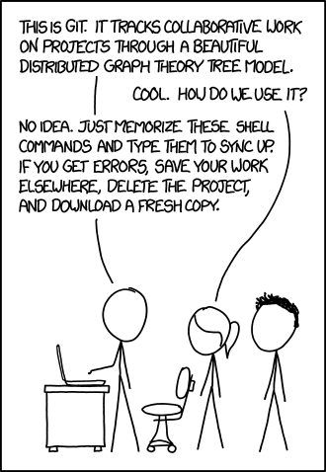
https://xkcd.com/1597/

Slide 4
Vocabulary
Git – A version-control protocol.
GitHub – A service providing remote Git repo hosting.
“Repository” (“Repo”) – A collection of code.
“Add” – Process of staging changed files before…
“Commit” – Process of creating a change record.
“Push” – Uploading change records to remote host.
“Pull” – Download change records from remote host.
“Clone” – Download a personal copy of a code repo.
“Branch” – A separate, working copy of a repository.
“Merge” – Combining two branches into a single copy

Slide 5
Setting Up Git
Try Me!
Register for a GitHub Account
http://github.com/join
Install Git
https://git-scm.com/book/en/v2/Getting-Started-Installing-Git
Windows: Download GitHub for Windows (see below)
Mac: Install Xcode Tools (run “git” from terminal)
Linux: Use package-manager (i.e. yum install git-all)
(OPTIONAL) Install GitHub Desktop
http://mac.github.com
http://windows.github.com

Slide 6

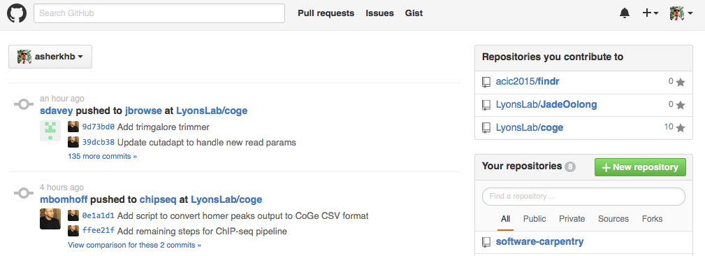
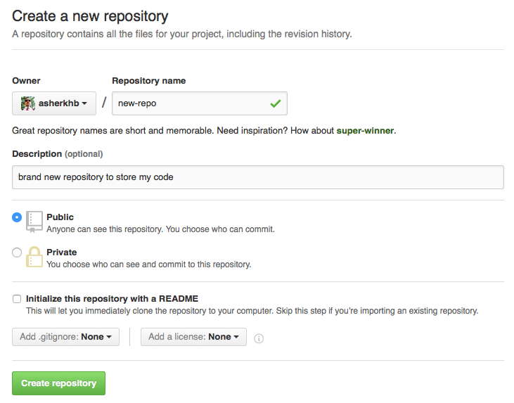
Your First Repository in 1, 2, 3, 4
Try Me!
1. Navigate to github.com & Log In
2. Select “New Repository”
3. Name & Describe Repository
NOTE: Because we are going to be
importing an existing project, do not
initialize with any files

Slide 7
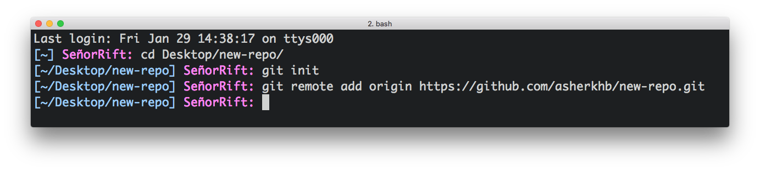
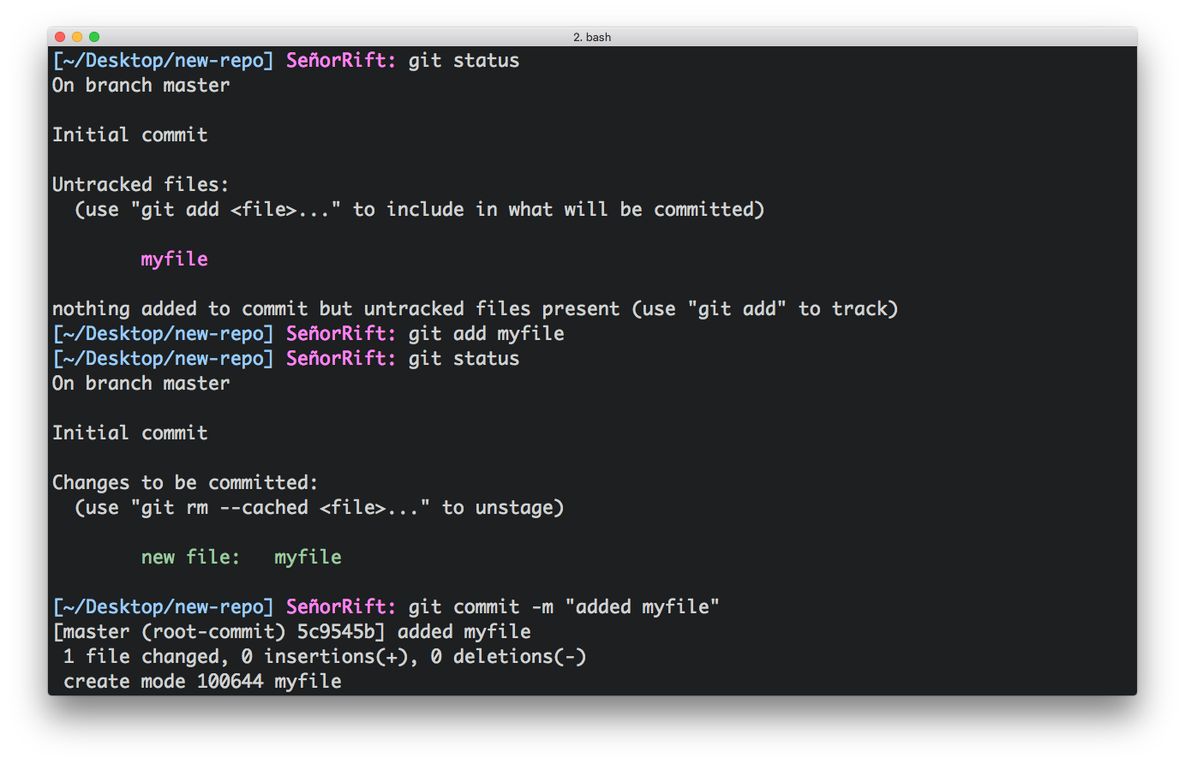
Linking Project & GitHub
Try Me!
Initialize Project with Git
1. Navigate to project directory
2. Initialize Git
3. Add remote host URL
Check Status, Add & Commit Changes
Check Status
git status
Add New/Modified Files
git add <file>
Commit Changes
git commit –m “<msg>”

Slide 8
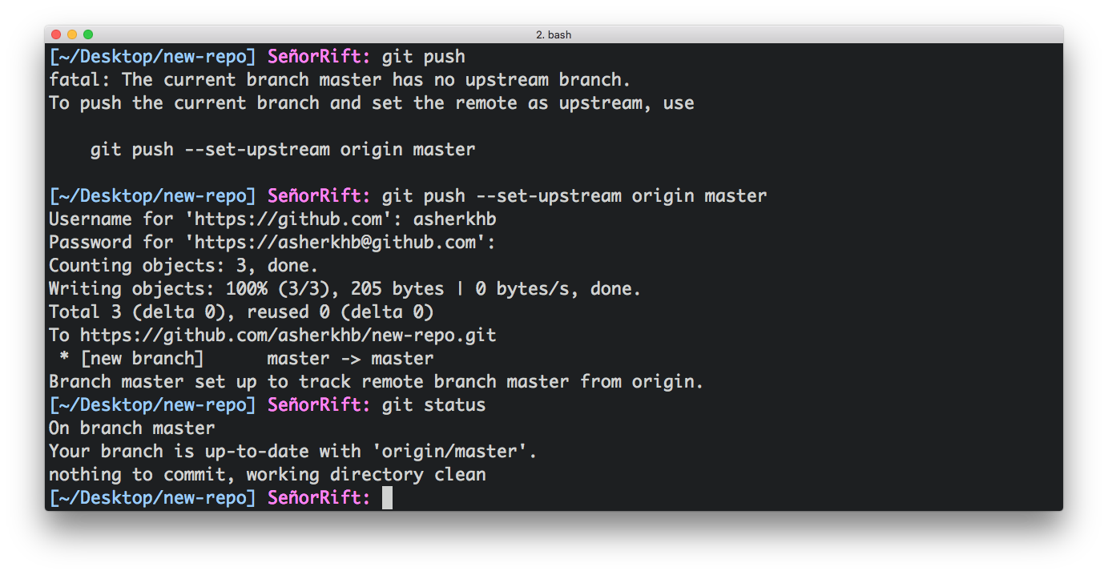
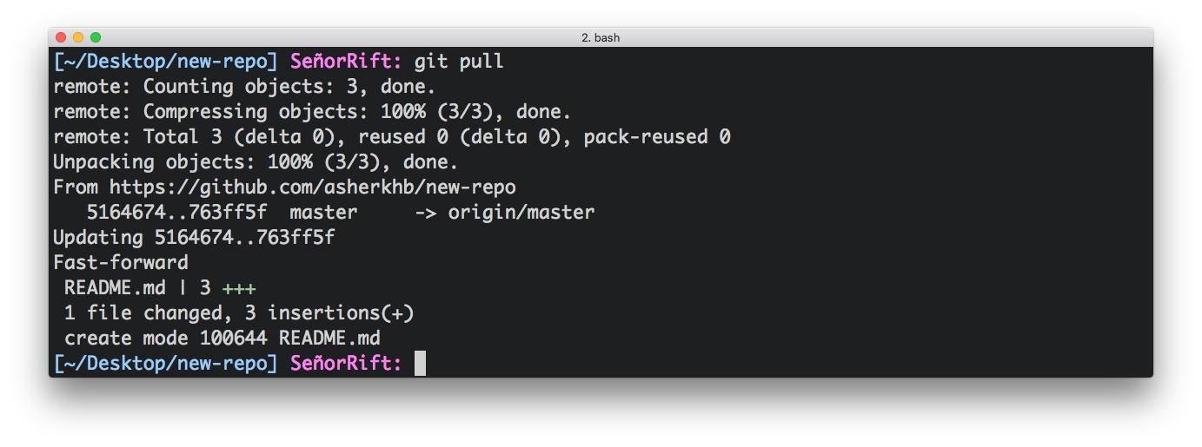
Linking Project & GitHub, Cont.
Try Me!
Uploading content to GitHub
Upload Content
git push
NOTE: Error Message!
Set Upload Path & Upload
--set-upstream <host> <branch>
NOTE: Only necessary first time, or on new branches (more later…)
Downloading changes from GitHub
Download Changes
git pull

Slide 9
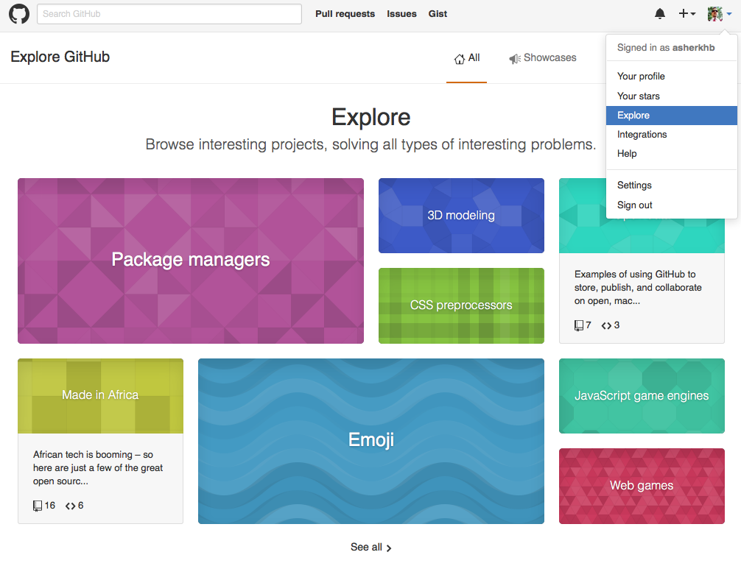
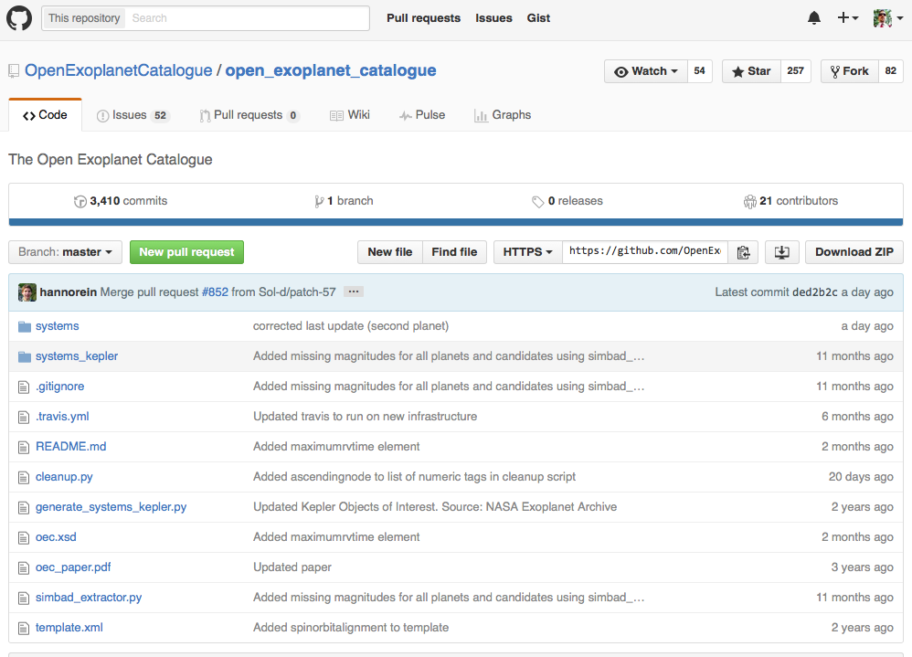

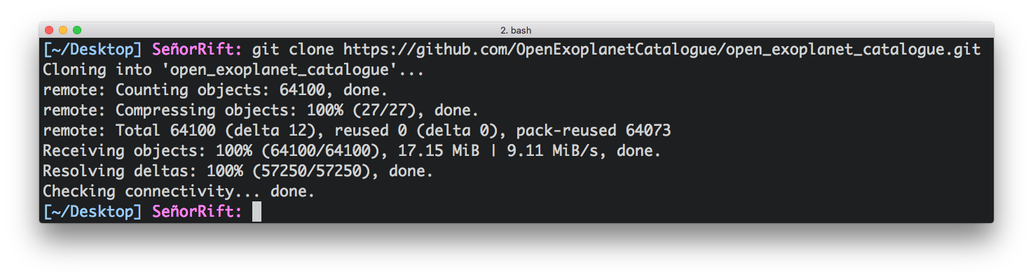
Obtaining Other Code
Try Me!
Finding New Repositories
Downloading New Repositories
Cloning a Repo
git clone <url>

Slide 10
Review
Setup
Initializing a Project as Git…..
Setting Remote Host…..........
Basics
Checking Status…..................
Adding Changes….................
Committing Changes…..........
Uploading Changes…............
Downloading Changes….......
Obtaining Additional Repos..
git init
git remote add origin <url>
git status
git add <file>
git commit -m <message>
git push
git pull
git clone <url>

Slide 11
Git & GitHub Resources
Interactive Lessons
https://www.codecademy.com/learn/learn-git
https://try.github.io/
Cheat Sheets
https://training.github.com/kit/downloads/github-git-cheat-sheet.pdf
https://help.github.com/articles/good-resources-for-learning-git-and-github/
https://www.git-tower.com/blog/git-cheat-sheet/
Pro-Git: A Comprehensive book on using Git (free online).
https://git-scm.com/book/en/v2/
Notes:
https://help.github.com/articles/changing-a-remote-s-url/

