Slide 1
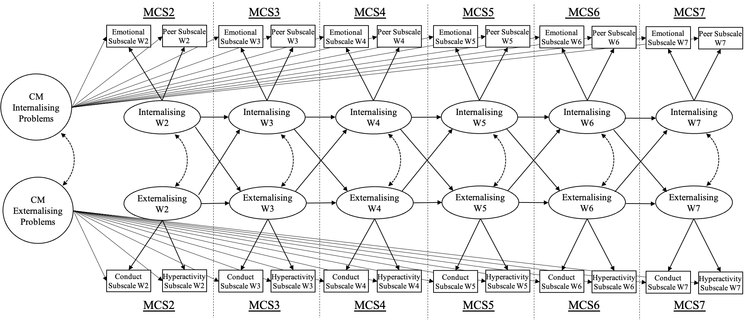
Old Figure 1

Slide 2
CM
Emotional
MCS2 MCS3 MCS4 MCS5 MCS6 MCS7
MCS2 MCS3 MCS4 MCS5 MCS6 MCS7
Emotional Subscale W2
Peer Subscale W2
Emotional Subscale W3
Peer Subscale W3
Emotional Subscale W4
Peer Subscale W4
Emotional Subscale W5
Peer Subscale W5
Emotional Subscale W6
Peer Subscale W6
Emotional Subscale W7
Peer Subscale W7
CM
Peer
Internalising W2
Internalising W3
Internalising W4
Internalising W5
Internalising W6
Internalising W7
CM
Hyperactivity
Externalising W2
Externalising W3
Externalising W4
Externalising W5
Externalising W6
Externalising W7
Conduct Subscale W2
Hyperactivity Subscale W2
Conduct Subscale W3
Hyperactivity Subscale W3
Conduct Subscale W4
Hyperactivity Subscale W4
Conduct Subscale W5
Hyperactivity Subscale W5
Conduct Subscale W6
Hyperactivity Subscale W6
Conduct Subscale W7
Hyperactivity Subscale W7
CM Conduct
Figure 1

Slide 3
CM
Emotional
MCS2 MCS3 MCS4 MCS5 MCS6 MCS7
MCS2 MCS3 MCS4 MCS5 MCS6 MCS7
Emotional Subscale W2
Peer Subscale W2
Emotional Subscale W3
Peer Subscale W3
Emotional Subscale W4
Peer Subscale W4
Emotional Subscale W5
Peer Subscale W5
Emotional Subscale W6
Peer Subscale W6
Emotional Subscale W7
Peer Subscale W7
CM
Peer
Internalising W2
Internalising W3
Internalising W4
Internalising W5
Internalising W6
Internalising W7
CM
Hyperactivity
Externalising W2
Externalising W3
Externalising W4
Externalising W5
Externalising W6
Externalising W7
Conduct Subscale W2
Hyperactivity Subscale W2
Conduct Subscale W3
Hyperactivity Subscale W3
Conduct Subscale W4
Hyperactivity Subscale W4
Conduct Subscale W5
Hyperactivity Subscale W5
Conduct Subscale W6
Hyperactivity Subscale W6
Conduct Subscale W7
Hyperactivity Subscale W7
CM Conduct
Figure 3

Slide 4
CM
Emotional
MCS2 MCS3 MCS4 MCS5 MCS6 MCS7
MCS2 MCS3 MCS4 MCS5 MCS6 MCS7
Emotional Subscale W2
Peer Subscale W2
Emotional Subscale W3
Peer Subscale W3
Emotional Subscale W4
Peer Subscale W4
Emotional Subscale W5
Peer Subscale W5
Emotional Subscale W6
Peer Subscale W6
Emotional Subscale W7
Peer Subscale W7
CM
Peer
Internalising W2
Internalising W3
Internalising W4
Internalising W5
Internalising W6
Internalising W7
CM
Hyperactivity
Externalising W2
Externalising W3
Externalising W4
Externalising W5
Externalising W6
Externalising W7
Conduct Subscale W2
Hyperactivity Subscale W2
Conduct Subscale W3
Hyperactivity Subscale W3
Conduct Subscale W4
Hyperactivity Subscale W4
Conduct Subscale W5
Hyperactivity Subscale W5
Conduct Subscale W6
Hyperactivity Subscale W6
Conduct Subscale W7
Hyperactivity Subscale W7
CM Conduct
Figure 4

Slide 5
CM
Emotional
MCS2 MCS3 MCS4 MCS5 MCS6 MCS7
MCS2 MCS3 MCS4 MCS5 MCS6 MCS7
Emotional Subscale W2
Peer Subscale W2
Emotional Subscale W3
Peer Subscale W3
Emotional Subscale W4
Peer Subscale W4
Emotional Subscale W5
Peer Subscale W5
Emotional Subscale W6
Peer Subscale W6
Emotional Subscale W7
Peer Subscale W7
CM
Peer
Internalising W2
Internalising W3
Internalising W4
Internalising W5
Internalising W6
Internalising W7
CM
Hyperactivity
Externalising W2
Externalising W3
Externalising W4
Externalising W5
Externalising W6
Externalising W7
Conduct Subscale W2
Hyperactivity Subscale W2
Conduct Subscale W3
Hyperactivity Subscale W3
Conduct Subscale W4
Hyperactivity Subscale W4
Conduct Subscale W5
Hyperactivity Subscale W5
Conduct Subscale W6
Hyperactivity Subscale W6
Conduct Subscale W7
Hyperactivity Subscale W7
CM Conduct
Figure 5

Slide 6
CM
Emotional
MCS2 MCS3 MCS4 MCS5 MCS6 MCS7
MCS2 MCS3 MCS4 MCS5 MCS6 MCS7
Emotional W2
Emotional W3
Emotional W4
Emotional W5
Emotional W6
Emotional W7
Internalising W2
Internalising W3
Internalising W4
Internalising W5
Internalising W6
Internalising W7
Externalising W2
Externalising W3
Externalising W4
Externalising W5
Externalising W6
Externalising W7
Conduct W2
Conduct W3
Conduct W4
Conduct W5
Conduct W6
Conduct
CM Conduct
Figure 6

Slide 7
CM
Emotional
MCS2 MCS3 MCS4 MCS5 MCS6 MCS7
Age 3 Age 5 Age 7 Age 11 Age 14 Age 17
Emotional Subscale W2
Peer Subscale W2
Emotional Subscale W3
Peer Subscale W3
Emotional Subscale W4
Peer Subscale W4
Emotional Subscale W5
Peer Subscale W5
Emotional Subscale W6
Peer Subscale W6
Emotional Subscale W7
Peer Subscale W7
CM
Peer
Internalising W2
Internalising W3
Internalising W4
Internalising W5
Internalising W6
Internalising W7
CM
Hyperactivity
Externalising W2
Externalising W3
Externalising W4
Externalising W5
Externalising W6
Externalising W7
Conduct Subscale W2
Hyperactivity Subscale W2
Conduct Subscale W3
Hyperactivity Subscale W3
Conduct Subscale W4
Hyperactivity Subscale W4
Conduct Subscale W5
Hyperactivity Subscale W5
Conduct Subscale W6
Hyperactivity Subscale W6
Conduct Subscale W7
Hyperactivity Subscale W7
CM Conduct
Blog post

