Slide 1
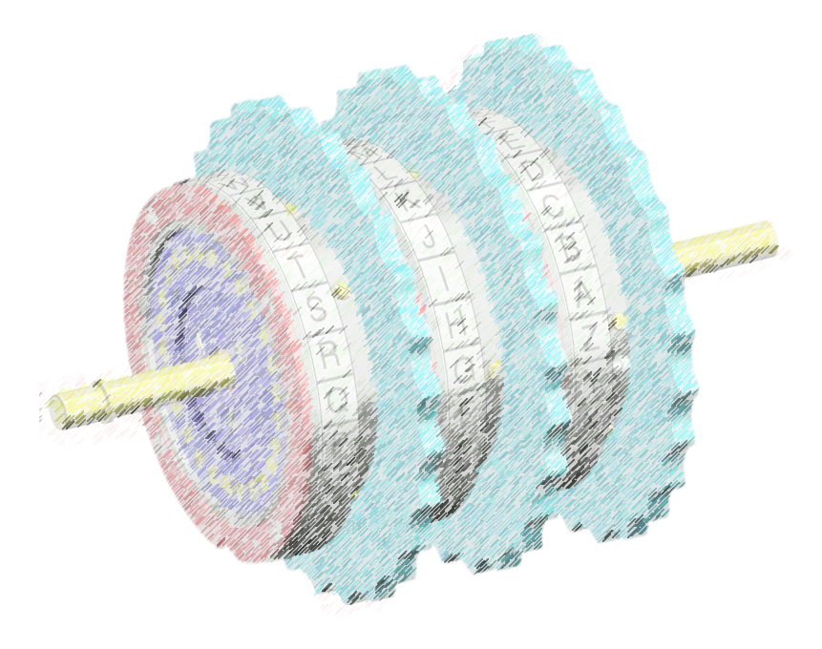
The Enigma Machine
Alyssa La Fleur, Asher Mancinelli, Jude Battista

Slide 2
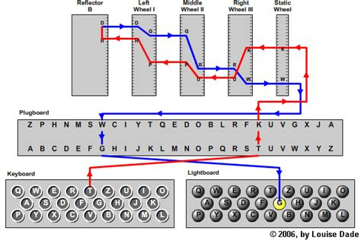
Originally commercially sold by Swedes pre-war, less secure
Tyre, core, Ringstellung (clip), (even if starting position letters known, Ringstellung must be known also)
20 of 26 letters could be stickered
8 rotors: I-V turned once/revolution and VI-VIII turned twice/revolution
http://enigma.louisedade.co.uk/wiringdiagram.png

Slide 3
Enigma Machine Combinations
3-5 rotors, 26x26x26 minimum encrypted letters until the rotors return to starting position
To decode a message: wheel order, clips/Ringstellung, starting position, and Stecker
Wheel order (3 rotors) | 336 possibilities (P(8,3))
Clip combinations | 17,576 (26^3)
Starting positions | 17,576 (26^3)
Stecker | 1- ~0.5 billion (varied greatly)

Slide 4


Keys
K book, key sheets, bigram tables
Indicator procedures were used to send the key to the receiver, usually they consisted of two trigrams
key ID group (Schluesselkenngruppe) from daily tables
procedure ID group (Vefahrenkenngruppe) randomly chosen
Different procedures were used for different Enigma networks (Keys), and each network had its own key sheets assigned. Some networks were Yellow, Red, Dolphin, Shark, Kestrel, etc.

Slide 5
Architecture of the Enigma Machine: Basics
Don’t worry if this is intimidating; I will go into more detail in a couple slides

Slide 6
Architecture of the Enigma Machine: In Code
Main Idea:
Every mechanical part of the enigma machine is mimicked by some part of the program

Slide 7
Plugboard
Object contains a dictionary where each letter is mapped to another, reflexive.
Plugboard Object
S
A
Plugboard Object
A
S

Slide 8
Rotors: Rotations
Similar to plugboard, except not reflective
Internal character mapping rotates every character evaluated
EX: This is what happens internally after each evaluation:
22,
22, 3, 16, 2, 4…, 9

Slide 9
Rotors: Evaluation
Almost exactly like the plugboard, but not reflexive
Rotor Object
A
S
Rotor Object
S
V

Slide 10
Reflector
Almost exactly the same as a rotor, but does not rotate values
Notice that the reflector evaluates to the same character after multiple evaluations, unlike a rotor
Reflector Object
A
S
Reflector Object
A
S

Slide 11
Rotors: Evaluation in Reverse
Almost exactly like the plugboard, but not reflexive
Note:
Before, the rotor mapped a->s and s->z, but now in reverse, the opposite is true
Rotor Object
A
S
Rotor Object
A
S

Slide 12
Enigma Machine: Putting It All Together
The actual enigma machine object uses several rotors, a reflector, and optionally a plugboard, same as in the actual machine.

Slide 13
In Practice:
The ‘controller’ of the program puts all the parts together, and this is what it looks like in pseudocode:
plaintext = ‘hello there class’
ciphertext = ‘’
for letter in plaintext:
ct_letter = enigmamachine.evaluate(letter)
ciphertext = ciphertext + ct_letter
print_to_screen(ciphertext)

Slide 14
Demo
With program:
Encrypt simple message
Decrypt message
On board:
Demonstration of two-letter encryption

Slide 15
Class Exercise!
Each row break into three groups
Plugboard
Rotor
Reflector
Come up with a five letter word to encrypt
Encrypt letter by letter (confirm with program if needed)
Pass to group in front of you
Decrypt message

Slide 16
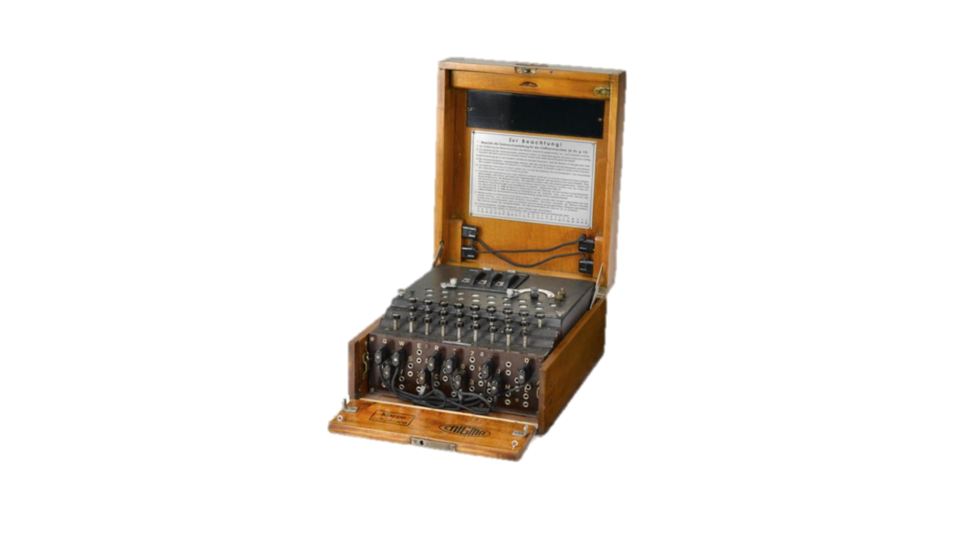
The Bomba
Indicator Settings: RTJ DQY HPB
Trigrams: WAHWIK DWJMWR RAWKTW
Pair 1 Right rotor: 1r,
Pair 2 Right rotor: 2r = 1r + 15,
Pair 3 Right rotor: 3r = 1r + 18
Conclusion: Keying W makes the same letter light up for:
Pair 1: 1r & 1r + 3
Pair 2: 1r +15 +1 & 1r + 15 + 4, so 1r + 16 & 1r + 19
Pair 3: 1r + 18 + 2 & 1r + 18 + 5, so 1r + 20 & 1r + 23
The Bomba could decrypt messages with a certain key transmission method. Method abandoned 1940.
6 replica Enigma machines, all same wheel order, with linked pairs locked in step
Assumed that no turnovers occurred with the second and third wheel
Could not correct Stecker

Slide 17
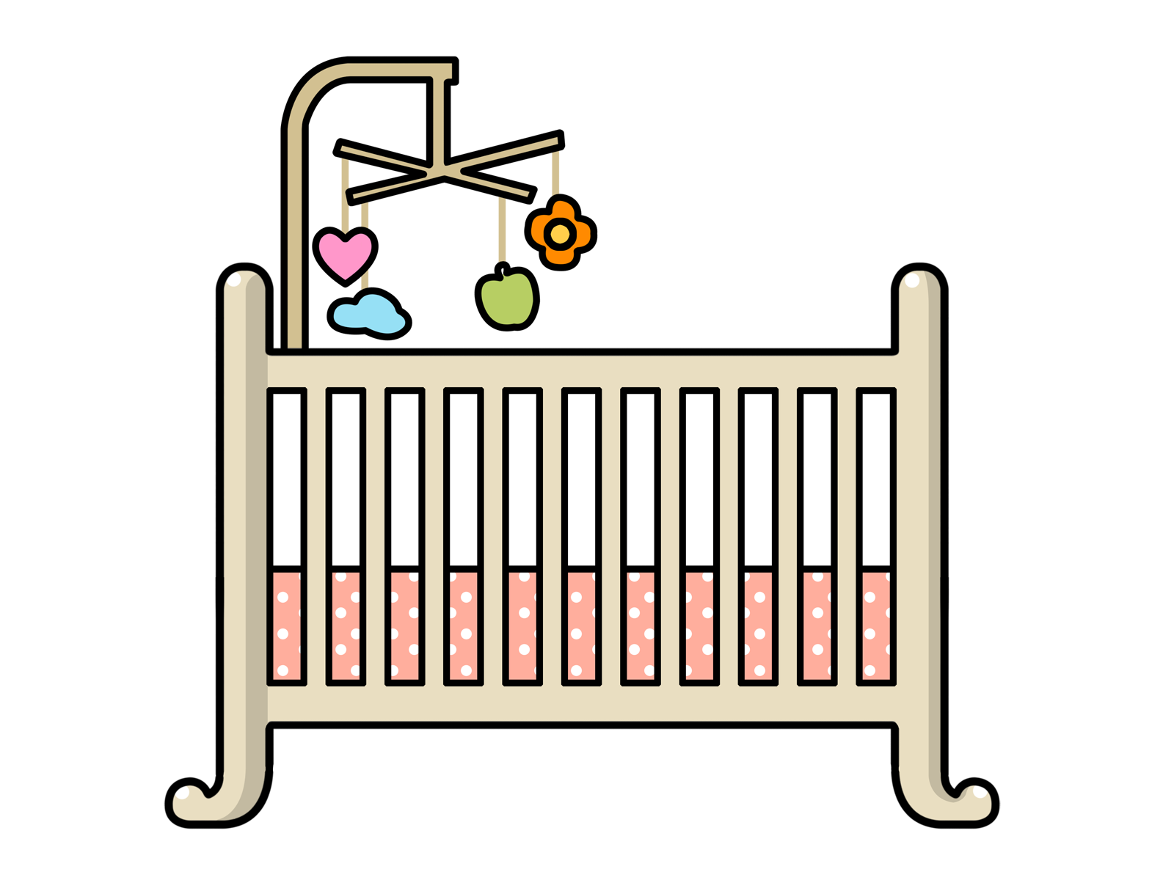
Known Plaintext Attacks AKA “Cribbing”
A crib was a guess at the plaintext, which could be used to attempt decoding
Depth Cribs: Multiple ciphertexts and at least one plaintext were slid along each other to find ‘reciprocal letters’ and ‘clicks’
Straight Cribs: Comparison of likely plaintext with the ciphertext by sliding along the message
Re-encodements: Large cribs generated when a message was encoded again and redistributed in another network (often weather reports)

Slide 18
Banburismus
Take two messages with two rotor settings in common and derive the third by statistical analysis of offset text.
DubisteinemderklassischenFehlerzumOpfergefallen
DerberühmtestedavonistnieineinenLandkrieginAsienverwickelt
DerberühmtestedavonistnieineinenLandkrieginAsienverwickelt
OZJGNXNPMWVFTIJVCUNDTQKTQAZQOXMILUKSYSUUTNSCOVA
MLXCRTTNHCJELFMOZSDTUVVZXGXVDOFUYQGTMCNPDTHQXTEUALPQQMYUW
MLXCRTTNHCJELFMOZSDTUVVZXGXVDOFUYQGTMCNPDTHQXTEUALPQQMYUW
MLXCRTTNHCJELFMOZSDTUVVZXGXVDOFUYQGTMCNPDTHQXTEUALPQQMYUW

Slide 19
Bayes’ Theorem
Consider a population of women, aged 40, who participate in regular breast cancer screenings.
1% of this population has breast cancer
80% of women who have breast cancer have positive mammographies.
9.6% of women who do not have cancer will have positive mammographies.
If a woman in this population has a positive mammography, what is the percent chance she has cancer?

Slide 20
Bayes’ Theorem
States that the probability of A given B, denoted p(A|B), is equal to:
p(B|A) * p(A)
p(B|A) * p(A)
or
p(B|A) * p(A) + p(B|~A) * p(~A)
p(B)
Thus the probability of cancer, given a positive test is:
(.80) * (.01)
(.01 * .8) + (.99 * .096)
Or 7.8%

Slide 21
Bayesian Analysis
Prior probability : The percentage of the population with cancer
Conditional probabilities: true positives and false positives on the test
Together these are known as ‘priors’
Posterior probability: the percentage of women with positive tests who also have cancer

Slide 22
Back to the Enigma
Prior probability : The chance the alignment is correct
Conditional probabilities: The chance of getting a match given a correct alignment and the chance of getting a match with an incorrect alignment
Posterior probability: The chance the alignment is correct, given a match

Slide 23
Priors for the Enigma
Ratio of repetition
German Naval: 1 in 17
Random: 1 in 26
Chance of an alignment being correct: 1 in 50
Chance of the alignment being correct given a match?
Given a mismatch?

Slide 24
Chance of correct alignment given a match:
1/17 * 1/50
or about 1.53 * 1/50
1/26
Chance of correct alignment given a mismatch:
16/17 * 1/50
or about .979 * 1/50
25/26

Slide 25
Alignment score
Individual comparisons are essentially independent
Composite factor
Decibans

Slide 26
Ultra’s Impact on the ETO
War in the North Atlantic
Western Allied intelligence efforts
Who was responsible for defeating Germany?

Slide 27
Soviets and Ultra
Lucy spy ring
John Cairncross
Battle of Kursk
Germany surrenders 7 May 1945
6 August 1945

Slide 28
IMPORTANT POINTS:
Enigma machine rotors are not reflexive
The stecker/plugboard setup stays the same during use
The enigma machine cannot encode a letter as itself
The Polish Bomba could not find stecker/plugboard connections
John Cairncross delivered Ultra intelligence to the USSR
Bayesian theorem tells us that tests for a rare condition are much less accurate than we expect (less than 10 %)
Any questions?

