Slide 1

What We Want: An Analysis of College Prestige and Virality on Google Trends
By: Asher Noel, Geena Kim, Thuan Tran, Jenny Lu

Slide 2
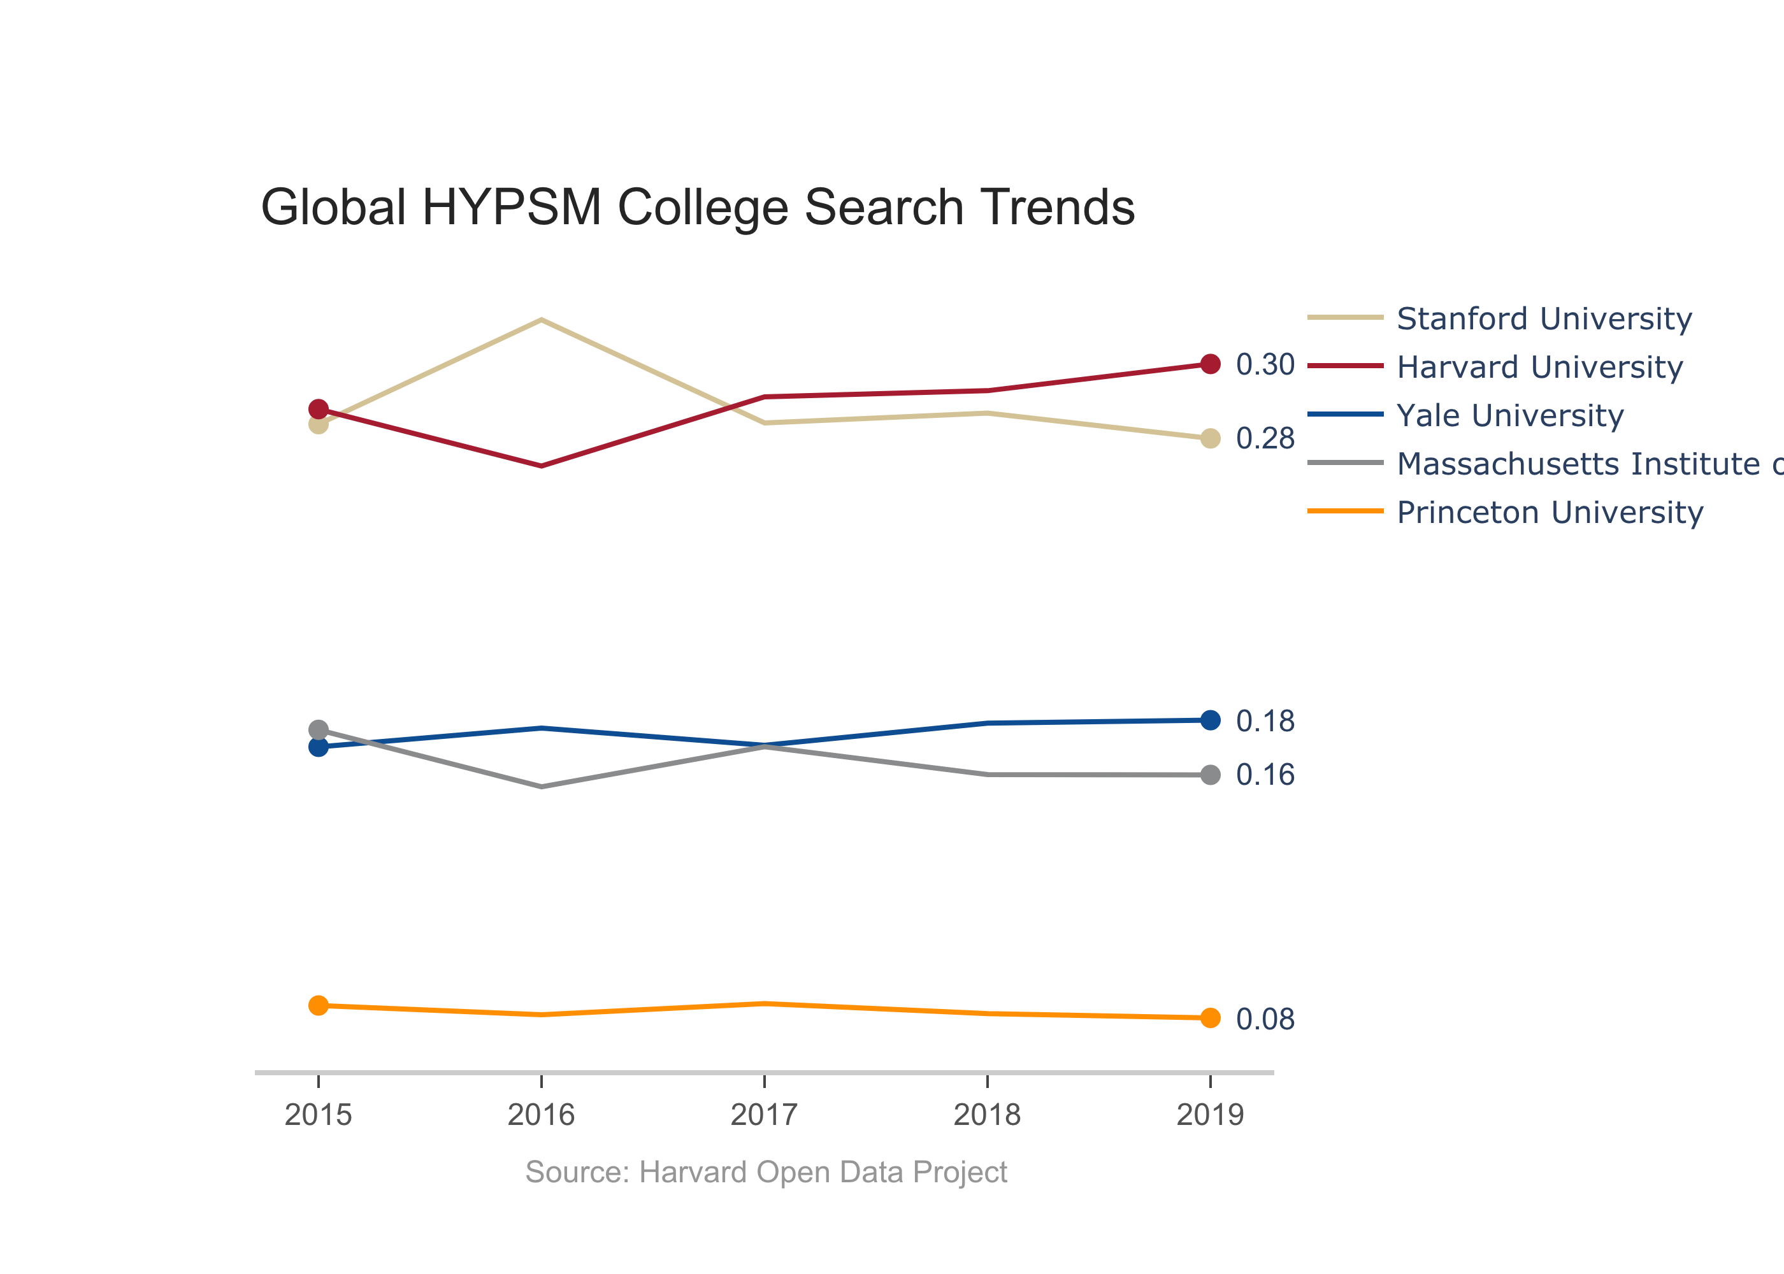
Traditional Rankings:
US News:
Princeton
Harvard
Yale
MIT
6) Stanford
THE:
Stanford
MIT
Princeton
Harvard
Yale

Slide 3
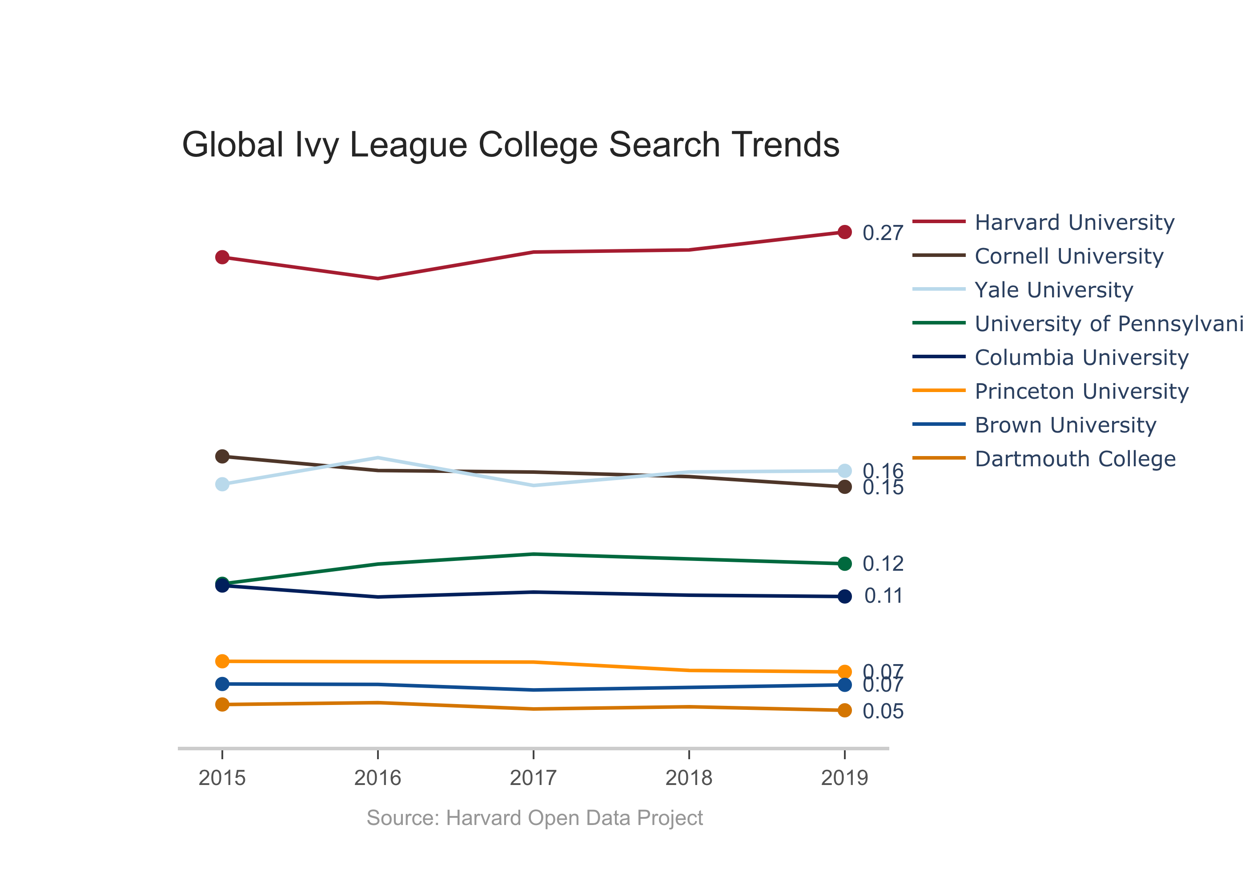
Traditional Rankings:
US News:
Princeton
Harvard
Yale
Columbia
Penn
12) Dartmouth
14) Brown
17) Cornell

Slide 5
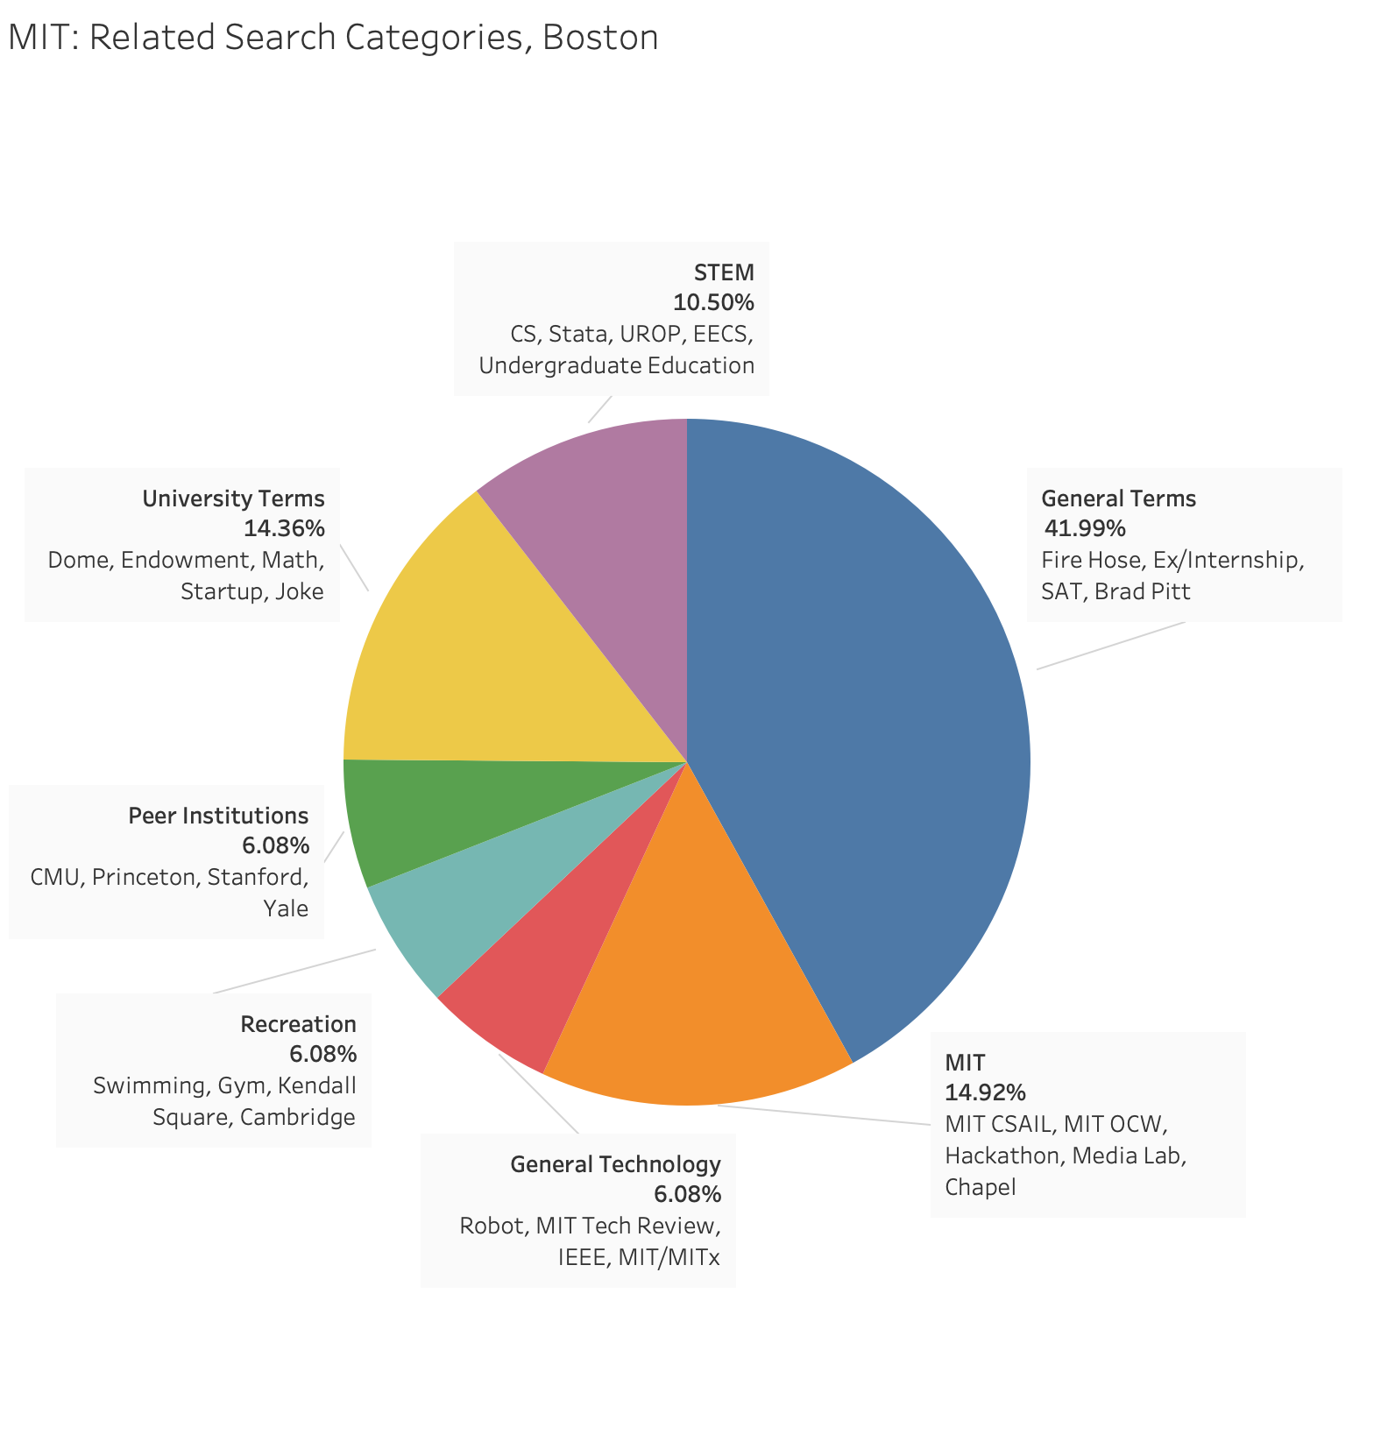
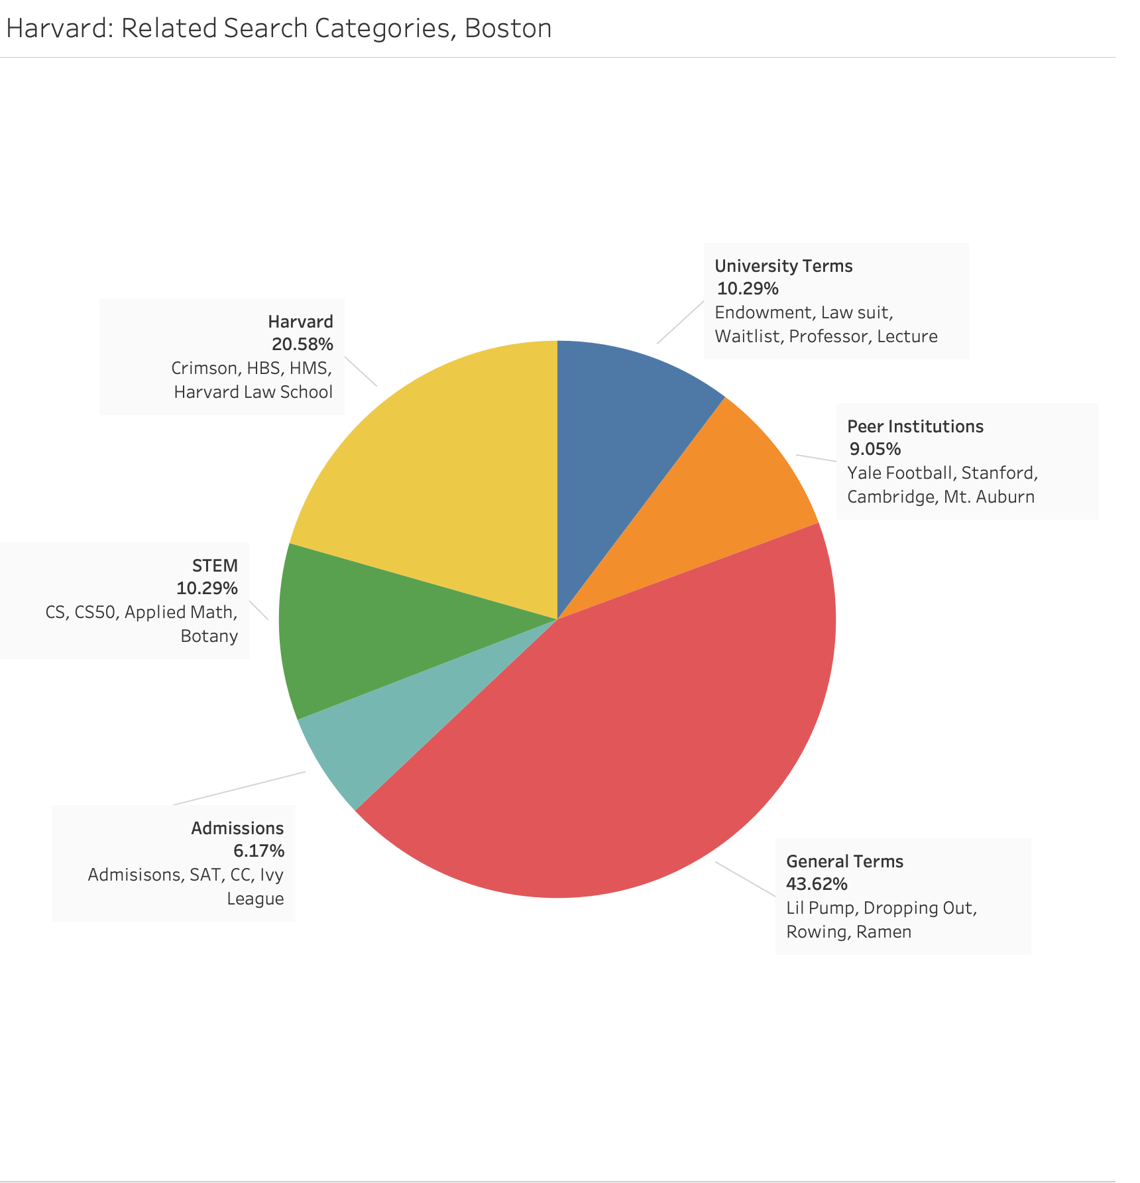

Slide 6
