Slide 1
Roulette Bets - Evens
Bet | Probability of Winning | Payout | Expected Winnings on a $100 Bet
Red | 18/37 ~ 48.6% | 1:1 | (18/37)($100) + (19/37)(-$100) ~ -$2.70
Black | 18/37 ~ 48.6% | 1:1 | ~ -$2.70
Even | 18/37 ~ 48.6% | 1:1 | ~ -$2.70
Odd | 18/37 ~ 48.6% | 1:1 | ~ -$2.70
Low (1-18) | 18/37 ~ 48.6% | 1:1 | ~ -$2.70
High (19-36) | 18/37 ~ 48.6% | 1:1 | ~ -$2.70
Notes:
Probability of Winning comes from uniform distribution

Slide 2
Roulette Bets - 2:1
Bet | Probability of Winning | Payout | Expected Winnings on a $100 Bet
First Dozen (1-12) | 12/37 ~ 32.4% | 2:1 | (12/37)($200) + (25/37)(-$100) ~ -$2.70
Middle Dozen (13-24) | 12/37 ~ 32.4% | 2:1 | ~ -$2.70
Last Dozen (25-36) | 12/37 ~ 32.4% | 2:1 | ~ -$2.70
Column bet (12 numbers) | 12/37 ~ 32.4% | 2:1 | ~ -$2.70

Slide 3
Roulette Bets - Long Odds
Bet | Probability of Winning | Payout | Expected Winnings on a $100 Bet
Line Bet (6 numbers) | 6/37 ~ 16.2% | 5:1 | (12/37)($200) + (25/37)(-$100) ~ -$2.70
Corner Bet (4 numbers) | 4/37 ~ 10.8% | 8:1 | (4/37)($800) + (33/37)(-$100) ~ -$2.70
Street Bet (3 numbers) | 3/37 ~ 8.1% | 11:1 | (3/37)($1,100) + (34/37)(-$100) ~ -$2.70
Split Bet (2 numbers) | 2/37 ~ 5.4% | 17:1 | (2/37)($1,700) + (35/37)(-$100) ~ -$2.70
Straight up (1 number) | 1/37 ~ 2.7% | 35:1 | (1/37)($3,500) + (36/37)(-$100) ~ -$2.70

Slide 4
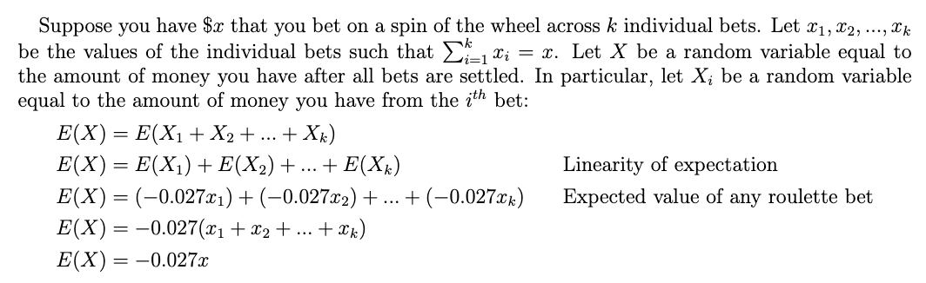
The Expected Return on Any Roulette Spin is -2.7%

Slide 5
The Martingale System
Bet $x on an even bet (red, black, odd, even, high, or low)
If you lose, bet $2x on an even bet
At every loss, continue doubling your bet ($4x, $8x, $16x, etc.) until you win
If you do this forever, you will eventually win, earning back all of your losses plus $x dollars of profit
If you had an unlimited supply of credit and no bet limit at the table, then there is only one outcome to this random experiment: winning $x.
Therefore, your expected return on one iteration of the Martingale system will be $x.

Slide 6

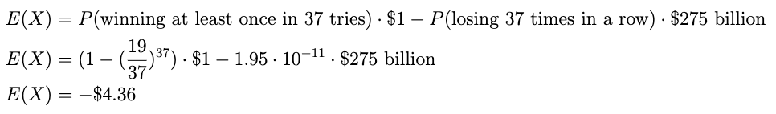
Why the Martingale system won’t work…
Suppose you had Elon Musk’s net worth of $212 billion. You bet $1 on the first spin, followed by $2, $4, $8, $16, and so on. If you’re really unlucky, you might lose 37 consecutive times*, amounting to a loss of $275 billion. While this is certainly unlikely, it will occur with some nonzero probability.
Let’s calculate your expected earnings:
*Most if not all casinos have betting limits, meaning you wouldn’t be allowed to keep doubling for this long

Slide 7
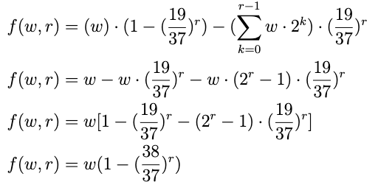
Is there any realistic Martingale system with a positive expected return?
Let
w = the size of the initial bet
r = the maximum number of consecutive losses
f(w, r) = expected return as a function of w and r
This is strictly less than or equal to 0 for all nonnegative values of r and w!

