Slide 1
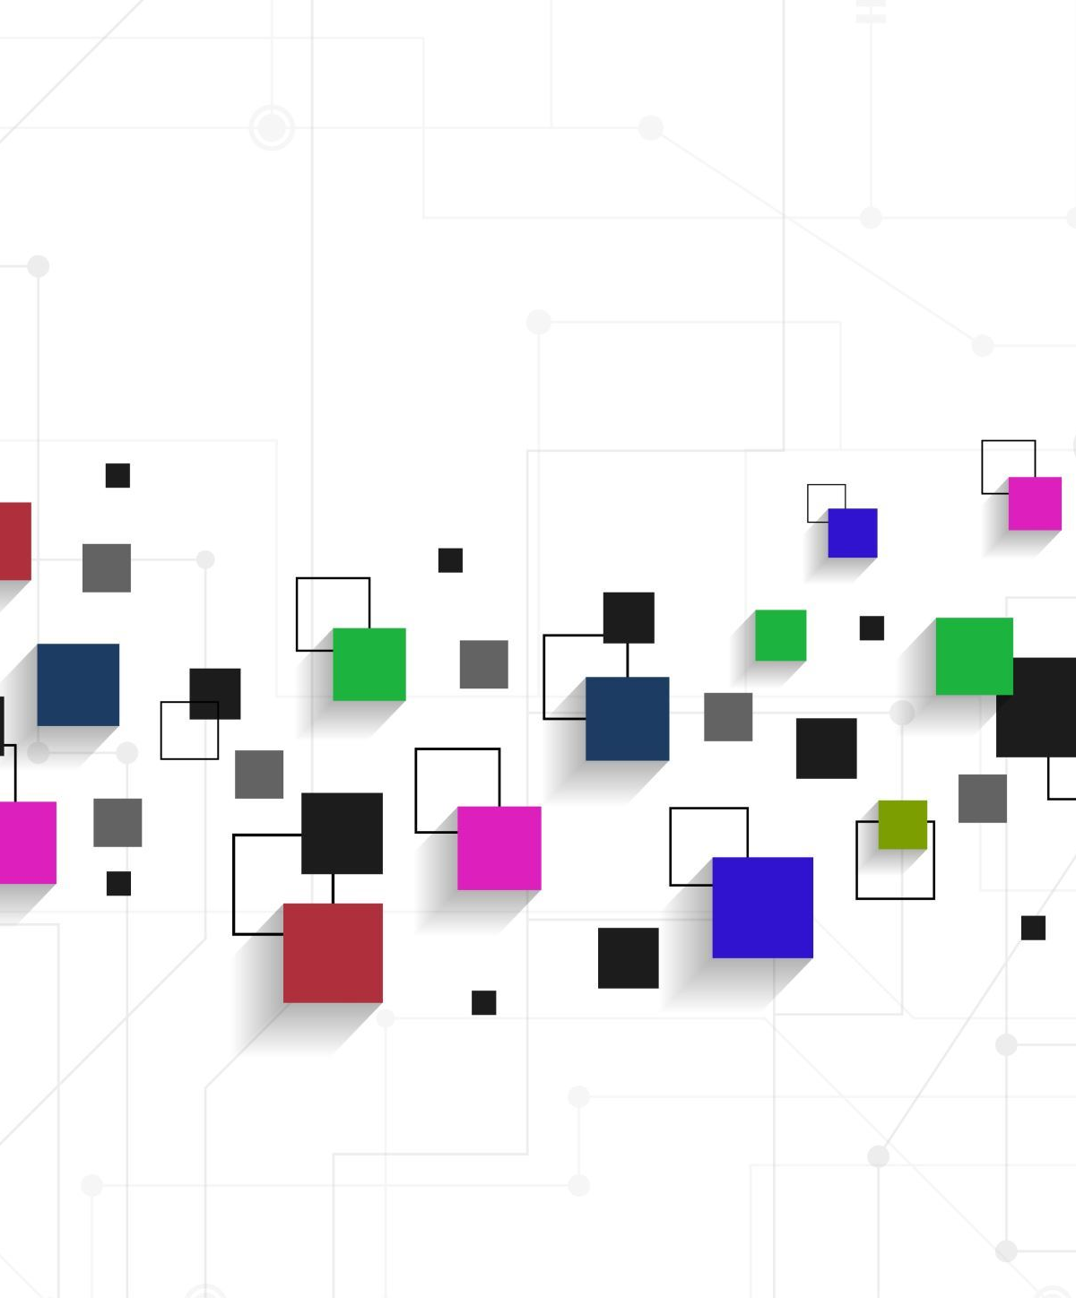
API
Development Lifecycle
Connecting Applications

Slide 2

What are APIs?
An API (Application Programming Interface) is a set of rules that allows different software applications to communicate with each other.
APIs enable seamless data exchange and functionality sharing between systems, improving interoperability and efficiency.
Types of APIs: REST, SOAP, GraphQL

Slide 3
Student API:
Create a new student record
Read student record
Update a student record
Delete a student record

Slide 4
5 Phases of Developing an API
Planning and Design Phase
Develop Phase
Test Phase
Deploy Phase
Maintainance Phase

Slide 5
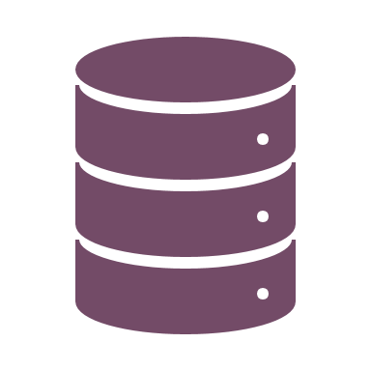
Planning and Design
What is the purpose of the API?
To manage student records (Create, Read, Update, Delete - CRUD).
What type of API is being developed?
A RESTful API with JSON responses.
What are the main API endpoints?
Get, Read, Update, Delete, GetAll – What could be some other endpoints?
How will authentication be handled?
Using API key.

Slide 6

DEMO – Swagger UI

Slide 7

2. Develop Phase
What technologies will be used?
Backend: Flask (Python)
Database: SQLite
What are the key steps in development?
Set up API routes and controllers.
Connect the API to the database.
Implement CRUD operations with validation.
Secure API with authentication and error handling.

Slide 8
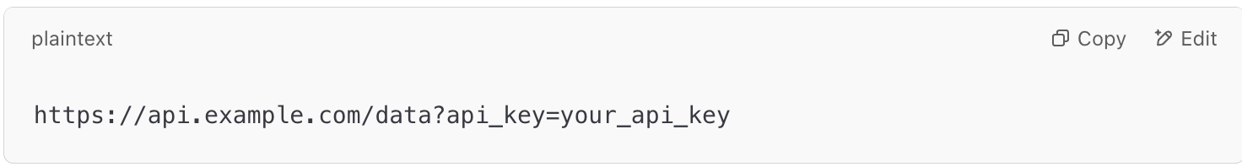
Securing with API Key
An API key is a unique identifier used to authenticate requests made to an API (Application Programming Interface). It acts like a password that allows access to a service.
Why Are API Keys Important?
Ensures that only authorized users can access the API.
Helps monitor and control how the API is being used.
Prevents excessive requests to protect the API from abuse.

Slide 9

3. Test Phase
What types of testing will be performed?
Functional Testing: Validate API responses
Performance Testing: Measure API efficiency
Security Testing: Prevent vulnerabilities
Example Test Case:
Scenario: Send a POST /students request with missing student name.
Expected Result: API should return 400 Bad Request.

Slide 10

Demo – Testing API with Postman

Slide 11

4. Deploy Phase
Where will the API be hosted?
Cloud providers like AWS, Azure, or GCP.
How will the database be managed?
Using managed databases like AWS RDS or Firebase.
What tools will be used for deployment?
CI/CD pipeline with GitHub Actions/Jenkins.
How will API traffic be managed?
Using API Gateways (AWS API Gateway, Nginx).

Slide 12

5. Maintenance Phase
How will we monitor API performance?
How will issues be tracked?
How will we handle API versioning?
Implementing version control (v1/students).
What security measures will be maintained?
Regular authentication updates and security patches.

Slide 13
Example use of api
Frontend uses to display and search data
Another API uses it

Slide 14
DEMO - Client Accessing our API

Slide 15

Thank you

