Slide 1
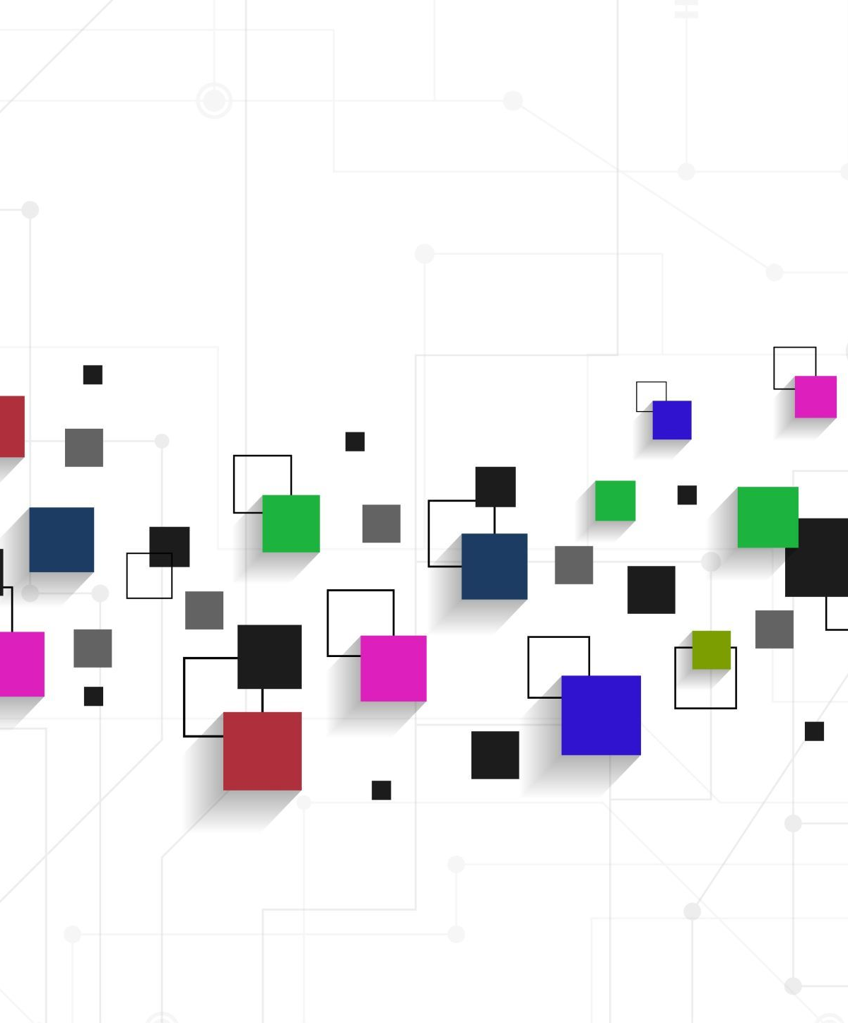
API
Development Lifecycle
Connecting Applications

Slide 2

What are APIs?
An API (Application Programming Interface) is a set of rules that allows different software applications to communicate with each other.
Types of APIs: REST, SOAP, GraphQL

Slide 3

Why should you care about apis?
APIs enable seamless data exchange and functionality sharing between systems, improving interoperability and efficiency.

Slide 4
Student API:
Create a new student record
Read student record
Update a student record
Delete a student record

Slide 5
5 Phases of the API lifecycle
Planning and Design Phase
Develop Phase
Test Phase
Deploy Phase
Maintainance Phase

Slide 6

Planning and design phase

Slide 7

Questions?
What is the purpose of the API?
What type of API is being developed?
What are the main API endpoints?
How will authentication be handled?

Slide 8

Answers!
The purpose is to manage student records (Create, Read, Update, Delete - CRUD).
A RESTful API with JSON responses.
Get, Read, Update, Delete
Using API key.

Slide 9

DEMO – Swagger UI

Slide 10

2. Develop Phase

Slide 11
Questions?
What technologies will be used?
What are the key steps in development?

Slide 12

Answers!
We will use the following technologies:
Backend: Flask (Python)
Database: SQLite
The Key steps are the following:
Set up API routes and controllers.
Connect the API to the database.
Implement CRUD operations with validation.
Secure API with authentication and error handling.

Slide 13
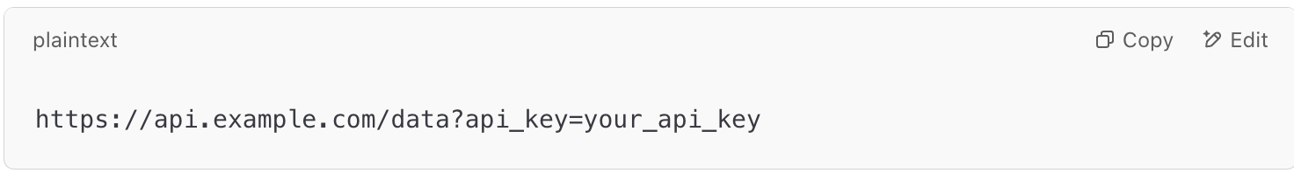
Securing with API Key
An API key is a unique identifier used to authenticate requests made to an API (Application Programming Interface). It acts like a password that allows access to a service.
Why Are API Keys Important?
Ensures that only authorized users can access the API.
Helps monitor and control how the API is being used.
Prevents excessive requests to protect the API from abuse.

Slide 14

3. Test Phase

Slide 15

Questions?
What types of testing will be performed?
What will we be testing for?

Slide 16

Answers!
We will be performing the following tests:
Functional Testing: Validate API responses
Performance Testing: Measure API efficiency
Security Testing: Prevent vulnerabilities
Example Test Case:
Scenario: Send a POST /students request with missing student name.
Expected Result: API should return 400 Bad Request.

Slide 17

Demo – Testing API with Postman

Slide 18

4. Deploy Phase

Slide 19

Questions?
Where will the API be hosted?
How will the database be managed?
What tools will be used for deployment?
How will API traffic be managed?

Slide 20
Answers!
We can use cloud providers like Azure, AWS, GCP to host our APIs. Eg. Azure App Service Plan
The Database can also be handled through cloud services.
CI/CD pipeline with GitHub Actions/Azure DevOps.
Using API Gateways (AWS API Gateway, Nginx).

Slide 21

5. Maintenance Phase

Slide 22
Questions?
How will we monitor API performance?
How will issues be tracked?
How will we handle API versioning?
Implementing version control (v1/students).
What security measures will be maintained?
Regular authentication updates and security patches.

Slide 23

Answers!
We can use cloud services like Azure App insights for monitoring API performance.
We need a platform like Jira or Github to track issues
Implementing version control (v1/students).
Regular authentication updates and security patches.

Slide 24
Example use of api
A website frontend uses to display and search data
Another API uses it for student records

Slide 25
DEMO - Client Accessing our API

Slide 26

Thank you

