Slide 1


Super Dynamic Innovation
John Klein, Matthew Molenaar, Brendan Chermack
Terrance Wallace, Jaymin Swedlund, Ashesh Nepal

Slide 2

Overview
Intro
Problem Solving Process
Technology
Demo
Looking Forward
Notes:
Our main problem with solving this challenge was the legend. Half of the PDFs included a legend in a corner and our current algorithm has trouble identifying it. We proposed a few solutions but were unable to create it. One idea was to box off the area that had the most amount of contouring and largest area but were unable to create it. We decided to create an option to crop the PNG out in case a legend was not cropped.

Slide 3
Intro
Challenge was to automate removing whitespace from floorplan PDFs into PNGs
The initial pass will remove whitespace in floorplan
Two additional tools for edge cases
Notes:
Our challenge was to create a process for trimming whitespace in PDFs. Our solution involves converting the PDF into a PNG format as a first step. Then, through an initial pass, we remove the whitespace, effectively making the PDF transparent. Users will then view the current floor plan in PNG format and will have the option to crop out any unnecessary elements. This functionality is particularly useful if a legend appears on the floor plan.

Slide 4
Problem Solving Process
Used Flood Fill algorithm to change the same color neighboring pixels into transparent ones
Due to how Flood Fill works there were some unexpected results from edge cases
Made two tools to handle the edge cases
Notes:
Our main problem with solving this challenge was the legend. Half of the PDFs included a legend in a corner and our current algorithm has trouble identifying it. We proposed a few solutions but were unable to create it. One idea was to box off the area that had the most amount of contouring and largest area but were unable to create it. We decided to create an option to crop the PNG out in case a legend was not cropped.

Slide 5
Technologies
Front-End
React: The front-end framework for implementing UI’s.
Material Ui: The library used for React components.
Axios: Makes requests to the back-end.
Back-End
Python: This is the language we used for the back-end for our project.
Flask: Creates the back-end server.
Flask Cors: Makes cross-origin AJAX possible.

Slide 6
Libraries
Pdf2Image: Used to convert PDFs to PNGs
Poppler: Renders PDF documents ( Pdf2Image dependency)
OpenCV: Computer-Vision library used for image processing
All are open-source

Slide 7
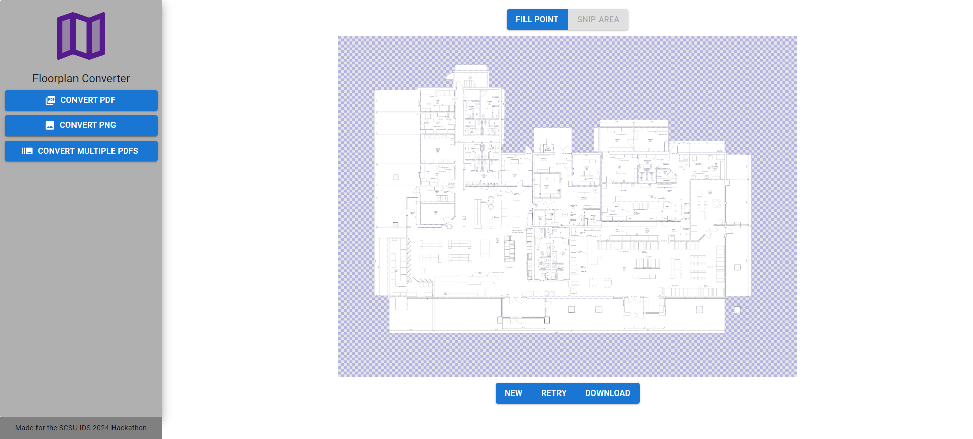
Demo

Slide 8
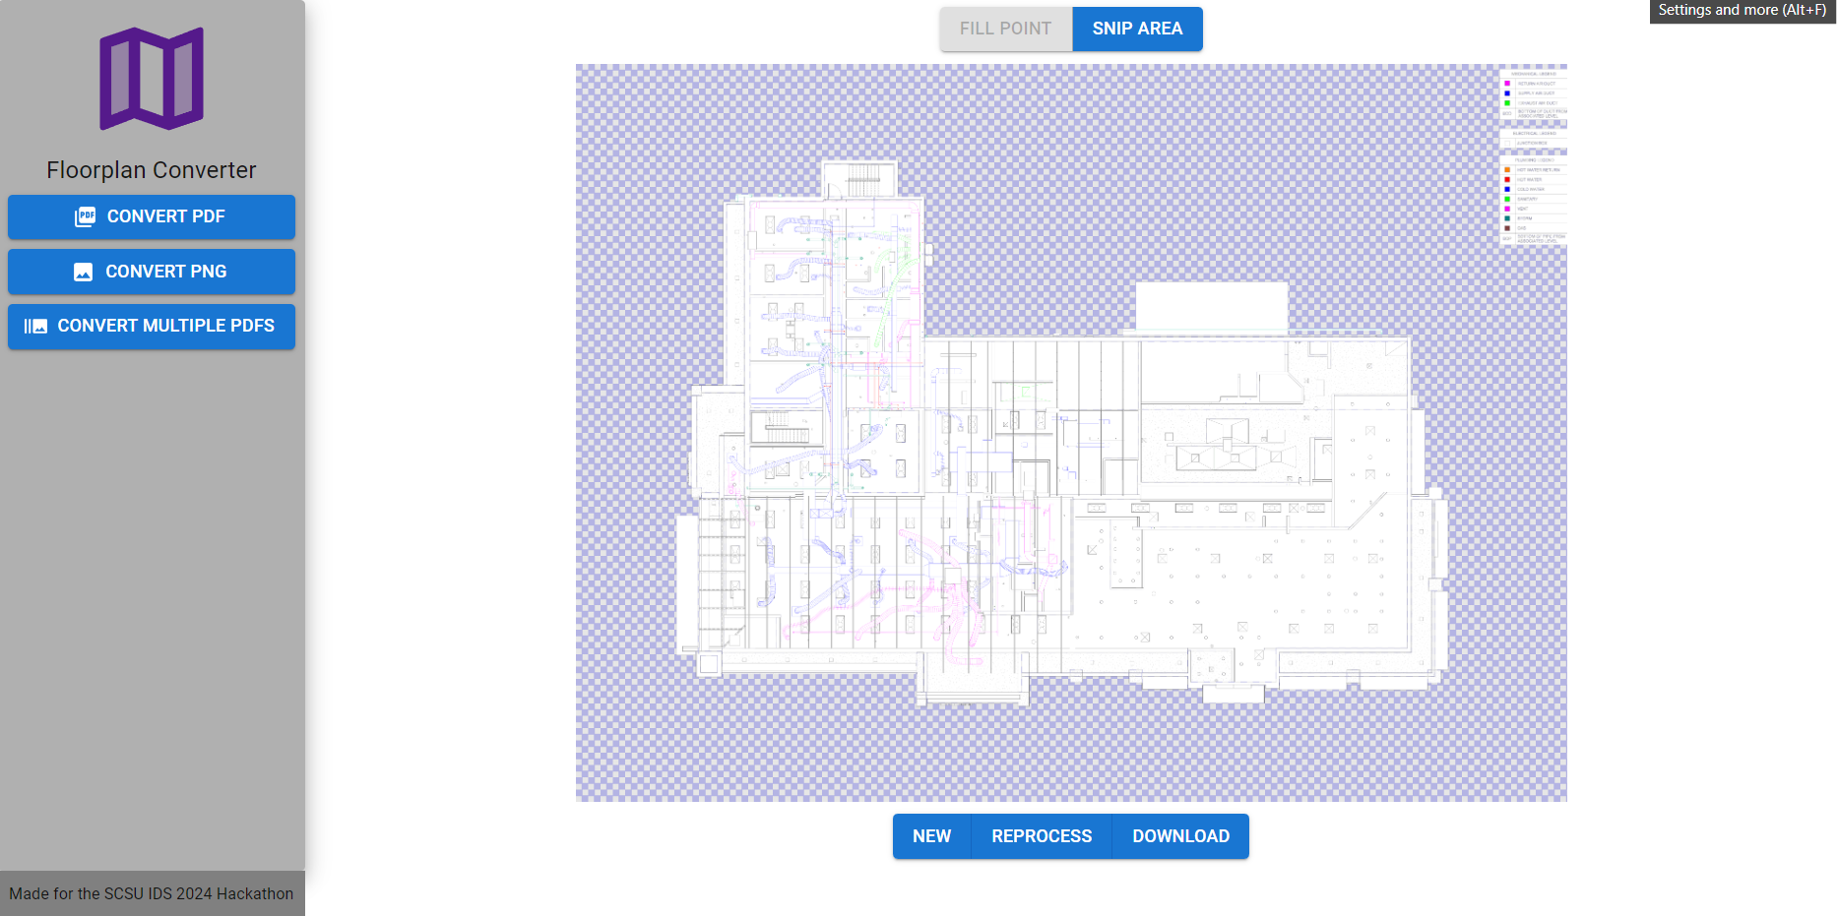
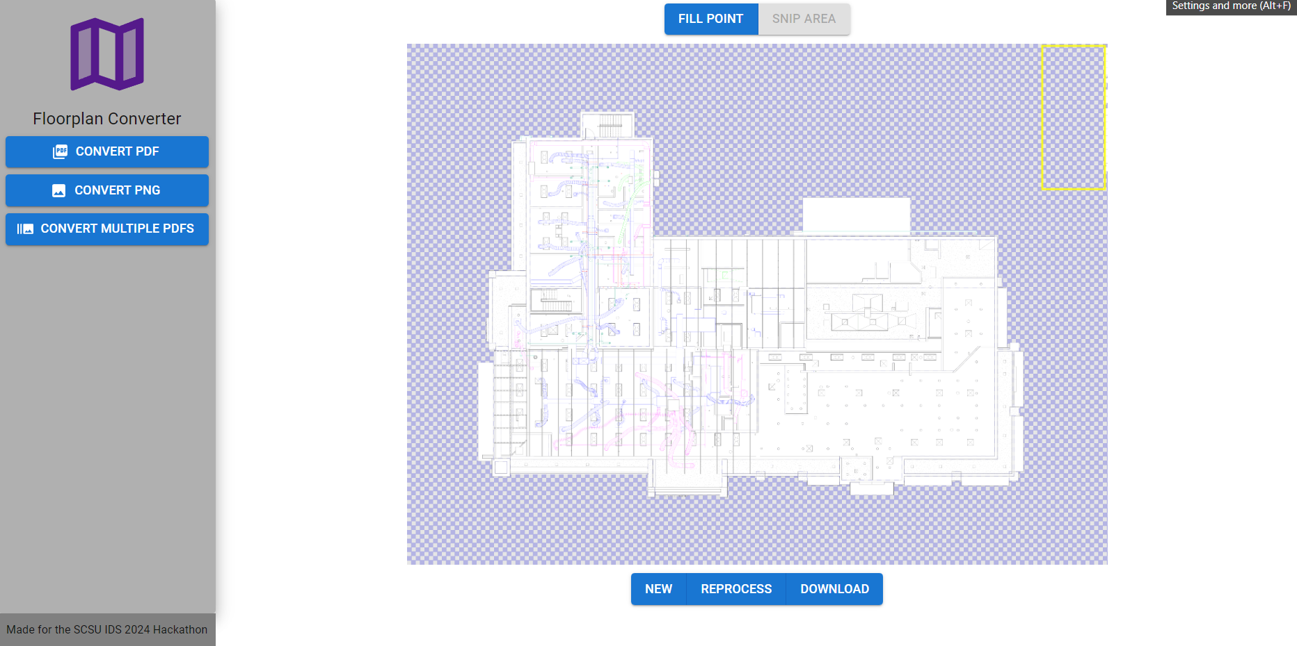
Demo

Slide 9
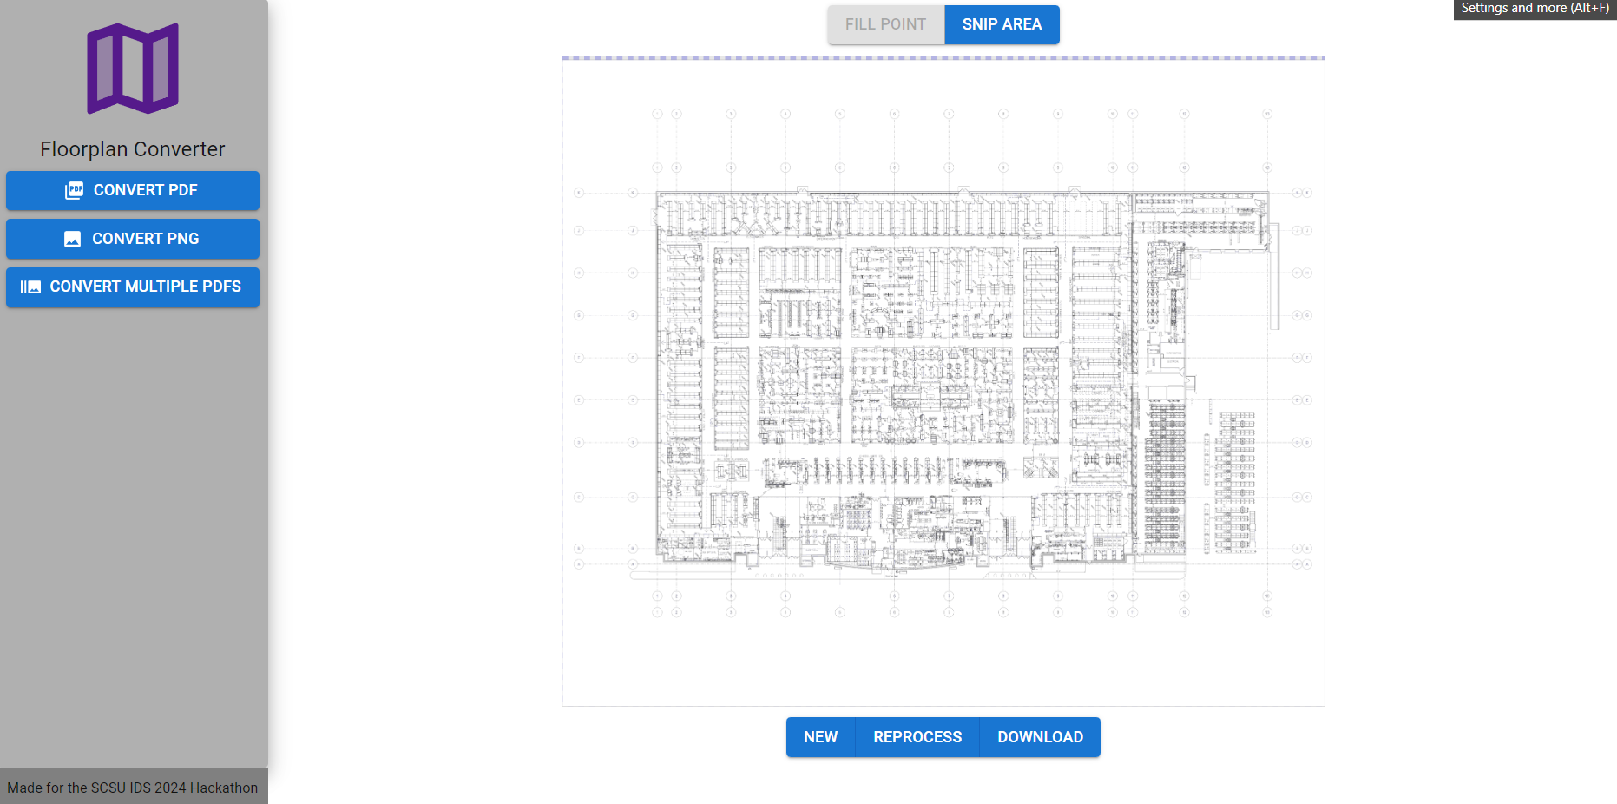
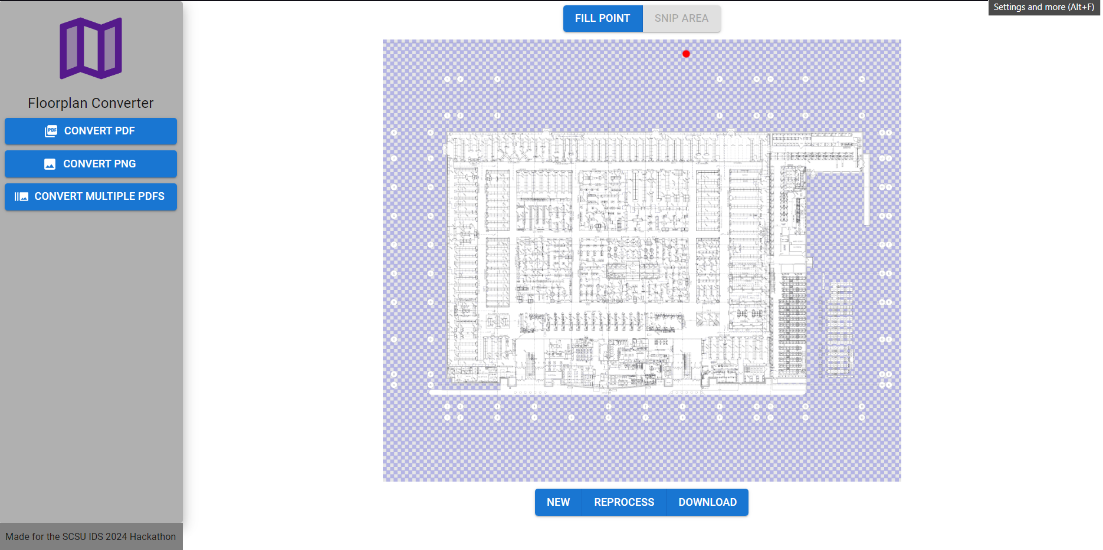
Demo

Slide 10
Looking Forward
Input multiple PDFs to convert them to PNGs at once, have the initial pass applied, and populate gallery to modify or download.
Deployment Strategy – Deploy the backend script as a S3 bucket triggered Amazon Lambda function which will automatically process the PDFs and place them in the IDS server
Machine learning
Notes:
In the future if we were to pursue fully automating this project and getting rid of the legend we would use machine learning to be able to identify the legend, other oddities, and multiple floor plans in the PNG. It would need to be fed an adequate amount of correct PNGs so it can learn what to discard. We would also deploy this as a serverless API.

