Slide 1

CSC 699 Project Presentation Sentiment Analysis of Short Texts on Twitter Data
Committee Members
Dr. Andrew H. Sung
Dr. Zhaoxian Zhou
Dr. Kala R. Marapareddy
By
Asheshbabu Pothuraju
w982732

Slide 2
Contents
Introduction
Project Description
Existing System
Proposed System
Software Requirements
Data Set Description
Proposed Algorithms
Results
Conclusion
References

Slide 3
Introduction
Microblogging has become a very popular communication tool among internet users now
Millions of users share their opinions on different aspects of everyday life in popular social networking stiles like Twitter, Facebook, and Tumblr
Due to the phenomenal growth of social networks, companies and media organizations are increasingly seeking ways to mine the social media data and gain information about “what people are thinking about their products, services, and companies?”
Notes:
Existing traditional techniques are like grid computing RDBMS

Slide 4
Project Description
This project deals with sentiment analysis of short text on Twitter data
Sentiment analysis is a process of learning sentiments from the text data. It is extremely useful in some of the cases like customer reviews on ecommerce sites, and movie reviews
In the same way we can use this technique to analyze the sentiments of the tweets posted on Twitter
Many researchers used same kind of techniques to analyze the sentiments of Twitter data, movie review, product review

Slide 5
Project Description
Many researchers used different techniques like Neural Network, Topic Modelling to analyze the sentiments of Twitter data, movie reviews, product reviews

Slide 6
Applications
Many countries like USA, India, and Canada are analyzing social media data in the interest of national security
The mass shooting happened in San Bernardino, California in December 2015, where social media was used as main communication channel by terrorist groups
United States Citizenship and Immigration Services department is accessing social media data of immigrants to provide a better security system

Slide 7
Existing System
A lot of research work has been happened on the sentiment analysis of Twitter data
The sentiment analysis algorithms and libraries are very effective for long texts, but these techniques have limitations working with short texts
This trend was observed in the previous research work: An Approach for Pattern Recognition and Prediction of Information Diffusion Model on Twitter

Slide 8
Disadvantages with the Existing System
Short texts are ambiguous, in which a huge amount of text data is categorized as neutral data
Tweet replies are an important resource of data but no researcher has used this method to analyze the data
Twitter API provided by Twitter developers platform does not have a predefined function for collecting replies of a particular tweet

Slide 9
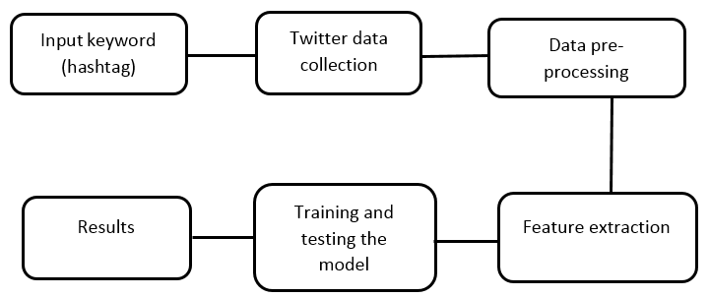
Proposed System
Fig. 1 Project lifecycle

Slide 10
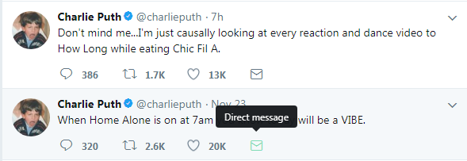
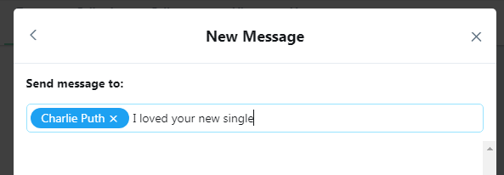
Direct Message
Fig. 2 Direct message option
Fig. 3 Composed message

Slide 11
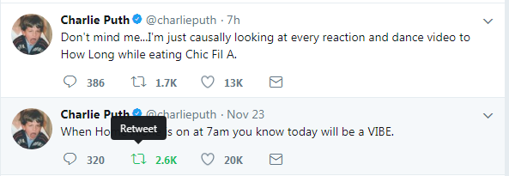
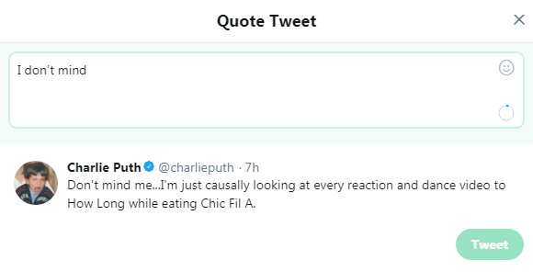
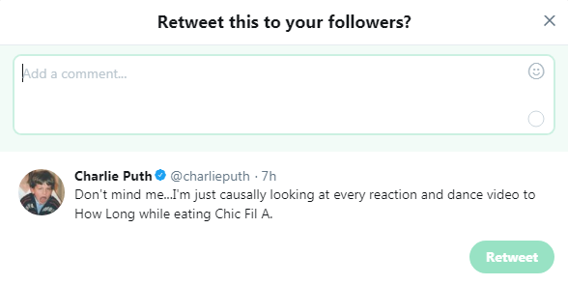
Retweet
Fig. 4 Retweet option
Fig. 6 Adding text converts in to a tweet
Fig. 5 Retweeting process

Slide 12
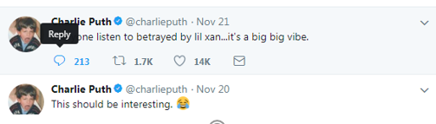
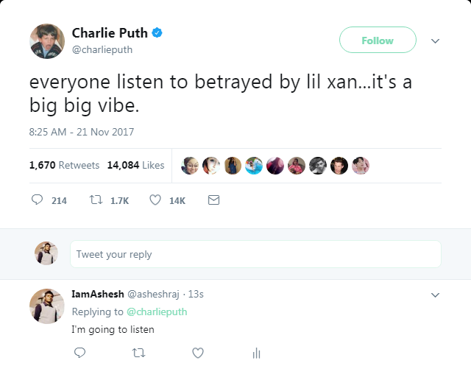
Tweet Reply
Fig. 7 Reply option
Fig. 8 Replies under a tweet

Slide 13
Data Collection
I have collected 21 gigabytes of data from twitter over a period of 7 days
I have used TweePy framework provided by Python to collect data from Twitter
Data of more than 20 hashtags are collected
Data of 7 hashtags are used for analysis because of the significant amount of data (tweets and replies)
Data is collected in to JSON files, which is a NoSQL data format

Slide 14
Data Preprocessing
Observed Patterns in the JSON data
RT @[username]
Retweeting @[Username]
Extracted required information like “tweeted”, “type”, and “fulltext” from JSON files in to CSV files
More than 4000 tweets are manually labeled with sentiment values
Positive tweets are assigned with +1 and negative tweets are assigned with -1

Slide 15
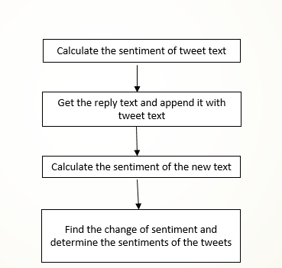
Proposed Method of Data Handling
Fig. 9 Data handling method

Slide 16
Content Based Features
Direct message
Includes username
Includes hashtag
Includes URL
Exclamation mark
Question mark
Term positive
Term negative
Emoticon positive
Emoticon negative
Positive, Negative, and Combined sentiments
Parts of speech using NLTK
Topics (Not included)

Slide 17
Tools and Frameworks
We have used python to scrape data from Twitter web application
In python we have used TweePy package to scrape the data
I have used TwitteR package in R language to collect the data
Jupyter is the Integrated Development Environment (IDE) used

Slide 18
Proposed Algorithms
Natural Language Tool Kit (NLTK) is used to analyze the sentiments of the data, and we got very less accuracy which is less than 50%
I have used different classification algorithms to analyses sentiments
Support Vector Machine (SVM)
Random Forest
Decision Tree
Naïve Bayes

Slide 19
Results
Two scenarios are considered for executing the tests
Analysis on original data
Analysis on merged data
In both the scenarios
SVM outperformed Naïve Bayes, Decision Tree and Random Forest
Naïve Bayes accuracy is very less

Slide 20
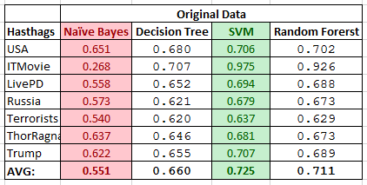
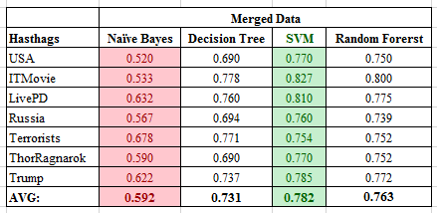
Results
Table 1: Accuracy on original data
Table 2: Accuracy on merged data

Slide 21
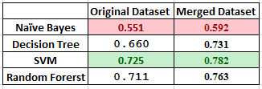
Results
I have compared average values of SVM, RF, Decision Tree, and Random Forest in two different scenarios, shown in Table 3
Table 3: Comparison of results

Slide 22
Conclusion
The new method of handling the twitter data is very efficient when compared to the old method
It gives a specific context to short texts which were treated as ambiguous texts before
I have observed significant increase in the accuracy

Slide 23
Contribution
In the current research work we have contributed a new data set with all its corresponding tweets
Data preprocessing technique to get a better sentiment result

Slide 24
Future Work
To implement a Latent Dirichlet Allocation (LDA) topic modelling algorithm on Twitter data
To implement LDA model, Python is providing a framework Gensim with a big corpus made from Wikipedia with more than 250 topics
It helps to understand the context of the text
“I liked firing event in Olympics”
“A man started firing at people who are enjoying music concert at a hotel in Las Vegas”
Writing a paper

Slide 25
References
Guille, A., Hacid, H., Favre, C., & Zighed, D. A. (2013). Information diffusion in online social networks: A survey. ACM Sigmod Record, 42(2), 17-28
AlSumait, L., Barbará, D., Gentle, J., & Domeniconi, C. (2009). Topic significance ranking of LDA generative models. Machine Learning and Knowledge Discovery in Databases, 67-82
Naveed, N., Gottron, T., Kunegis, J., & Alhadi, A. C. (2011, June). Bad news travel fast: A content-based analysis of interestingness on twitter. In Proceedings of the 3rd
Guille, A., Hacid, H., Favre, C., & Zighed, D. A. (2013). Information diffusion in online social networks: A survey. ACM Sigmod Record, 42(2), 17-28
Pak, A., & Paroubek, P. (2010, May). Twitter as a corpus for sentiment analysis and opinion mining. In LREc (Vol. 10, No. 2010)
Tumasjan, A., Sprenger, T. O., Sandner, P. G., & Welpe, I. M. (2010). Predicting elections with twitter: What 140 characters reveal about political sentiment. Icwsm, 10(1), 178-185
https://dev.twitter.com/web/overview/languages
Bird, Steven, Edward Loper and Ewan Klein (2009), Natural Language Processing with Python. O’Reilly Media Inc
Gupta, M., Dalmia, A., Jaiswal, A., & Reddy, C. T. Sentiment Analysis in Twitter. International Web Science Conference (p. 8). ACM

