Slide 1
Battle Between Two Tic-Tac-Toe Reinforcement Agents
By: Ashesh Byanju
Date: May 1, 2021

Slide 2
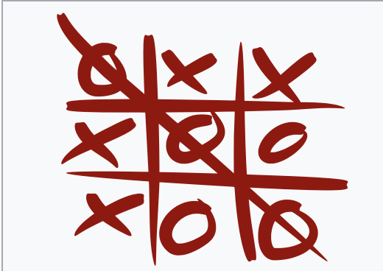
Introduction To Tic-Tac-Toe
Tic-tac-toe is a game of nine points, three horizontal lines, three vertical lines, and two diagonal lines, each with at least three points, as seen in the incidence structure to the right.
In order to win the game, a player must place three of their marks in a horizontal, vertical, or diagonal row.
Notes:
Tic tac toe is a paper-and-pencil game for two players, X and O, who take turns marking the spaces in a 3×3 grid. We have 9 spaces where each player turn by turn can mark either o or cross respectively. The player who succeeds in placing three of their marks in a diagonal, horizontal, or vertical row is the winner.

Slide 3
Objectives
In this project, tic-tac-toe agents will be trained to compete with each other to win the game.
Will be using reinforcement Q-Learning to achieve goal
Agent will learn using Q-learning, in which the agent remembers which action he performed in each state so that the next time he experiences the same state, he will perform the same action.
Main objective of the project is to train the agent to learn the strategy to find the best available move and beat Random Agent.
Out of total games played, Q-Learning agent should be able to win against Random agent by more than 75%.

Slide 4
Approach
Tools :
Python 3.7
Spyder
Pandas
Matplotlib
Techniques :
Solving the tic-tac-toe using Reinforcement learning.
Use two strategies: (Random and Q-Learning)
Will play 4 games: Random vs Random, Random vs Q-learning, Q-learning vs Random and Q-Learning vs Q-Learning
We will play 10,000 games using each strategy and after the games are played we will gather our statistics and plot the results to see how Q-Learning agent performed.

Slide 5
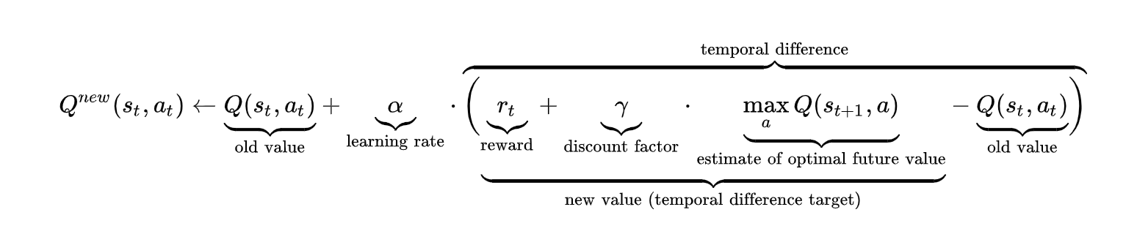
Approach Continue...
Define 2 strategies for the game: some players will play by randomly selecting a move from a list of available moves, while some other players will use Q-Learning to select the best move
The core of Q-Learning is to estimate a value for every possible of a state (s) and an action (a) by getting rewarded.
The update of the q-value is done according to the equation below.

Slide 6
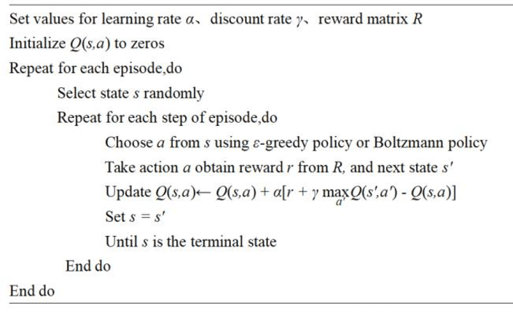
Q-Learning Algorithm

Slide 7
Q-Learning - Implementation
Few parameters for Q-Learning Bellman equation:
Learning rate: how fast the agent picks up new information vs. how long the agent remembers previous information
Discount factor/Decay rate: to assist our agent in deciding whether early or late moves are more critical for the game's outcome.
Exploratory rate: The possibility that the agent will make a random move rather than using the Q-Learning algorithm. This is what I'm using to let the agent explore unknown territory in the hopes of learning new tactics.
We need to store all of the states our agent experiences during its lifetime in order for the Q-Learning algorithm to work.
This will allow our agent to remember which action is performed in each state, so that the next time he experiences the same state, it will perform the same action.
This is our agent's memory, which will be saved in the states sector of our class.

Slide 8
Implementation Continue...
State field is a map with the key being a hash of our board (a unique string formed from the board configuration) and the value being the Q-value of that board configuration, which is the value calculated using the Bellman equation.
The states history field is the final field in our class, and it contains the hashes of all the board configurations encountered by the player in the last game.
After the game is over, the model will retrace the steps in the history and generate new q-values for the next game.
This is the learning part of our model.
Another very important method is the reward method which will be named at the end of each game.
This will take the positive or negative reward (depending on the game winner) and change the Q values for the board configuration we saw in the previous game using the Bellman equation.

Slide 9
Evaluation And Result
We played 4 games:
Random vs Random - I used this to see whether the X-player or the O-player wins more games in Tic Tac Toe. This will assist us in evaluating the success of our Q Learning agent.
Random vs Q-Learning agent
Q-Learning agent vs Random
Q-Learning agent vs Q-Learning agent
So after the games, I compiled all results and plot the performance.
Each round had a total of 10,000 games.

Slide 10
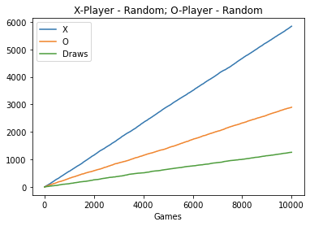
Results: Random vs Random
The figures for the first game are as follows.
Number of games: 10000
X-Player Wins: 5845 (58%)
O-Player Wins: 2895 (28%)
Draws: 1259 (12%)
Time taken to execute 11.02 seconds
It seems that X players are more likely to win games.
Our plot, obviously, tells us the same story.

Slide 11
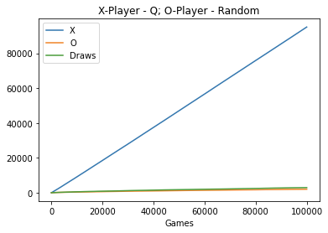
Results: Q-Learning Agent vs Random
Let's see our results for Random vs Q Agent.
Number of games: 10,000
X-Player Wins: 9197 (91%)
O-Player Wins: 397 (3%)
Draws: 405 (4%)
Time taken to execute 16.28 seconds
The Q model seems to be destroying the Random player in this case.
In reality, there are more ties than victories in this game.

Slide 12
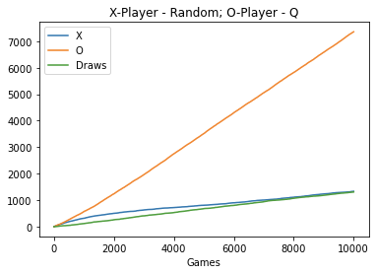
Results: Random Vs Q-Learning Agent
Number of games: 10000
X-Player Wins: 1332 (13%)
O-Player Wins: 7358 (73%)
Draws: 1309 (13%)
Time taken to execute 15.27 seconds
There are more wins for the random player and more draws in this round than in the previous round.
Even so, the Q model continues to win by a large margin.

Slide 13
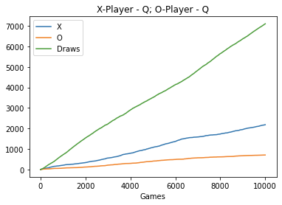
Results: Q-Learning Agent Vs Q-Learning Agent
Number of games: 10000
X-Player Wins: 2322 (23%)
O-Player Wins: 691 (6%)
Draws: 6986 (69%)
Time taken to execute 20.61 seconds
Although X-Player had some advantages at the beginning, there are more number of draws than wins.

Slide 14
Conclusion
The players were initially on a fair competition, and the model was still learning.
However, after a while, the Q model began to smash the other player confirming that indeed the model was learning.
Learned how to build reinforcement Q learning agent to win Tic Tac Toe game.

Slide 15
References
https://towardsdatascience.com/simple-reinforcement-learning-q-learning-fcddc4b6fe56
https://medium.com/ai%C2%B3-theory-practice-business/reinforcement-learning-part-6-td-%CE%BB-q-learning-99cdfdf4e76a
https://www.freecodecamp.org/news/an-introduction-to-q-learning-reinforcement-learning-14ac0b4493cc/

Slide 16
THANK YOU!!!

