Slide 1

New Materials for the Gate Stack of MOS-Transistors
Presented By:
Ashesh Jain
Tutor: Dr. Nandita Das Gupta
Indian Institute of Technology, Delhi

Slide 2
Contents
Overview of MOSFETs
Moore’s Law
Problems with thin gate oxide: Gate leakage current, Polysilicon gate depletion, Boron penetration
High-K oxide solution
Choice of high-K materials
Permittivity and barrier height
Thermodynamic stability on Si
Interface quality
Film morphology
Process compatibility
Fermi level pinning and mobility degradation
Conclusions

Slide 3
Overview of MOSFETs
MOSFET has been continually scaled down in size
Reasons:
Increase in drive current
Higher switching speed
More number of transistors on same real estate
Scaling leads to short channel effects
Gate start losing control over channel charge
SiO₂ has to be proportionally scaled to increase gate coupling with channel
Notes:
Drive current is inversely proportional to channel length
Switching time is inversely proportional to saturation current
We can put more functionality on same silicon chip which means more profit
For gate to gain control over channel charge we have to increase its coupling with the channel

Slide 4
Advantages of using SiO₂ and Poly-Si
Advantages of SiO₂
Thermodynamically stable on Si
High quality SiO₂-Si interface
Interface state density,
Excellent insulator
Advantages of poly-Si
Easy to fabricate
High quality poly-Si/ SiO₂ interface
Adjustable Fermi level by controlling dopant concentration
Compatible with both PMOS and NMOS
Notes:
Does not react with Si to give undesirable product.
High quality interface gives good carrier mobility
Interface defects order of magnitude less than other dielectric/SiO2 interface and large band gap

Slide 5
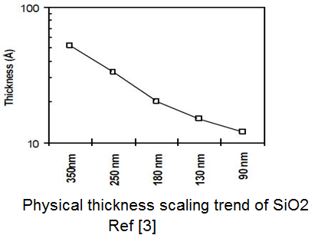
Moore’s Law
Coined by Gordon E Moore in “Cramming more components onto Integrated circuits” published in 1965
“Transistor density on the chip doubles every year”
SiO₂ thickness has to be scaled @ ~0.7x every year
Notes:
Inorder to enable this scaling we have to decrease the thickness of SiO2 at the rate of 0.7 times every year

Slide 6
Problems associated with thin SiO₂
Thickness of SiO₂ layer required in 45nm technology is about 1.2nm (4 atomic layers deep!!)
Gate oxide is running out of atoms
Quantum nature of channel electron dominates.
Results in:
Leaky gate oxide
Poly-Si gate depletion
Boron penetration

Slide 7
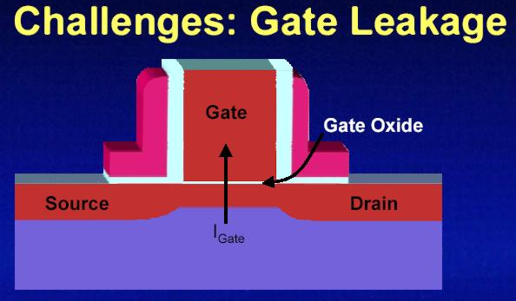
Gate Leakage Current
Gate oxide 5 atomic layer thick
Quantum Mechanical phenomenon of electron tunneling
Results in:
Leakage current
Power consumption
Ref [9]

Slide 8
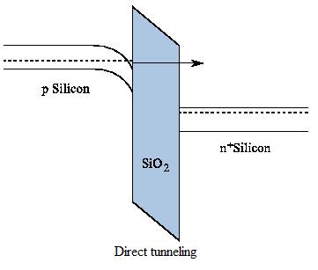
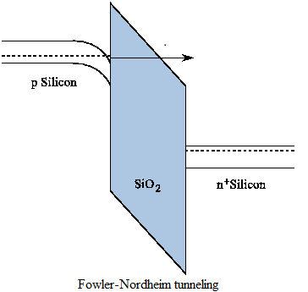
Quantum mechanical tunneling
Transition of carriers through classically forbidden energy states
Electrons tunnel through the dielectric, even if energy barrier is higher than electron energy
Two types of tunneling
Direct Tunneling (DT)
Fowler-Nordheim Tunneling:
Ref [6]

Slide 9
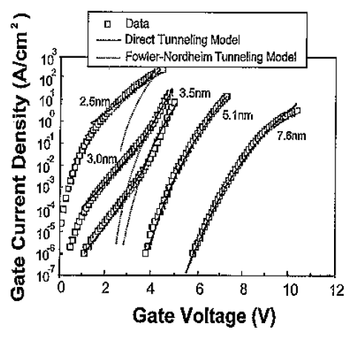
Direct Tunneling
Significant in thin dielectric
Tunnels through entire SiO₂
Tunneling current increases exponentially with decrease in oxide thickness
Fowler-Nordheim Tunneling is another tunneling mechanism
Take place for thick dielectric at sufficiently high electric field
Ref [10]

Slide 10
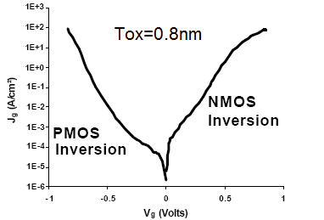
Gate leakage for 0.8nm thick gate oxide
Inversion gate leakage measurements of SiO₂ gate oxide for NMOS and PMOS, Ref [2]

Slide 11
Consider this..
Presently a processor chip contains about 100million transistors
If each transistor leaked a current so high…
Heating problems will be ensured…
To reduce leakage, a thicker oxide layer is required.
But this means less control over channel charge
Moreover:
Gate leakage has direct consequences in PD-SOI MOSFETs
Modifies the body voltage and related floating body effects
Give rise to “Gate induced floating body effects” (GIFBE)
Responsible for kink in characteristics
Notes:
In Partially Depleted (PD) SOI devices, a direct consequence is the modification of the body-voltage and related floating-body effects. Such Gate-Induced Floating-Body Effects (GIFBE) are responsible for a kink in ID(VG) characteristics and an outstanding second peak in transconductance.

Slide 12
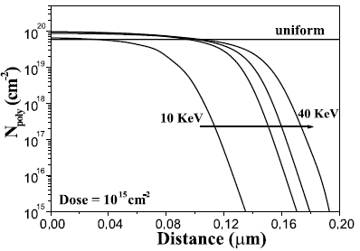
Gate Depletion
In case of thin oxide implant dose of low energy is used for polysilicon gate
Polysilicon near the gate oxide is lightly doped
Assumption of uniform doping no longer holds
Thus a considerable polysilicon gate depletion effect
Depletion region thickness becomes very much comparable to oxide thickness
Doping concentration in polysilicon gate Vs distance. An annealing of 850˚C for 10min was performed after the implant, Ref [1]
Notes:
This is done to prevent doping of polySi from entering gate oxide.
Insufficient doping of polySi near gate oxide
We can observe from the curve (1) lower the dose lower is the doping concentration near the gate oxide
Depletion of polySi because of work function difference

Slide 13
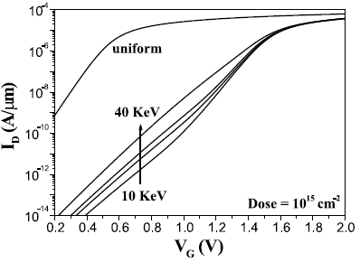
Contd…
Results in:
Increase in threshold voltage
Decrease in drain current
A part of the applied gate voltage falls across depletion region
Sub threshold drain current Vs gate voltage for different implant conditions, Ref[1]
Notes:
Decrease in drain current and threshold voltage. Change in subthreshold characteristics

Slide 14
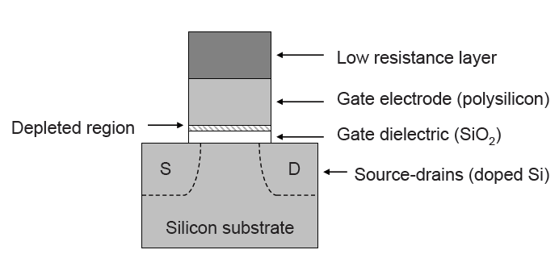
Depletion Layer formation

Slide 15
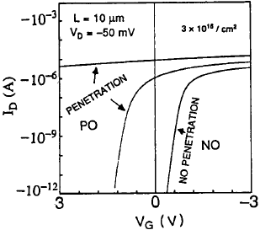
Boron Penetration
Boron penetrates from a P+ poly gate electrode through the thin gate oxide into the silicon substrate
Threshold voltage decreases
Becomes normally on
Sub-threshold slope (s-factor) increases
Nitridation of gate oxide prevents boron penetration
BF₃
characteristics of boron penetrated and non boron penetrated PMOS, Ref [4]
Notes:
For gate oxide thickness of 6.5nm low energy implant followed by annealing can solve the problem of boron penetration
Reason for penetration is the concentration gradient concentration gradient between the heavily doped poly-Si gate electrode, the undoped oxide and lightly doped Si channel
For thickness less than 6.5nm nitride oxide can solve the problem

Slide 16
Key points
Nitridation:
Performed by RTN
Nitrogen concentration should be uniform and small at interface
Effective in screening boron penetration down to 2nm
Boron Penetration:
Depends significantly on boron dose
Extent of boron penetration is judged by s-factor
Fluorine enhances boron penetration
Notes:
After nitridation nitrogen concentration should be uniform and it should not be high at the interface

Slide 17
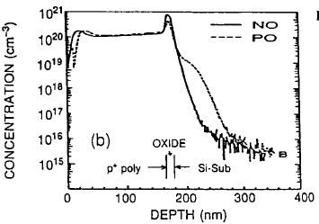
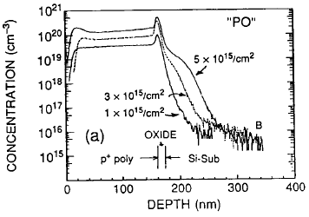
Boron concentration with depth
BF₃ Dose
Boron profile with different boron dose for pure gate oxide(PO). Annealed at 850˚C, Ref [4]
Boron profile. Nitride oxide(NO) sample in comparison with pure oxide(PO). BF₃ dose 1e15/cm2, Ref [4]

Slide 18
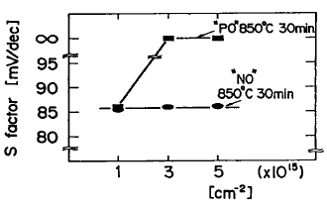
S-factor for “PO” and “NO”
Dependence of subthreshold slope on boron dose
Pure oxide(PO): S-factor varies with boron dose
Nitride oxide(NO): S-factor is constant with boron dose
Boron Dose
Sub threshold slope (s factor) dependence on BF₃ dose for low temp. annealing case. = 6.5nm, Ref [4]

Slide 19
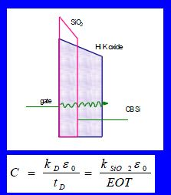
The High-K oxide solution
To continue the scaling trend
Increase gate-channel capacitance
Scaling SiO₂ further not possible
Increase both and
need to change gate oxide
Notes:
Till now we saw at the problems associated with thin gate oxide

Slide 20
Choice of High-K oxide
High-K oxide should satisfy the following properties:
High Dielectric constant and Barrier Height
Thermodynamic stability
Interface Quality
Gate compatibility
Process Compatibility
Fixed oxide charge
Notes:
Before replacing SiO2 by any other oxide one need to answer many questions.
There are many other questions like reliability of the new oxide

Slide 21
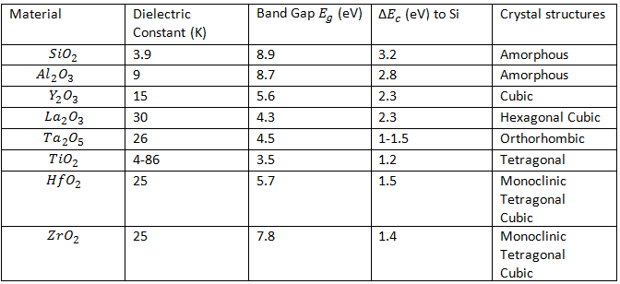
Potential High-K materials
Ref [5]
Which one of them is appropriate??
Dielectric constant and band gap of a given material generally exhibit an inverse relationship?? (some materials have significant departure from this trend)

Slide 22
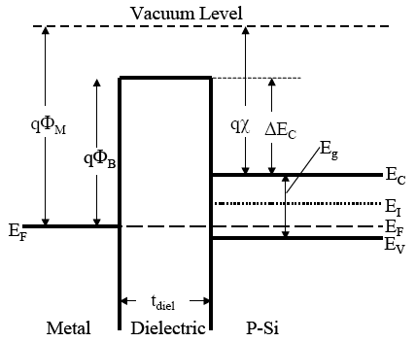
Permittivity and Barrier Height
Barrier Height:
Tunneling current is negligible
Leakage current increases exponentially with decreasing barrier height
Ta₂O₅ and TiO₂ have small value of and hence large leakage current
HfO₂ and ZrO₂ offer higher value of K and
Band Diagram
Ref [5]

Slide 23
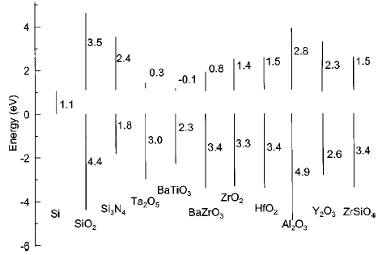
Band offset for high-k gate dielectric material
Barrier Height
Band offset calculations for a number of potential High-K dielectric materials, Ref [5]

Slide 24
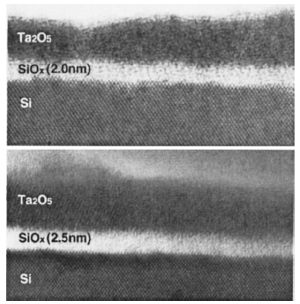
Thermodynamic Stability on Si
Observations:
Most of the High-K metal oxides are unstable on Si
Reacts with Si to form an undesirable interfacial layer
Interfacial layer may alter the barrier height ( )
Require an interfacial reaction barrier
Need to modify both gate and channel interface
Reaction at Ta₂O₅/Si interface resulting in formation of a thin SiO₂ layer, Ref [5]

Slide 25
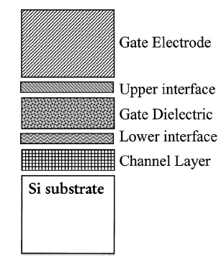
Schematic of two interface
Two interface:
Upper Interface: Between Gate Electrode and Gate Dielectric
Lower Interface: Between Gate Dielectric and Channel Layer
(Poly-Si)
(High-K oxide)
Schematic of important regions of a field effect transistor gate stack, Ref [5]

Slide 26
Interface Engineering
Developing reaction barriers between high-k/Si interface
Depositing an interfacial layer of SiO₂ or low permittivity material
Reduce the extent of reaction between high-K and Si
High quality SiO₂-Si interface helps maintain high carrier mobility
Limits the highest possible gate stack capacitance
Increased process complexity
Notes:
By depositing interfacial layer we create two interfaces. High-k should be stable on the interfacial layer
The increased process complexity for the deposition and control of additional ultrathin dielectric layers
The expected increase in the gate capacitance associated with the high-k dielectric is compromised

Slide 27
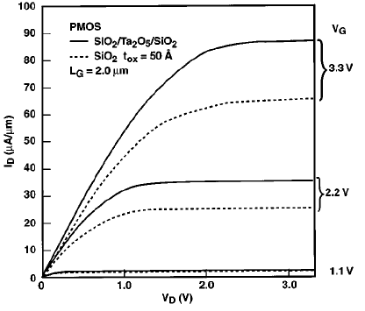
Improved Results
Comparison of drive current and saturation current for long channel PMOS transistors incorporating SiO₂/Ta₂O₅/SiO₂ dielectric stack, Ref [5]

Slide 28
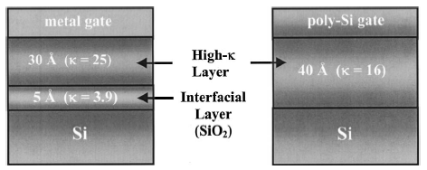
Issues with Interface Engineering
For 45nm and below technology EOT~ 1nm is desired
Interface layer of SiO₂~ 5Å thick
Problems with thin interfacial layer:
Extremely difficult to obtain with high quality
Will not prevent reaction between High-K and Si
Thin interfacial layer will allow a large amount of direct electron tunneling into the high-k dielectric
High electric field in the thin oxide can lead to charge trapping
Comparison of stacked and single layer gate dielectrics in a hypothetical transistor gate stack. Either structure results in the same overall gate stack capacitance or EOT= 10Å , Ref [5]

Slide 29
Thermodynamic stability of metal oxides on Si
Al₂O₃ very stable and robust
Stable on Si against SiO₂ formation
Drawback :
K~ 8 – 10, hence a short term solution
Fixed oxide charge at poly Si/High-K interface
Significant mobility degradation
Boron diffuses through ALCVD Al₂O₃ during dopant activation anneals
Notes:
Si has high affinity for oxygen. So if we use a dielectric which has a lesser affinity fr oxygen then Si will take that oxygen away from it

Slide 30
Contd…
Ta₂O₅ and TiO₂ unstable to SiO₂ formation
Tend to pahse separate into SiO₂ and metal oxide and possibly silicide phases
ZrO₂ , HfO₂ stable in direct contact with Si up to high temperature
ZrO₂ , HfO₂ can be potential replacement of SiO₂
Pseudobinary alloys and are stable on Si up to high temperatures
Notes:
it is possible to combine the desirable properties from two different oxides while eliminating the undesirable properties of each individual material

Slide 31
Interface Quality
Midgap interface state density for SiO₂ ,
Most of high-K materials reported,
Over- or underconstrained interface leads to high interface defect density
Y₂O₃ & La₂O₃ forms underconstrained interface
Ta₂O₅ & TiO₂ forms overconstrained interface
Any M-Si bonding near channel interface lead to poor leakage current and electron channel mobility
Notes:
The bonding at the interface is very imp. If the avg no. of bonds per atom is more than is more than 3 then the defect density increases proportionally

Slide 32
Contd….
ZrO₂ , HfO₂ have high oxygen diffusivities
Any annealing step with excess oxygen will lead to diffusion of oxygen and result in formation of SiO₂ at high-K/Si interface
Severely compromise the capacitance gain

Slide 33
Film Morphology
Polycrystalline films:
Amorphous films:
Grain boundaries serve as high-leakage paths, and this may lead to the need for an amorphous interfacial layer to reduce leakage current
Grain size and orientation changes throughout the film causing variations in K
Hence are problematic
Exhibit isotropic electrical properties
Don’t suffer from grain boundaries
Can easily be deposited
An amorphous film structure is
the ideal one
Notes:
Single crystal oxides grown by MBE can in principle avoid grain boundaries while providing a good interface, but these materials also require sub monolayer deposition control, which may only be obtainable by MBE approaches
Al2O3, ZrO2, HfO2 all have polycrystalline oxides
ALCVD deposited ZrO2 has shown promising results

Slide 34
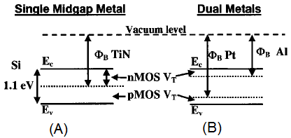
Gate compatibility and Metal Gates
Most potential High-K dielectric require metal gates
Same instability with Si exist at both channel and poly-Si gate interface
Metal gates are very desirable for eliminating gate depletion effects
Two types of metal electrodes are studied:
A single Midgap metal
Two separate metals
Energy band diagrams of threshold voltages for nMOS and pMOS devices using (a) Midgap metal gates and (b) dual metal gates, Ref [5]

Slide 35
Single Midgap metal approach
Advantages:
Symmetrical for both pmos and nmos
Simpler CMOS processing steps, only one mask and one metal would be required for gate electrode
Drawbacks:
High threshold voltage~0.5V
compensation implants will degrade channel carrier mobility
Not provide performance improvement worthy of the added process complexity
Notes:
With the voltage supply becoming less than 1V if we have 0.5V threshold voltage than we will not be able to turn on the transistor

Slide 36
Dual band metal
Separate metal for nmos and pmos
Can choose the workfunction of the metal accordingly
Can achieve much lower threshold voltage
Feasible electrode metal for nmos: Al, Ta, TaN and conducting metal oxide IrO₂
Feasible electrode metal for pmos: Pt and conducting metal oxide RuO₂
Current roadmap predicts that poly-Si gate technology likely be phased
out beyond the 70 nm node, after which a metal gate substitute
appears to be required
Notes:
Al not used because it reduces almost any gate oxide
Pt is not used does not adhere well to most dielectrics, and is expensive

Slide 37
Process Compatibility
PVD:
Sputter PVD results in surface damage thus creating interfacial states
Line of sight deposition results in poor step coverage
CVD:
Provided uniform coverage over complicated device topologies
Reaction kinetics require careful attention in order to control interfacial layer formation
ALCVD :
Gave good results in deposition of HfO₂ and ZrO₂

Slide 38
Replacing poly-Si/SiO₂ by poly-Si/High-K
Transistors built using Poly-Si gate and High-K gate oxide suffers from:
High threshold voltage because of Fermi level pinning at poly-Si/High-K interface
Degraded channel carrier mobility

Slide 39
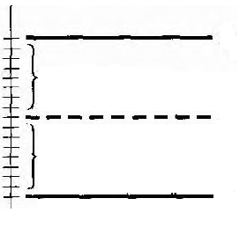
Interface states
Observed at metal semiconductor interface
Donor states:
Donate electrons and become positively charged
Above - positive
Acceptor states:
Accept electrons and become negatively charged
Below - negative
Acceptor States
Donor States
Semiconductor
Notes:
Below energy phi we have donor states, above phi we have acceptor states.
Fermi level will be somewhere between Ec and Ev
Donor states contain electrons. They are neutral when they have it and becomes positive after they give out their electrons.
Acceptor states accept electrons. They are neutral when they don’t have electron. And be negative once they accept electron

Slide 40
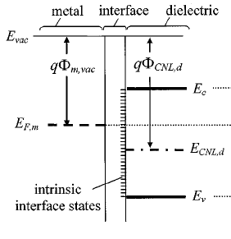
Fermi Level Pinning
Caused by interface states
Workfunction of metal differs from its value in vacuum
Negatively charged dipole created on dielectric side
Dipole drives to
S – Slope factor, accounts for dielectric screening
Negative charge
Larger dielectric screening
Smaller S
Higher degree of pinning to
Metal Dielectric Interface
Notes:
Occurs when metal comes in contact with dielectric. The fermi level of the metal gets pinned at some other value. Because of it workfunction of metal differs from its vacuum value.
Because that would give zero dipole charge
Because of the change in workfunction of metal, threshold voltage changes
The value of 0<S<1
When S=1 idea case
When S=0 max pinning

Slide 41
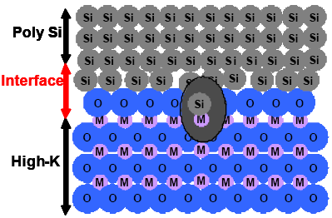
Fermi Level Pinning at poly-Si/High-K interface
Caused by interface defect
Hf-Si and Si-O-Al bonds for HfO₂ and Al₂O₃ respectively
Results in:
High threshold voltage
Low drive current
Hence the need to replace poly-Si gate by a suitable metal
Defect formation at the polySi and high-K interface is most likely the cause of the Fermi level pinning which causes high threshold voltages in MOSFET (M=Zr or Hf), Ref [6]
Notes:
Pinning causes a significant variation in workfunction of of poly-si which results in increase of threshold voltage of mosfet.

Slide 42
Mobility Degradation
Reason for mobility degradation:
Surface phonon scattering in high-κ dielectrics
Mechanism:
High-K dielectric has polarizable metal oxygen bonds
Oscillating dipoles interacts with channel carriers when gate plasma oscillations and phonons in high-K are in resonance
This resonance condition leads to significant degradation of channel carrier mobility
Resonance occurs when gate carrier density is
To Avoid:
Use metal whose free carrier density exceeds
Resonance condition is not satisfied
Weakens the interaction

Slide 43
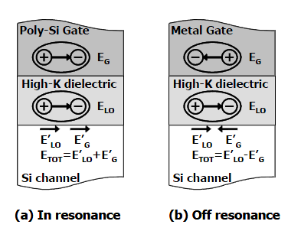
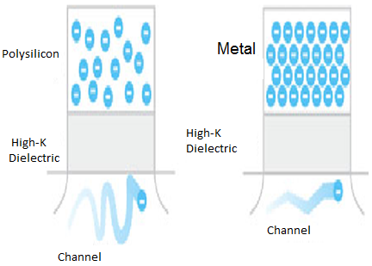
Surface Phonon Limited Mobility
Ref [7]
Ref [8]

Slide 44
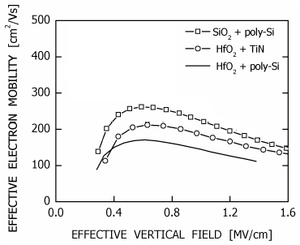
Mobility Improvement by using TiN
Effective electron mobility as a function of effective vertical electric field, Ref [6]

Slide 45
The Metal Gate Solution
Metal gates instead of Poly-Si could solve the following problems:
Less amount of defects at the surface solving the fermilevel pinning to a certain extent
Screening of surface phonon based vibrations because the high concentration of electrons
Effectively no depletion layer formation
Less resistance compared to poly-Si
Notes:
Reduced gate resistance reduces the RC delay

Slide 46
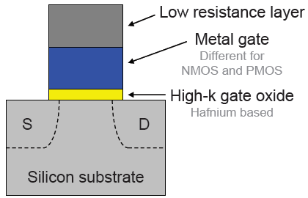
Metal Gate/High-K Transistor

Slide 47
Intel 45nm Transistor – performance
Performance improvements compared to 65nm transistors:
~2x improvement in transistor density
~30% reduction in switching power
~20% improvement in switching speed
>10x reduction in gate oxide leakage power

Slide 48
Summary
Problems associated with thin SiO₂
SiO₂ need to be replaced by High-K oxide for 45nm and below technology
HfO₂ and ZrO₂ show promising results
Problems associated with poly-Si/High-K interface
Use of metal gate instead of poly-Si give better results

Slide 49
References
[1] R. Shireen, et al.,"Influence of polysilicon-gate depletion on the subthreshold behaviour
of submicron MOSFETs",December 2010 [online]
[2] R. Chau, S. Datta, M. Doczy, J. Kavalieros, and M. Metz, “Gate dielectric scaling for high performance CMOS: from SiO2 to high-κ”, Extended Abstract of International Workshop on Gate Insulator, Tokyo, Japan, pp. 124–126, 2003
[3] K. Mistry, et al., “A 45nm Logic Technology with High-k+Metal Gate Transistors, Strained Silicon, 9 Cu Interconnect Layers, 193nm Dry Patterning, and 100% Pb-free Packaging” in Electron Devices Meeting, 2007. IEDM 2007. IEEE International, January 2008, pp. 247-250
[4] T. Morimoto, et al.,"Effects of boron penetration and resultant limitations in ultra thin pure-oxide and nitrided-oxide gate-films" in Electron Devices Meeting, 1990. IEDM '90. Technical Digest., International, pp. 429-432
[5] G. Wilk, et al., "High-k gate dielectrics: Current status and materials properties considerations", Applied Physics Journal, January 2001

Slide 50
References
[6] R. Chau et al., “Advanced metal gate/high-_ dielectric stacks for high performance CMOS transistors”, in AVS 5th Int. Microelectronics Interfaces Conf., Santa Clara, CA, 2004, pp. 3–5.
[7] R. Chau, et al., “Application of high-κ gate dielectrics and metal gate electrodes to enable silicon and non-silicon logic nanotechnology,” Microelectron. Eng., vol. 80, pp. 1–6, Jun. 2005
[8] M. T. Bohr, R. Chau, T. Ghani and K. Mistry, “The high-k solution”, IEEE Spectrum-the high-k solution, October 2007
[9]http://www.xtremesystems.org/forums/showthread.php?t=253738&page=4[ Accessed: 3rd December.2010]
[10] Chenming Hu, “Gate Oxide Scaling Limits and Projection”, in Electron Devices Meeting, 1996. IEDM 1996 , pp. 319-322
[11] http://www.iue.tuwien.ac.at/phd/entner/node23.html [Accessed: 6th December, 2010]

Slide 51
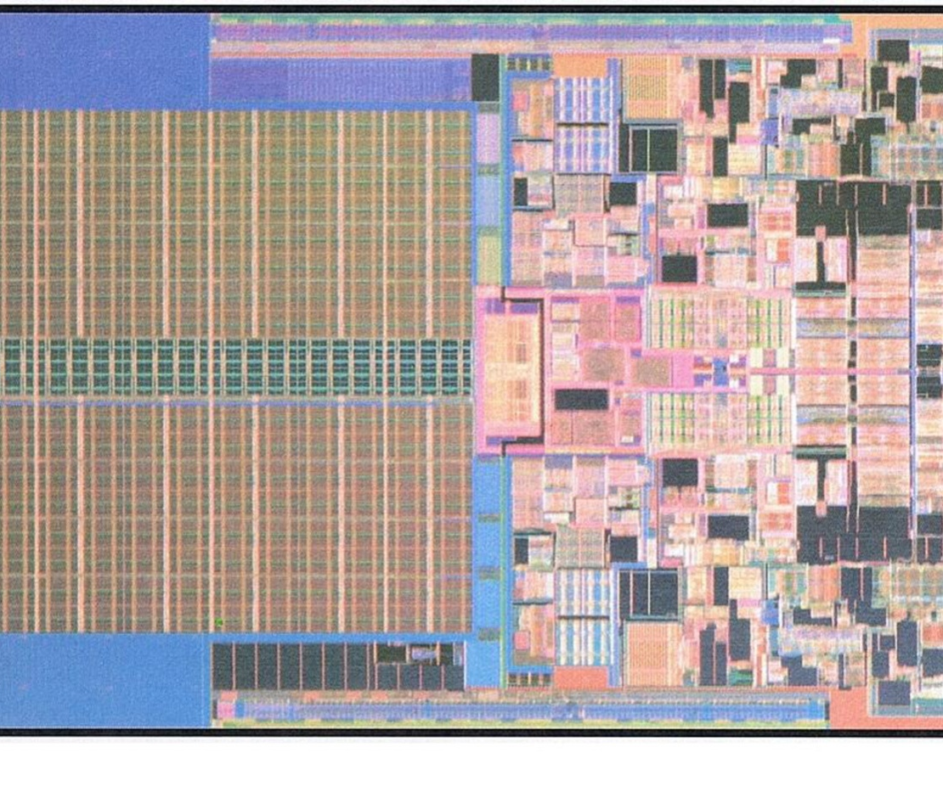

THANK YOU!!

