Slide 1
Learning Preferences on Trajectories via Iterative Improvement
Ashesh Jain, Thorsten Joachims, Ashutosh Saxena
Cornell University
Notes:
I’ll be talking about Learning Preferences on Trajectories via Iterative Improvement. Hello, I am Ashesh Jain and this is joint work with Thorsten Joachims and Ashutosh Saxena.

Slide 2
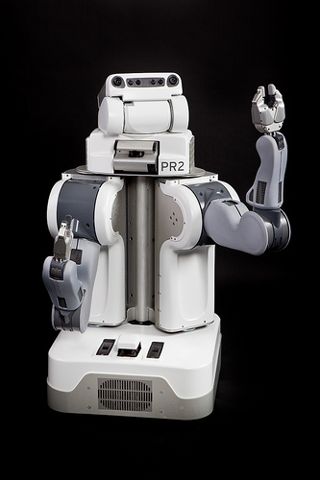
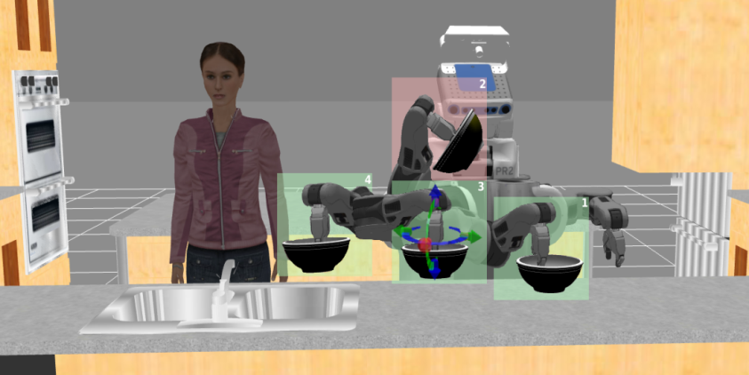
Motivation
High DoF robots
Generate multiple trajectories for a task
Only a few are desirable by user
We learn preferences over trajectories
2
3
1
Notes:
1. We have many High DoF houeshold or assembly robots such as PR2 and Baxter.
2. As shown in the figure, these robots can generate multiple different trajectories for a task.
3. However, depending on the task and environment, only few of the generated trajectories are desirable by the end user i.e. the user have preferences over trajectories. In this work, we closely study examples of such preferences and propose an algorithm to learn them for high DoF robots.

Slide 3
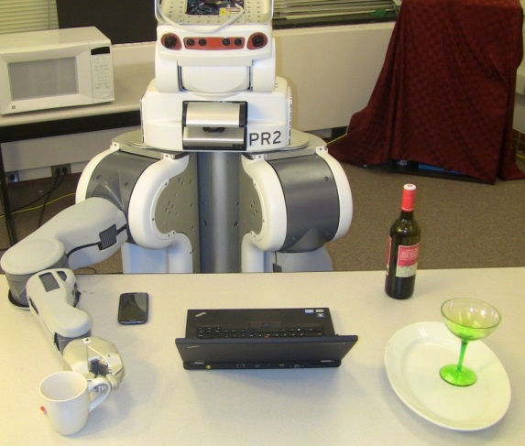
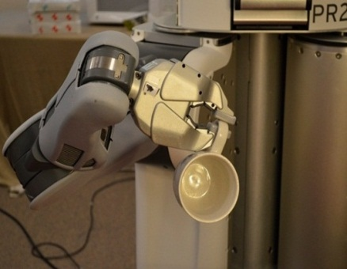
Example of Preferences
Glass of water upright
Notes:
Now, lets look at some examples of such preferences for a household robot.
If a robot is moving a glass of water, then the glass should not only be upright.

Slide 4
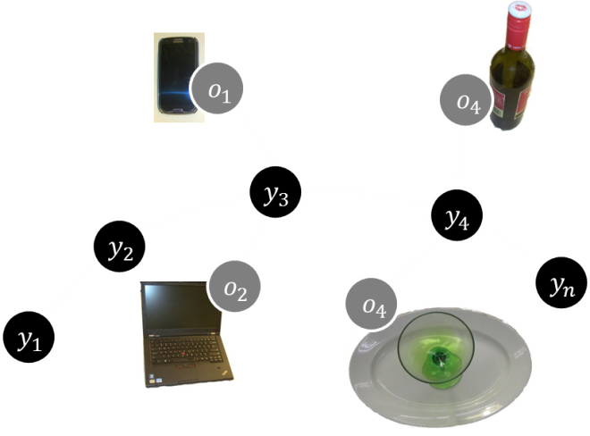
Example of Preferences
Environment dependent preferences:
Don’t move water over laptop
Notes:
But the robot should also be aware of its surrounding and keep water away from electronic devices such as laptop or mobile.

Slide 5
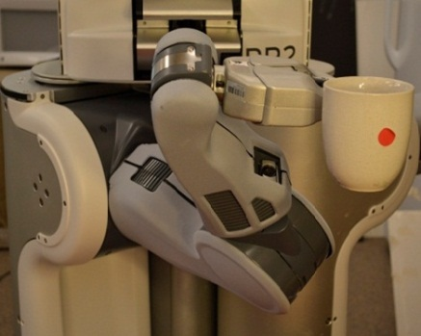
Example of Preferences
Glass of water upright.
Environment dependent preferences:
Don’t move water over laptop.
User likes to predict robot’s move
Contorted arm configurations are not preferred
Notes:
Furthermore, the robot should produce motion which is predictable by user and therefore should avoid contorted arm configurations
as shown in the figure. This makes the problem challenging because the user preferences are governed by complete arm
configuration is not just the end effector location.

Slide 6



Example of Preferences
Glass of water upright
Environment dependent preferences:
Don’t move water over laptop
User likes to predict robot’s move
Contorted arm configurations are not preferred
Preferences varies with users, tasks, and environment
Notes:
As we can see from this example, this problem is challenging because space of preferences can potentially be huge and preferences can further vary with user, tasks and environment.
Therefore manually coding them into the planners is not a viable option and therefore we rely on machine learning algorithms.

Slide 7
Learning preferences
Method 1
Learning from expert’s Demonstration
(Kobel and Peters 2011 , Abbeel et. al. 2010 , Ziebrat et. al. 2008 , Ratliff et. al. 2006)
Notes:
One method to learn user preferences is from expert’s demonstration and it has been shown to be useful in many applications.
However, for the problem we consider, this approach faces two challenges.

Slide 8
Learning preferences
Method 1
Learning from expert’s Demonstration
(Kobel and Peters 2011 , Abbeel et. al. 2010 , Ziebrat et. al. 2008 , Ratliff et. al. 2006)
Do not scale well to high DoF manipulators
Notes:
On the algorithmic side, these methods do not scale well to the high DoF robots specially when the user is concerned with robot’s complete arm configuration.

Slide 9
Learning preferences
Method 1
Learning from expert’s Demonstration
(Kobel and Peters 2011 , Abbeel et. al. 2010 , Ziebrat et. al. 2008 , Ratliff et. al. 2006)
Do not scale well to high DoF manipulators
Near optimal demonstrations
Providing kinesthetic demonstrations on high DoF robots is difficult
Notes:
On the practical side, the assumption that the user knows the optimal trajectory may no longer be true. And even if user knows the optimal demonstration, providing such kinesthetic demonstrations accurately is hard.
To overcome this, we propose a new method for human robot interaction.

Slide 10
Learning preferences
Method 1
Learning from expert’s Demonstration
Our Method
Learns from suboptimal online user feedback
(Kobel and Peters 2011 , Abbeel et. al. 2010 , Ziebrat et. al. 2008 , Ratliff et. al. 2006)
Do not scale to high DoF manipulators
Near optimal demonstrations
Providing kinesthetic demonstrations on high DoF robots is difficult
Notes:
Where the robot learns from suboptimal user feedbacks i.e. expert demonstrations are not required.

Slide 11
Learning preferences
Method 1
Learning from expert’s Demonstration
Our Method
Learns from suboptimal online user feedback
User iteratively improves the trajectory proposed by robot
(Kobel and Peters 2011 , Abbeel et. al. 2010 , Ziebrat et. al. 2008 , Ratliff et. al. 2006)
Do not scale to high DoF manipulators
Near optimal demonstrations
Providing kinesthetic demonstrations on high DoF robots is difficult.
Notes:
As a feedback user iteratively improves the trajectory proposed by the robot.

Slide 12
Learning preferences
Method 1
Learning from expert’s Demonstration
Our Method
Learns from suboptimal online user feedback
User iteratively improves the trajectory proposed by robot
Theoretical guarantee on regret bounds
(Kobel and Peters 2011 , Abbeel et. al. 2010 , Ziebrat et. al. 2008 , Ratliff et. al. 2006)
Do not scale to high DoF manipulators
Near optimal demonstrations
Providing kinesthetic demonstrations on high DoF robots is difficult
Notes:
We further show even with the suboptimal feedback our method converges at the same rate as if optimal demonstrations were available.

Slide 13
Learning preferences
Method 1
Learning from expert’s Demonstration
Our Method
Learns from suboptimal online user feedback
User iteratively improves the trajectory proposed by robot
Theoretical guarantee on regret bounds
User NEVER disclose the optimal trajectory
(Kobel and Peters 2011 , Abbeel et. al. 2010 , Ziebrat et. al. 2008 , Ratliff et. al. 2006)
Do not scale to high DoF manipulators
Near optimal demonstrations
Providing kinesthetic demonstrations on high DoF robots is difficult
Notes:
Finally, in this entire procedure the user never disclose the optimal trajectory to the robot.

Slide 14
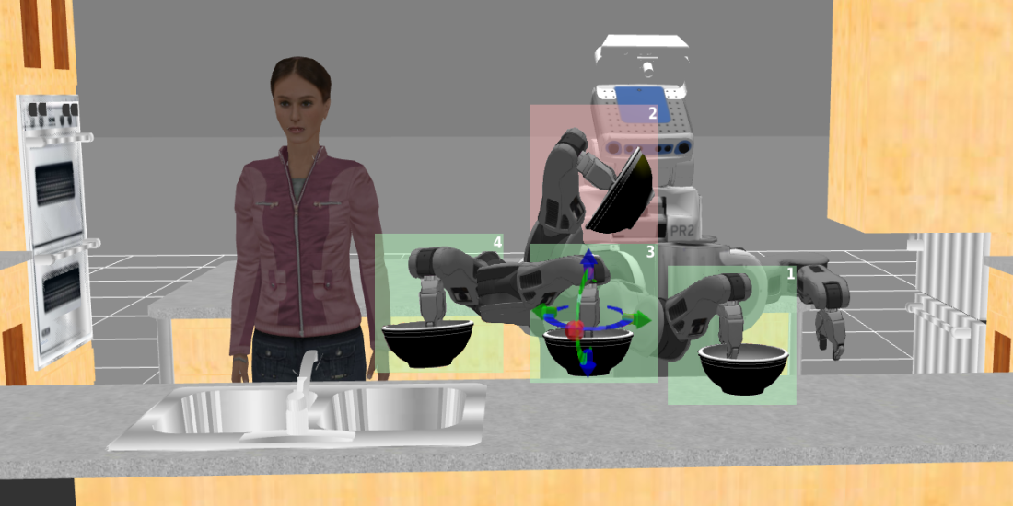
Iterative Improvement
Co-active Learning setting:
Interactively improves a trajectory
Clicks on one trajectory from a ranked list of trajectories
Similar to search engine
2
3
1
2
Notes:
One way to improve trajectory is by correcting one of its waypoint, as shown in the figure. We implement this using
ROS interactive manipulation tool.

Slide 15
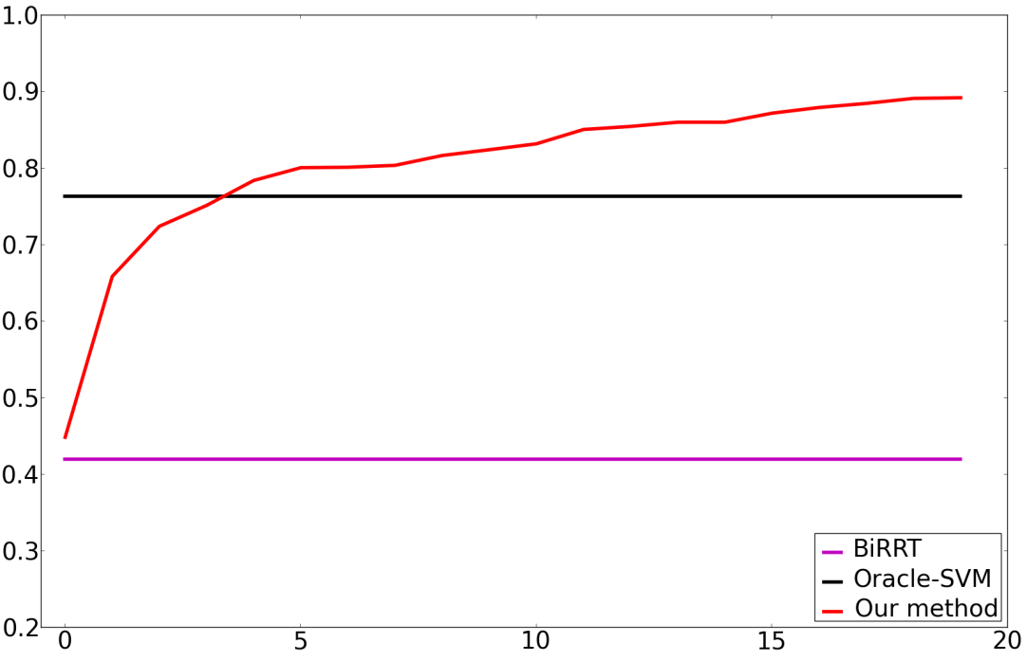
Result
nDCG@3
# Feedbacks
Tested on 35 different tasks
In less than 5 feedback our method outperforms fully supervised batch methods
Notes:
We evaluated our method on a significant number of house hold tasks and show we outperform fully supervised batch algorithms in less than 5 feedback on average.
We also produce better trajectories than sampling based planners with manually coded constraints.

Slide 16
Thank You
Visit our poster for more details.

