Slide 1
A5
DATASAVER
MEMBERS
Mohammed-Hanif Abdulai
Ernest Kuffour
Winifred Quartey-Papafio
Abdul Muhsin Iddris
Niena Rahma Alhassan

Slide 2
SCENARIO I
Customer: Tasha Annan is a 22 year old senior who lives on campus
Context: Tasha needs wants to download a tutorial for the software engineering class.
Problem: She has tried to download the video several times but the internet on campus is not stable. Anytime she tries to download the videos, her room-mates suffer as the internet speed worsens.
Payoff: She checks the Data Saver app and finds three other people who have the tutorial. She takes the video from one of them on a pen drive
1.Internet speed is not slowed
2.Bandwidth consumption is optimized on the Ashesi campus

Slide 3
SCENARIO II
Customer: Michael is a 21 year old second year student who learns a lot from watching videos and has fun watching movies too
Context: Michael always feels the need to download videos to facilitate learning and also get the latest videos.
Problem: The internet in Ashesi can be very slow. Sometimes too, the firewall blocks certain sites that offer educational videos.
Payoff: Michael can find out the videos that other students have that he wants. He can then contact the students and copy the files on a pendrive, tablet or other storage device

Slide 4
Persona I:Tasha Annan
Name: Tasha Annan
Occupation: Senior at Ashesi University
Age: 22
Residential status: Om campus
Tasha loves music, movies and is mostly concerned about how internet in school is usually limited and therefore is not able to download assignment files, tutorial videos and movies for relaxation. She is time conscious and doesn’t like to go round asking her colleagues if they have copies of a given assignment or a new movie she wants to watch.

Slide 5
Persona II: Michael Aboagye
Name: Michael Aboagye
Occupation: Sophomore student of Ashesi University
Age: 20
Michael is a second year student in Ashesi. He is a visual learner who likes to watch tutorials in addition to the lectures he takes in class. He loves to watch movies and play the latest games. He keeps the movies that he watches.

Slide 6
USER/AUDIENCE
Ashesi students

Slide 7
DEMO
bit.ly/1u8fNbP

Slide 8
FEEDBACK FROM USERS
Datasaver has been deployed on the Ashesi server
Editing file names
Deleting file names
User interface

Slide 9
PROJECT MANAGEMENT
Iteration One: user interface, search, add file
Iteration Two: sign up, login, send e-mail feature
Iteration Three: login, sign-up, user account, connecting to a database
Iteration Four: Saving to a database, adding file and viewing user files
Iteration Five: delete file name, edit file name, validation, pagination, user interface

Slide 10
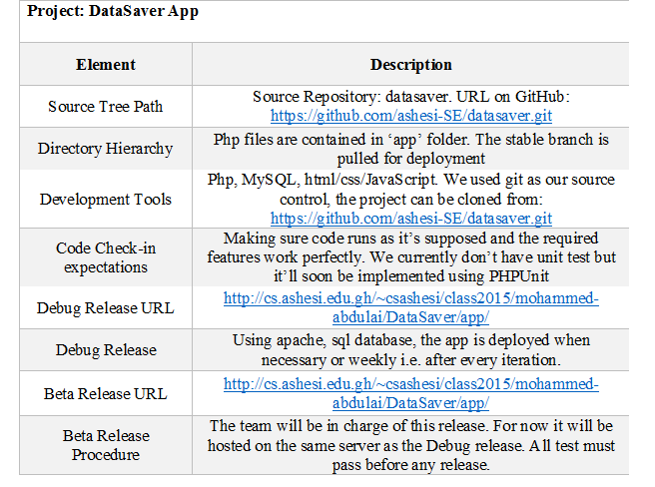
Architecture table

Slide 11
Deployment Plan
The app is currently hosted on the Ashesi server

Slide 12
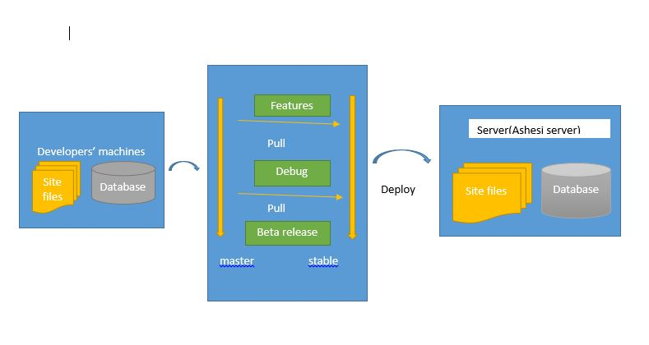
Deployment Architecture

Slide 13
Burn-up progress

Slide 14
Work division
Depended on what to be done in next iteration
Team members would make a to-do list and everybody would pick something from the list

Slide 15
RETROSPECTIVE/LESSONS LEARNT
User feedback is very helpful
It’s good to switch hats in software development
To the next SE students: Nothing is impossible, start work early and do enough research

Slide 16
WHAT’S NEXT FOR DATASAVER
Implement forget- password feature for account holders
Implement a display of a paginated full list of file names
Include forms for getting user feedback

Slide 17
Thank-you

