Slide 1
Rebalancing the kinetochore
A drug-repurposing case for one child with mosaic variegated aneuploidy
“Every cell-cycle drug in clinical use was built to break the cell cycle.
Not one was built to make it work better.”
Maaz Asher Khurram · mk7790@nyu.edu
MVA Hackathon 2026 · Track 2 · proband WGS_EX2312012 · BUB1B p.Leu737Ter / p.Asn1002Lys

Slide 2
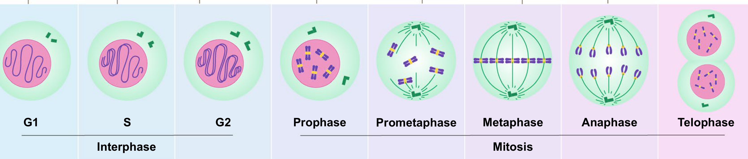
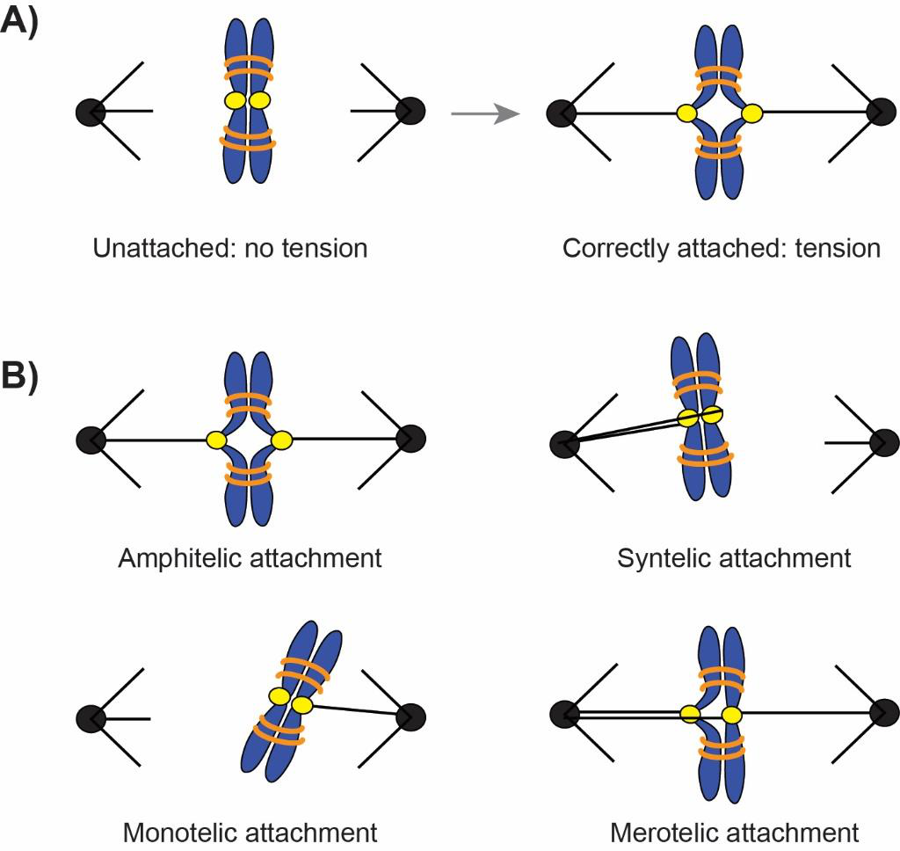
THE PROBLEM: every cell division is a chance to get the chromosome count wrong
A checkpoint guards the hand-off
Each chromosome must grip both poles. Three of the four ways it can attach are wrong, so the cell holds mitosis until every one is right.
In this child the guard is weak
MVA: cells are born with the wrong chromosome count, giving growth failure, microcephaly and childhood cancer risk.
Bloom & North 2021 PMID 33892776 · McVey 2021 PMID 34445523, CC BY 4.0

Slide 3
THE QUESTIONS we made this work answer, before we let ourselves pick anything
1 What do these two alleles actually leave behind?
Not “pathogenic”. How much protein, and with which domains.
2 Is the deficit reversible at all?
If restoring BubR1 does nothing, no drug can work. Someone tested this.
3 Is there any drug that raises BubR1, or its phosphatase?
Asked across the whole druggable universe, not a shortlist.
4 If not, what else sits on the same node — and at what dose?
Answered on measured human exposure, or not answered.
Each question had to close before the next one opened

Slide 4
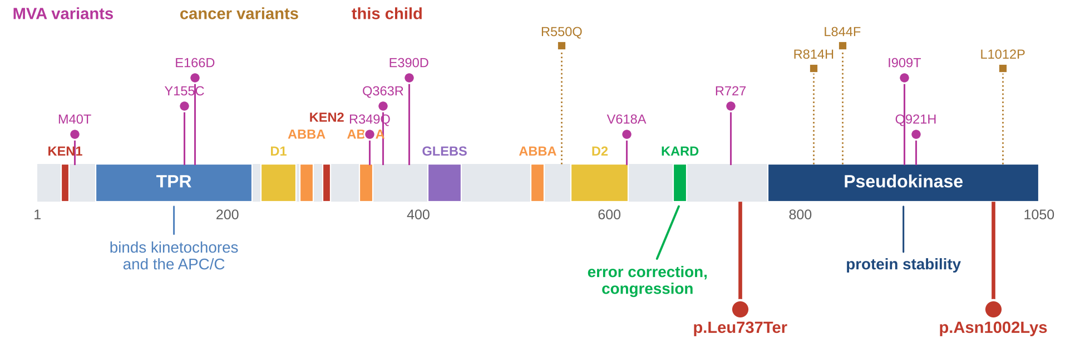
Q1 — Two alleles, and the domain that sits between them
Allele 1 truncates at 737
747 nt upstream of the last exon-exon junction, far past the 50-55 nt rule, so the transcript is destroyed.
Allele 2 is buried, not surface
87% buried. PREDICTED to be made, then degraded — a dosage mutant, not an interface one.
Both land on the KARD
667–681: the motif that recruits the phosphatase PP2A-B56.
Domain layout adapted from Bloom & North 2021, PMID 33892776

Slide 5
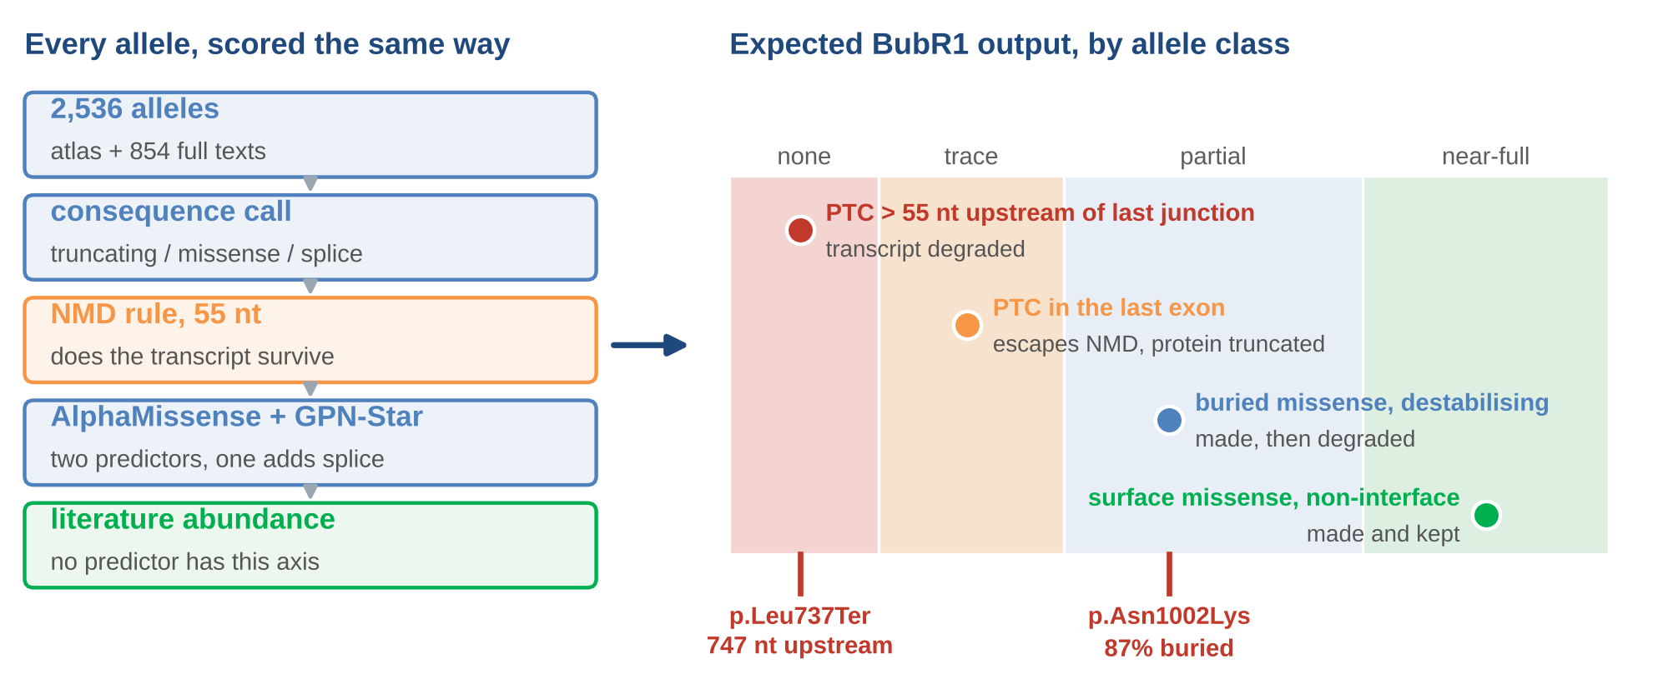
SCALABILITY (15%) — we scored every BUB1B allele, not this child's two
Scalability 15%
Suijkerbuijk reached the same two classes experimentally: truncating alleles lose the transcript, missense alleles are made and turned over.
Suijkerbuijk et al., Cancer Res 2010, PMID 20516114

Slide 6
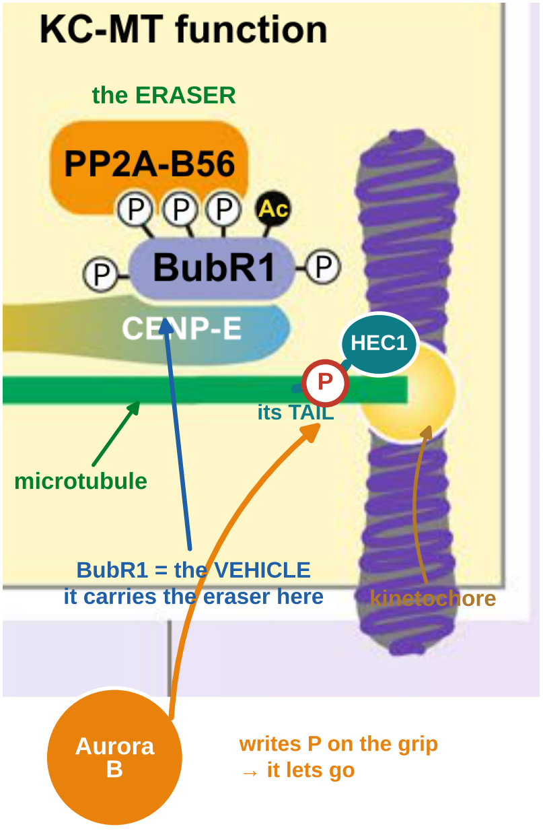
Q1 — Aurora B LOOSENS grips on purpose. PP2A-B56 SETS them. This child cannot set.
AURORA B — the loosener
Phosphorylates the Hec1 grip. A phosphorylated grip lets go — that is how wrong attachments get broken.
PP2A-B56 — the setter
Removes those phosphates so a correct grip can set. Both are needed: this is a tug-of-war.
BubR1 carries the eraser. Plk1's 3 phosphates on its KARD are the TICKET PP2A-B56 binds — a different set from Aurora B's, opposite job.
No KARD delivered → no setter arrives → Aurora B is not stronger, it is UNOPPOSED. So we lower it to match.
Adapted from Bloom & North 2021, PMID 33892776, Fig 2

Slide 7
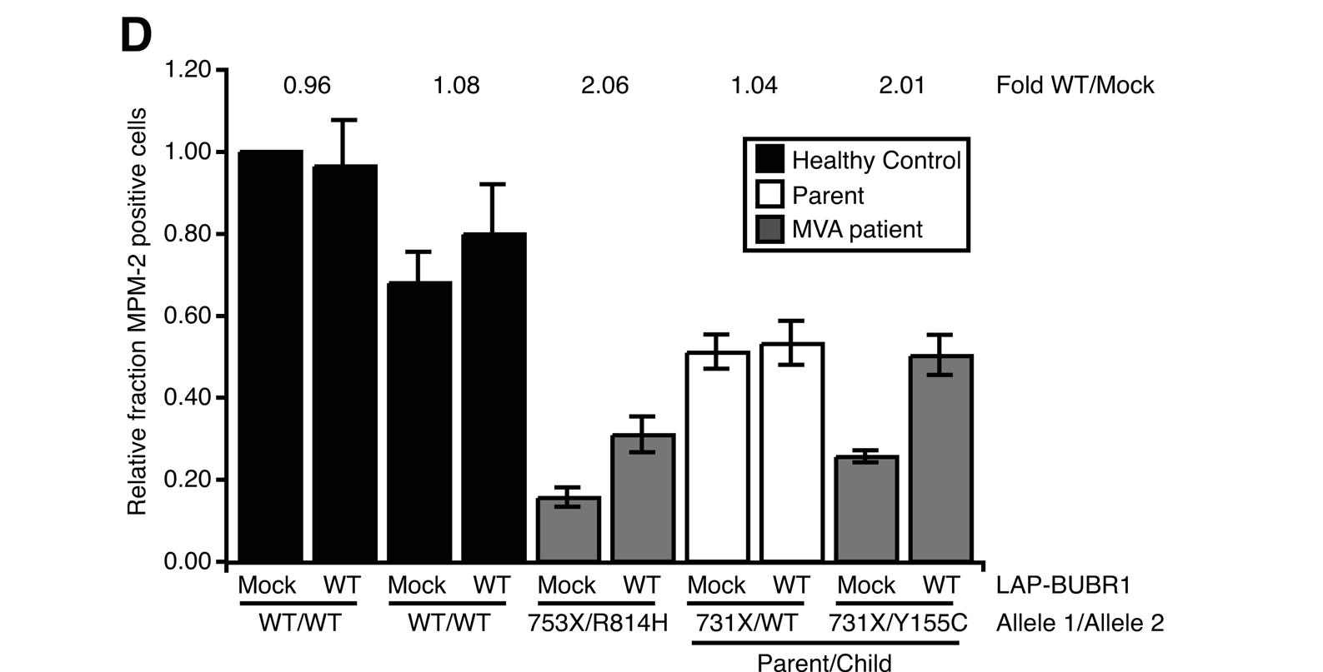
Q2 — The deficit is reversible: put BubR1 back and the checkpoint recovers
This child's genotype shape
753X/R814H and 731X/Y155C: one truncating allele, one missense — the MVA pattern.
2.06x and 2.01x
Nocodazole arrest doubles when BubR1 is restored. Healthy controls and the carrier parent do not move.
But it does not normalise
15%→31% and 26%→50% of healthy. And no drug raises BubR1.
Suijkerbuijk et al., Cancer Res 2010, PMID 20516114, Fig 1D

Slide 8
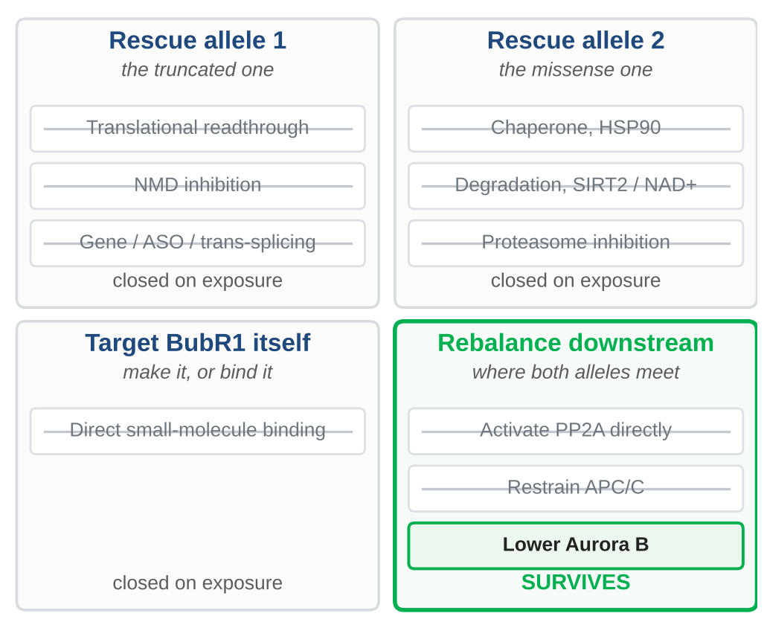
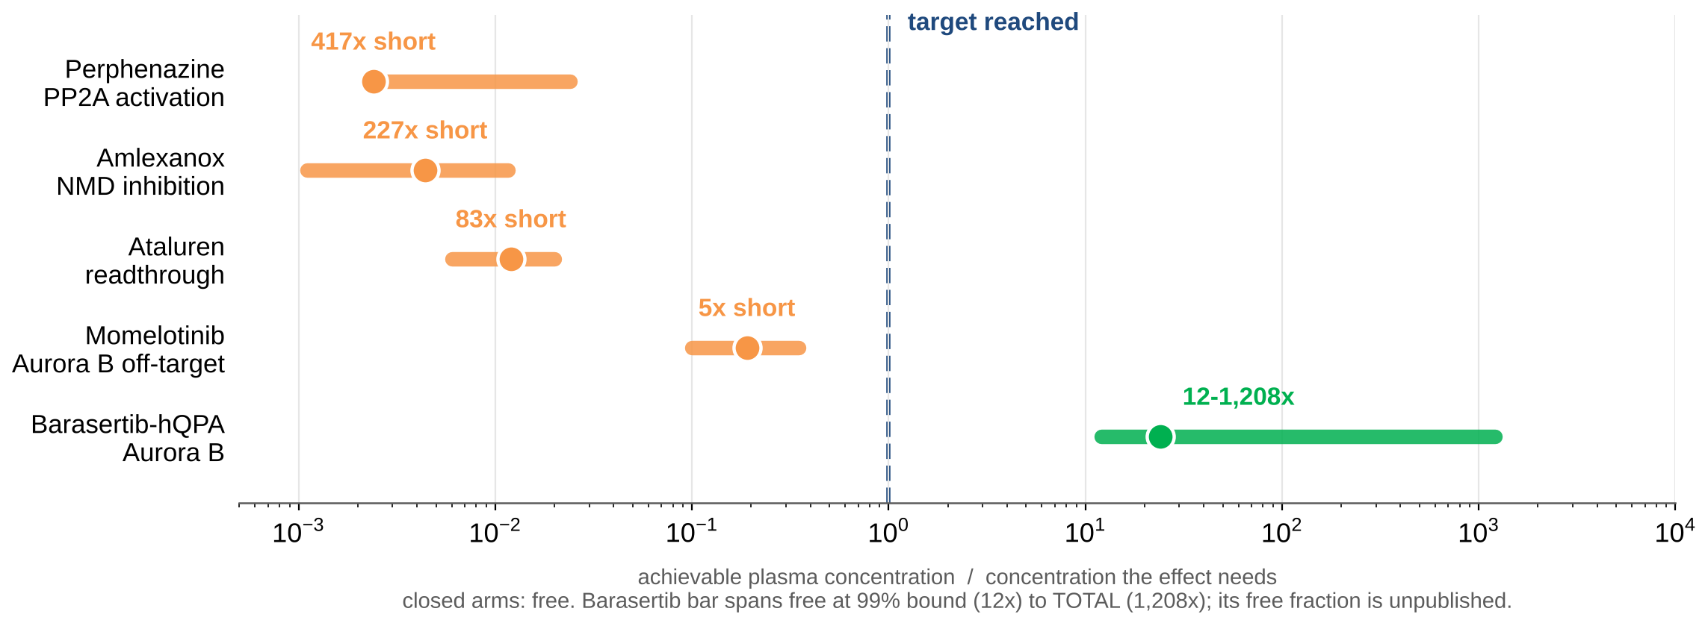
SCIENTIFIC RIGOR (35%) — Q3: ten arms, four themes, every one closed on a number
Scientific rigor 35%
Two gates closed these arms. EXPOSURE: most needed more drug than a person can be given. SAFETY: proteasome and HSP90 inhibitors are carcinogenic, disqualifying where tumour risk comes from missegregation.
Three themes die upstream. One node survives.

Slide 9
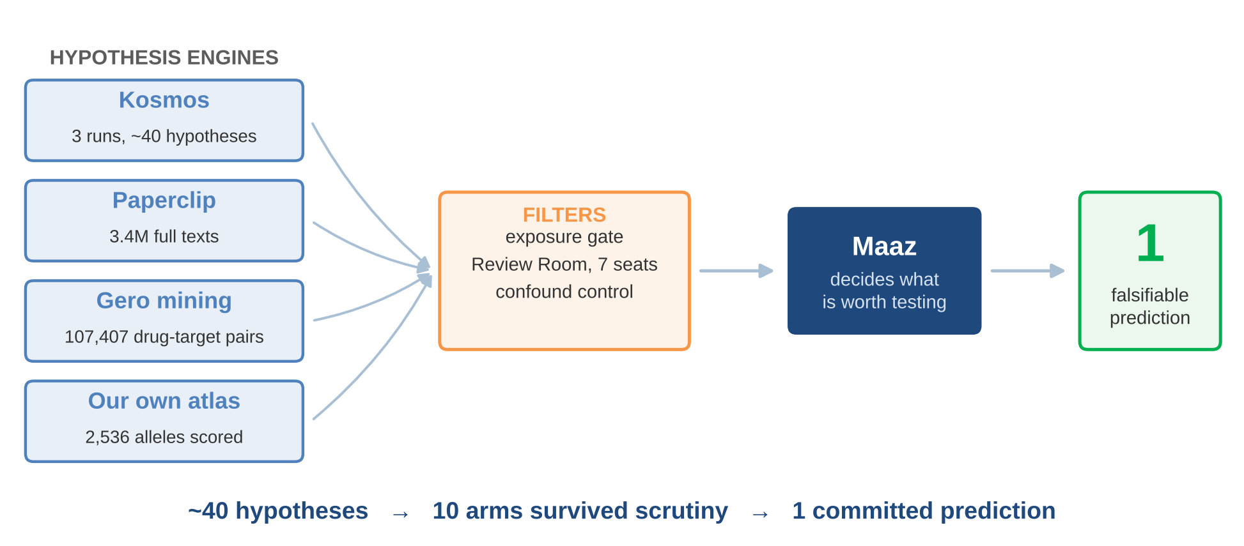
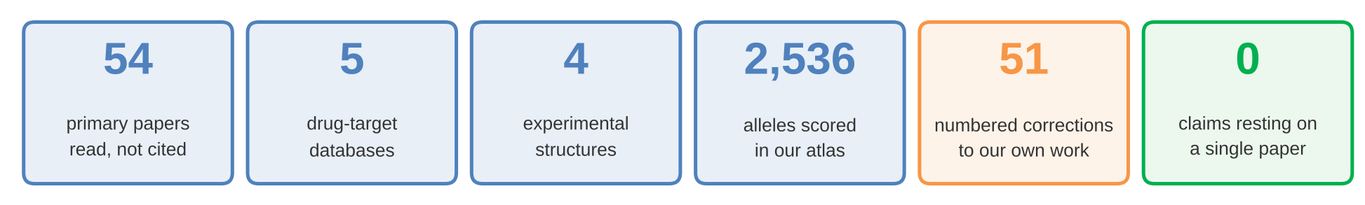
INNOVATION (25%) — many engines generate, one human decides, nothing rests on one paper
Innovation 25%

Slide 10
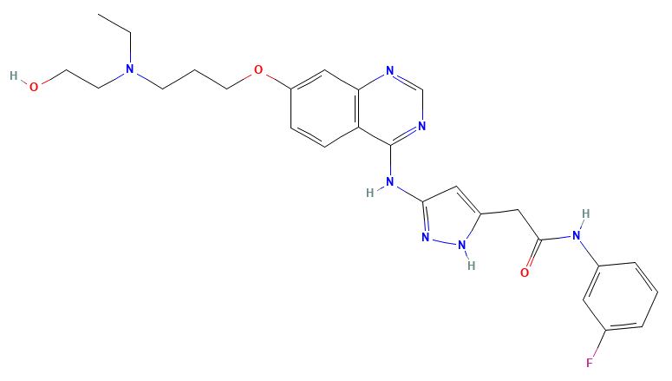
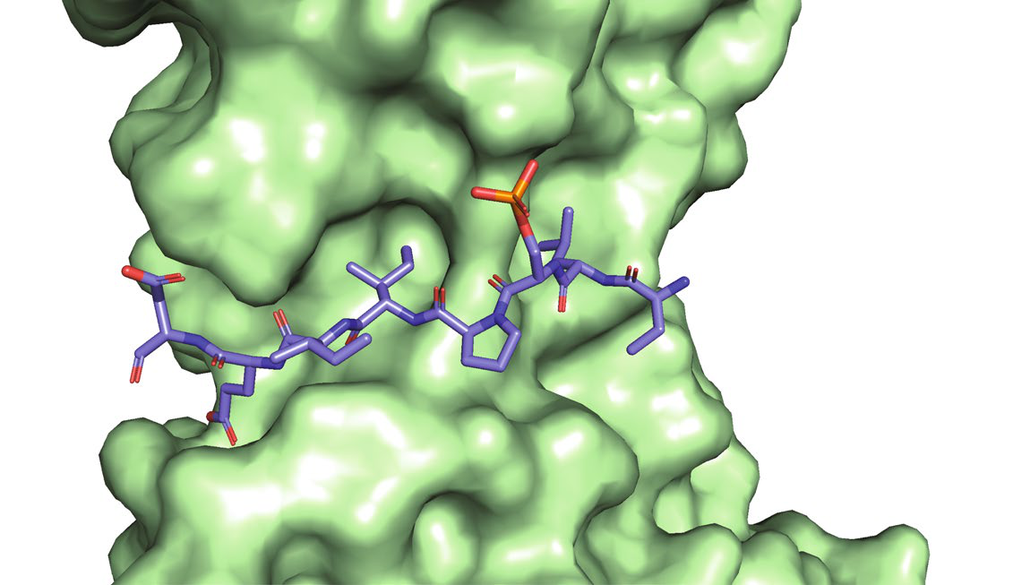
POTENTIAL IMPACT (25%) — Q4: lower the kinase, because the phosphatase cannot be raised
OUR PICK AZD2811-NP — AstraZeneca, in Phase II now
Built to do KILL dividing cells — SCLC, AML, lymphoma
Status Phase I/II. Never approved. Not withdrawn for safety.
Dose-limiting tox neutropenia, from ABLATING Aurora B in marrow
AZD2811-NP (barasertib-hQPA)
Why the NP 2-h infusion not 7-day, and the live asset
That toxicity is the ARGUMENT, not the obstacle
It comes from ABLATING Aurora B. We want 30-50% engagement.
Alisertib? Oral, given to 139 children — but it targets Aurora A, the wrong kinase. Caveat we own: the NP releases over days.
PP2A-B56 with the BubR1 KARD bound — the groove neither allele reaches
0.37 nM
Aurora B IC50
3,700x
over Aurora A
<100 mg
our proposed dose

Slide 11
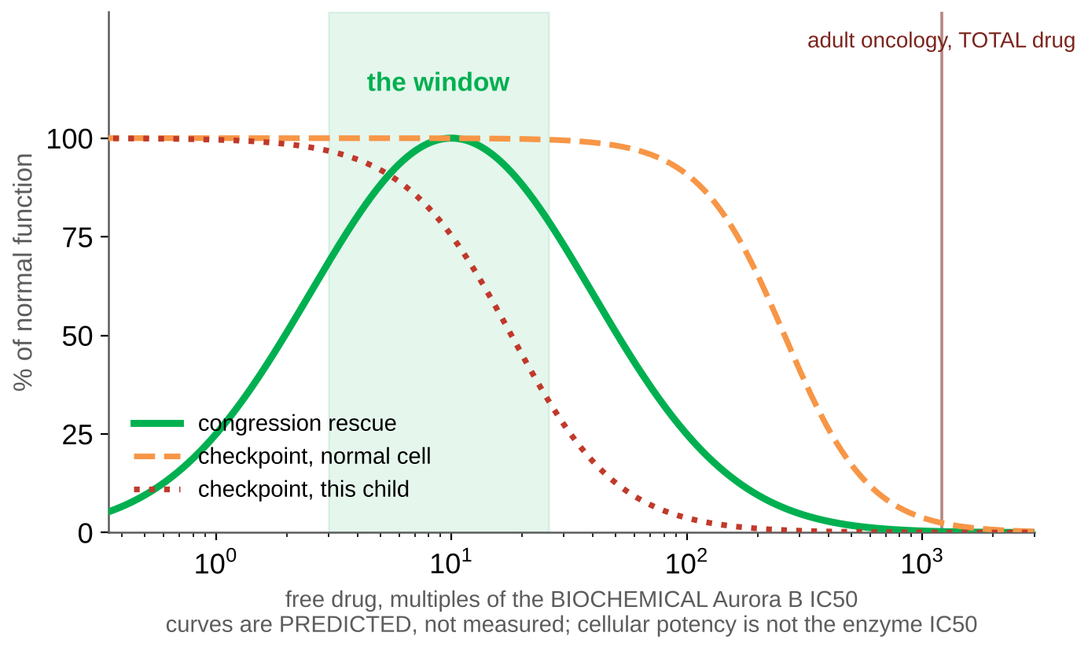
The dose, anchored on human data: BELOW the dose that first touches marrow
500 mg
oncology RP2D + G-CSF.
15 of 21 had grade 3+ AEs
200 mg
where marrow pharmacology
FIRST appears
≤100 mg
cohorts 1-5: NO neutropenia,
NO dose-limiting toxicity
AZD2811 phase I mapped this in humans
51 patients, 15-600 mg. Neutropenia is the ON-TARGET marker of Aurora B engagement — and the toxicity we must avoid. At the oncology dose it is severe. That is the argument for going far below it.
We propose BELOW 100 mg/cycle
a 5x reduction, in the SAME formulation, titrated on phospho-Hec1
Falchook 2023 PMID 36871042 · Johnson 2026 PMID 41933194

Slide 12
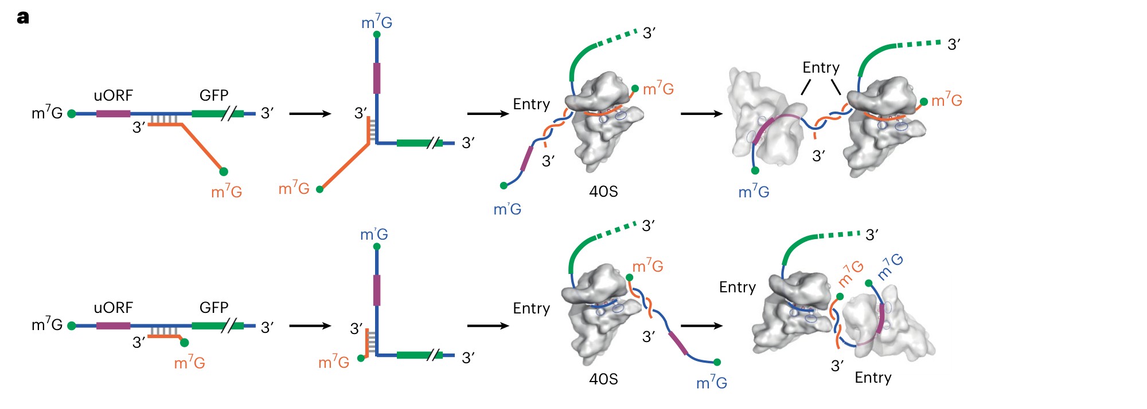
The moonshot: programmable translation, on the message the patient already has
What it does
A separate capped RNA (orange) base-pairs with the target mRNA (blue). The ribosome loads from the trans-cap and is handed to a start codon of our choosing.
Why it reaches this child
Allele 1's transcript is gone, so nothing can rescue it. But allele 2's message IS present — raising its output is a genome-free way to restore the dose.
Why it deserves funding
One mechanism, no edit, and dosage disease is a whole class. Delivery is the unsolved half: liver and muscle today, brain and marrow not yet.
Jia et al., Nat Biotechnol 2025, Fig 1a

Slide 13
What we answered, and the one prediction we commit to
Q1 What do the alleles leave? No transcript, and an unstable protein. Both lose the KARD's function.
Q2 Is it reversible? Yes — restoring BubR1 doubles checkpoint arrest in patient cells.
Q3 Can a drug raise BubR1? No. Zero compounds across 107,407 curated pairs, and no PP2A activator.
Q4 What else sits on the node? Aurora B — the one target where human exposure runs in our favour.
The prediction: partial Aurora B inhibition rescues congression in this child's cells BEFORE it costs checkpoint competence. If it does not, we are wrong.
Maaz Asher Khurram · mk7790@nyu.edu

