Slide 1
BioSim project INF200
By Ashesh Raj Gnawali and Martin Bø
22.06.2020

Slide 2
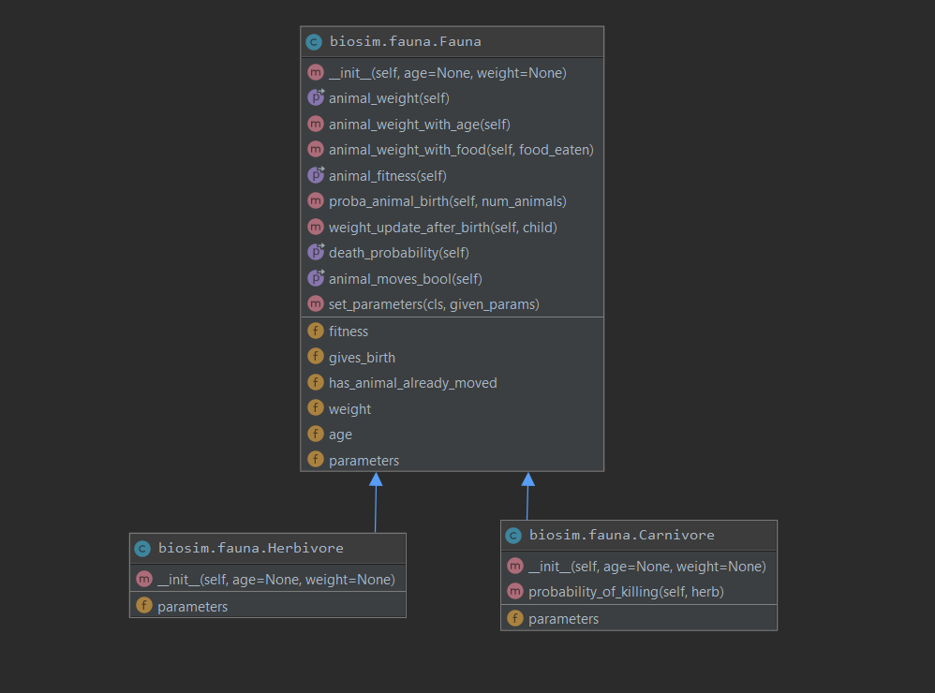
Brief overview of code structure - Fauna
Parent class “Fauna”
Child classes
Herbivore
Carnivore
All methods in Fauna apply for both animals, besides the probability of killing which is specific for the carnivores

Slide 3
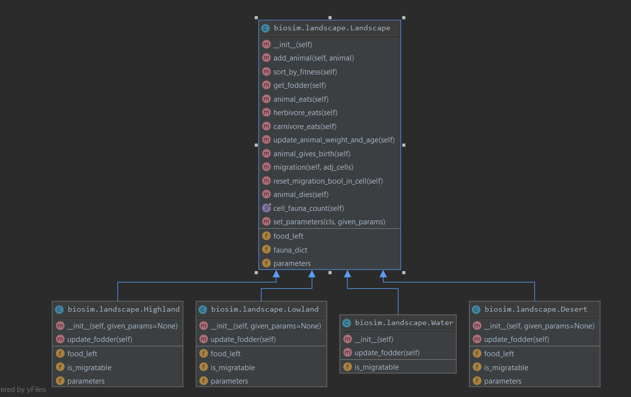
Brief overview of code structure - Landscape
Parent class “Landscape”, includes common methods for all landscape types
Child classes Highland, Lowland, Water and Desert
These have slightly different parameters and values where the desert is migratable and contains no food for herbivores. Water is also not migratable
Most functions in landscape are used in the lifecycle method in the island class

Slide 4
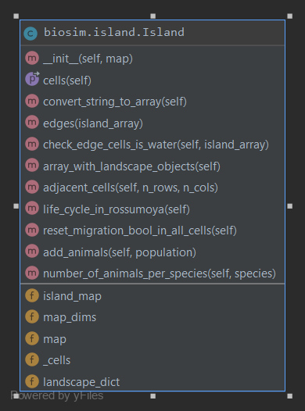
Brief overview of code structure - Island
The Island only contains one class, Island.
Here the multiline string input is converted to a 2D array and made to include landscape objects
This is where the map and animals are added according to the cells specified.
Methods involving migration and location is in the island class, which refers to landscape types in the landscape class.

Slide 5
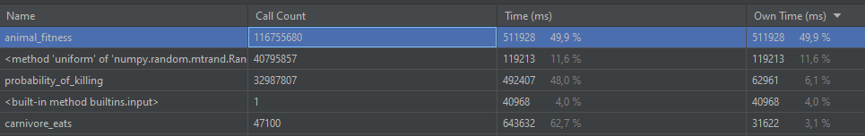
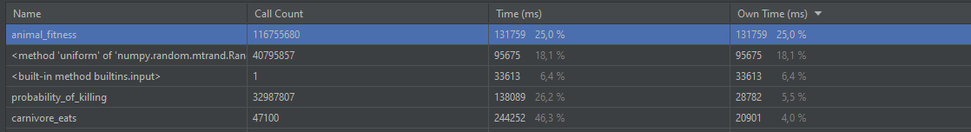
Optimization
By changing numpy.exp to math.e for the calculation of fitness, the program ran twice as fast. This test was run for 300 years where carnivores were introduced after 100 years.

Slide 6
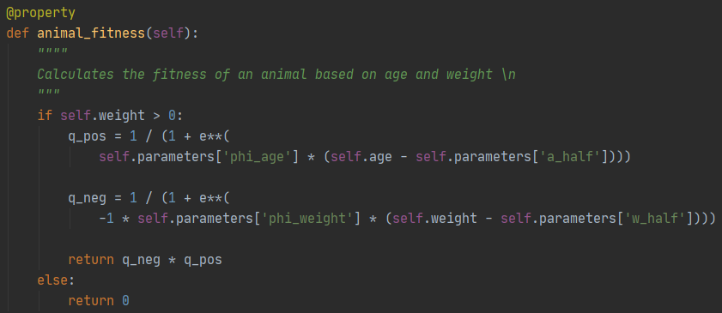
Possible improvements
The optimization could be improved further by splitting functions with calculation in two, where one part does the calculation and the other returns a bool by checking multiple conditions. This allowes the usage of packages like numba and the @jit decorator to speed up the calculations.
@njit(parallel = True, fastmath= True)

Slide 7
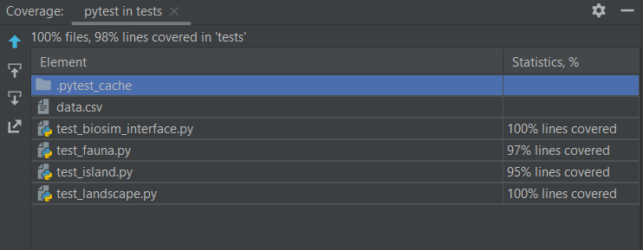
Test coverage and reliability
We have written a variety of tests covering all the major parts of our code. Test-driven development was our starting point, where we tried to write tests and make sure to pass them before moving on in the code. We used kanban cards in Github to list issues describing the problems and programmed parallely
Our tests cover most of the code, and when we ran tests with coverage in pycharm we get the following results:

Slide 8
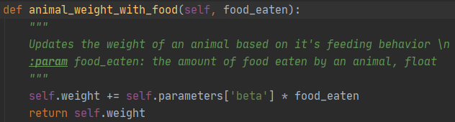
Simple code and detailed documentation
The picture on the right shows an example of one of our methods. It updates the animals weight after eating. Variables names are chosen such that it is easily readable and understandable, even for unexperienced programmers.
The doc strings are detailed enough that it explains what the function does.
Thus making the documentation generated through Sphinx more detailed and easy to use

Slide 9
Play video

Slide 10
Thank you for your attention

