Slide 1
Intro to the Canvas
Canvas is an HTML5 element
<canvas id="mycanvas" width=150 height=150>
If you see this, your browser doesn't support the canvas
</canvas>
Canvas is manipulated with javascript
c = document.getElementById("mycanvas");
c.width = screen.width - 100;
c.height = screen.height - 100;
Drawing is done in a 2D context
ctx = c.getContext("2d");
Notes:
A useful cheat sheet is found at http://www.nihilogic.dk/labs/canvas_sheet/HTML5_Canvas_Cheat_Sheet.pdf

Slide 2
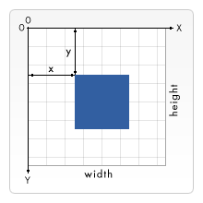
Drawing Shapes
Drawing is done by calling methods of the 2D context
ctx.drawmethod(arguments);
Drawing rectangles
fillRect(x, y, width, height)
strokeRect(x, y, width, height)
clearRect(x, y, width, height)
Drawing paths
beginPath()
closePath() // connects last point to first
stroke()
fill() // closes then fills the shape
Notes:
For a good tutorial on the canvas, see https://developer.mozilla.org/en-US/docs/Web/Guide/HTML/Canvas_tutorial

Slide 3
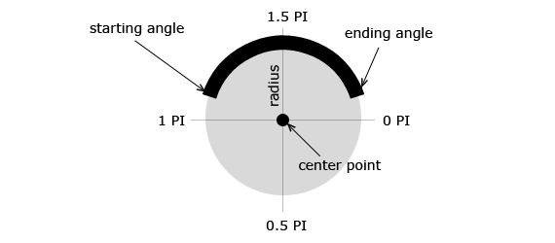
Drawing Paths
moveTo lifts the pen and moves it, without drawing anything
moveTo(x, y)
Drawing lines & polygons
lineTo(x, y)
Drawing arcs
arc(x, y, radius,
startAngle,
endAngle, ccw)
Drawing curves
quadraticCurveTo(cp1x, cp1y, x, y)
bezierCurveTo(cp1x, cp1y, cp2x, cp2y, x, y)
Notes:
Here's another great canvas reference: http://www.w3schools.com/tags/ref_canvas.asp
http://www.html5canvastutorials.com

Slide 4
Canvas Colors
Current drawing colors, gradients, and patterns are properties of the 2D context
  fillStyle
  strokeStyle
Color strings
  Named colors ("magenta")
  Hexadecimal values("#ff00ff")
  RGB & RGBA ("rgba(255,0,255,1)")
Constant alpha can be set for all drawing
    globalAlpha
Notes:
For more on specifying colors, see http://www.quackit.com/css/css_color_codes.cfm

Slide 5
Lines & Shadows
Current line styles are properties of the 2D context
  lineWidth – value, in pixels
  lineCap – "butt", "round", or "square"
  lineJoin – "bevel", "round", or "miter"
  miterLimit – value, in pixels
Shadows involve 4 properties of the 2D context
  shadowOffsetX – value, in pixels
  shadowOffsetY – value, in pixels
  shadowBlur – value, in pixels
  shadowColor – color string
Notes:
For more on specifying colors, see http://www.quackit.com/css/css_color_codes.cfm

Slide 6
Drawing Images
  Place a copy at (x,y)
  drawImage(image, x, y)
  Place a copy, scaled to fit (width, height)
  drawImage(image, x, y, width, height)
  Fit part of source image into destination
  drawImage(image, sx, sy, swidth, sheight, dx, dy, dwidth, dheight)
  Put canvas image at (x, y)
  putImageData(image, x1, y1)
Notes:
Be sure image is loaded before using it.
For tips and tricks regarding pre-loading multiple images, see http://perishablepress.com/3-ways-preload-images-css-javascript-ajax/

Slide 7
Image Types
3 types of CanvasImageSource can be drawn:
HTMLImageElement – uses an image created elsewhere
var img = new Image();
img.onload = function(){
/* use it */
};
img.src = imagefile;
HTMLVideoElement – can be used to dynamically update the canvas
HTMLCanvasElement – for image processing
Notes:
Be sure image is loaded before using it.
For tips and tricks regarding pre-loading multiple images, see http://perishablepress.com/3-ways-preload-images-css-javascript-ajax/
See http://html5doctor.com/video-canvas-magic/ for copying video to the canvas

Slide 8
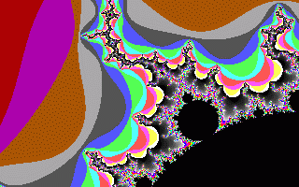
Using the Canvas Element
Create a new, blank ImageData object
var idata = ctx.createImageData(width, height);
var idata = ctx.createImageData(image);
The data is an array of RGBA values
idata.data[0]
idata.data[3]
Can put (and get) the
resulting image
ctx.putImageData(idata,
x1, y1);
var idata =
ctx.getImageData(x1, y1,
width, height);
Notes:
See a good explanation of how to draw the Mandelbrot Set here: http://plus.maths.org/content/computing-mandelbrot-set

Slide 9
Gradient & Pattern Objects
Specifying the gradient
createLinearGradient(x1, y1, x2, y2)
createRadialGradient(x1, y1, r1, x2, y2, r2)
Specifying color stops
addColorStop(position, color)
  position ranges from 0 .. 1
  color is any color string
Specifying a pattern
createPattern(image, type)
  Image can be any CanvasImageSource
  type is repeat, repeat-x, repeat-y or no-repeat
Notes:
For more on specifying colors, see http://www.quackit.com/css/css_color_codes.cfm

