Slide 1
Understanding CSS
Cascading Style Sheets control the presentation of content in HTML pages
Style Sheets separate formatting from the content
  Styles defined for tags, classes, and identifiers
  Selectors allow for finer definition of styles in a particular context
  Saving in separate files is preferred
Cascading has to do with how styles are applied
  The most recent style defined overrules any previous definitions
  ID styles override Class styles override Element styles
Notes:
For tutorials on CSS see …
W3Schools: http://www.w3schools.com/css/css_intro.asp
HTML.net: http://html.net/tutorials/css/lesson1.php
DesignShack: http://designshack.net/articles/css/what-is-css-back-to-basics/
For an overview of selectors, see http://www.w3schools.com/cssref/css_selectors.asp & click on "Selector Tester"

Slide 2
Setting CSS in Dreamweaver
Add a new CSS rule
  Choose a Selector Type and Name
  Choose where the rule will be defined
Edit your CSS rule
  Set the most common properties using the dialog box by selecting the Category
  Less common properties can be set by choosing Add Property in the CSS panel
View your existing CSS rules
  Can view All or Current (selected) rules in the CSS panel
  See the actual CSS code in Split or Code view
Notes:
For tutorials on CSS see …
W3Schools: http://www.w3schools.com/css/css_intro.asp
MDN: https://developer.mozilla.org/en-US/docs/Web/Guide/CSS
HTML.net: http://html.net/tutorials/css/lesson1.php
DesignShack: http://designshack.net/articles/css/what-is-css-back-to-basics/

Slide 3
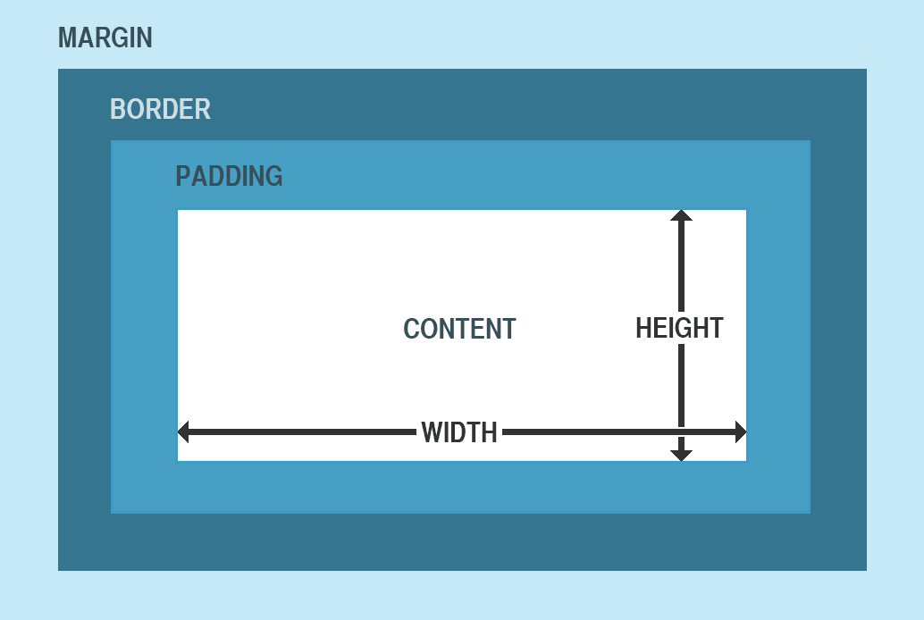
Boxes in CSS
Every HTML element is
contained in a rectangular
region
Border defines the
outline of the region
  Can set style, width & color in dialog
  Can also specify border-radius & box-shadow
Padding is the space between the border & the content
Margins represent the space between the border and the surrounding elements
Box can have a background-color (for padding & content)
  Use RGBA setting for semi-transparent background-color
  Values range from 0 (transparent) to 1 (opaque)
Notes:
For description of Box model see
https://developer.mozilla.org/en-US/docs/Web/CSS/box_model
http://www.w3schools.com/css/css_boxmodel.asp
http://inserthtml.com/codex/css-guide-box-model/

Slide 4
Responsive Web Designs
A responsive web design will "fluidly change and respond to fit any screen or device size"
The div element is used to define layout
  Position is static (default), absolute, fixed, or relative
  Positions are defined with top, right, bottom, and left
  Divs may overlap one another
  Divs may be nested
Determining front-to-back ordering
  By default, the last thing defined goes on top
  Z-index can be any positive or negative integer
  Largest numbers go in front, 0 is default
Notes:
See http://www.techrepublic.com/blog/web-designer/what-is-the-difference-between-responsive-vs-adaptive-web-design/

Slide 5
Div Layouts
Fixed position
  Does not scroll; position is relative to the window
  Used to create parallax effects
Absolute position
  Position is relative to the page
  Responsive websites use this to maintain borders
  Can overlap other elements
Relative position
  Position is relative to surrounding elements
  Use Float to shift to right or left
  Use Clear to go to the next line
Notes:
See http://www.techrepublic.com/blog/web-designer/what-is-the-difference-between-responsive-vs-adaptive-web-design/

Slide 6
Centering Elements
Relative divs are centered with margins at "auto"
  Margin: top right bottom left
Absolute divs must combine both positioning and margins
  Left: 50%;
  Margin: 0 0 0 –halfwidth;
Notes:
See http://designshack.net/articles/css/how-to-center-anything-with-css/

Slide 7
Formatting Text
Set default Text styles in <body> rules
  Text alignment (left, right, center, justify) is set under Block
  Can also set text-shadow
Set styles for links in <a> rules
  To remove underline, check "none" under text-decoration
  Can change appearance of different link states by creating rules for :link, :visited, :hover, and :active
Notes:
How to specify the shadow is found in http://www.w3schools.com/cssref/css3_pr_text-shadow.asp
To add special Google fonts, go to http://www.google.com/fonts, add fonts to your collection, then click on Use
For more on link selectors see http://www.w3schools.com/cssref/sel_link.asp

