Slide 1

Dynamic Media in HTML5
Nature of dynamic media
  Temporal
  Sampling & quantization
  Downloaded vs. streaming
Embedded media vs. players

Slide 2

Media Formats
Audio
  MP3
  OGG
  WAV
Video
  MP4 (H.264)
  OGG/OGV
  WebM (Google)
To change formats, you need to convert it
Notes:
See http://www.w3schools.com/html/html5_audio.asp for audio compatibility
See http://www.w3schools.com/html/html5_video.asp for video compatibility
Online tool: http://www.online-convert.com
Command-line tool: http://www.ffmpeg.org

Slide 3
Embedding Media Formats
Embedding media
<audio src="myaudio.ogg">
This appears if audio is not supported
</audio>
<video src="myvideo.ogg">
<img src="myvideo.ogg">
</video>
Defining the source
<video controls>
<source src="foo.ogv" type="video/ogg">
<source src="foo.mp4" type="video/mp4">
</video>

Slide 4
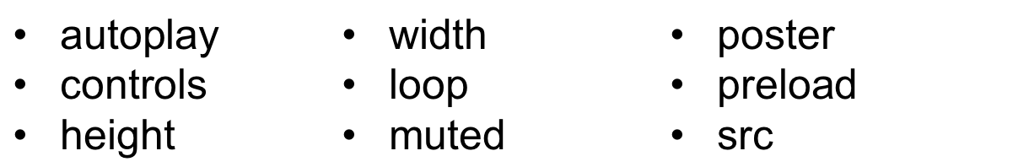
Embedding Media Formats
Optional attributes
Defining tracks
<video autoplay loop>
<source src="foo.ogv" type="video/ogg">
<source src="foo.mp4" type="video/mp4">
<track src="foo.en.vtt" kind="subtitles" srclang="en" label="English subtitle">
</video>
Notes:
For defining tracks see http://html5doctor.com/video-subtitling-and-webvtt/

