Slide 1
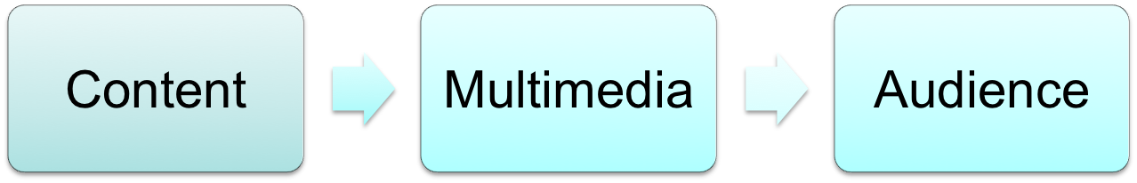
Planning Your Website
What information do you want to present?
  Collect your resources
  Create a narrative
Who are you presenting it to?
  Education level
  Stylistic preferences
  Context of usage

Slide 2

Choose A Style
Color theme
  Mood, Harmony, Balance
  https://kuler.adobe.com/
Typography
  Web font, Stylistic considerations
  http://www.google.com/fonts
Icons
  Color, 3D, size, style
  http://www.premiumpixels.com/
Notes:
Image from http://www.zazzle.com/i_hate_mondays_t_shirt-235963926751320666

Slide 3
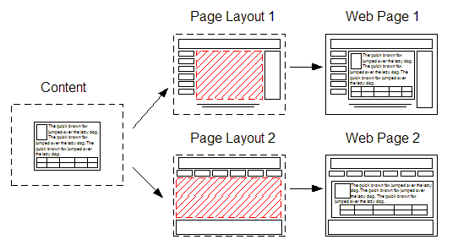
Mockup Your Page
Identify all the
elements
  Header & footer
  Navigation
  Image(s) & video(s)
  Body copy
Determine a point of interest
Achieve balance
  Symmetry vs. asymmetry
  Size & contrast
  Effective use of white space
Notes:
Image from http://www.xstandard.com/en/support/edit-web-pages/

Slide 4
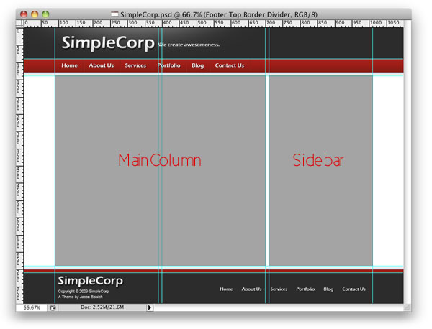
Layout Page in Photoshop
Create a page big enough for your layout
  Desktop/laptop/tablet: 1024 x 768
  Mobile: 640 x 960
  Responsive: 1000px
Setup guides within
  Create rectangles
  Align carefully
  Snap guides
Rename & group layers
Notes:
To setup workspace:
Create new image that is the size of your webpage (1024x768 is good; 1280x1024 for larger displays)
Make sure rulers are showing, using pixels to measure
Use selection rectangle to define areas for snapping guides to (have info panel showing)
Add content: place images, insert text
Group & name layers
Image from http://www.psdpenguin.com/2009/11/creating-a-photoshop-web-design-layout-part-3/

Slide 5
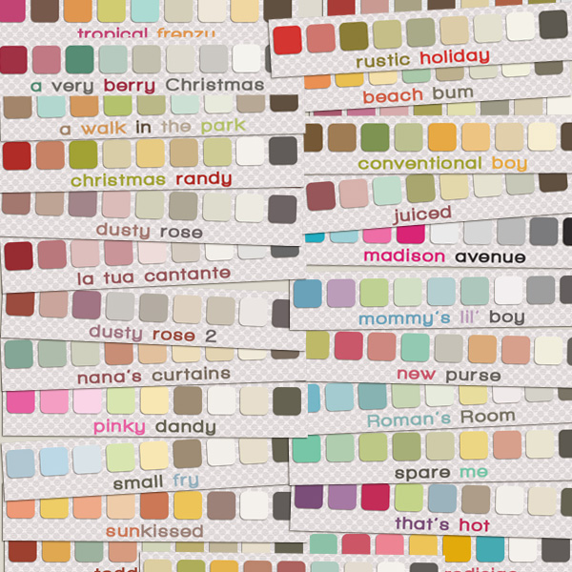
Colors in Photoshop
Setup of workspace
  Open text panels, save workspace preferences
  Color settings -> monitor
  Save for Web ->
  uncheck sRGB
  Swatches -> web spectrum
Create/find color palettes
  Goto kuler.adobe.com
  Find/edit color palettes
  Select from image
  Export to .ase
Import swatches
  Load swatches
  Rename swatches
Notes:
Image from http://justjaimee.com/26-free-designer-photoshop-swatches/

Slide 6
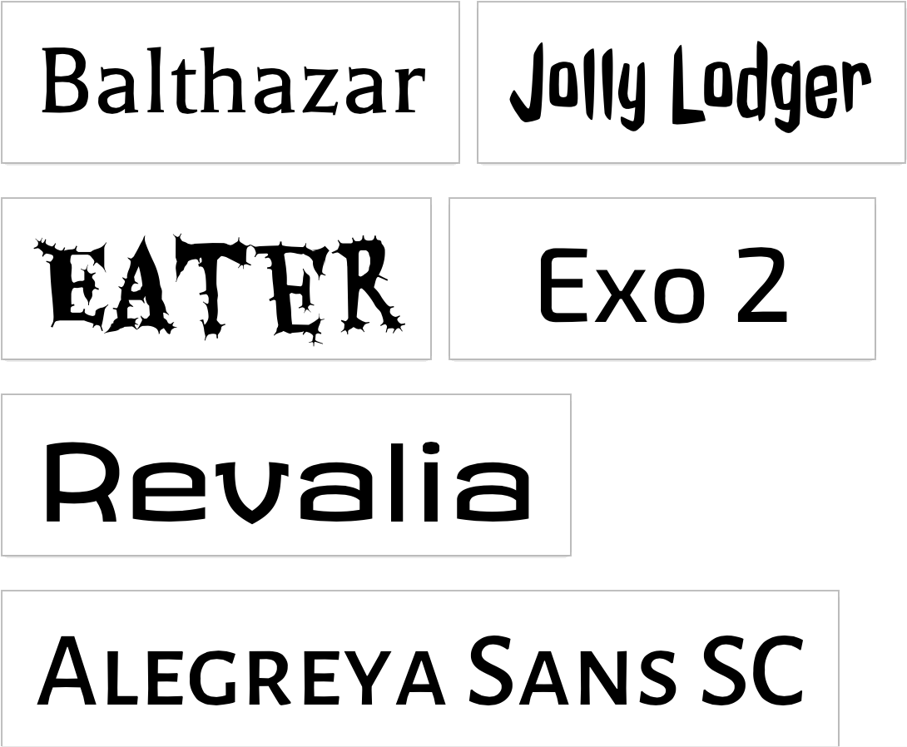
Text in Photoshop
Types of text
  Pont vs. paragraph text
  Text vs. image
Select fonts
  Web fonts: serif,
  sans-serif, monotype
  Custom fonts: see
  Google Fonts
  Download & install
Set text styles
  Select text
  Add new style
Set paragraph styles
Notes:
Image from http://www.google.com/fonts

Slide 7
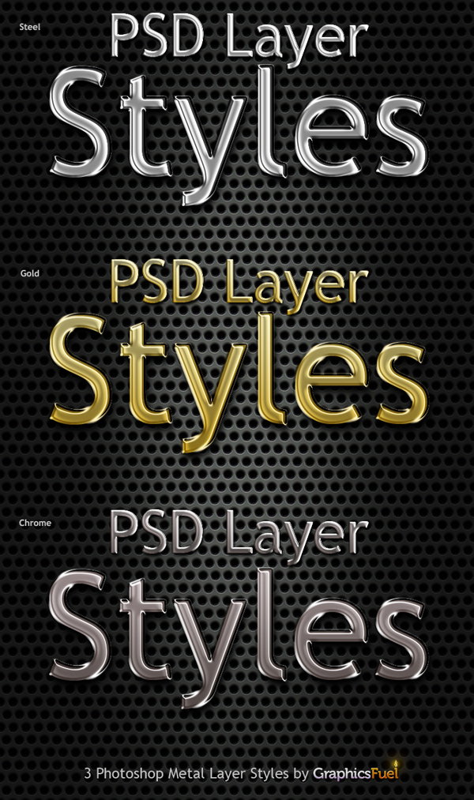
Layer Styles in Photoshop
Add effects
  Shadows, overlays, etc.
  Changing & hiding
Smart objects
  Right-click to create
  Need to save to accept
Fill/adjustment layers
  Affect layers below
Notes:
Image from http://www.graphicsfuel.com/2010/10/psd-metal-text-styles/

Slide 8
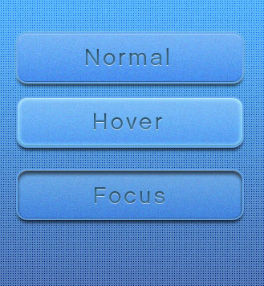
Add Interactive Element Placeholders
Form elements
  35 px high
Buttons
  25-35 px high
Image Sprites
  Use grid to layout
  Use adjustment layers for different states
Notes:
Image from http://slayerd1.deviantart.com/art/Sprite-Button-code-psd-255988851

Slide 9
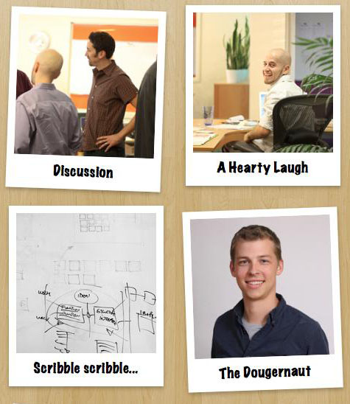
Add Media Placeholders
Add images
  Make Smart Objects for editing outside
  Multiple sizes for multiple devices
Add effects
  Simulate CSS
Add media placeholders
  Use posters, not video
  Overlay Play button
Notes:
Image from http://technotab.com/14-amazing-and-fresh-css3-effects-2012/

Slide 10
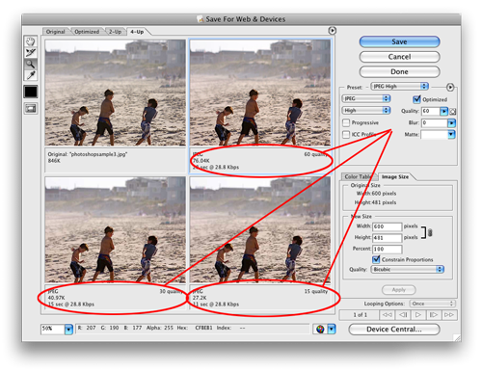
Save Web Graphics
Create slices
  Move guides around
  graphics to save out
  Outline with slice tool
  Name slices
Save for Web
  Use 4-up view to review various optimizations
  Balance quality & size in selecting settings
Notes:
NOTE: Careful about slicing up slices!
Image from http://technotab.com/14-amazing-and-fresh-css3-effects-2012/

