Slide 1
Saving Form Data
You can save form data in Google Spreadsheets using the following steps.
Create a Google Spreadsheet in your documents
Use Tools to Create a Form

Slide 2
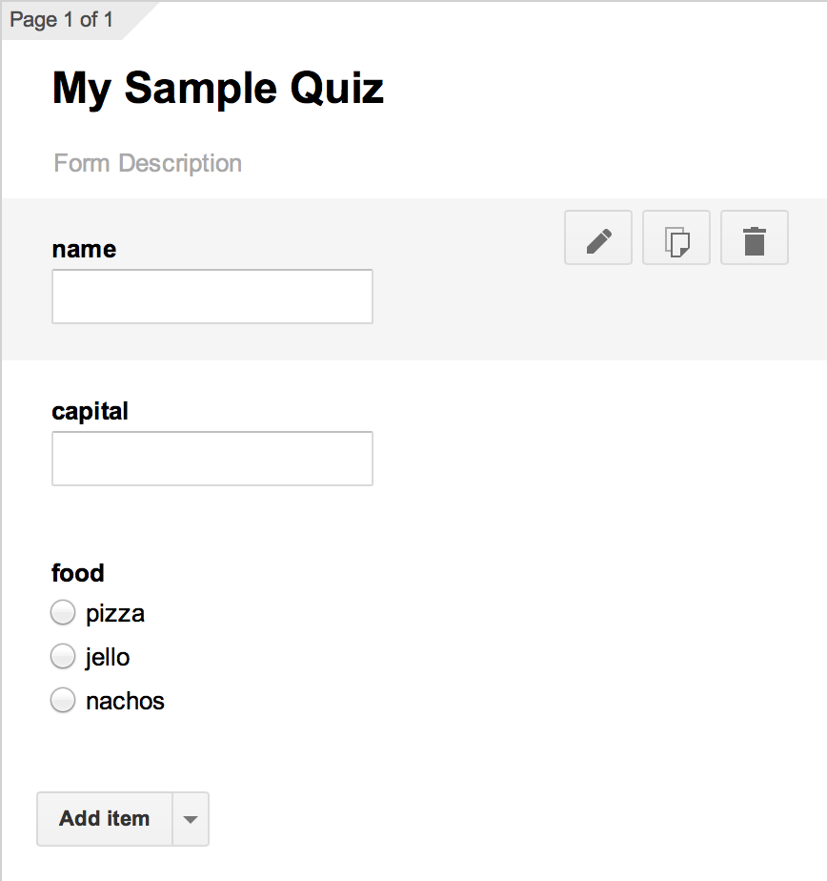
Create a Simple Form
In Google Forms, create a "question" for each of the
inputs you'll need.
Use simple labels
for the
"questions".

Slide 3
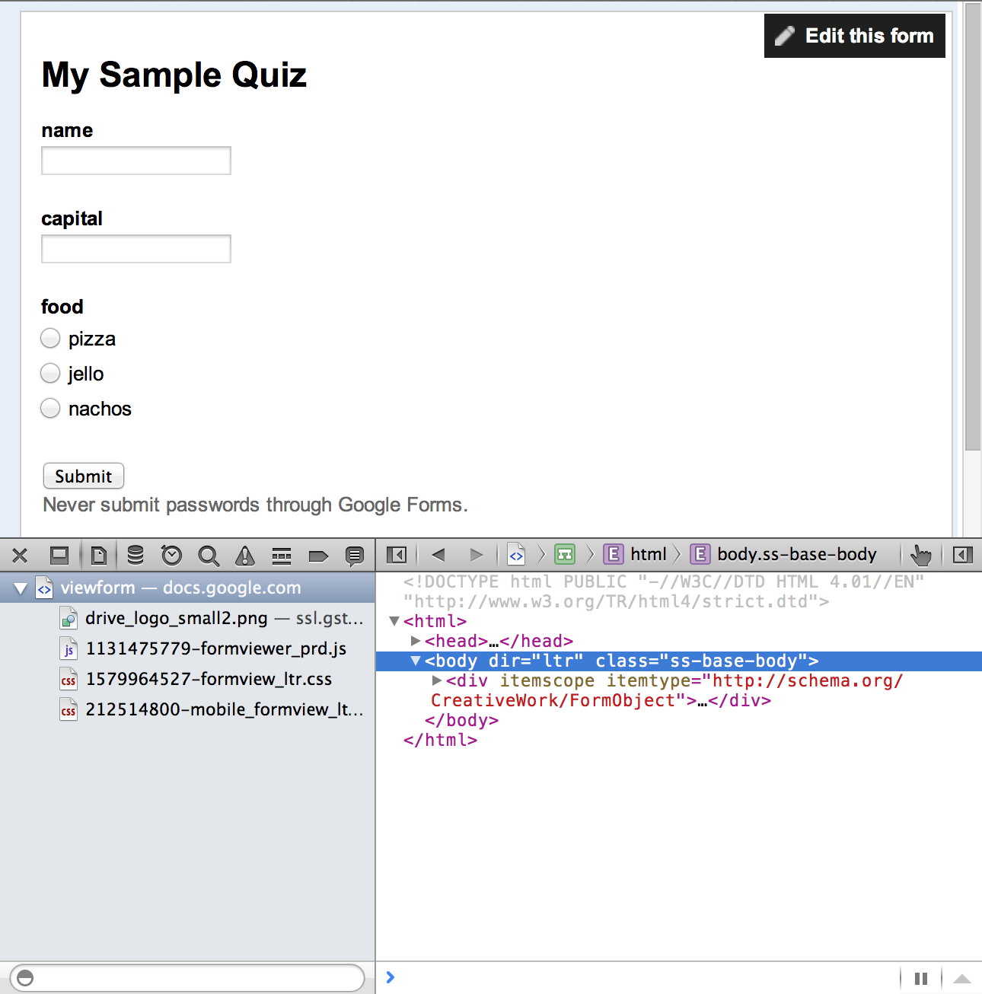
View the Form
Choose to View Live Form
In the browser,
choose
Develop ->
Show Web
Inspector

Slide 4
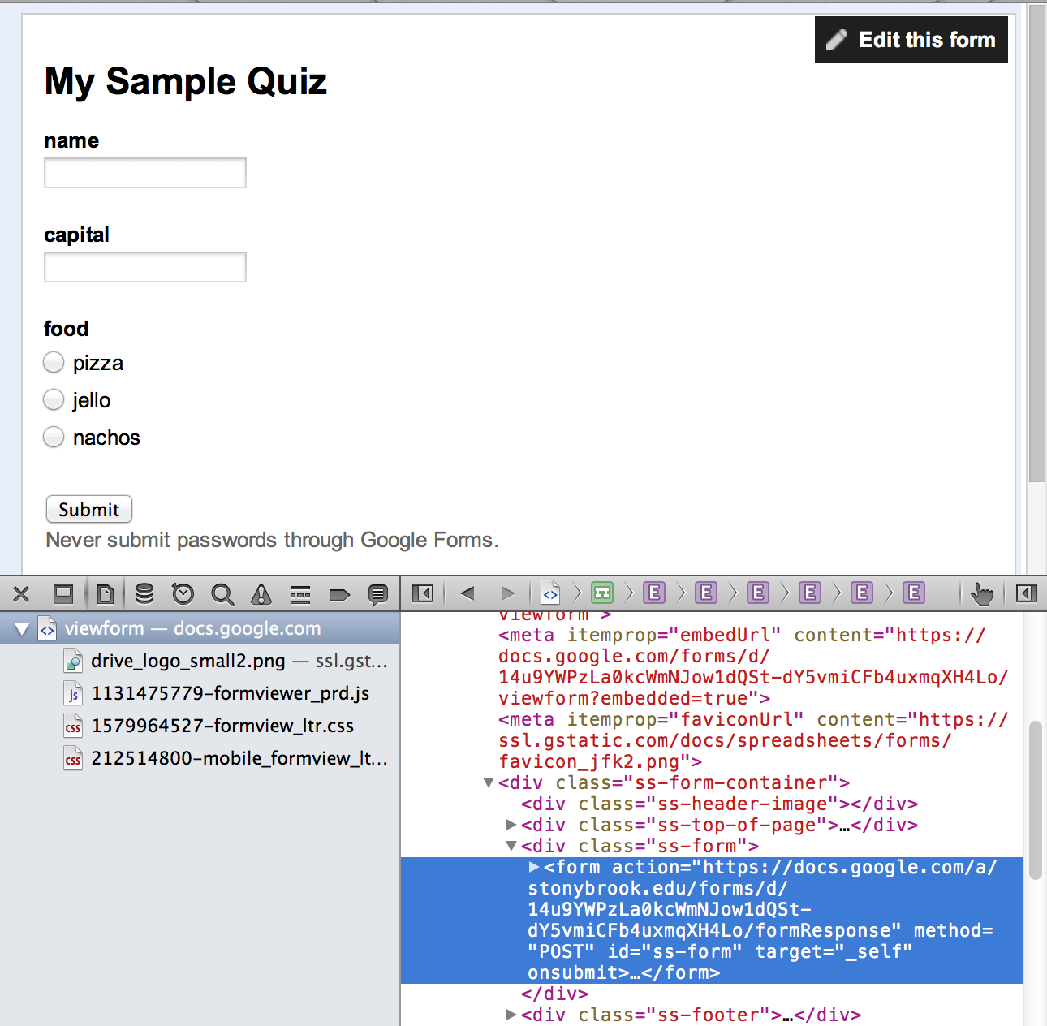
Copy the Code
Open up the body and find the form tag
Highlight the
form tag &
copy it
Paste the code
into a text
editor

Slide 5
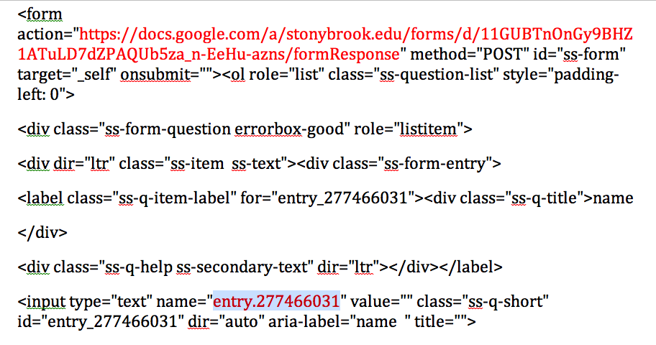
Find Names
Find the form action and name for each input in the form. You'll need these later.

Slide 6
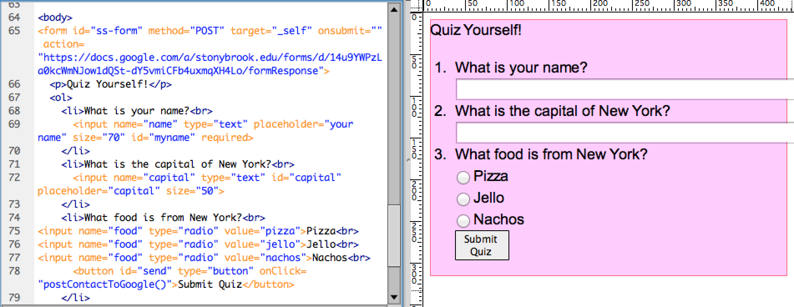
Create Custom Form
Create your own form in Dreamweaver.
Set the form action to the Google action.
Instead of a Submit input, create a Button. Set the action to "postContactToGoogle()"

Slide 7
Include JQuery
Include the JQuery library in your header:
<script
src="http://ajax.googleapis.com/ajax/libs/jquery/1.11.0/jquery.min.js">
</script>
Write the function in your header:
<script type="text/javascript">
function postContactToGoogle(){
}
</script>

Slide 8
Write "postContactToGoogle"
function postContactToGoogle(){
var name = $('#myname').val();
var capital = $('#capital').val();
var food = $('input[name=food]:checked', '#ss-form').val();
if (name !== "") {
$.ajax({ url: "https://docs.google.com/a/stonybrook.edu/forms/d/14u9YWPzLa0kcWmNJow1dQSt-dY5vmiCFb4uxmqXH4Lo/formResponse",
data: {"entry_1246722274" : name, "entry_2088117344" : capital, “entry_199895091” : food},
type: "POST",
dataType: "xml",
statusCode: {
0: function (){alert("Success 0!")},
200: function (){alert("Success 200!")}
}
});
} else { /*Error message*/ }
}
Notes:
NOTES:
URL sent to AJAX is the action from your Google Form
DATA sent to AJAX has the Google Form IDs for the entries

Slide 9
Notes on "postContactToGoogle"
Values of the inputs are read into variables, using JQuery
var name = $('#myname').val();
var capital = $('#capital').val();
Value of a radio selection can also be found using JQuery
var food = $('input[name=food]:checked', '#ss-form').val();
The URL sent to AJAX should be the same as the form action
url: "https://docs.google.com/a/stonybrook.edu/forms/d/14u9YWPzLa0kcWmNJow1dQSt-dY5vmiCFb4uxmqXH4Lo/formResponse"
The DATA sent to AJAX should use the name labels from the Google form, with ‘.’ replaced by ‘_’
data: {"entry_1246722274" : name, "entry_2088117344" : capital, “entry_199895091” : food}
Notes:
NOTES:
URL sent to AJAX is the action from your Google Form
DATA sent to AJAX has the Google Form IDs for the entries

