Slide 1
HTML5 Sections
Old structuring elements
  body, div, address, blockquote
  headings: h1, h2, h3, …
  ul, ol, table
New structuring elements
  header, footer, main, nav
  section, article, aside, figure
Labeling of elements
  id vs. class
WAI-ARIA
  Roles: application, banner, complimentary content-info, form, main, navigation, search
  States & properties: aria-checked, aria-haspopup, aria-describedby
Notes:
Web Accessibility Initiative's Accessible Rich Internet Applications
see http://www.w3.org/TR/wai-aria/
For elements list see https://developer.mozilla.org/en-US/docs/Web/Guide/HTML/HTML5/HTML5_element_list

Slide 2
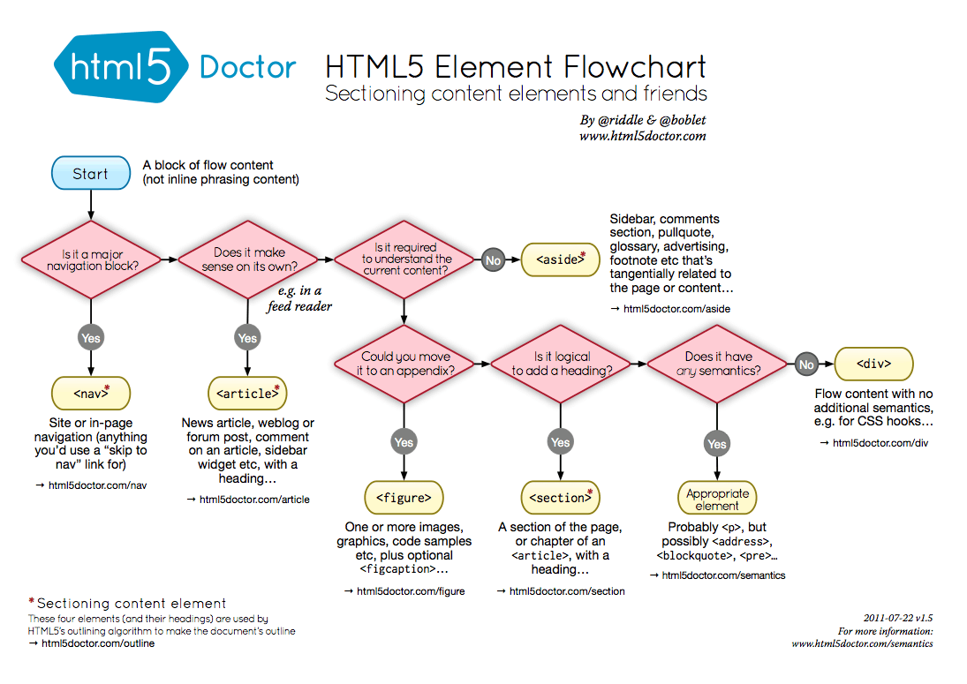
Sectioning Your Website
Notes:
Decide what sections go into your document
From html5doctor.com

Slide 3
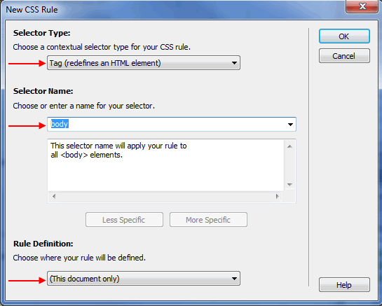
Setting Up Dreamweaver
Create a new Workspace
Create an HTML5 document
Add sections
Insert DIVs
Rename DIV ids
Notes:
To setup workspace:
Need folder devoted to your project; make that your workspace
New -> HTML, make sure it's HTML5
Sections: header, footer, main, nav
Use ids for special divs, classes for types of divs

Slide 4
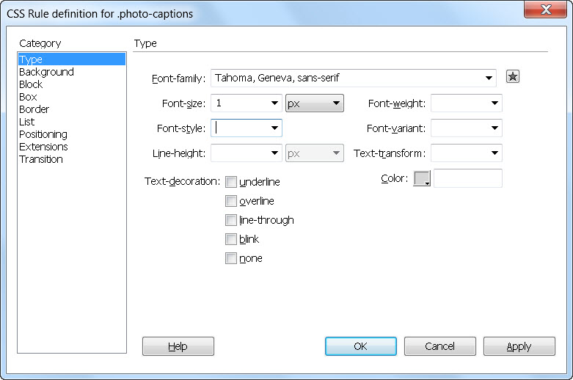
Dreamweaver CSS Styles
Type: font, size, style, weight, color
Background: color, image, repeating
Block: text spacings
Box: margins,
dimensions
Positioning
Border
List
Notes:
See http://reference.sitepoint.com/css/propertyref for more

