Slide 1
Wi-Gi -Wireless Gesture Input System
Under the guidance of: Prof. Raghavendra S
: Prof. Anil Kumar D
Student Members: Ashfaq Farooqui (1BY08EC011)
Charul Sampath (1BY08EC015)
Komal K Kubsad (1BY08EC024)
Suhail (1BY08EC052)

Slide 2
Aim: To design and implement a wireless device that will behave as an input system based on hand gestures and control sensors.

Slide 3
Applications
Human Interface System
Augmented Reality
Wireless Mobility

Slide 4
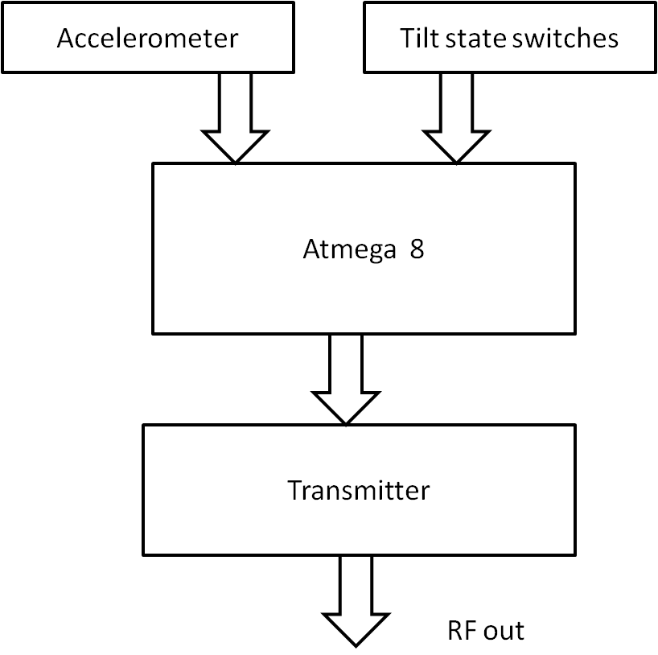
Block Diagram of “Wi-Gi”
Transmitter

Slide 5
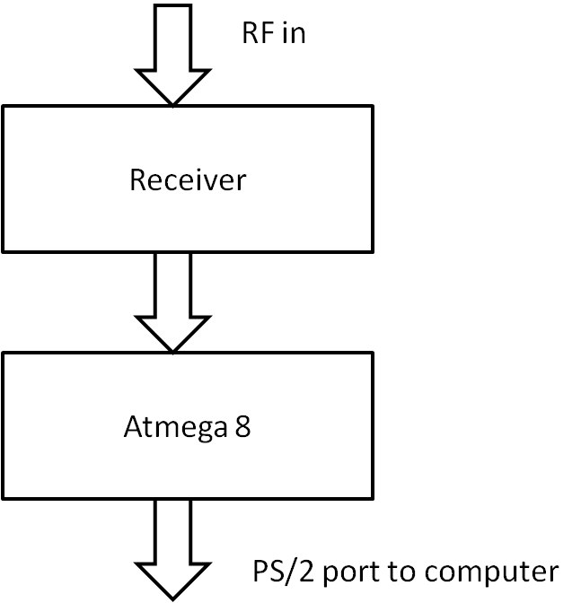
Receiver

Slide 6
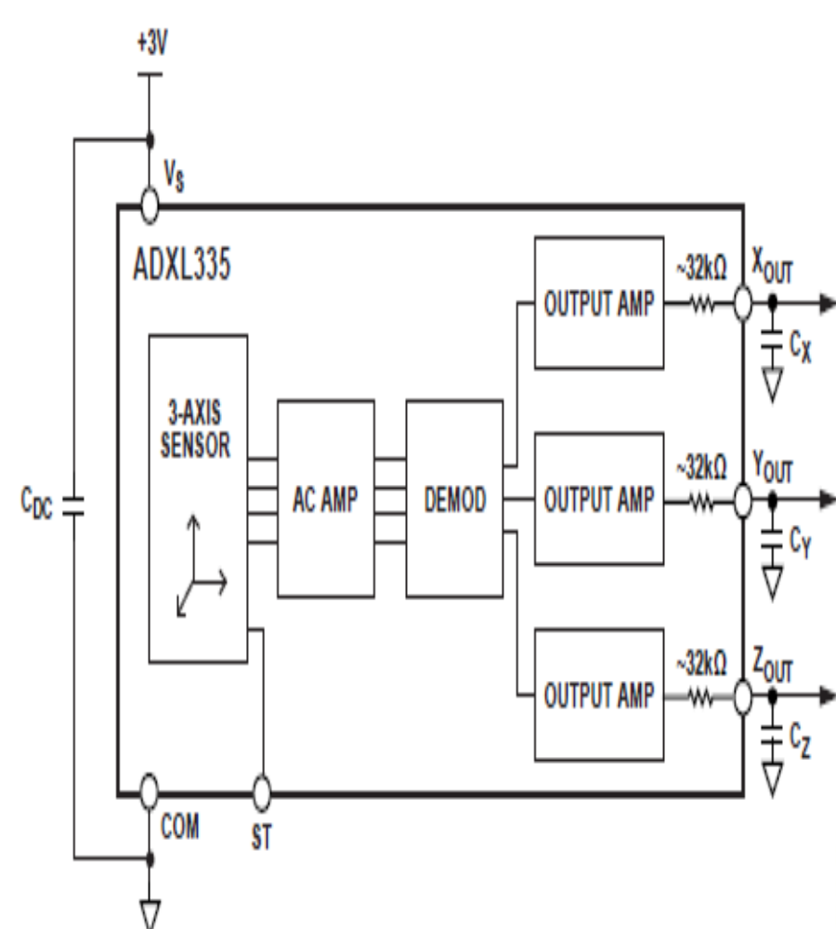
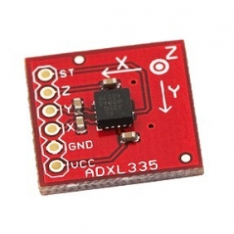
Accelerometer- ADXL335

Slide 7
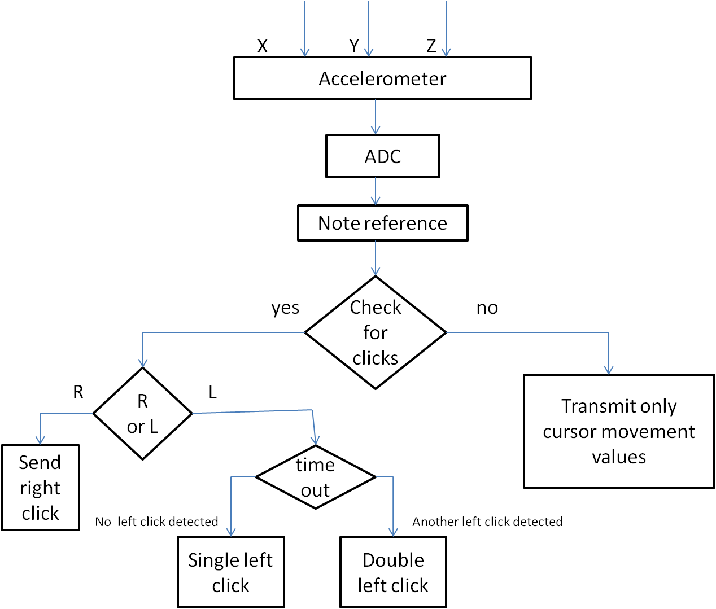

Slide 8
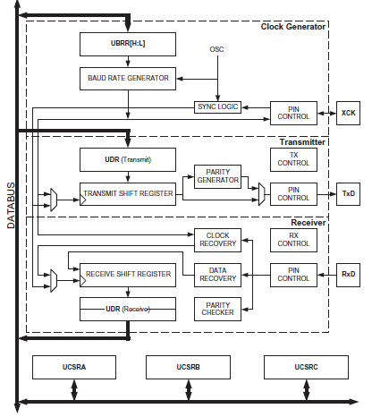
USART

Slide 9
USART Transmitter is enabled by setting the Transmit Enable (TXEN) bit in the UCSRB Register
The USART Receiver is enabled by writing the Receive Enable (RXEN) bit in the UCSRB Register to one
In Asynchronous mode (U2X=0),
USART Baud Rate = Fosc/16(UBRR+1)
One start bit and 2 stop bits are used

Slide 10
USART Algorithm
Start
Wait for previous transmission to complete
complete
Load UDR with data to be
Transmitted.
Return

Slide 11
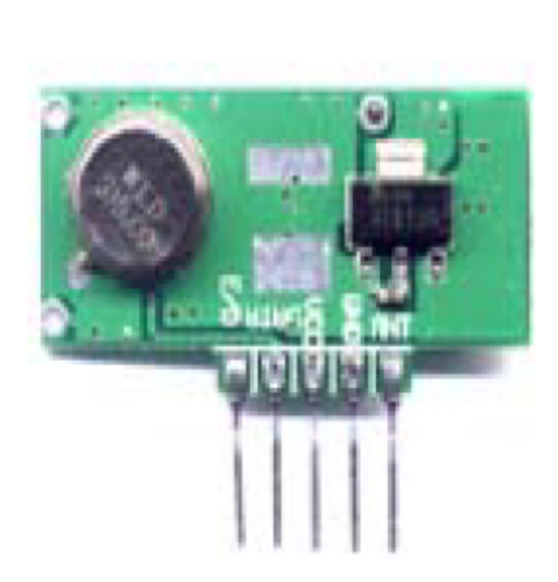
RF Module
    TLP434A and RLP434A
• Frequency : 433.92 MHZ
• Modulation: ASK
• Circuit Shape: SAW
• Date Rate: 8K bps
• Supply Voltage: +5V
• Power Supply range for I/O pins: 0 to 5 V
• Non-Operating Case Temperature: -20 to +85 C
• Soldering Temperature ( 10 Seconds ) : 230 C

Slide 12

6-pin Mini-DIN (PS/2)
1 - Data
2 - Not Implemented
3 - Ground
4 - Vcc (+5V)
5 - Clock
6 - Not Implemented
Power Specifications
Vcc = +4.5V to +5.5V.
Max Current = 275 mA.

Slide 13
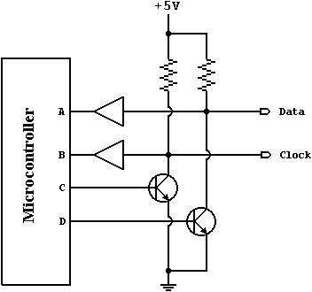
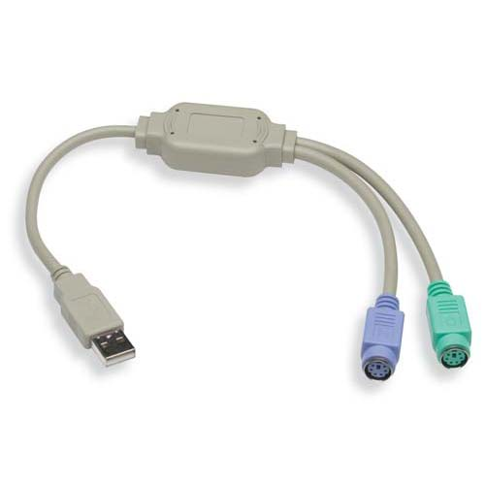
Ps2 Mouse-Keyboard Protocol
.

Slide 14
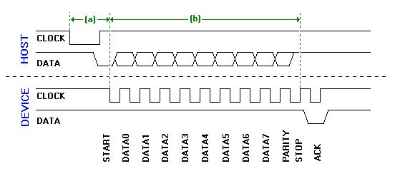
The ps2 connector enables efficient interfacing between the keyboard and mouse.

Slide 15
Scope for Future Work
Keyboard In-sync
Entertainment
Artificial Intelligence
Elderly Users and Wi-Gi

Slide 16
Limitations
Calibration of accelerometer is difficult.
Is always on and thus the power consumption is high
Transmitter runs on amateur band frequency and hence can easily be affected by other devices working on the same frequency.

Slide 17
THANK YOU

