Slide 1
Lecture 10
Function

Slide 2
Topics
Invertibility and Inverse Functions
Function Compositions

Slide 3
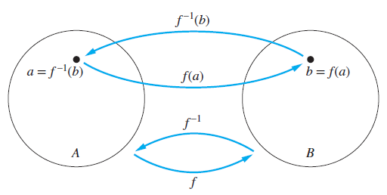
Inverse Functions and Compositions of Functions
Let f be a one-to-one correspondence from the set A to the set B. The inverse function of f is the function that assigns to an element b belonging to B to the unique element a in A such that f(a) = b. The inverse function of f is denoted by f ⁻¹. Hence, f ⁻¹(b) = a when f(a) = b.
Fig : The function f ⁻¹ is the inverse function of f

Slide 4
Inverse Functions and Compositions of Functions
A one-to-one correspondence is called invertible because we can define an inverse of this function. A function is not invertible if it is not a one-to-one correspondence, because the inverse of such a function does not exist.
EXAMPLE: Let f be the function from {a, b, c} to {1, 2, 3} such that f(a) = 2, f(b) = 3, and f(c) = 1. Is f invertible, and if it is, what is its inverse?
SOLUTION: The function f is invertible because it is a one-to-one correspondence. The inverse function f ⁻¹ reverses the correspondence given by f , so f ⁻¹(1) = c, f ⁻¹(2) = a, and f ⁻¹(3) = b.

Slide 5
Examples
EXAMPLE: Let f be the function from R to R with f(x) = x². Is f invertible?
SOLUTION: Because f(−2) = f(2) = 4, f is not one-to-one. If an inverse function were defined, it would have to assign two elements to 4. Hence, f is not invertible. (Note we can also show that f is not invertible because it is not onto.)

Slide 6
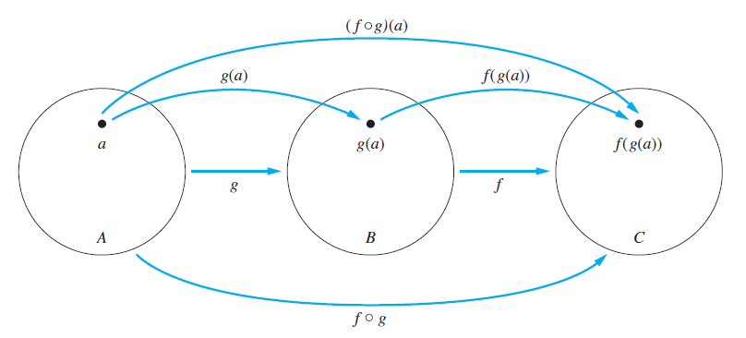
Compositions of Functions
Let g be a function from the set A to the set B and let f be a function from the set B to the set C. The composition of the functions f and g, denoted for all a ∈ A by f◦g, is the function from A to C defined by (f◦g)(a) = f(g(a)).
Fig : The composition of the functions f and g

Slide 7
Examples
EXAMPLE: Let g be the function from the set {a, b, c} to itself such that g(a) = b, g(b) = c, and g(c) = a. Let f be the function from the set {a, b, c} to the set {1, 2, 3} such that f(a) = 3, f(b) = 2, and f(c) = 1. What is the composition of f and g, and what is the composition of g and f ?
SOLUTION: The composition f◦g is defined by (f◦g)(a) = f(g(a)) = f(b) = 2, (f◦g) (b) = f(g(b)) = f(c) = 1, and (f◦g)(c) = f(g(c)) = f(a) = 3.
Note that g◦f is not defined, because the range of f is not a subset of the domain of g.

Slide 8
Examples
EXAMPLE: Let f and g be the functions defined by f : R → R⁺∪ {0} with f(x) = x² and g : R⁺∪ {0} → R with g(x) = √x (where √x is the nonnegative square root of x). What is the function (f◦g)(x)?
SOLUTION: The domain of (f◦g)(x) = f(g(x)) is the domain of g, which is R⁺∪ {0}, the set of nonnegative real numbers. If x is a nonnegative real number, we have (f◦g)(x) = f(g(x)) = f(√x) = (√x)² = x. The range of f◦g is the image of the range of g with respect to the function f. This is the set R⁺∪ {0}, the set of nonnegative real numbers. Summarizing, f : R⁺∪ {0} → R⁺∪ {0} and f(g(x)) = x for all x.

Slide 9
Explanation
When the composition of a function and its inverse is formed, in either order, an identity function is obtained. To see this, suppose that f is a one-to-one correspondence from the set A to the set B. Then the inverse function f ⁻¹ exists and is a one-to-one correspondence from B to A. The inverse function reverses the correspondence of the original function, so f ⁻¹(b) = a when f(a) = b, and f(a) = b when f ⁻¹(b) = a. Hence, (f ⁻¹◦f)(a) = f ⁻¹(f(a)) = f ⁻¹ (b) = a, and (f◦f ⁻¹)(b) = f( f ⁻¹(b)) = f(a) = b. Consequently f ⁻¹◦f = I_{A} and f ◦f ⁻¹ = I_{B}, where I_{A} and I_{B} are the identity functions on the sets A and B, respectively. That is, (f ⁻¹)⁻¹ = f .

Slide 10
Some Important Functions
The floor function assigns to the real number x the largest integer that is less than or equal to x. The value of the floor function at x is denoted by ⌊x⌋.
The ceiling function assigns to the real number x the smallest integer that is greater than or equal to x. The value of the ceiling function at x is denoted by ⌈x⌉.

Slide 11
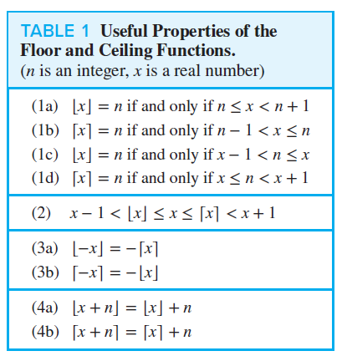

Slide 12
Examples
EXAMPLE: Prove that if x is a real number, then ⌊2x⌋ = ⌊x⌋ + ⌊x + 1⁄2⌋.
SOLUTION: To prove this statement we let x = n + 𝜖, where n is an integer and 0 ≤ 𝜖 < 1. There Examples are two cases to consider, depending on whether 𝜖 is less than, or greater than or equal to 1⁄2 . (The reason we choose these two cases will be made clear in the proof.)
We first consider the case when 0 ≤ 𝜖 < 1⁄2 . In this case, 2x = 2n + 2𝜖 and ⌊2x⌋ = 2n because 0 ≤ 2𝜖 < 1. Similarly, x + 1⁄2 = n + ( 1⁄2 + 𝜖), so ⌊x + 1⁄2 ⌋ = n, because 0 < 1⁄2 + 𝜖 < 1. Consequently, ⌊2x⌋ = 2n and ⌊x⌋ + ⌊x + 1⁄2 ⌋ = n + n = 2n.

Slide 13
Examples
Next, we consider the case when 1⁄2 ≤ 𝜖 < 1. In this case, 2x = 2n + 2𝜖 = (2n + 1) + (2𝜖 − 1). Because 0 ≤ 2𝜖 − 1 < 1, it follows that ⌊2x⌋ = 2n + 1. Because ⌊x + 1⁄2⌋ = ⌊n + ( 1⁄2 + 𝜖)⌋ = ⌊n + 1 + (𝜖 − 1⁄2 )⌋ and 0 ≤ 𝜖 − 1⁄2 < 1, it follows that ⌊x + 1⁄2⌋ = n + 1. Consequently, ⌊2x⌋ = 2n + 1 and ⌊x⌋ + ⌊x + 1⁄2⌋ = n + (n + 1) = 2n + 1. This concludes the proof.

Slide 14
Thank You

