Slide 1
Lecture 14
Topics:
Divisibility
Modular Arithmetic
Congruence Relation

Slide 2
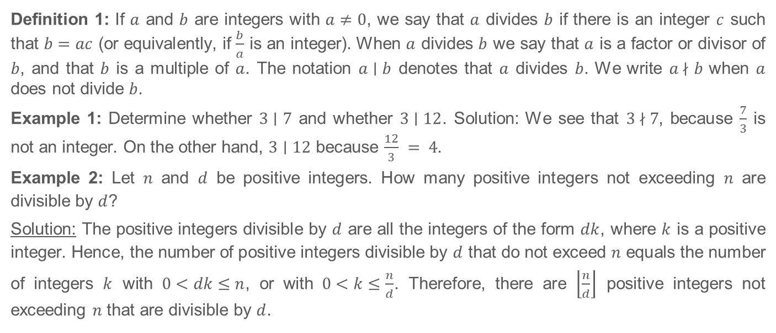
4.1 Divisibility and Modular Arithmetic
Definition 1: If $a$ and $b$ are integers with $a≠0$, we say that $a$ divides $b$ if there is an integer $c$ such that $b=ac$ (or equivalently, if $\frac{b}{a}$ is an integer). When $a$ divides $b$ we say that $a$ is a factor or divisor of $b$, and that $b$ is a multiple of $a$. The notation $a∣b$ denotes that $a$ divides $b$. We write $a \text{∤} b$ when $a$ does not divide $b$.
Example 1: Determine whether $3∣7$ and whether $3∣12$. Solution: We see that $3 \text{∤} 7$, because $\frac{7}{3}$ is not an integer. On the other hand, $3∣12$ because $\frac{12}{3} = 4$.
Example 2: Let $n$ and $d$ be positive integers. How many positive integers not exceeding $n$ are divisible by $d$?
Solution: The positive integers divisible by $d$ are all the integers of the form $dk$, where $k$ is a positive integer. Hence, the number of positive integers divisible by $d$ that do not exceed $n$ equals the number of integers $k$ with $0<dk≤n$, or with $0<k≤\frac{n}{d}$. Therefore, there are $\left\lfloor \frac{n}{d}\right\rfloor$ positive integers not exceeding $n$ that are divisible by $d$.

Slide 3
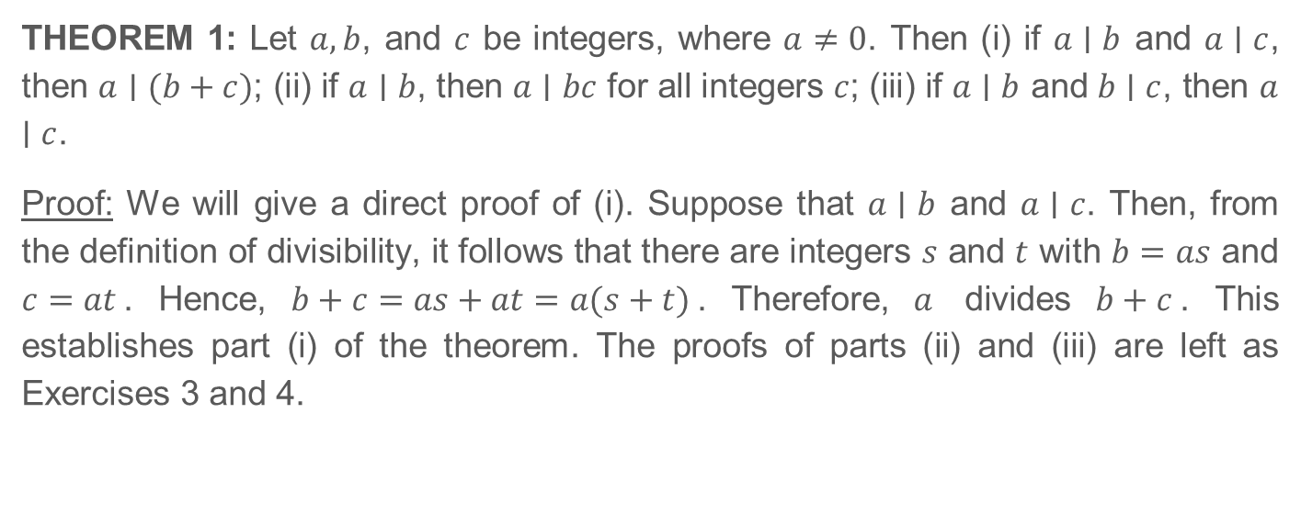
4.1 Divisibility and Modular Arithmetic (Continued)
THEOREM 1: Let $a,b$, and $c$ be integers, where $a≠0$. Then (i) if $a∣b$ and $a∣c$, then $a∣(b+c)$; (ii) if $a∣b$, then $a∣bc$ for all integers $c$; (iii) if $a∣b$ and $b∣c$, then $a∣c$.
Proof: We will give a direct proof of (i). Suppose that $a∣b$ and $a∣c$. Then, from the definition of divisibility, it follows that there are integers $s$ and $t$ with $b=as$ and $c=at$. Hence, $b+c=as+at=a(s+t)$. Therefore, $a$ divides $b+c$. This establishes part (i) of the theorem. The proofs of parts (ii) and (iii) are left as Exercises 3 and 4.

Slide 4
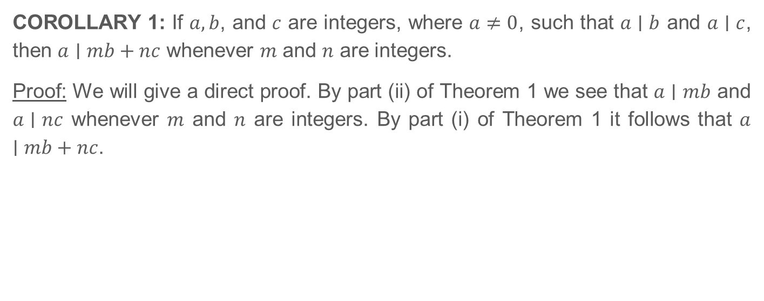
4.1 Divisibility and Modular Arithmetic (Continued)
COROLLARY 1: If $a, b$, and $c$ are integers, where $a≠0$, such that $a∣b$ and $a∣c$, then $a∣mb+nc$ whenever $m$ and $n$ are integers.
Proof: We will give a direct proof. By part (ii) of Theorem 1 we see that $a∣mb$ and $a∣nc$ whenever $m$ and $n$ are integers. By part (i) of Theorem 1 it follows that $a∣mb+nc$.

Slide 5
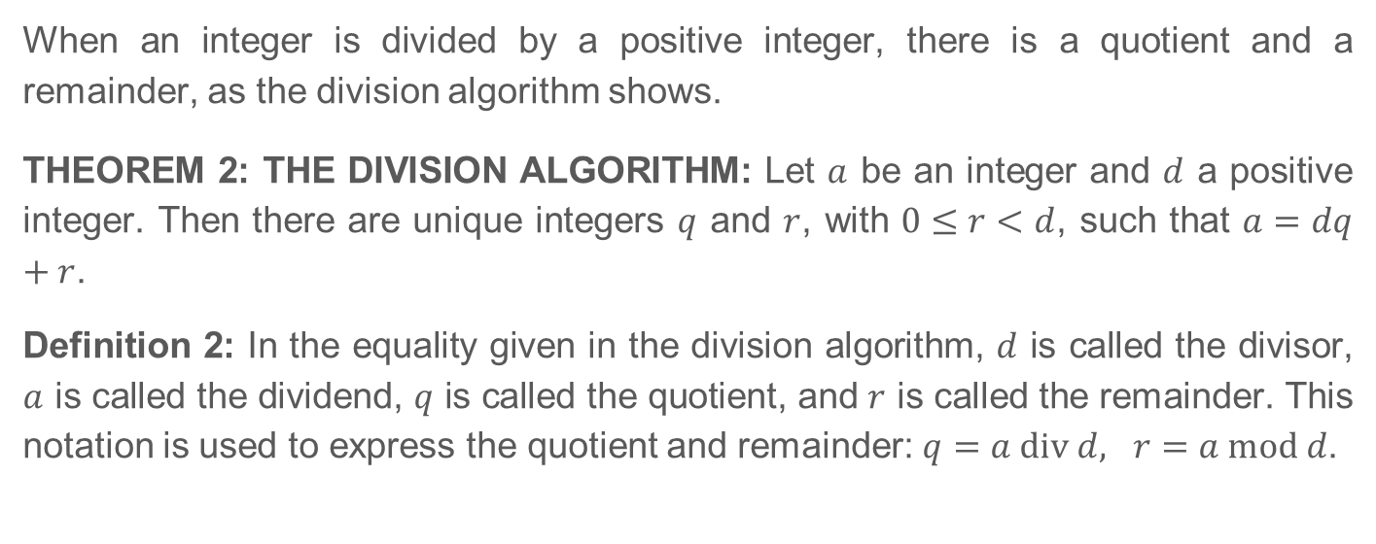
4.1.3 The Division Algorithm
When an integer is divided by a positive integer, there is a quotient and a remainder, as the division algorithm shows.
THEOREM 2: THE DIVISION ALGORITHM: Let $a$ be an integer and $d$ a positive integer. Then there are unique integers $q$ and $r$, with $0≤r<d$, such that $a=dq+r$.
Definition 2: In the equality given in the division algorithm, $d$ is called the divisor, $a$ is called the dividend, $q$ is called the quotient, and $r$ is called the remainder. This notation is used to express the quotient and remainder: $q=a div d, r=a mod d$.

Slide 6
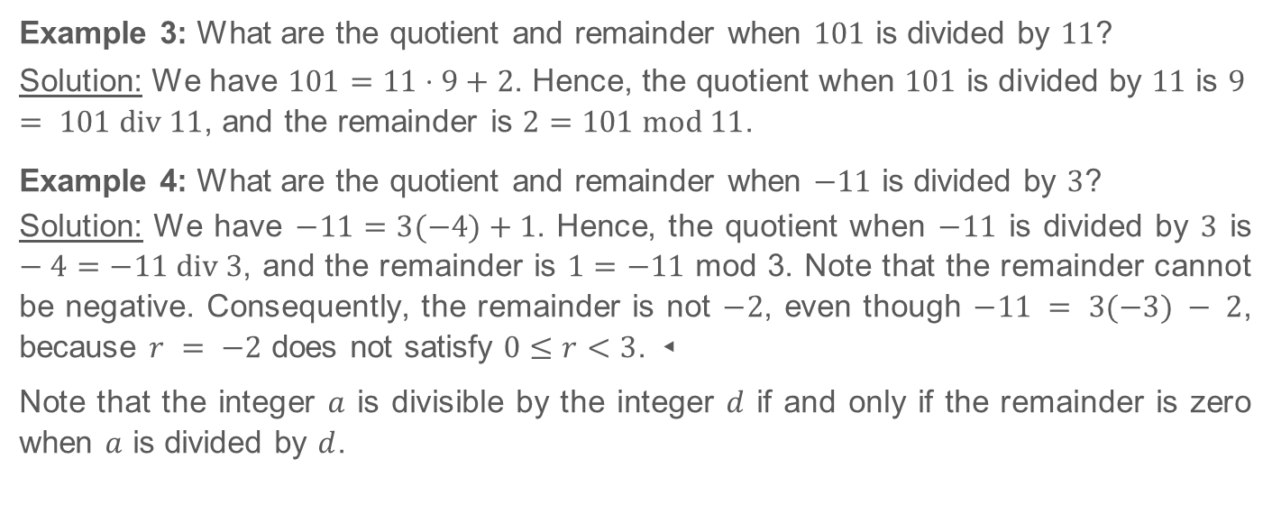
4.1.3 The Division Algorithm (Continued)
Example 3: What are the quotient and remainder when $101$ is divided by $11$?
Solution: We have $101=11⋅9+2$. Hence, the quotient when $101$ is divided by $11$ is $9 = 101 div 11$, and the remainder is $2=101 mod 11$.
Example 4: What are the quotient and remainder when $−11$ is divided by $3$?
Solution: We have $−11=3(−4)+1$. Hence, the quotient when $−11$ is divided by $3$ is $−4=−11 div 3$, and the remainder is $1=−11$ mod 3. Note that the remainder cannot be negative. Consequently, the remainder is not $−2$, even though $−11 = 3(−3) − 2$, because $r = −2$ does not satisfy $0≤r<3$. ◂
Note that the integer $a$ is divisible by the integer $d$ if and only if the remainder is zero when $a$ is divided by $d$.

Slide 7
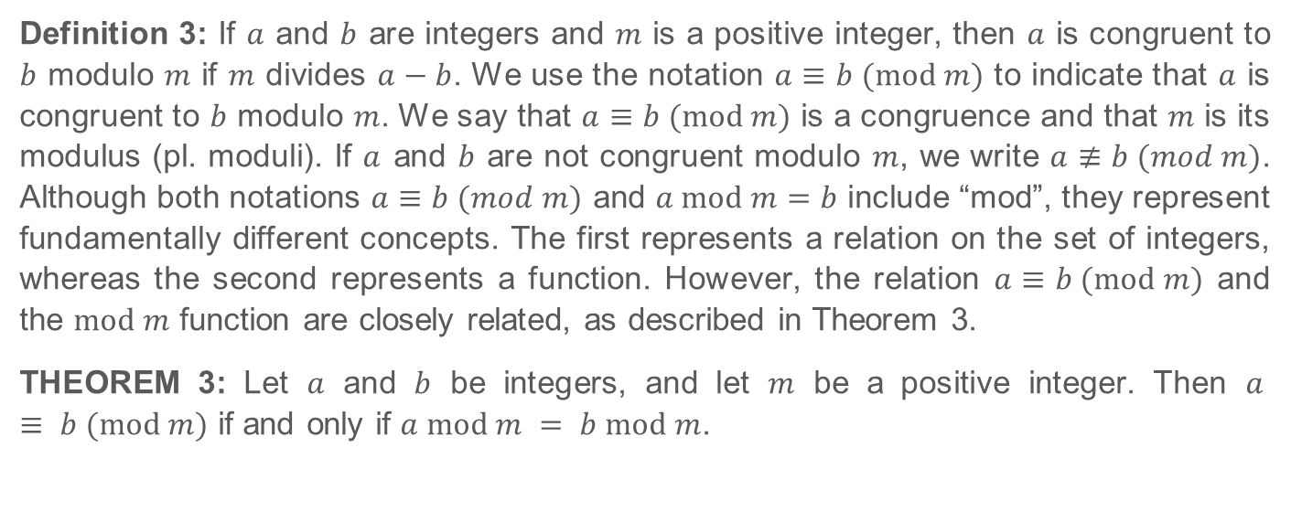
4.1.4 Modular Arithmetic
Definition 3: If $a$ and $b$ are integers and $m$ is a positive integer, then $a$ is congruent to $b$ modulo $m$ if $m$ divides $a−b$. We use the notation $a≡b (mod m)$ to indicate that $a$ is congruent to $b$ modulo $m$. We say that $a≡b (mod m)$ is a congruence and that $m$ is its modulus (pl. moduli). If $a$ and $b$ are not congruent modulo $m$, we write $a≢b (mod m)$. Although both notations $a≡b (mod m)$ and $a mod m=b$ include “mod”, they represent fundamentally different concepts. The first represents a relation on the set of integers, whereas the second represents a function. However, the relation $a≡b (mod m)$ and the $mod m$ function are closely related, as described in Theorem 3.
THEOREM 3: Let $a$ and $b$ be integers, and let $m$ be a positive integer. Then $a ≡ b (mod m)$ if and only if $a mod m = b mod m$.

Slide 8
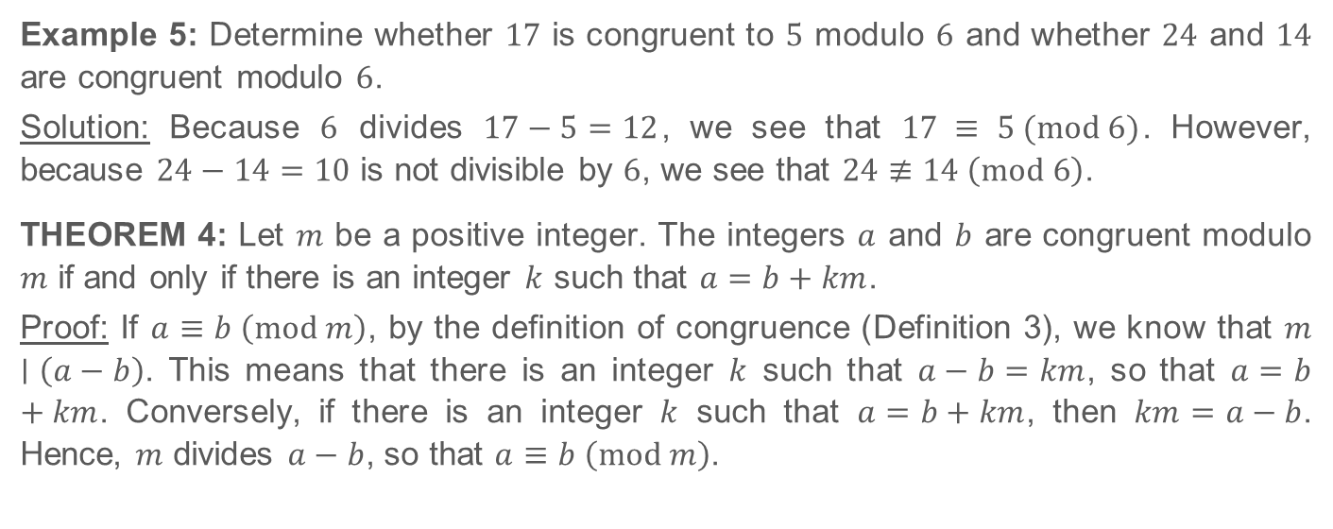
4.1.4 Modular Arithmetic (Continued)
Example 5: Determine whether $17$ is congruent to $5$ modulo $6$ and whether $24$ and $14$ are congruent modulo $6$.
Solution: Because $6$ divides $17−5=12$, we see that $17 ≡ 5 (mod 6)$. However, because $24−14=10$ is not divisible by $6$, we see that $24≢14 \left(mod 6\right)$.
THEOREM 4: Let $m$ be a positive integer. The integers $a$ and $b$ are congruent modulo $m$ if and only if there is an integer $k$ such that $a=b+km$.
Proof: If $a≡b \left(mod m\right)$, by the definition of congruence (Definition 3), we know that $m∣\left(a−b\right)$. This means that there is an integer $k$ such that $a−b=km$, so that $a=b+km$. Conversely, if there is an integer $k$ such that $a=b+km$, then $km=a−b$. Hence, $m$ divides $a−b$, so that $a≡b \left(mod m\right)$.

Slide 9
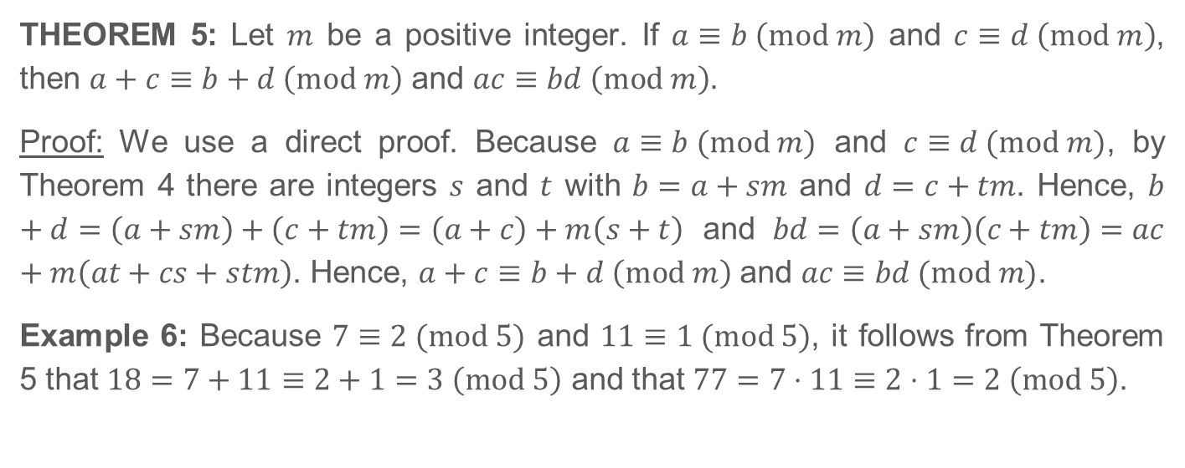
4.1.4 Modular Arithmetic (Continued)
THEOREM 5: Let $m$ be a positive integer. If $a≡b \left(mod m\right)$ and $c≡d \left(mod m\right)$, then $a+c≡b+d \left(mod m\right)$ and $ac≡bd \left(mod m\right)$.
Proof: We use a direct proof. Because $a≡b (mod m)$ and $c≡d (mod m)$, by Theorem 4 there are integers $s$ and $t$ with $b=a+sm$ and $d=c+tm$. Hence, $b+d=\left(a+sm\right)+\left(c+tm\right)=\left(a+c\right)+m\left(s+t\right)$ and $bd=\left(a+sm\right)\left(c+tm\right)=ac+m\left(at+cs+stm\right)$. Hence, $a+c≡b+d \left(mod m\right)$ and $ac≡bd (mod m)$.
Example 6: Because $7≡2 (mod 5)$ and $11≡1 (mod 5)$, it follows from Theorem 5 that $18=7+11≡2+1=3 \left(mod 5\right)$ and that $77=7⋅11≡2⋅1=2 \left(mod 5\right)$.

Slide 10
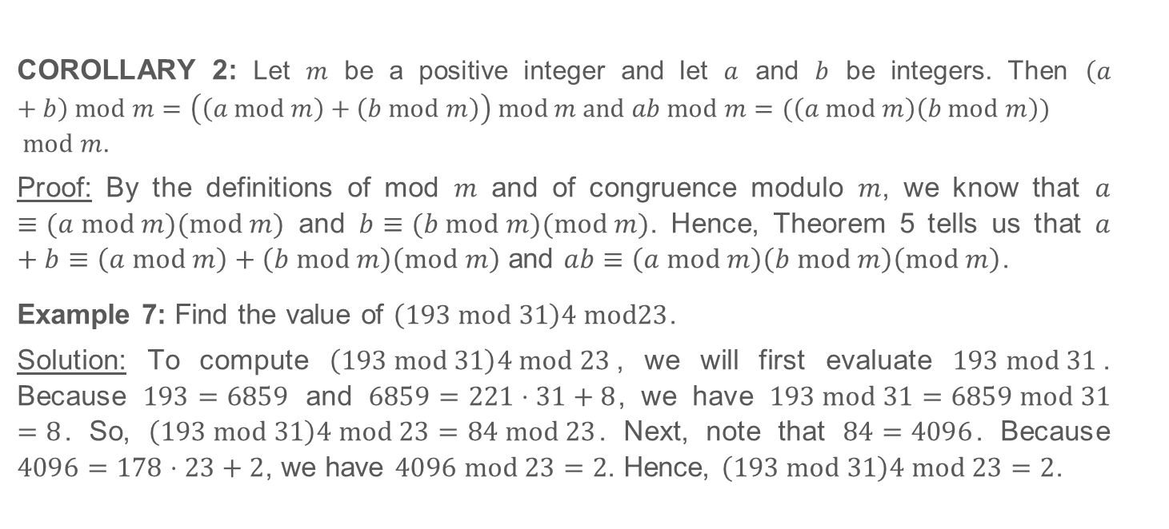
4.1.4 Modular Arithmetic (Continued)
COROLLARY 2: Let $m$ be a positive integer and let $a$ and $b$ be integers. Then $\left(a+b\right) mod m=\left(\left(a mod m\right)+\left(b mod m\right)\right) mod m and ab mod m=(\left(a mod m\right)\left(b mod m\right))$ $mod m$.
Proof: By the definitions of mod $m$ and of congruence modulo $m$, we know that $a≡(a mod m)(mod m)$ and $b≡(b mod m)(mod m)$. Hence, Theorem 5 tells us that $a+b≡\left(a mod m\right)+\left(b mod m\right)\left(mod m\right)$ and $ab≡\left(a mod m\right)\left(b mod m\right)\left(mod m\right)$.
Example 7: Find the value of $\left(193 mod 31\right)4 mod23$.
Solution: To compute $\left(193 mod 31\right)4 mod 23$, we will first evaluate $193 mod 31$. Because $193=6859$ and $6859=221⋅31+8$, we have $193 mod 31=6859 mod 31=8$. So, $\left(193 mod 31\right)4 mod 23=84 mod 23$. Next, note that $84=4096$. Because $4096=178⋅23+2$, we have $4096 mod 23=2$. Hence, $\left(193 mod 31\right)4 mod 23=2$.

Slide 11
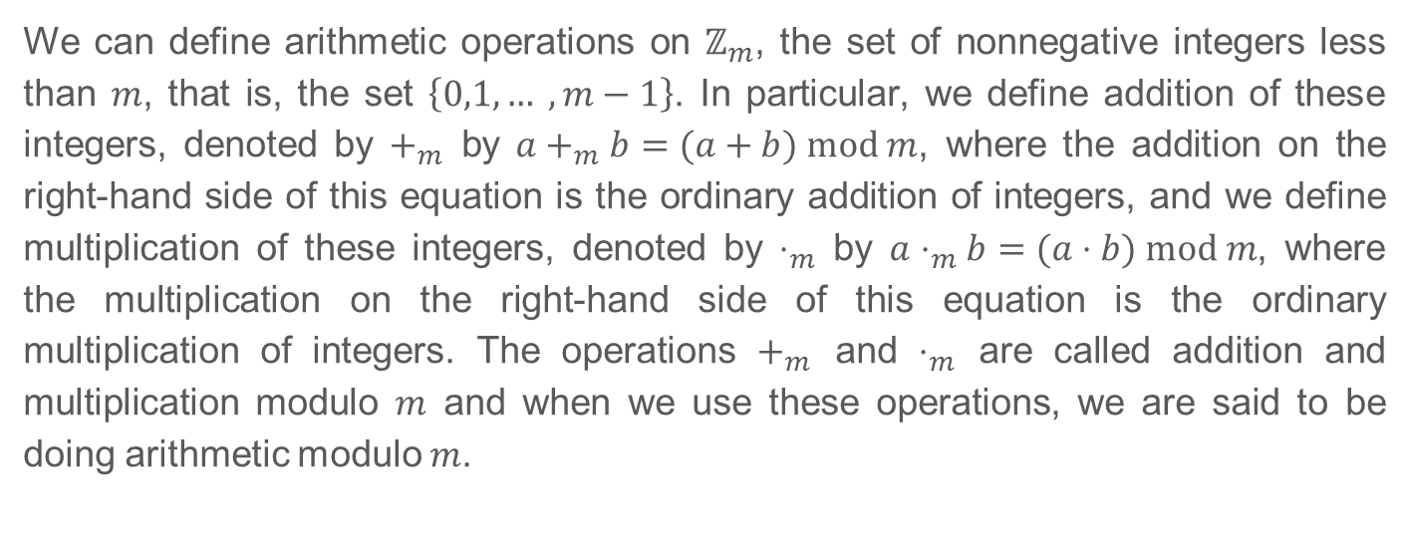
4.1.5 Arithmetic Modulo m
We can define arithmetic operations on $ℤ_{m}$, the set of nonnegative integers less than $m$, that is, the set $\left\{0,1, … ,m−1\right\}$. In particular, we define addition of these integers, denoted by $+_{m}$ by $a+_{m}b=(a+b) mod m$, where the addition on the right-hand side of this equation is the ordinary addition of integers, and we define multiplication of these integers, denoted by $⋅_{m}$ by $a⋅_{m}b=(a⋅b) mod m$, where the multiplication on the right-hand side of this equation is the ordinary multiplication of integers. The operations $+_{m}$ and $⋅_{m}$ are called addition and multiplication modulo $m$ and when we use these operations, we are said to be doing arithmetic modulo $m$.

Slide 12
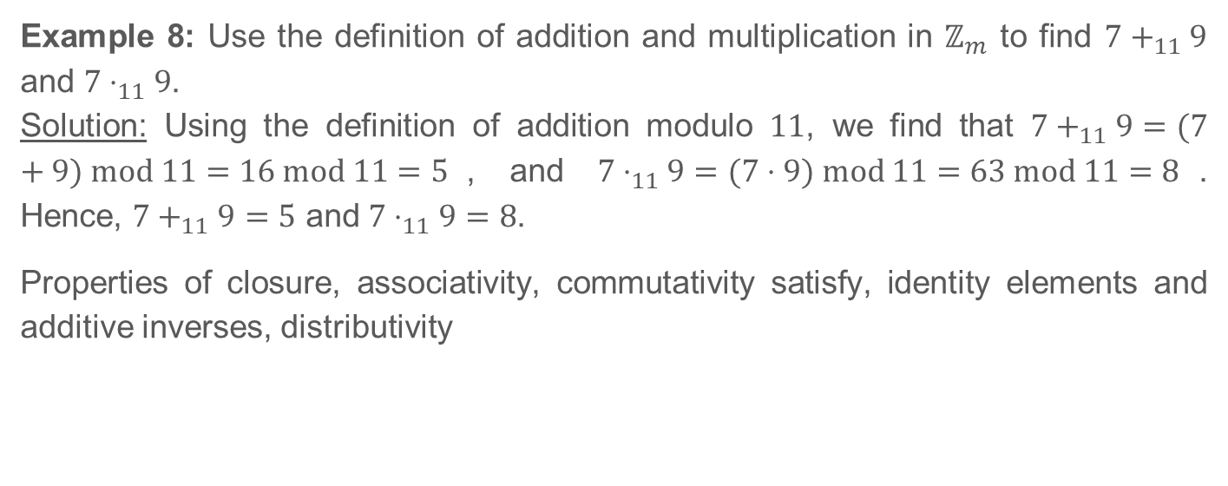
4.1.5 Arithmetic Modulo m (Continued)
Example 8: Use the definition of addition and multiplication in $ℤ_{m}$ to find $7+_{11}9$ and $7⋅_{11}9$.
Solution: Using the definition of addition modulo $11$, we find that $7+_{11}9=(7+9) mod 11=16 mod 11=5$, and $7⋅_{11}9=(7⋅9) mod 11=63 mod 11=8$. Hence, $7+_{11}9=5$ and $7⋅_{11}9=8$.
Properties of closure, associativity, commutativity satisfy, identity elements and additive inverses, distributivity

