Slide 1
Lecture 15
Topics:
Logic of Integer Representation
Decimal and Hexadecimal Representations
Binary Representation
Binary Addition Algorithm
Binary Multiplication Algorithm

Slide 2
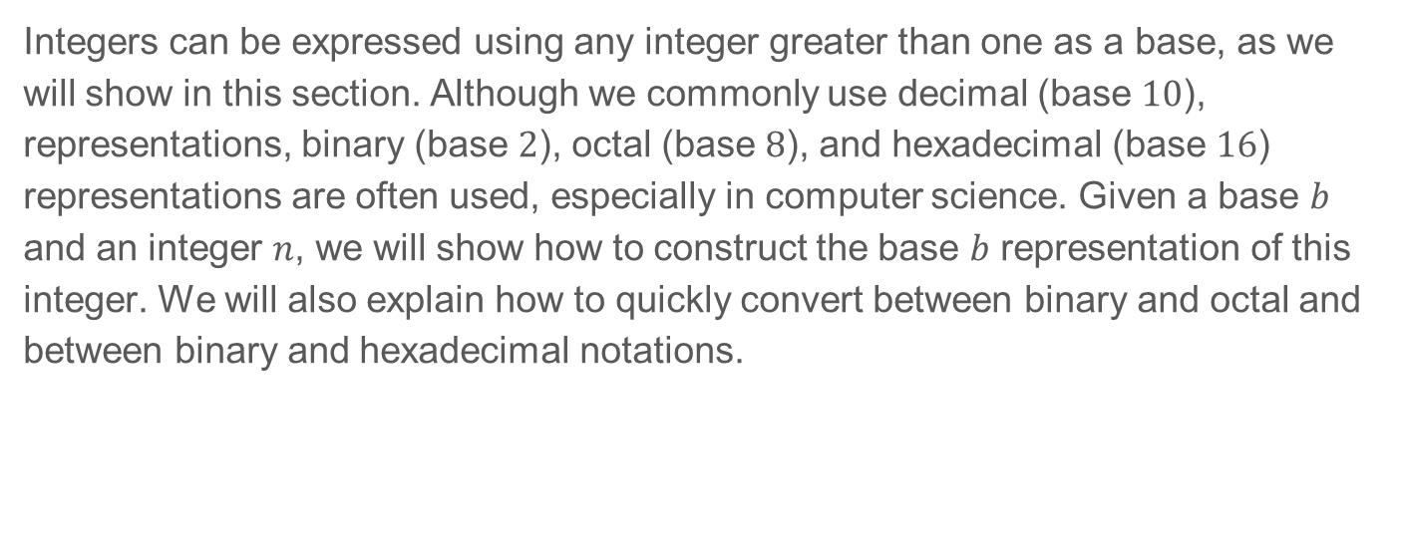
4.2 Integer Representations and Algorithms
Integers can be expressed using any integer greater than one as a base, as we will show in this section. Although we commonly use decimal (base $10$), representations, binary (base $2$), octal (base $8$), and hexadecimal (base $16$) representations are often used, especially in computer science. Given a base $b$ and an integer $n$, we will show how to construct the base $b$ representation of this integer. We will also explain how to quickly convert between binary and octal and between binary and hexadecimal notations.

Slide 3
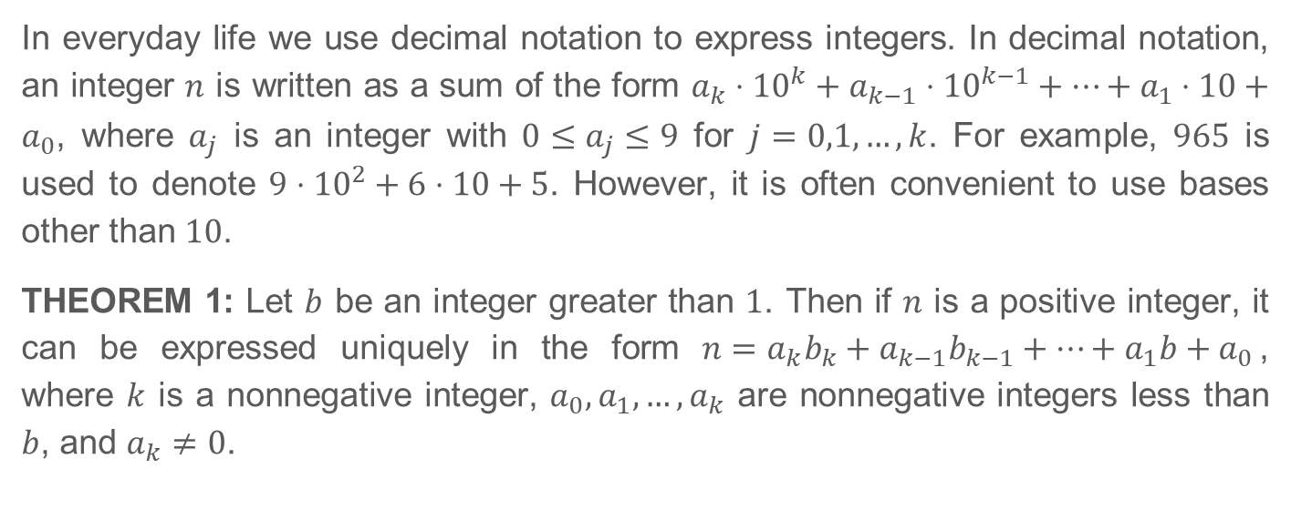
4.2.2 Representations of Integers
In everyday life we use decimal notation to express integers. In decimal notation, an integer $n$ is written as a sum of the form $a_{k}⋅{10}^{k}+a_{k−1}⋅{10}^{k−1}+⋯+a_{1}⋅10+a_{0}$, where $a_{j}$ is an integer with $0≤a_{j}≤9$ for $j=0,1,…,k$. For example, $965$ is used to denote $9⋅{10}^{2}+6⋅10+5$. However, it is often convenient to use bases other than $10$.
THEOREM 1: Let $b$ be an integer greater than $1$. Then if $n$ is a positive integer, it can be expressed uniquely in the form $n=a_{k}b_{k}+a_{k−1}b_{k−1}+⋯+a_{1}b+a_{0}$, where $k$ is a nonnegative integer, $a_{0},a_{1},…,a_{k}$ are nonnegative integers less than $b$, and $a_{k}≠0$.

Slide 4
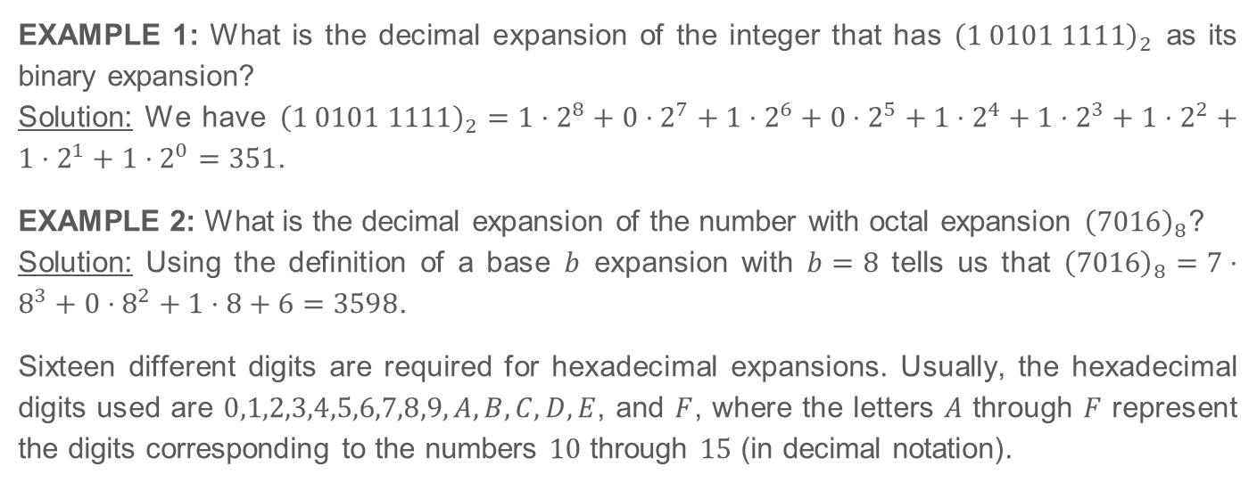
4.2.2 Representations of Integers (Continued)
EXAMPLE 1: What is the decimal expansion of the integer that has ${\left(1 0101 1111\right)}_{2}$ as its binary expansion?
Solution: We have ${\left(1 0101 1111\right)}_{2}=1⋅2^{8}+0⋅2^{7}+1⋅2^{6}+0⋅2^{5}+1⋅2^{4}+1⋅2^{3}+1⋅2^{2}+1⋅2^{1}+1⋅2^{0}=351$.
EXAMPLE 2: What is the decimal expansion of the number with octal expansion ${\left(7016\right)}_{8}$?
Solution: Using the definition of a base $b$ expansion with $b=8$ tells us that ${\left(7016\right)}_{8}=7⋅8^{3}+0⋅8^{2}+1⋅8+6=3598$.
Sixteen different digits are required for hexadecimal expansions. Usually, the hexadecimal digits used are $0,1,2,3,4,5,6,7,8,9,A,B,C,D,E$, and $F$, where the letters $A$ through $F$ represent the digits corresponding to the numbers $10$ through $15$ (in decimal notation).

Slide 5
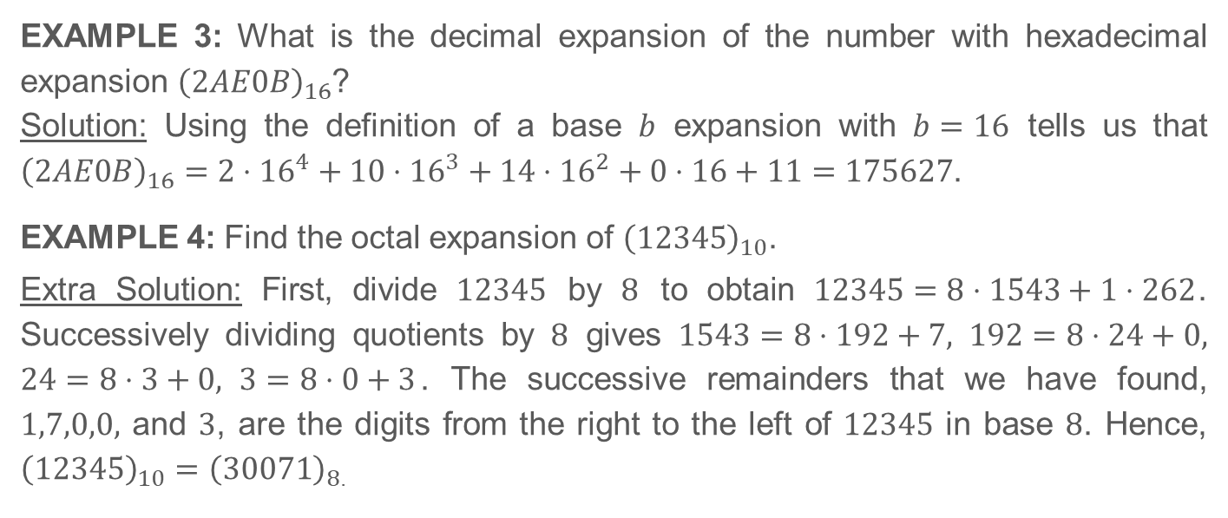
4.2.2 Representations of Integers (Continued)
EXAMPLE 3: What is the decimal expansion of the number with hexadecimal expansion ${\left(2AE0B\right)}_{16}$?
Solution: Using the definition of a base $b$ expansion with $b=16$ tells us that ${\left(2AE0B\right)}_{16}=2⋅{16}^{4}+10⋅{16}^{3}+14⋅{16}^{2}+0⋅16+11=175627$.
EXAMPLE 4: Find the octal expansion of ${\left(12345\right)}_{10}$.
Extra Solution: First, divide $12345$ by $8$ to obtain $12345=8⋅1543+1⋅262$. Successively dividing quotients by $8$ gives $1543=8⋅192+7, 192=8⋅24+0, 24=8⋅3+0, 3=8⋅0+3$. The successive remainders that we have found, $1,7,0,0,$ and $3$, are the digits from the right to the left of $12345$ in base $8$. Hence, ${\left(12345\right)}_{10}={\left(30071\right)}_{8}$.

Slide 6
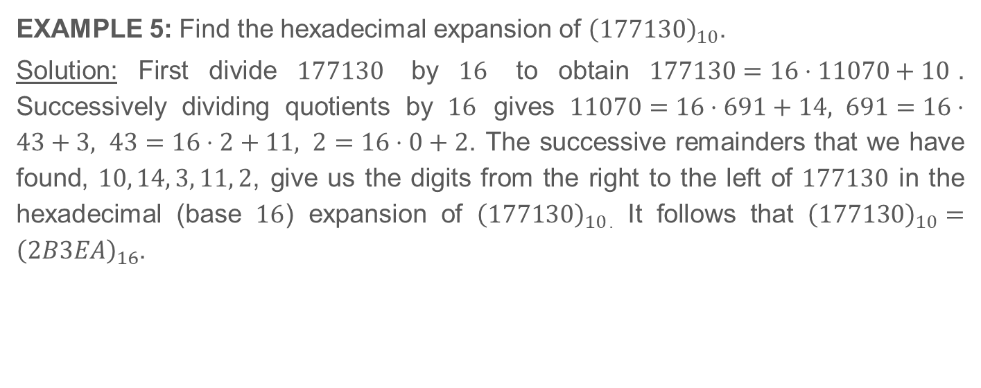
4.2.2 Representations of Integers (Continued)
EXAMPLE 5: Find the hexadecimal expansion of ${\left(177130\right)}_{10}$.
Solution: First divide $177130$ by $16$ to obtain $177130=16⋅11070+10$. Successively dividing quotients by $16$ gives $11070=16⋅691+14, 691=16⋅43+3, 43=16⋅2+11, 2=16⋅0+2$. The successive remainders that we have found, $10, 14, 3, 11, 2$, give us the digits from the right to the left of $177130$ in the hexadecimal (base $16$) expansion of ${\left(177130\right)}_{10}$. It follows that ${\left(177130\right)}_{10}={\left(2B3EA\right)}_{16}$.

Slide 7
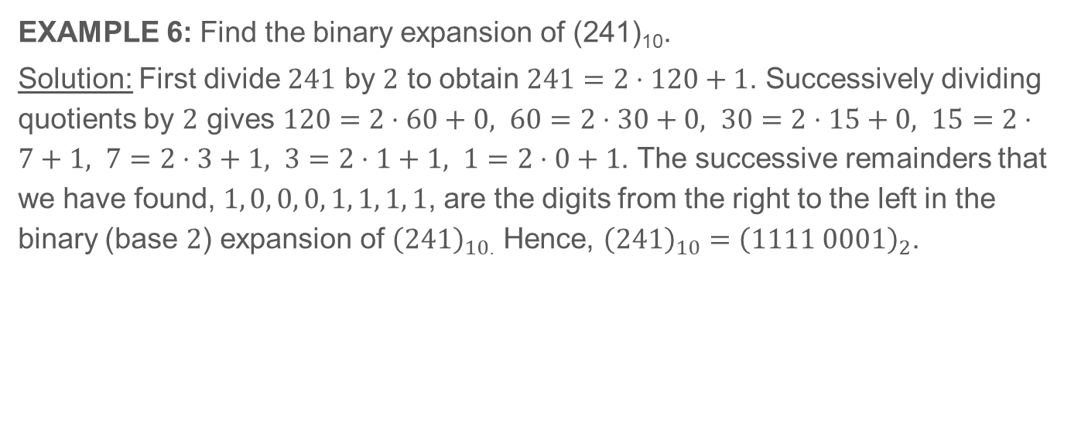
4.2.2 Representations of Integers (Continued)
EXAMPLE 6: Find the binary expansion of (241)₁₀.
Solution: First divide $241$ by $2$ to obtain $241=2⋅120+1$. Successively dividing quotients by $2$ gives $120=2⋅60+0, 60=2⋅30+0, 30=2⋅15+0, 15=2⋅7+1, 7=2⋅3+1, 3=2⋅1+1, 1=2⋅0+1$. The successive remainders that we have found, $1, 0, 0, 0, 1, 1, 1, 1$, are the digits from the right to the left in the binary (base $2$) expansion of ${\left(241\right)}_{10}$. Hence, ${\left(241\right)}_{10}={\left(1111 0001\right)}_{2}$.

Slide 8
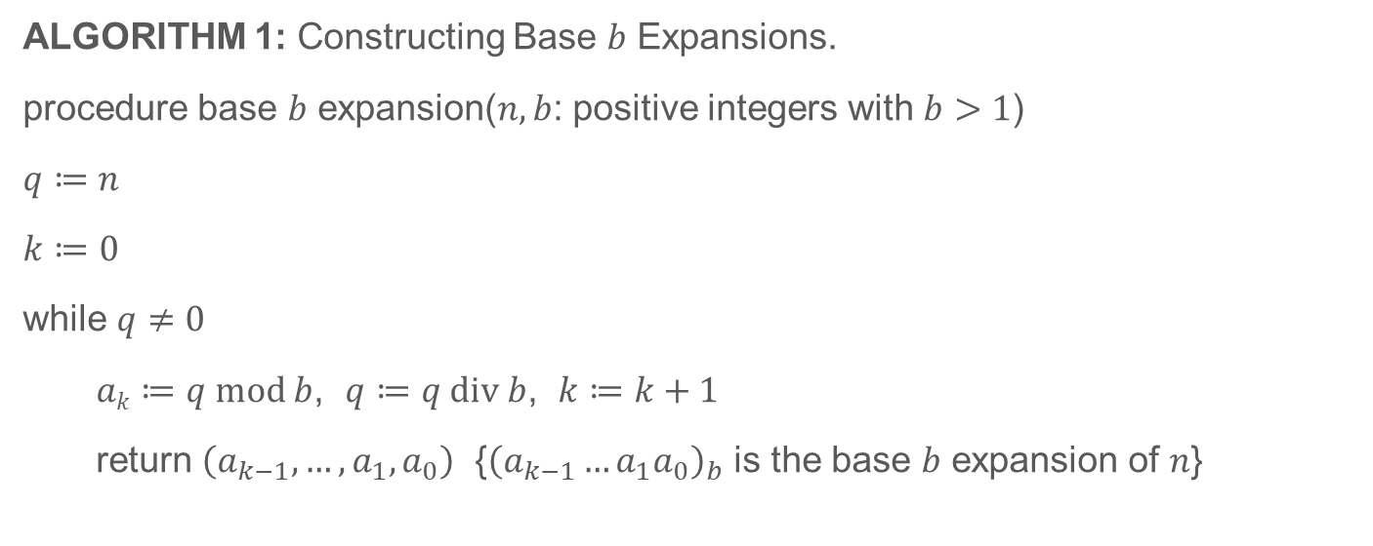
4.2.2 Representations of Integers (Continued)
ALGORITHM 1: Constructing Base $b$ Expansions.
procedure base $b$ expansion($n, b$: positive integers with $b>1$)
$q≔n$
$k≔0$
while $q≠0$
$ak≔q mod b$, $q≔q div b$, $k≔k+1$
return $\left(a_{k−1},…,a_{1},a_{0}\right)$ {${\left(a_{k−1}…a_{1}a_{0}\right)}_{b}$ is the base $b$ expansion of $n$}

Slide 9
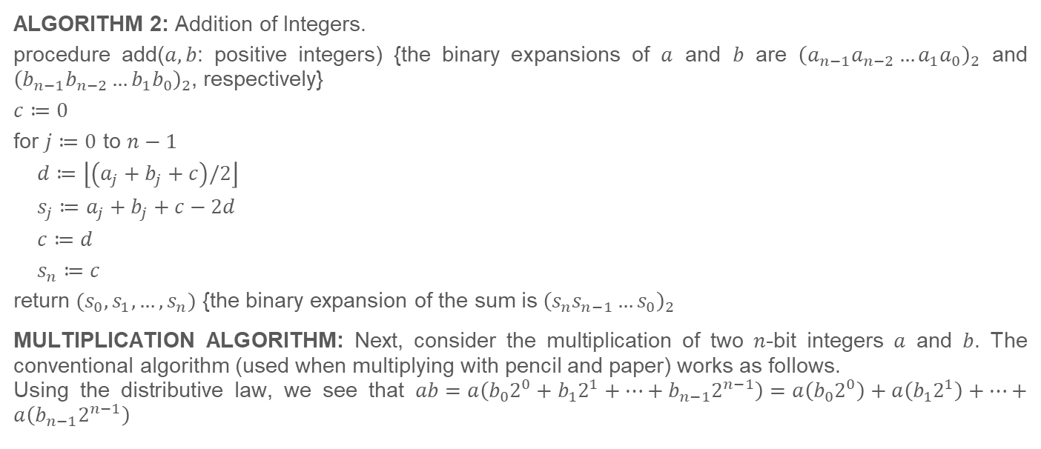
4.2.2 Representations of Integers (Continued)
ALGORITHM 2: Addition of Integers.
procedure add($a, b$: positive integers) {the binary expansions of $a$ and $b$ are ${\left(a_{n−1}a_{n−2}…a_{1}a_{0}\right)}_{2}$ and ${\left(b_{n−1}b_{n−2}…b_{1}b_{0}\right)}_{2}$, respectively}
$c≔0$
for $j≔0$ to $n−1$
$d≔\left\lfloor \left(a_{j}+b_{j}+c\right)/2\right\rfloor$
$s_{j}≔a_{j}+b_{j}+c−2d$
$c≔d$
$s_{n}≔c$
return $(s_{0}, s_{1},…, s_{n})$ {the binary expansion of the sum is ${\left(s_{n}s_{n−1}…s_{0}\right)}_{2}$
MULTIPLICATION ALGORITHM: Next, consider the multiplication of two $n$-bit integers $a$ and $b$. The conventional algorithm (used when multiplying with pencil and paper) works as follows.
Using the distributive law, we see that $ab=a\left(b_{0}2^{0}+b_{1}2^{1}+⋯+b_{n−1}2^{n−1}\right)=a\left(b_{0}2^{0}\right)+a\left(b_{1}2^{1}\right)+⋯+a\left(b_{n−1}2^{n−1}\right)$

Slide 10
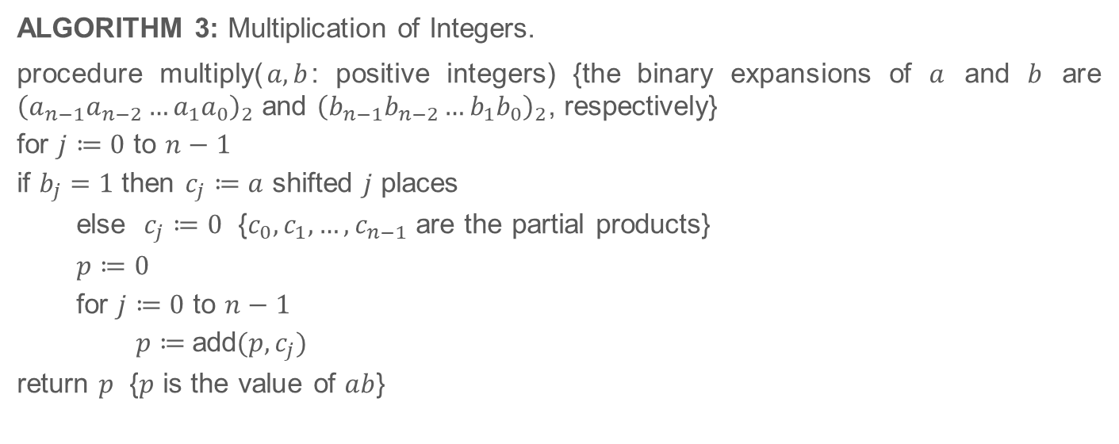
4.2.2 Representations of Integers (Continued)
ALGORITHM 3: Multiplication of Integers.
procedure multiply($a, b$: positive integers) {the binary expansions of $a$ and $b$ are ${\left(a_{n−1}a_{n−2}…a_{1}a_{0}\right)}_{2}$ and ${\left(b_{n−1}b_{n−2}…b_{1}b_{0}\right)}_{2}$, respectively}
for $j≔0$ to $n−1$
if $b_{j}=1$ then $c_{j}≔a$ shifted $j$ places
else $c_{j}≔0$ {$c_{0}, c_{1},…, c_{n−1}$ are the partial products}
$p≔0$
for $j≔0$ to $n−1$
$p≔$add$(p, c_{j})$
return $p$ {$p$ is the value of $ab$}

Slide 11
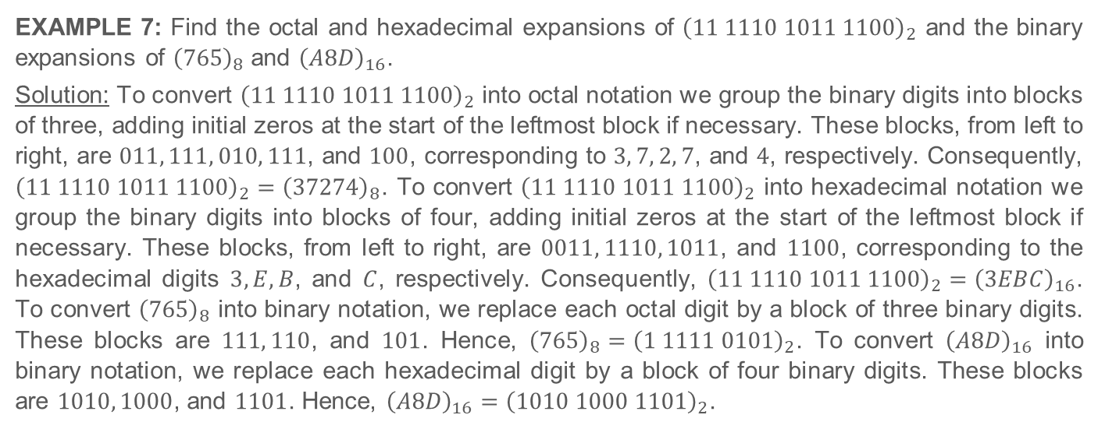
4.2.2 Representations of Integers (Continued)
EXAMPLE 7: Find the octal and hexadecimal expansions of ${\left(11 1110 1011 1100\right)}_{2}$ and the binary expansions of ${\left(765\right)}_{8}$ and ${\left(A8D\right)}_{16}$.
Solution: To convert ${\left(11 1110 1011 1100\right)}_{2}$ into octal notation we group the binary digits into blocks of three, adding initial zeros at the start of the leftmost block if necessary. These blocks, from left to right, are $011, 111, 010, 111$, and $100$, corresponding to $3, 7, 2, 7$, and $4$, respectively. Consequently, ${\left(11 1110 1011 1100\right)}_{2}={\left(37274\right)}_{8}$. To convert ${\left(11 1110 1011 1100\right)}_{2}$ into hexadecimal notation we group the binary digits into blocks of four, adding initial zeros at the start of the leftmost block if necessary. These blocks, from left to right, are $0011, 1110, 1011$, and $1100$, corresponding to the hexadecimal digits $3, E, B$, and $C$, respectively. Consequently, ${\left(11 1110 1011 1100\right)}_{2}={\left(3EBC\right)}_{16}$. To convert ${\left(765\right)}_{8}$ into binary notation, we replace each octal digit by a block of three binary digits. These blocks are $111, 110$, and $101$. Hence, ${\left(765\right)}_{8}={\left(1 1111 0101\right)}_{2}$. To convert ${\left(A8D\right)}_{16}$ into binary notation, we replace each hexadecimal digit by a block of four binary digits. These blocks are $1010, 1000$, and $1101$. Hence, ${\left(A8D\right)}_{16}={\left(1010 1000 1101\right)}_{2}$.

Slide 12
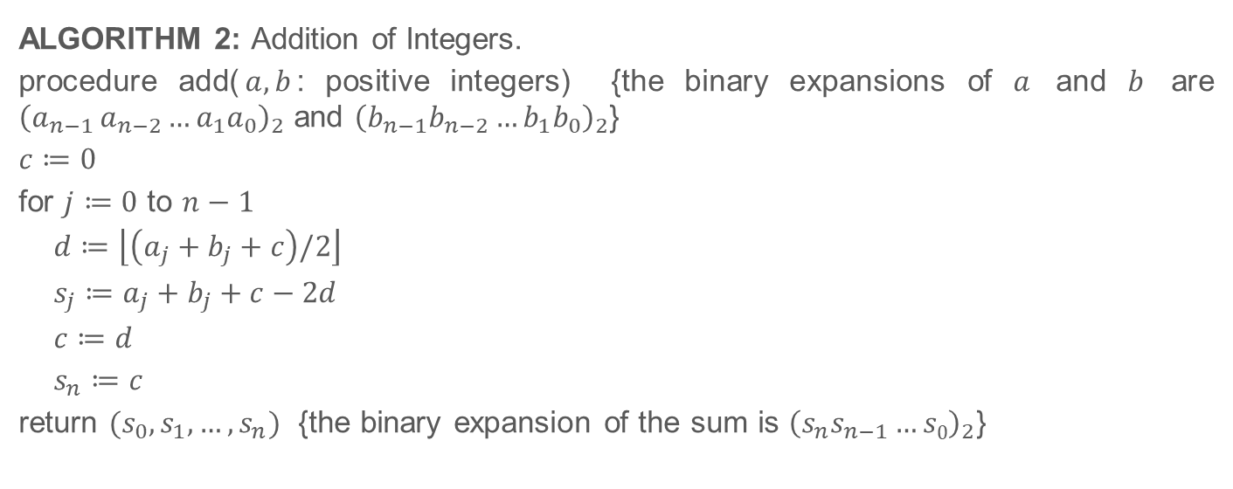
Integer Operations
ALGORITHM 2: Addition of Integers.
procedure add($a, b$: positive integers) {the binary expansions of $a$ and $b$ are ${\left(a_{n−1 }a_{n−2}…a_{1}a_{0}\right)}_{2}$ and ${\left(b_{n−1}b_{n−2}…b_{1}b_{0}\right)}_{2}$}
$c≔0$
for $j≔0$ to $n−1$
$d≔\left\lfloor \left(a_{j}+b_{j}+c\right)/2\right\rfloor$
$s_{j}≔a_{j}+b_{j}+c−2d$
$c≔d$
$s_{n}≔c$
return $(s_{0},s_{1},…, s_{n})$ {the binary expansion of the sum is ${\left(s_{n}s_{n−1}…s0\right)}_{2}$}

Slide 13
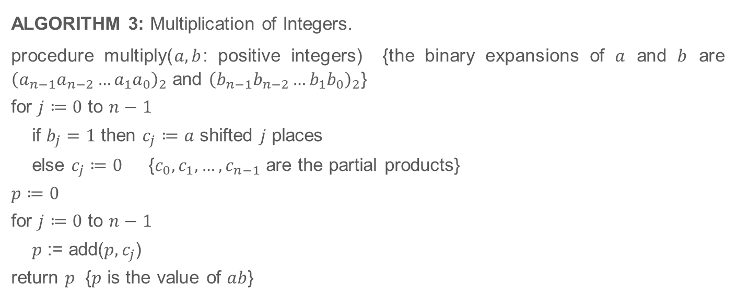
Integer Operations (Continued)
ALGORITHM 3: Multiplication of Integers.
procedure multiply($a, b$: positive integers) {the binary expansions of $a$ and $b$ are ${\left(a_{n−1}a_{n−2}…a_{1}a_{0}\right)}_{2}$ and ${\left(b_{n−1}b_{n−2}…b_{1}b_{0}\right)}_{2}$}
for $j≔0$ to $n−1$
if $b_{j}=1$ then $c_{j}≔a$ shifted $j$ places
else $c_{j}≔0$ {$c_{0}, c_{1},…, c_{n−1}$ are the partial products}
$p≔0$
for $j≔0$ to $n−1$
$p$ := add($p, c_{j}$)
return $p$ {$p$ is the value of $ab$}

Slide 14
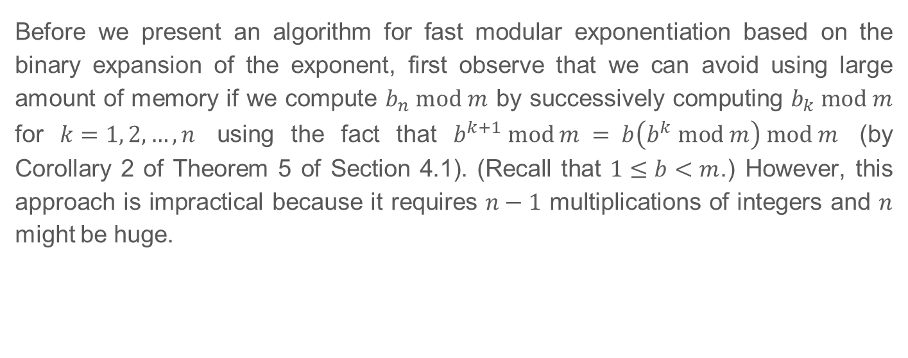
4.2.4 Modular Exponentiation
Self Study and Homework
Before we present an algorithm for fast modular exponentiation based on the binary expansion of the exponent, first observe that we can avoid using large amount of memory if we compute $b_{n} mod m$ by successively computing $b_{k} mod m$ for $k=1, 2,…,n$ using the fact that $b^{k+1} mod m = b\left(b^{k} mod m\right) mod m$ (by Corollary 2 of Theorem 5 of Section 4.1). (Recall that $1≤b<m$.) However, this approach is impractical because it requires $n−1$ multiplications of integers and $n$ might be huge.

Slide 15

4.2.4 Modular Exponentiation (Continued)
Self Study and Homework
To motivate the fast modular exponentiation algorithm, we illustrate its basic idea. We will explain how to use the binary expansion of $n$, say $n={\left(a_{k−1}…a_{1}a_{0}\right)}_{2}$, to compute $b_{n}$. First, note that $b_{n}=b^{a_{k−1}⋅2^{k−1}+⋯+a_{1}⋅2+a_{0}}=b^{a_{k−1}⋅2^{k−1}}⋯ b^{a_{1}⋅2}⋅b^{a_{0}}$

Slide 16

4.2.4 Modular Exponentiation (Continued)
Self Study and Homework
For example, to compute $311$ we first note that $11={\left(1011\right)}_{2}$, so that $3^{11} =383231$. By successively squaring, we find that $3^{2}=9, 3^{4}=9^{2}=81$, and $3^{8}= {\left(81\right)}^{2}=6561$.
Consequently, $3^{11}=3^{8}3^{2}3^{1}$

Slide 17
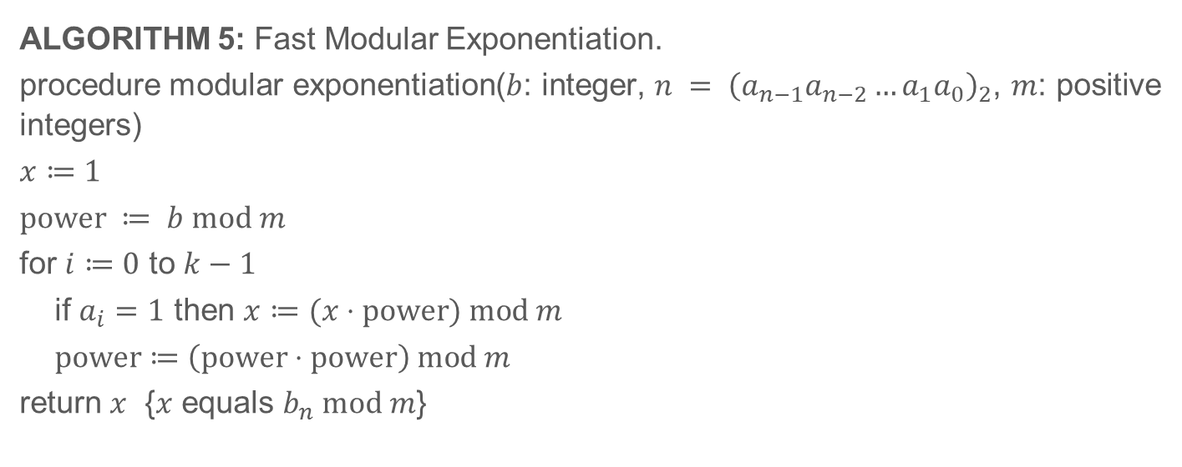
4.2.4 Modular Exponentiation (Continued)
Self Study and Homework
ALGORITHM 5: Fast Modular Exponentiation.
procedure modular exponentiation($b$: integer, $n = {\left(a_{n−1}a_{n−2}…a_{1}a_{0}\right)}_{2}$, $m$: positive integers)
$x≔1$
$power ≔ b mod m$
for $i≔0$ to $k−1$
if $a_{i}=1$ then $x≔(x⋅power) mod m$
$power≔\left(power⋅power\right) mod m$
return $x$ {$x$ equals $b_{n} mod m$}

Slide 18
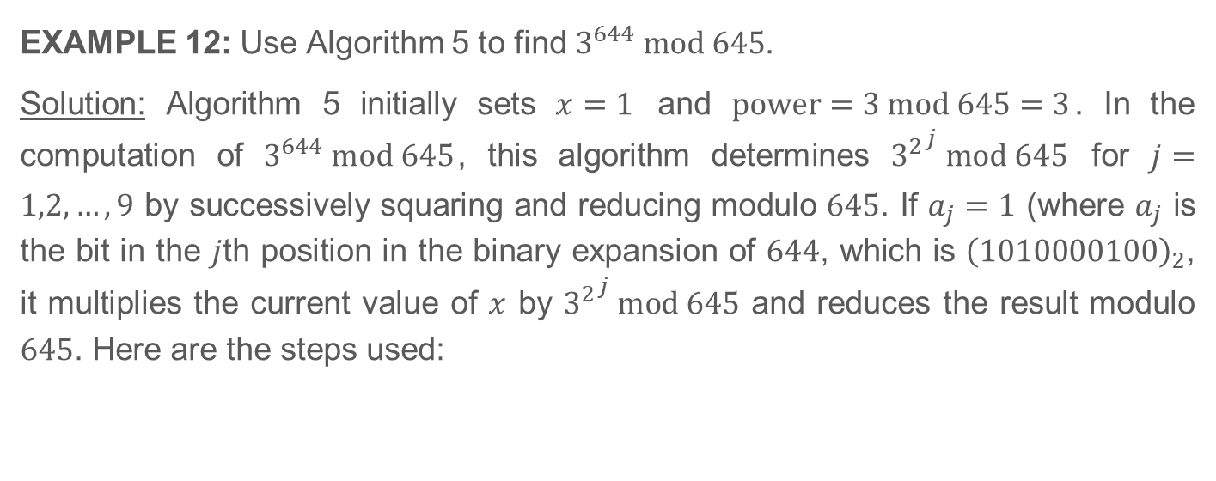
4.2.4 Modular Exponentiation (Continued)
Self Study and Homework
EXAMPLE 12: Use Algorithm 5 to find $3^{644} mod 645$.
Solution: Algorithm 5 initially sets $x=1$ and $power=3 mod 645=3$. In the computation of $3^{644} mod 645$, this algorithm determines ${3^{2}}^{j} mod 645$ for $j=1,2,…,9$ by successively squaring and reducing modulo $645$. If $a_{j}=1$ (where $a_{j}$ is the bit in the $j$th position in the binary expansion of $644$, which is ${\left(1010000100\right)}_{2}$, it multiplies the current value of $x$ by ${3^{2}}^{j} mod 645$ and reduces the result modulo $645$. Here are the steps used:

Slide 19
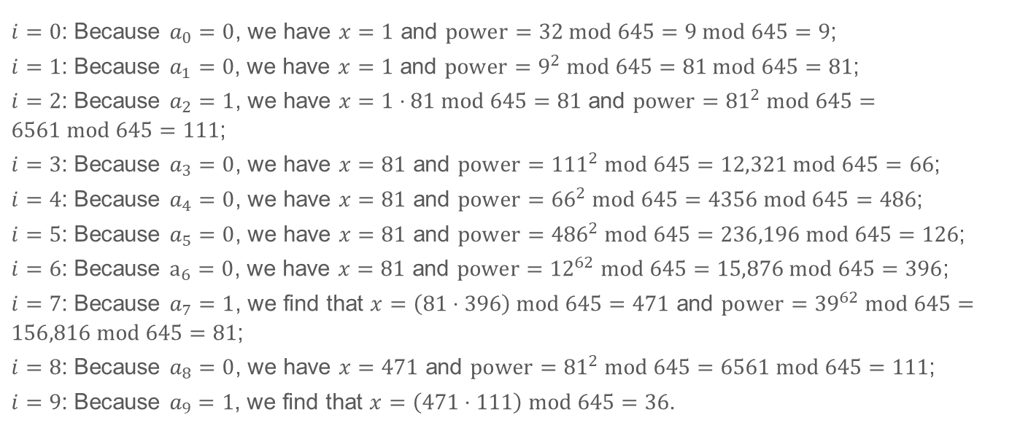
4.2.4 Modular Exponentiation (Continued)
Self Study and Homework
$i=0$: Because $a_{0}=0$, we have $x=1$ and $power=32 mod 645=9 mod 645=9$;
$i=1$: Because $a_{1}=0$, we have $x=1$ and $power=9^{2} mod 645=81 mod 645=81$;
$i=2$: Because $a_{2}=1$, we have $x=1⋅81 mod 645=81$ and $power={81}^{2} mod 645=6561 mod 645=111$;
$i=3$: Because $a_{3}=0$, we have $x=81$ and $power={111}^{2} mod 645=12,321 mod 645=66$;
$i=4$: Because $a_{4}=0$, we have $x=81$ and $power={66}^{2} mod 645=4356 mod 645=486$;
$i=5$: Because $a_{5}=0$, we have $x=81$ and $power={486}^{2} mod 645=236,196 mod 645=126$;
$i=6$: Because $a_{6}=0$, we have $x=81$ and $power={12}^{62} mod 645=15,876 mod 645=396$;
$i=7$: Because $a_{7}=1$, we find that $x=\left(81⋅396\right) mod 645=471$ and $power={39}^{62} mod 645=156,816 mod 645=81$;
$i=8$: Because $a_{8}=0$, we have $x=471$ and $power={81}^{2} mod 645=6561 mod 645=111$;
$i=9$: Because $a_{9}=1$, we find that $x=\left(471⋅111\right) mod 645=36$.

