Slide 1
IBM Db2Hack 2026 — IDEATION & ARCHITECTURE PROPOSAL
SmartStock AI
Autonomous Multi-Agent Food Waste Reduction & Dynamic Inventory Optimization Powered by IBM Db2
Author: Ashfin Prem | Tech Stack: IBM Db2, CrewAI, LangChain, FastAPI, Streamlit, LightGBM

Slide 2
IBM DB2HACK 2026 | ROUND 1 PROPOSAL
Problem Statement & Industry Impact
The Commercial Food Service Crisis
• The commercial food service industry loses billions annually to preventable ingredient spoilage.
• Cloud kitchens and restaurants operate on razor-thin margins (3% - 7%), where ingredient waste directly degrades profitability.
• Existing ERPs treat inventory as bulk aggregated numbers, lacking granular batch-level expiration timelines.
• Static reordering models cannot adapt to sudden demand surges, causing concurrent over-stocking and stockouts.
The SmartStock AI Opportunity
• Target Audience: Cloud kitchens, commercial restaurants, head chefs, and hospitality inventory managers.
• Automated FEFO: Strictly enforces First-Expired, First-Out batch consumption directly inside the transactional database.
• Predictive Intelligence: Foresees spoilage volume and multi-horizon demand before purchase decisions are executed.
• Recipe-Driven Waste Clearance: Dynamically prioritizes culinary dishes that deplete near-expiry stock.

Slide 3
IBM DB2HACK 2026 | ROUND 1 PROPOSAL
Proposed Solution & Key Features
1. FEFO Inventory Engine
• Batch-Level Expiry Tracking: Tracks inventory per batch with strict expiry deadlines.
• Automated Consumption: Directs kitchen consumption to earliest expiring batches first.
• Immutable Movement Logs: Complete audit trail across intake, usage, and disposal in IBM Db2.
2. Predictive AI & Restock
• LightGBM Spoilage Predictor: Classifies at-risk batches and predicts excess volume.
• Multi-Horizon Forecaster: Predicts 1-day, 3-day, and 7-day ingredient consumption trends.
• Smart Purchasing Agent: Automatically generates POs respecting supplier lead times and MOQs.
3. Agentic & NLP Interface
• Text-to-SQL Assistant: Query stock and recipe metrics via conversational plain English.
• Read-Only SQL Guardrails: Regex safety barrier preventing destructive DDL/DML execution.
• What-If Demand Simulator: Simulates sudden surges (+30%) to proactively calculate shortages.

Slide 4
IBM DB2HACK 2026 | ROUND 1 PROPOSAL
Autonomous Agentic AI Framework (CrewAI & LangChain)
6-Agent Autonomous Decision Crew
• Inventory Agent: Inspects current batch balances, storage temperatures, and shelf-life horizons in IBM Db2.
• Waste Prediction Agent: Runs LightGBM inference on active batches to flag imminent spoilage risk before financial loss.
• Demand Forecasting Agent: Evaluates consumption velocity across multi-day intervals to project depletion dates.
• Recipe Agent: Dynamically queries the RECIPES catalog to suggest special daily dishes that consume vulnerable ingredients.
• Purchasing Agent: Synthesizes forecast deficits with supplier lead-times and MOQs to propose optimized purchase orders.
• Reporting Agent: Consolidates findings into an executive briefing detailing estimated financial savings and urgent operational alerts.
• LLM Backend: Configured for local LM Studio (liquid/lfm2.5-1.2b) and IBM watsonx.ai Granite enterprise models.

Slide 5
IBM DB2HACK 2026 | ROUND 1 PROPOSAL
IBM Db2 Integration & Enterprise Schema Design
Db2 Integration & Connectors
• Edition: IBM Db2 Community Edition running containerized in Docker.
• Connector: High-performance native ibm_db driver with container execution bridge.
• Transactional Integrity: Full ACID compliance for atomic inventory deduction and purchase order state lifecycles.
• Read-Only Text-to-SQL: Parameterized query validation blocking unauthorized schema or data mutation.
• Dual-Resilience: Fast local SQLite synchronization mirror for real-time edge availability.
Key Relational Tables (12 Entities)
• INVENTORY: Tracks batch_number, expiry_date, unit_price, storage_temp, and active status.
• SUPPLIERS: Stores supplier lead times, ratings, and Minimum Order Quantities (MOQs).
• STOCK_MOVEMENTS: Immutable ledger recording all intake, consumption, and waste transactions.
• RECIPES & RECIPE_INGREDIENTS: Normalized recipe catalog mapped to ingredient consumption.
• PURCHASE_ORDERS: Tracks restock requests (PENDING_APPROVAL -> APPROVED -> DELIVERED).
• USERS: Enterprise Role-Based Access Control (Admin, Chef, Inventory Manager, Staff).

Slide 6
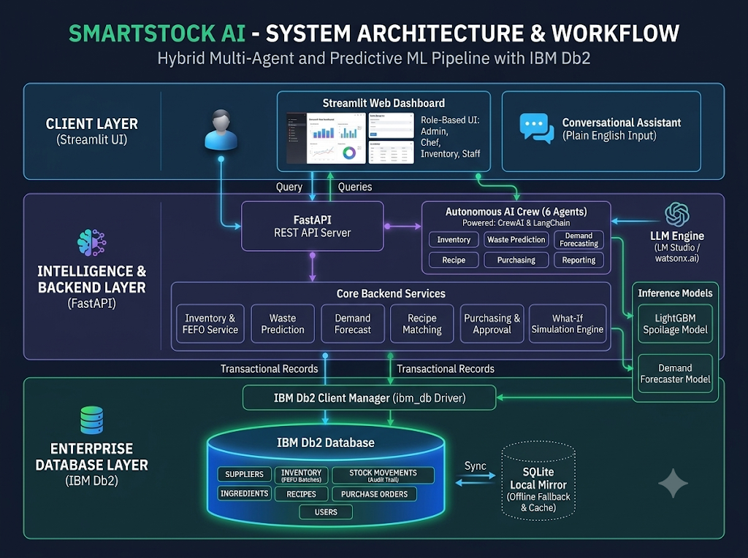
IBM DB2HACK 2026 | ROUND 1 PROPOSAL

Slide 7
IBM DB2HACK 2026 | ROUND 1 PROPOSAL
End-to-End Architecture Workflow & Measurable Impact
End-to-End System Workflow
• 1. Client Layer: Role-based Streamlit UI with Plotly analytics and natural language query bar.
• 2. API Gateway: FastAPI backend exposing 25+ domain REST endpoints with Pydantic validation.
• 3. Intelligence Layer: CrewAI multi-agent crew coupled with LightGBM ML models for waste and demand prediction.
• 4. Enterprise Data Layer: Authoritative IBM Db2 database processing FEFO queries (ORDER BY expiry_date ASC) and atomic commits.
Measurable Business Impact
• 30-40% Food Waste Reduction: Granular FEFO consumption and recipe prioritization drastically minimize expired spoilage.
• Capital Preservation: Prevents over-purchasing through lead-time and MOQ-aware replenishment orders.
• Sub-Second Decision Support: Natural language Text-to-SQL allows kitchen managers to query stock balances instantly.
• Enterprise Auditability: Immutable audit logs in Db2 ensure end-to-end traceability for hygiene and financial reporting.

