Slide 1





Team #1:
Ash Frazer, Cami Joyner, Miranda Nichols, Axel Pinard, Carson Stell
PixelMate is a fully customized, multiplayer game of Chess.

Slide 2

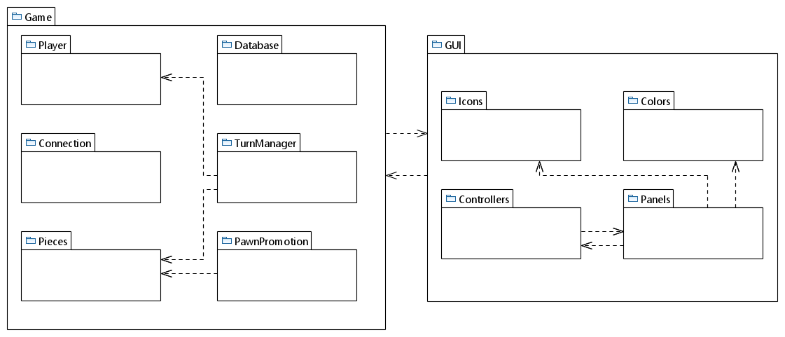
Miranda
Ash
Ash
Ash
Ash, Axel
Miranda
Ash, Axel
Ash
Ash, Axel, Cami, Carson, Miranda
Miranda
Ash, Axel, Cami, Carson, Miranda

Slide 3

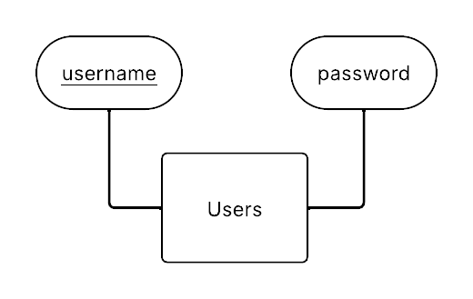
Primary Key →

Slide 4

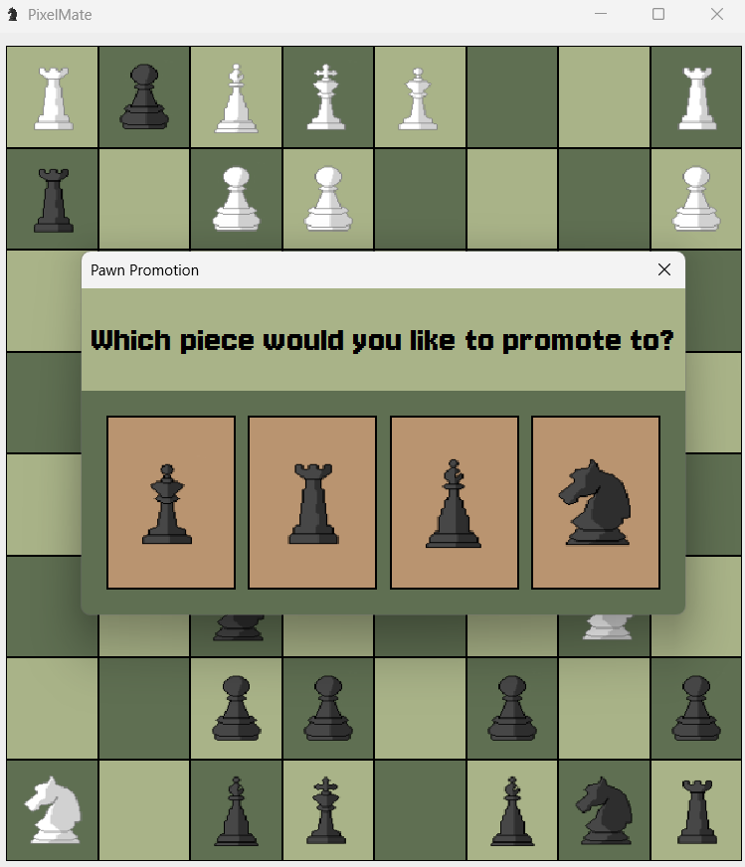
Functional Requirement: A pawn that reaches the opposite end of the board must be promoted to a queen, knight, rook, or bishop. (Pawn Promotion)

Slide 5

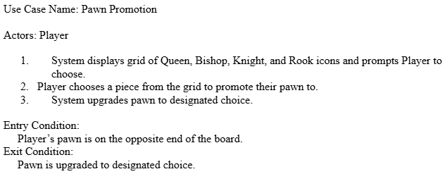

Slide 6

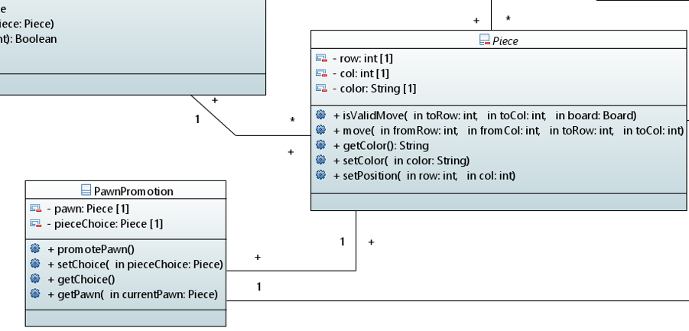

Slide 7

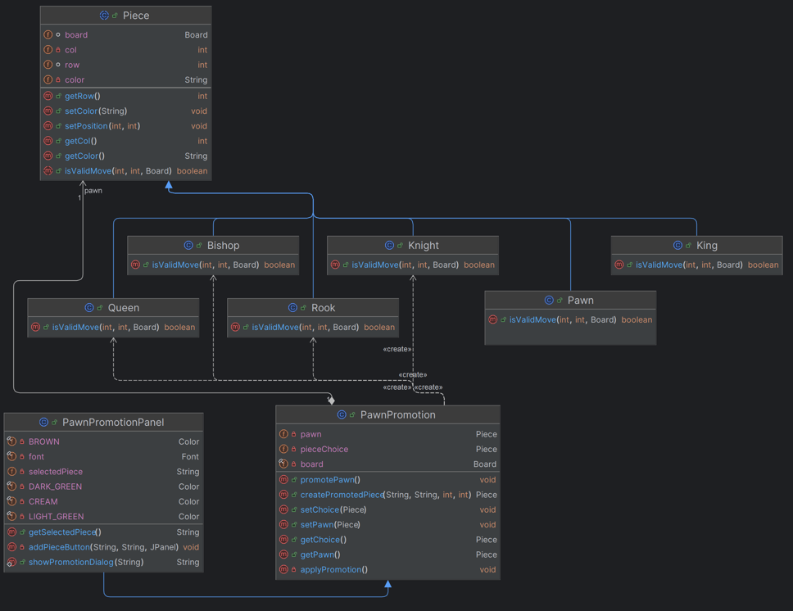
Final Class Diagram Snippet

