Slide 1
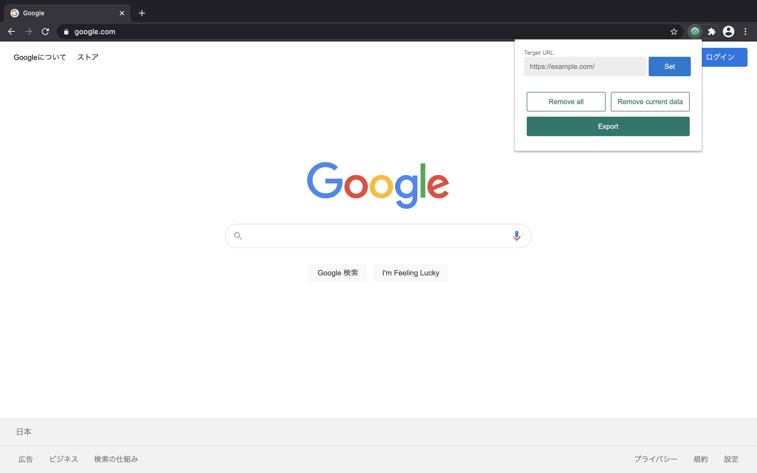
Performance
Collector

Slide 2
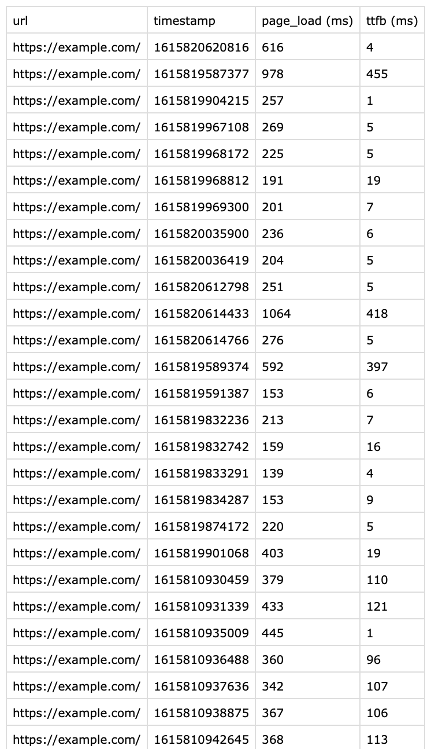
You can collect performance data
by just browsing websites!

