Slide 1
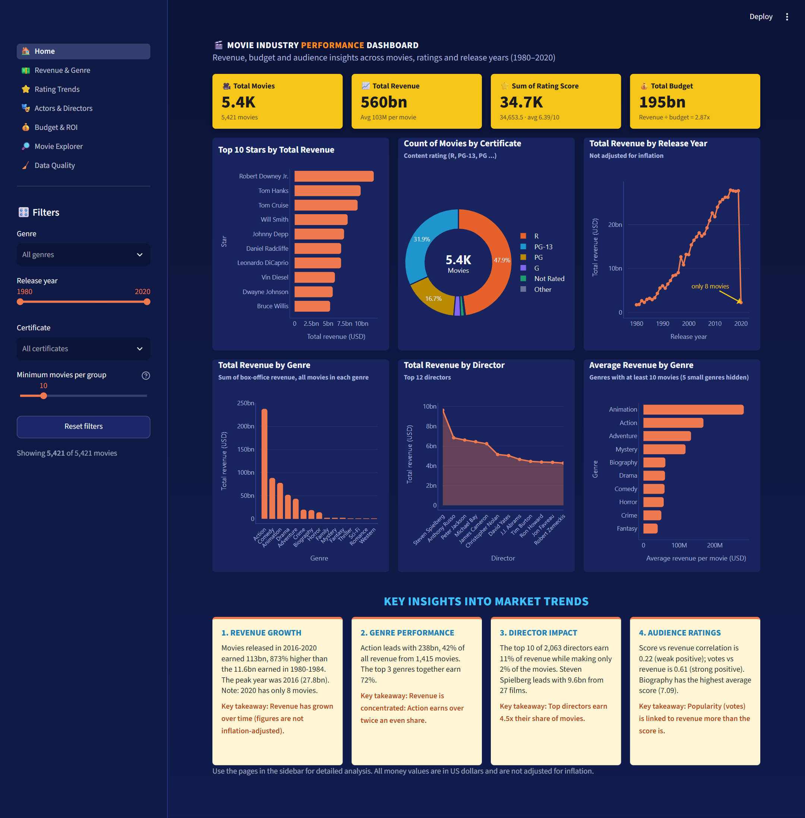
RESULTS: DASHBOARD
Python + Streamlit implementation of the Power BI design
Movie Industry Performance Dashboard · School of Computing - CSE
1

Slide 2
KEY PERFORMANCE INDICATORS
Totals match the Power BI dashboard exactly
Total Movies
Total Revenue
Sum of Rating Score
Total Budget
5,421
560bn
34,653.5
195bn
1980–2020
avg 103M / movie
average 6.39 / 10
revenue ÷ budget = 2.87x
▶ Dataset: 5,421 movies, 15 attributes; 0 missing values and 0 duplicates after cleaning (9 certificate labels after merging 'Unrated' → 'Not Rated').
▶ Median revenue is only 36.9M vs a mean of 103M: a few blockbusters earn far more than a typical film.
▶ Total profit 364bn, yet 32% of films earned less than their budget (median ROI 84%).
▶ Budget ↔ revenue r = 0.74; votes ↔ revenue r = 0.61; score ↔ revenue r = 0.22.
Movie Industry Performance Dashboard · School of Computing - CSE
2

Slide 3
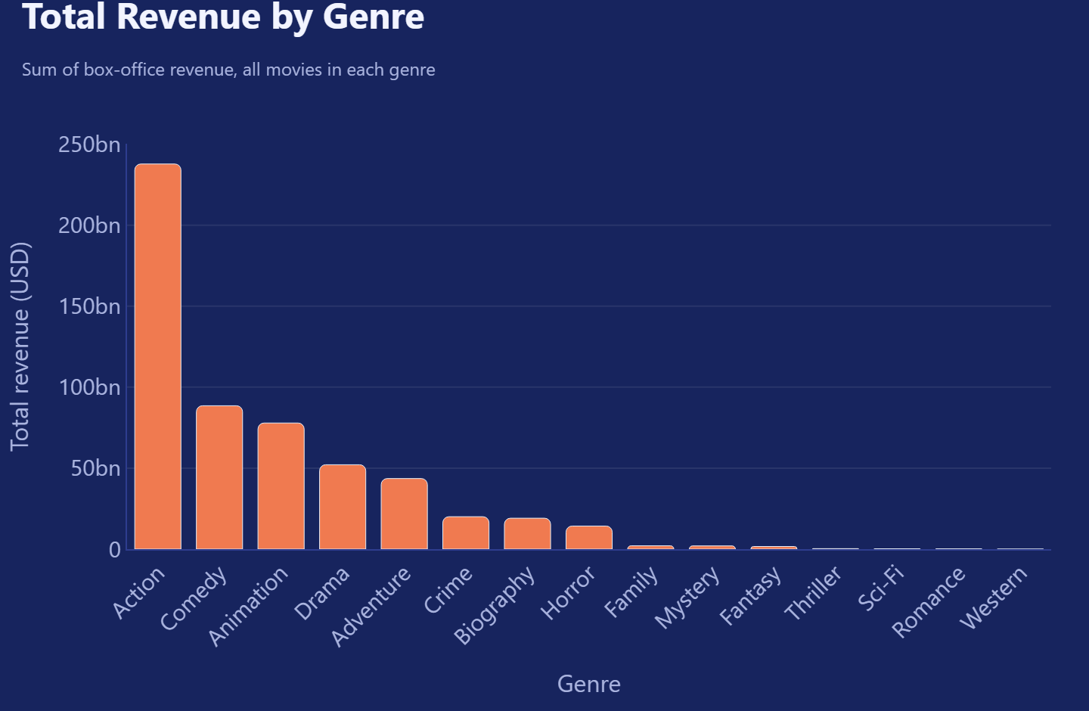
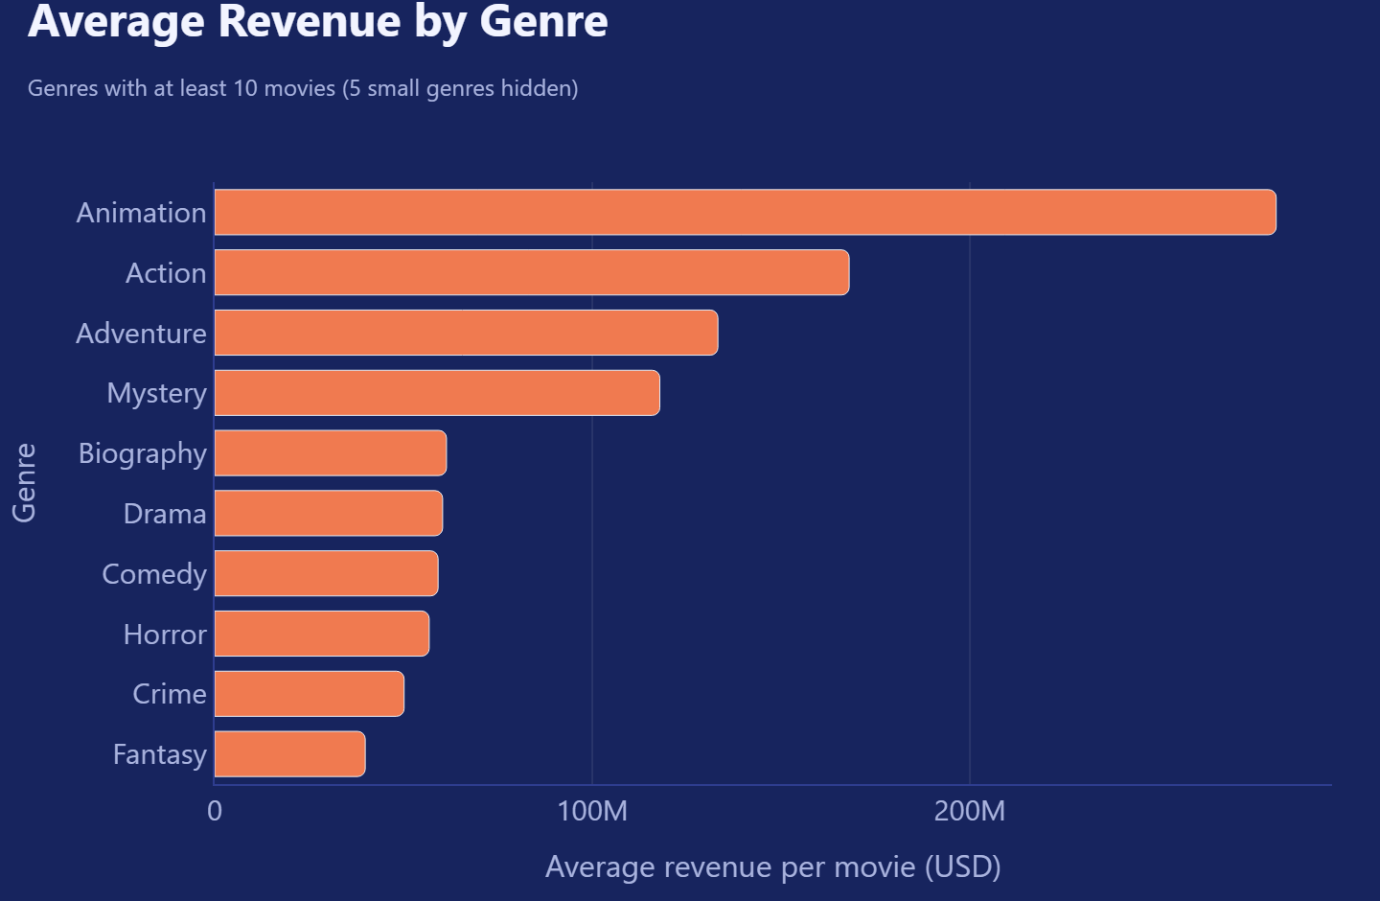
GENRE FINDINGS
Module 3 – Revenue & Genre Analysis
▶ Action earns 238bn = 42% of all revenue; the top 3 genres earn 72%.
▶ Best per film: Animation (281M average) · best return: Horror (median ROI 208%).
▶ Highest rated: Biography (7.09) – high-rated genres are not the high-earning ones.
▶ 5 small genres (e.g. Family, 4 films) are hidden from averages (minimum 10 films).
Movie Industry Performance Dashboard · School of Computing - CSE
3

Slide 4
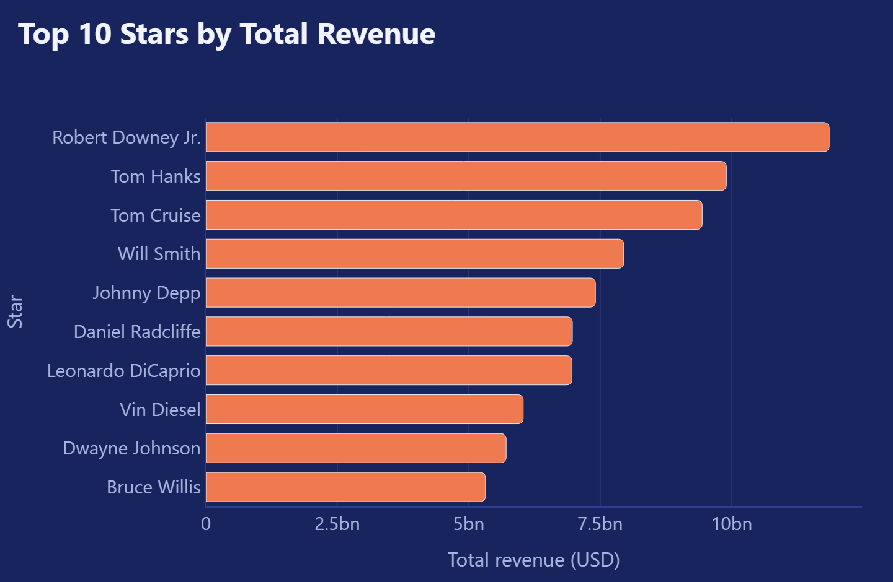
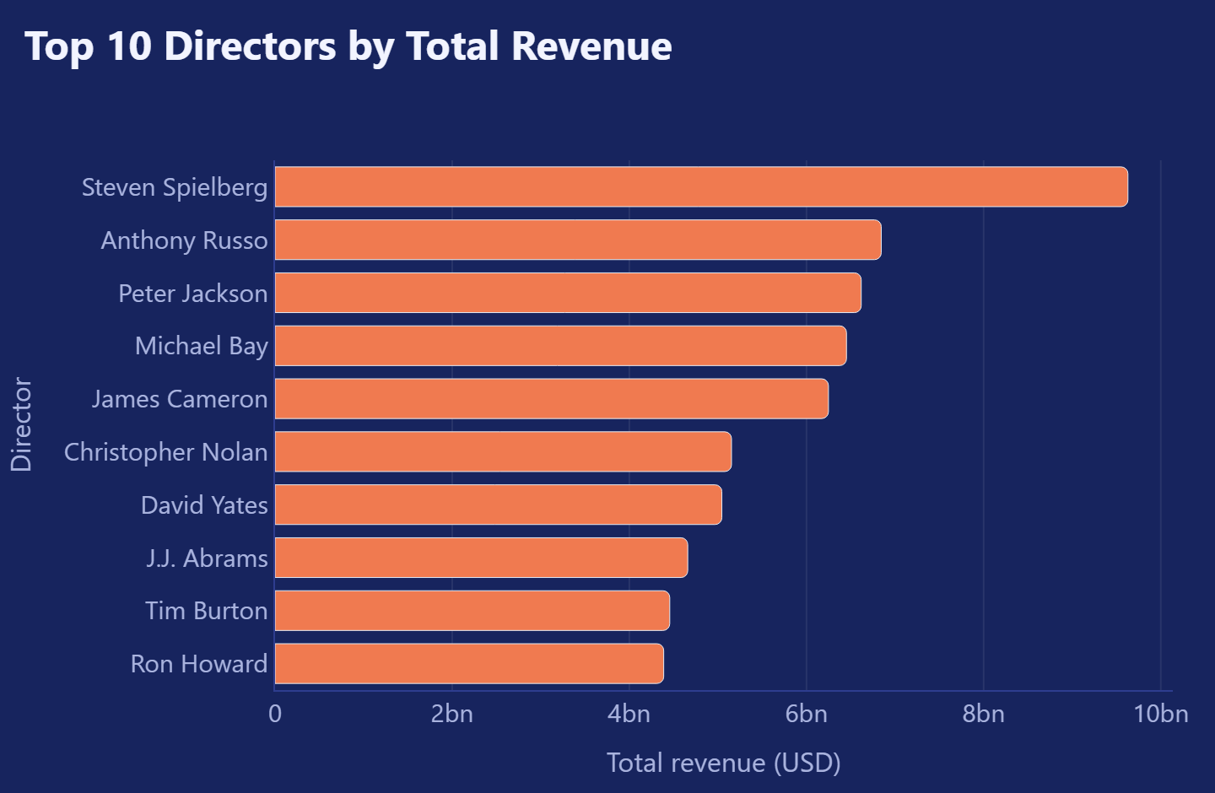
ACTOR & DIRECTOR FINDINGS
Module 5 – top performers by revenue and rating
▶ Top star: Robert Downey Jr. – 11.9bn from 19 films.
▶ Top director: Steven Spielberg – 9.6bn from 27 films (avg score 7.44).
▶ Top 10 directors earn 11% of revenue; top 10 stars earn 14%.
▶ Highest-rated director (≥ 5 films): Christopher Nolan (8.16).
Movie Industry Performance Dashboard · School of Computing - CSE
4

Slide 5
KEY INSIGHTS INTO MARKET TRENDS
Module 6 – generated automatically from the data
1. REVENUE GROWTH
2. GENRE PERFORMANCE
Movies released in 2016-2020 earned 113bn, 873% higher than the 11.6bn earned in 1980-1984. The peak year was 2016 (27.8bn). Note: 2020 has only 8 movies.
Action leads with 238bn, 42% of all revenue from 1,415 movies. The top 3 genres together earn 72%.
Key takeaway: Revenue has grown over time (figures are not inflation-adjusted).
Key takeaway: Revenue is concentrated: Action earns over twice an even share.
3. DIRECTOR IMPACT
4. AUDIENCE RATINGS
The top 10 of 2,063 directors earn 11% of revenue while making only 2% of the movies. Steven Spielberg leads with 9.6bn from 27 films.
Score vs revenue correlation is 0.22 (weak positive); votes vs revenue is 0.61 (strong positive). Biography has the highest average score (7.09).
Key takeaway: Top directors earn 4.5x their share of movies.
Key takeaway: Popularity (votes) is linked to revenue more than the score is.
Movie Industry Performance Dashboard · School of Computing - CSE
5

Slide 6
SYSTEM ARCHITECTURE
Layered design: each layer is one or more Python modules
Data Layer
Preprocessing
Analysis Layer
Visualization
Dashboard
Module 1 · Data Collection
Module 2 · Data Preprocessing
Modules 3, 4, 5
Module 6 · Charts & Insights
Streamlit web app
cleaned_data_final.csv
src/data_loader.py
missing values, duplicates,
labels · src/preprocessing.py
revenue & genre · ratings ·
actors & directors · src/analysis.py
Plotly charts · KPI cards ·
src/figures.py, src/insights.py
7 pages · shared filters ·
CSV download · app.py
👤 User: filters by genre, year, certificate
Every filter change re-runs the analysis on the filtered data, so all charts, KPIs and insight cards update together. Tests (pytest) check each layer.
Movie Industry Performance Dashboard · School of Computing - CSE
6

