Slide 1


Slide 2

K.Srivatsan - vatsank@gmail.com
IT Trainer Since 1991
Conducting Java Training Since 2004
About 60+ Corporate Clients

Slide 3
MICRO SERVICES – SPRING BOOT
Module-1 – Version -2

Slide 4
Course Outline
Introduction to Microservices
Spring Cloud Eureka
Spring Cloud Config Server and Client Configuration
Spring Boot Actuator and Admin Server
Introduction Project Reactor and Reactive Spring
Client Side Load-Balancing with Spring Cloud Load Balancer
Spring Cloud circuit breaker and resilience4j
Request Routing With Spring cloud gateway
Spring Security and OAuth2
Sleuth, Zipkin and ELK Stack
Introduction Kafka and Asynchronous Messaging
Spring Cloud Bus

Slide 5


Case Study Design
GIT Repo
Cloud Config Server
Admin Server
Eureka Discovery Server
API Gateway
{8080}
ZipKin Tracing
Review Service
7070
Restaurant Info Service
7075
Reservation Service
7080
MySql
MySql
MySql

Slide 6
INTRODUCTION TO MICRO SERVICES

Slide 7
Micro Services
Problems with Monolithic Application
What is Microservices
Advantages and disadvantages
When not to use Microservice
Use case for MicroServices

Slide 8
Monolith Application
A monolithic application is a single-tiered software application
  Has user interface and data access code combined into a single program from a single platform.
Its characteristics
  Doesn’t have Module but Modularized using object-based approach to be distributed across multiple computers
  Deployed together as a single deployment unit- EAR or WAR.
  Long Release Cycles
  Large Teams

Slide 9
Challenges to Monolith
  Large codebases become mess over the time
  Multiple teams working on single codebase become tedious
  Difficulty in Adapting to Device Explosion
  Scaling up certain parts of the application
  Technology updates/rewrites become complex and expensive tasks

Slide 10
Micro Services
An engineering approach focused on decomposing applications with well-defined interfaces - service contracts such as a JSON schema or WSDL
  Deployed independently as services and operated by small teams who own the entire lifecycle of the service.
  Each service handles a specific business domain (logging, auth, orders, customers)
  Each Service provides the implementation for user interface, business logic, and connection to database.
  Each Service can be scaled up Individually

Slide 11
Micro Service
  class UserApp() {
  User getUser() {
  // 1. auth user
  // 2. get user data
  // 3. log user actions
  }
  }
  class UserApp() {
  void authUser(User user) { ... }
  User getUserData() { ... }
  void logUserActions() { ... }
  }

Slide 12
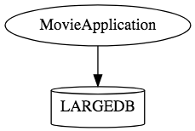
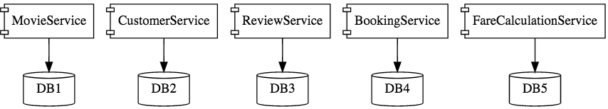
Micro Services

Slide 13
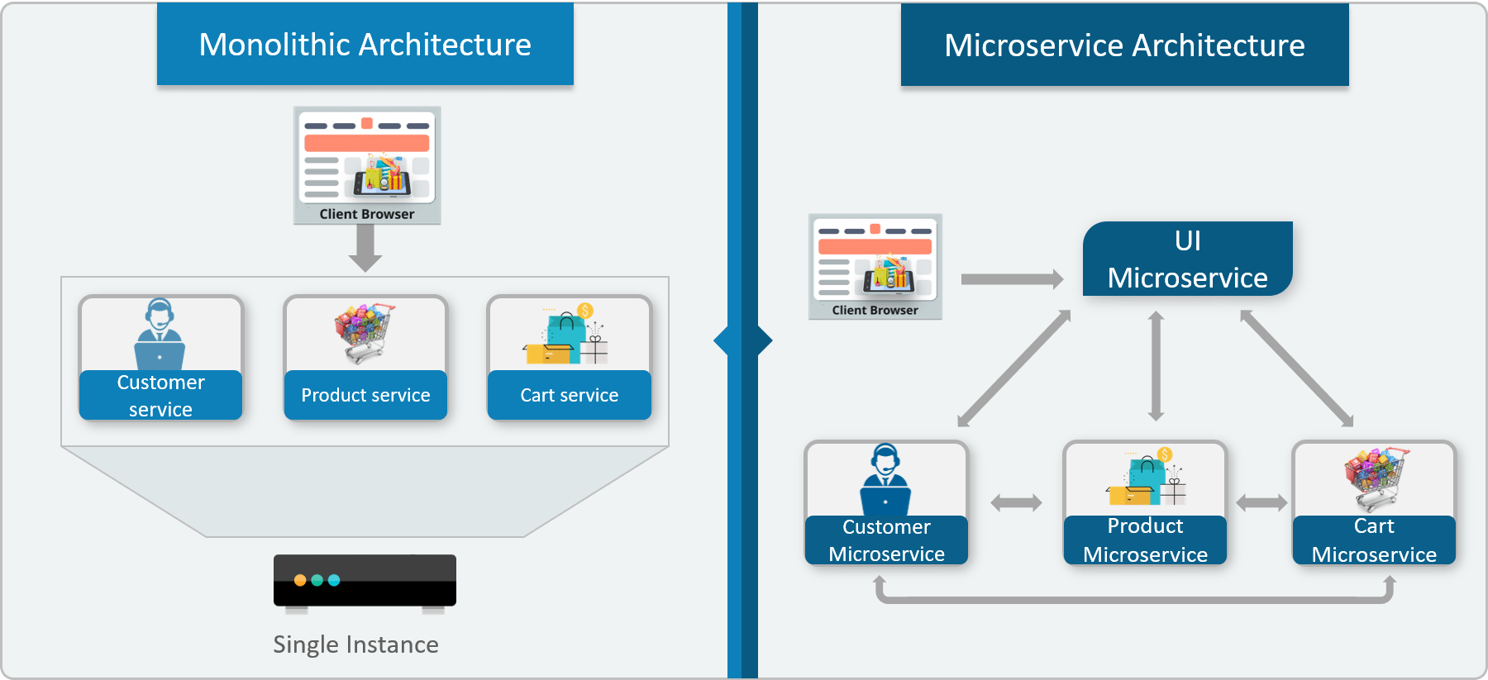

Monolithic vs Micro Service

Slide 14
Characteristics of Micro Service
Single-function
  Each and every service has a specific function, or responsibility.
  A service can do many tasks, but all of them are relevant to a single function.
Well-defined interfaces
  Services must provide an interface that defines to communicate with it.
  Defines a list of methods, and their inputs and outputs.
  JSON Schema or WSDL files

Slide 15
Characteristics of Micro Service
Independent
  Services doesn’t know about each other implementation.
  They can get tested, deployed, and maintained independently.
  Services may be implemented using different language stacks, and communicate with different databases.
    They can work together to complete a required operation.

Slide 16
Characteristics of Micro Service
Small Teams
  Split the work up and team across the services.
  Each team focuses on a specific service, they don’t need to know about internal workings of other teams.
  Teams can work efficiently, communicate easily,
  Each service can be deployed rapidly as soon as it’s ready.
Entire Lifecycle
  The team is responsible for the entire lifecycle of the service; from coding, testing, staging, deploying, debugging, maintaining.
  No separate team for coding, deployment. Etc

Slide 17
Characteristics of Micro Service
Minimizing Communication
  Only essential cross-team communication should be through the interface that each service provides.
  They all need to agree on the external interface, so that communication between services is clearly defined.
Cloud Enabled
  Dynamic Scaling

Slide 18
When Not to use Micro Services
Complexity is a key factor
  "...don't even consider microservices unless you have a system that's too complex to manage as a monolith...“ –Martin Fowler
If complexity isn't problem, microservices aren't the solution.
Micro service architecture also brings with it significant overhead
  Design
  Interoperability of services
  Management
  Use of system resources.

Slide 19
Challenges with Micro service
Development has some inherent complexities
Quick Setup needed
  Should be able to create micro services quickly.
Automation
  Smaller component build ,deployment, monitoring etc should automated
Visibility :
  Should be able to monitor and identify problems automatically.
  Need great visibility around all the components.
Debugging
  Centralized Logging and Dashboards are essential to debug problems.

Slide 20
Challenges with Micro service
Configuration Management
  Need to maintain configurations for hundreds of components across environments.
  Should Have Configuration Management solution
Dynamic Scale Up and Scale Down
  Applications should be easily scaled up and down
Pack of Cards :
  If a Service at the bottom of the call chain fails, it can have knock on effects on all other services.
  Services should be fault tolerant by Design.
Consistency
  Should have some decentralized governance around the languages, platforms, technology and tools used for implementing/deploying/monitoring

Slide 21
Solutions to Challenges
Spring Boot
  Enable building production ready applications quickly
  Provide non-functional features
  embedded servers (easy deployment with containers)
  metrics (monitoring)
  health checks (monitoring)
  externalized configuration

Slide 22
Solutions to Challenges
Spring Cloud
  Cloud solutions – From Spring and Open Sourced
Dynamic Scale Up and Down.
  Using a combination of Naming Server (Eureka)
  Client Side Load Balancing
  Feign (Easier REST Clients)
Visibility and Monitoring
  Zipkin Distributed Tracing
  API Gateway
Configuration Management
  Spring Cloud Config Server
Fault Tolerance
  Cloud Circuit Breaker

Slide 23
SPRING CLOUD EUREKA

Slide 24
Service Register and Discovery
Application is decomposed into Many Microservices.
  Each deployed in different servers and different ports.
Services may need to communicate with each other to execute some tasks
  Using ip address and port number has many limitations on invoking the services

Slide 25
Service Register and Discovery
“Service Registration“.
  Services are registered in a centralized location with an identifier and server details.
“Service Discovery”
  Microservice should be able to look up the list of registered services from the centralized location
Implementations of Service Registration and Discovery Server
  Netflix Eureka
  Consul
  Zookeeper

Slide 26
Netflix Eureka Server
Micro services will register with Eureka server
Services provide the following details
  host name, ip address, port, and health indicators etc…
serviceId.
  The Unique Id given to the registered Services
    Also Used to by other services for access

Slide 27
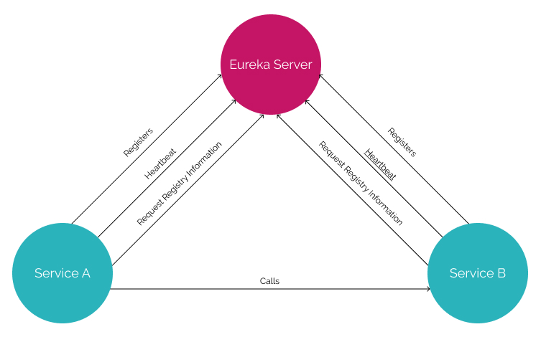
Service Registry

Slide 28
Service Registry
Handles only Registration
  Not communication between the two servers
  Communication is directly between the two services
Cache
  If Eureka is down, the client uses a cached copy of the remote service's address
  Can handle temporary network failures.

Slide 29
Netflix Eureka Server
EurekaServerConfigBean
  Implements EurekaServerConfig.
  Has properties that are prefixed by eureka.server.
  Maintains a registry of up and running micro services.
  Registered Services keeps pinging to notify that it’s alive.
EurekaInstanceConfigBean
  Represents a Eureka Instance
  Implements EurekaInstanceConfig.
  All properties are prefixed by eureka.instance.

Slide 30
Netflix Eureka Server
@EnableEurekaServer
  Added to the main Spring Boot Application configuration class
  Used to Notify the Spring Container that this application is a registration service by Netflix technology
  It also activates Eureka Server related configurations
  @EnableEurekaServer
  @SpringBootApplication
  public class EurekaServerApplication {
  public static void main(String[] args) {
  SpringApplication.run(EurekaServerApplication.class, args);
  }
  }

Slide 31
Server Config Properties
  server:
  port: 8761
  spring:
  application:
  name: eureka-server-registry
  eureka:
  client:
  fetch-registry: false
  register-with-eureka: false
  service-url:
  defaultZone: http://localhost:8761/eureka

Slide 32
Configuration Properties
fetch-registry=false (default: true)
  A Eureka instance is also a Eureka client
  It can fetch the registry containing the details of other instances.
  “false” means it will not be fetching the registry information
register-with-eureka=false (default: true)
  Should this server register itself as a client;
  “false” means it prevents itself from acting as a client.

Slide 33
Configuration Properties
eureka.client.serviceUrl.defaultZone
  In a standalone mode
    points to the local server address.
    Switch off the client-side behavior
    Does not keep trying and failing to reach its peers.

Slide 34
EUREKA DISCOVERY CLIENT

Slide 35
Discovery From Eureka Server
EurekaClientConfigBean
    Implementation of EurekaClientConfig.
    Properties are prefixed by eureka.client.
Discovery clients
  Clients can look up and fetch information of other services
  Can communicate without IP addresses and port numbers

Slide 36
Discovery Clients
@EnableDiscoveryClient
  Added in the main spring boot configuration class
  Works with any Discovery Client implementations
  Example : Eureka, Consul, Zookeeper
@EnableEurekaClient
  Works only with Eureka

Slide 37
Discovery Client Service
  @SpringBootApplication
  @EnableEurekaClient
  public class BloodDonarServiceApplication {
  public static void main(String[] args) {
  SpringApplication.run(BloodDonarServiceApplication.class, args);
  }
  }

Slide 38
application.yml
  spring:
  application:
  name: product-service
  server:
  port: 5454
  eureka:
  client:
  service-url:
  defaultZone: http://localhost:8761/eureka

Slide 39
SUMMARY

Slide 40
Working of Eureka
Eureka server:
  When the Eureka client is bootstrapped, it tries to talk with the Eureka server in the same Zone.
    If it is not available, then it fails over to another Zone.
  Target is determined using the defaultZone property
  If it's failing over to another Zone, the Eureka server should be peer connected.
Register:
  Eureka client shares the instance information with the Eureka server
  Registers with the {service-id } using (spring.application.name).

Slide 41
Working of Eureka
Heartbeat:
  Eureka client sends a heartbeat to the Eureka server to renew its leases.
  Heartbeat is sent to the eureka server every 30 seconds
  If after 90 seconds the Eureka server does not get any heartbeat from the Eureka client,
    Unregisters the Eureka client instance from the service registry
    Sends the updated registry to all peers and Eureka clients.

Slide 42
Working of Eureka
Fetching service registry:
  Clients fetch the service registry from the Eureka server
    Can discover other services and communicate with them.
  Registry information gets updated after every 30 seconds
    Done by receiving delta updates from the Eureka server.
  Eureka server also caches the delta updates every 3 minutes
    Eureka client can receive the same delta instances multiple times.
  After receiving delta updates, it again tries to compare its local registry with the server registry to check that delta is successfully applied.
    If there are any mismatches, it pulls all the registries again.

Slide 43
Working of Eureka
Unregister:
  When the client instances are going to shut down
  They send a cancel signal to the Eureka client so the Eureka server unregisters it from its registry.
Synchronization:
  There may be some time lag as the Eureka server and client manage the cache.

Slide 44
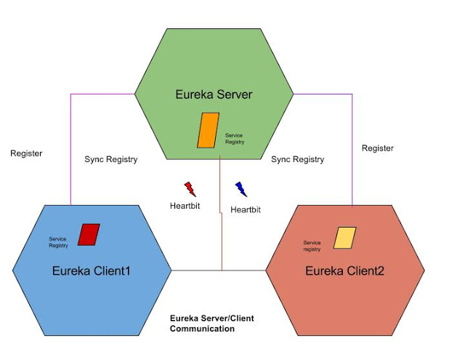
Eureka Working

Slide 45
Eureka Zones
  eureka:
  client:
  service-url:
  zone1: http://localhost:8761/eureka/
  fetch-registry: false
  register-with-eureka: false

Slide 46
CLUSTERING EUREKA

Slide 47
Eureka High Availability
Eureka achieves high availability Using Server Cluster
  Eureka can be deployed as a cluster of servers.
    When one of these Eureka servers crash,
  clients can still connect to the remaining Eureka servers and discover other services
Peer Awareness
  Individual servers of the cluster are called peers.
  When the peers start up, they register with each other
  Helps in synchronizing registrations among themselves.

Slide 48
High Availability
  It is the ability of a system or system component to be continuously operational for a desirably long length of time
  A client is provided with a list of Eureka servers through configuration
    Either to DNS or /etc/hosts
  Client attempts to connect to server1; where server2 is sitting idle.
  In case server1 is unavailable, the client tries the next one from the list.
  When server1 comes back online, client goes back to using server1.
  server1 and server2 can be ran in peer-aware mode, and their registries replicated.

Slide 49
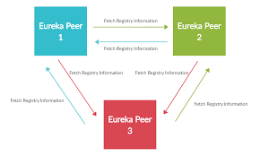
Peer Awareness

Slide 50
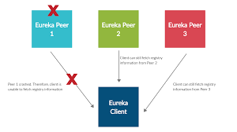
Peer Awareness

Slide 51
Application.yml
  spring:
  config:
  activate:
  on-profile:
  - peer1
  application:
  name: eureka-clustred
  eureka:
  instance:
  hostname: eureka-peer1
  appname: eureka-clustered
  client:
  service-url:
  defaultZone: http://eureka-peer2:8770/eureka
  server:
  port: 8765

Slide 52
Application.yml
  spring:
  config:
  activate:
  on-profile:
  - peer2
  application:
  name: eureka-clustered
  eureka:
  instance:
  hostname: eureka-peer2
  appname: eureka-clustered
  client:
  service-url:
  defaultZone: http://eureka-peer1:8765/eureka
  server:
  port: 8770

Slide 53
application.yml
eureka.instance.hostname:
  The hostname eureka advertises
eureka.instance.appName
  Eureka instances find each other using appName
  Its defaulted to spring.application.name
    If Not defined declared as UNKNOWN
  Used when registering multiple Instances
  Applications with the same name are clustered together in Eureka server.

Slide 54
Client – application.yml
  spring:
  application:
  name: cluster-client
  server:
  port: 6060
  eureka:
  client:
  service-url:
  defaultZone: http://eureka-peer1:8765/eureka

Slide 55
Setting Cluster in Local Machine
Each of the server peers will run on separate hosts and ports.
Additional configurations are required to start this entire cluster in local machine
Need to edit the hosts file found in C:\Windows\System32\drivers\etc\hosts file
  Need to open with administrator privilege
  127.0.0.1 eureka-peer1
  127.0.0.1 eureka-peer2
java -jar -Dspring.profiles.active= eureka-peer1 eureka-server-1.0.0-
SNAPSHOT.jar

Slide 56
SPRING CLOUD CONFIG SERVER

Slide 57
Move configuration away from application
Cloud Applications requires a way to maintain and distribute the Configuration data to all services
Auditing changes:
  Look at the history of what changes were done by whom and when they were applied.
Approval of changes:
  Lot of issues are caused by the wrong configuration.
  Changes should be approved by some one
Resiliency:
  Issues related to configuration tool being not available
Synchronization:
  Way to know that there is a change in the configuration

Slide 58
Spring-cloud-config-server
Pulls configuration for remote clients from various sources.
  It adds a PropertySourceLocator, which will use one or more EnvironmentRepository that talk to different systems.
  Repositories can resolve the Environment that applies for a specific application, profile, and label.
  There are different implementations of EnvironmentRepository that can connect to Git, SVN, or Vault.

Slide 59
Spring Cloud Config Client
The client which will connect to the server through HTTP.
It adds a PropertySourceLocator that will call the server to load up the applicable configuration.

Slide 60
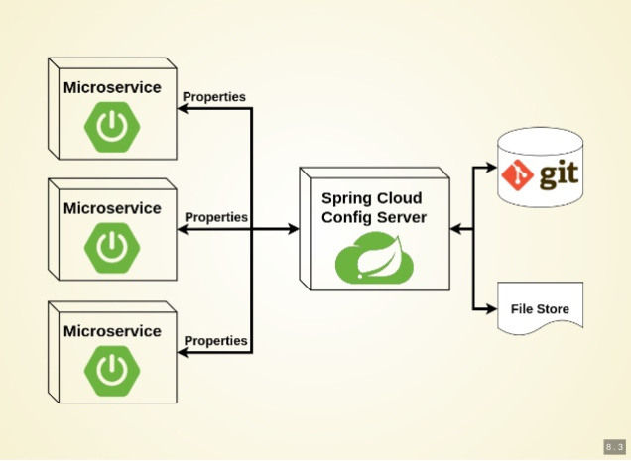
Working of Configuration Server

Slide 61
Types of Configuration
Global Configuration
  By Using application.yml or application.propeties
Application-Specific Configuration
  Serving only to a specific app.
  [APP-NAME].yml or [APP-NAME].properties
. Profile-Specific Configuration
  [APP-NAME]-[PROFILE-NAME].yml or [APP-NAME]-[PROFILE-NAME].properties

Slide 62
Git Repository
Can store the properties in git repository
Create or update a git repository.
Can Create and place the external property files
  Micro Service will be using external configuration of properties.
Can maintain same property name for different environment
It can be details of urls, credentials, database details etc.

Slide 63
Git Repository Directory Structure
https://github.com/vatsanTraining/spring-cloud-config
  common
    application.yml
  customer-service
    application.yml
  payment-service
    application.yml

Slide 64
Config Server
Spring Cloud Config Server provides an HTTP resource-based API for external configuration
@EnableConfigServer
  The server is embeddable in a Spring Boot application
  @SpringBootApplication
  @EnableConfigServer
  public class ConfigServer {
  public static void main(String[] args) { SpringApplication.run(ConfigServer.class, args);
  }
  }

Slide 65
Spring Cloud Configuration Server
Repository can also optionally store config files in sub-directories, and patterns to search for those directories can be specified as searchPaths.
  spring:
  cloud:
  config:
  server:
  git:
  uri: https://github.com/vatsank/spring-cloud-config
  search-paths:
  - '{application}'

Slide 66
Config Client Configuration
  spring:
  application:
  name: customer-service
  config:
  import: configserver:http://localhost:8888
  management:
  endpoints:
  web:
  exposure:
  include:
  - "*“
  http://localhost:8080/actuator/configprops

Slide 67
REACTIVE SPRING

Slide 68
Introduction
A programming paradigm that promotes
  asynchronous, non-blocking, event-driven approach to data processing.
Thread per request model to more requests with few number of threads
  Prevent threads from blocking while waiting for I/O operations to complete

Slide 69
Subscription
Subscription made by the subscriber
With the publisher
  To fetch data.
  public interface Subscription {
  public void request(long n);
  public void cancel();
  }

Slide 70
Subscriber
Represents the consumer of the stream data.
  public interface Subscriber<T> {
  public void onSubscribe(Subscription s);
  public void onNext(T t);
  public void onError(Throwable t);
  public void onComplete();
  }

Slide 71
Publisher
Represents the data source
  database, external service, etc.
  public interface Publisher<T> {
  public void subscribe(Subscriber<? super T> s);
  }

Slide 72
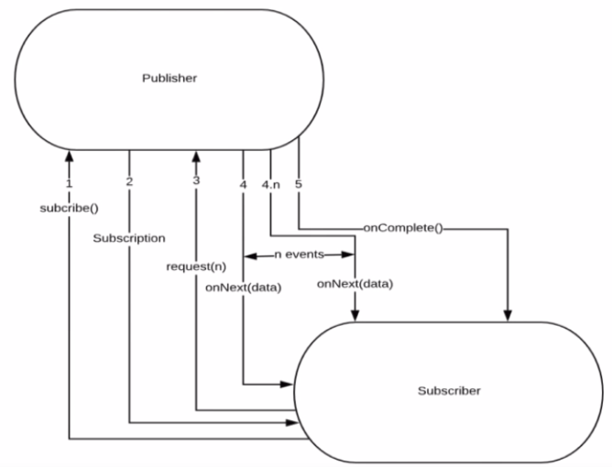
Flow Between Publisher and Subscriber

Slide 73
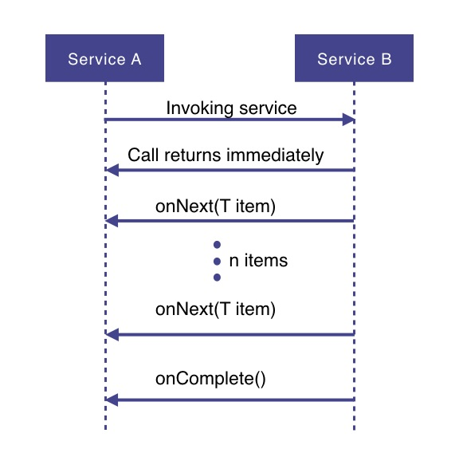
How Does it Work

Slide 74
How Does it Work
Service A wants to retrieve some data from service B.
Service A will make a request to service B which returns immediately
  Non-blocking and asynchronous.
Data requested will be made available to service A as a data stream,
  Service B will publish an onNext-event for each data item one by one.
When all the data has been published
  onComplete event is fired
In case of an error, an onError event would be published
  Items would not be emitted.

Slide 75
PROJECT REACTOR

Slide 76
PROJECT REACTOR
Spring Framework supports reactive programming since version 5.
  That support is build on top of Project Reactor.
WebFlux, Spring's reactive-stack web framework, requires Reactor as a core dependency.
Suited for Microservices Architecture
Offers backpressure-ready network engines for HTTP (including Websockets), TCP, and UDP.
Built and maintained by Pivotal
Recommended Library to work with Spring Boot
Runs on Java 8 and above.

Slide 77
Setting up a Project
Spring Boot application using Spring Initializr.
  Add Spring Reactive Web as dependecy
The spring-boot-starter-webflux dependency is added
  It will bring in the reactor-core dependency.
  The reactor-test has been added as a dependency.
Spring Webflux
  A reactive-stack web framework
  Runs on Netty, and Servlet 3.1+ containers.

Slide 78
Types of Publishers
Spring Webflux uses two Publishers
Mono
  To publish 0..1 element
  Mono is like the Optional type provided in Java 8.
  Mono to return a single object or VOid
Flux
  To publish 0..N element.
  Used to return lists.

Slide 79
Flux and Mono
They are both terminated either by a completion signal or an error
They call a downstream Subscriber's onNext, onComplete and onError methods.
Both provide a set of operators to support transformations, filtering, and error handling.

Slide 80
Creating Flux
Just (T... data)
  Overloaded method
  Create a new Flux that will only emit a single element then onComplete.
  Returns a new Flux
Flux<String> fluxColors = Flux.just("red", "green", "blue");
fluxColors.subscribe(System.out::println);

Slide 81
SPRING WEBCLIENT

Slide 82
WebClient
Introduced from Spring 5
  Its a non-blocking client with support for Reactive Streams.
  It’s a replacement for RestTemplate .
  Its more functional and is fully reactive.
  It's included in the spring-boot-starter-weblux dependency

Slide 83
Load Balancing
A distributed system may consist of many services running on different computers.
When the number of users is large, a service is created multiple replicas.
Each replica runs on a different computer.
A Load Balancer” helps to distribute incoming traffic equally among servers.

Slide 84
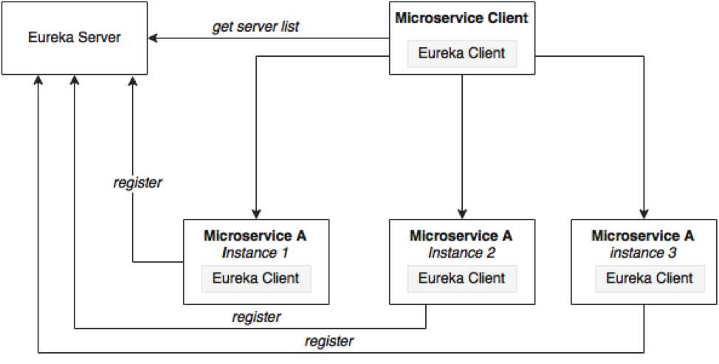
Load Balancing

Slide 85
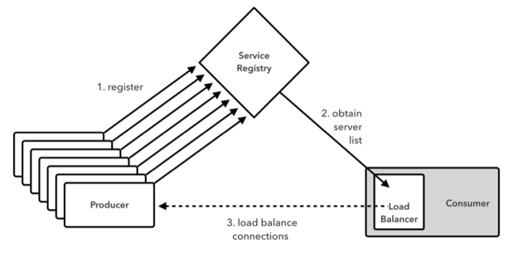
Working of Load Balancer

Slide 86
Load Balancing on Server Side
Load Balancers are components placed at the Server Side.
When the requests come from the Client, they will go to the load balancer, and the load balancer will designate a Server for the request.
It may use algorithm like random designation.
Most load balancers are hardware, integrated with software to control load balancing.
Need a separate server to host the load balancer instance which has the impact on cost and maintenance.

Slide 87
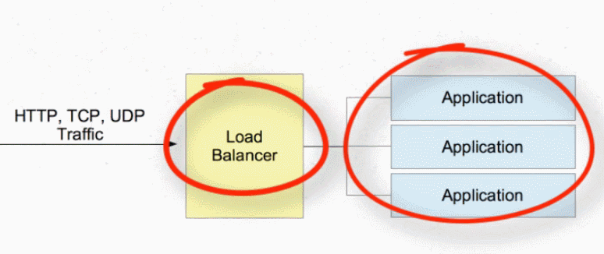
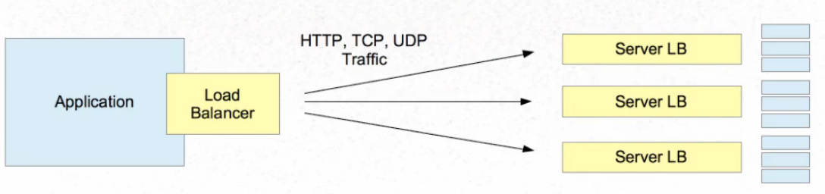
Server Side and Client Side

Slide 88
Scalability
As the traffic to a Service increases it can hinder its performance
  Should be managed properly.
Load balancing, gives ability to add a physical or virtual server to accommodate demand without causing a service disruption.
As new servers come online, the load balancer recognizes them and seamlessly includes them in the process.

Slide 89
Load Balancing with Web Client
Add spring-cloud-starter-load balancer dependencies
Web Client can be configured to work with Load Balancer client
WebClient.Builder
  Used to create a load-balanced WebClient
  Add the @Bean annotation

Slide 90
Load Balancing with Web Client
  @Bean
  @LoadBalanced
  WebClient.Builder builder() {
  return WebClient.builder();
  }
  @Bean
  WebClient client(WebClient.Builder builderRef) {
  return builderRef.build();
  }

Slide 91
Reactive Load Balancer
ReactiveLoadBalancer
  The Implementation of the interface uses a Round-Robin
  It gets instance from reactive ServiceInstanceListSupplier
  It retrieves available instances from Service Discovery using a Discovery Client available in the classpath.
@LoadBalanced
  Need to have a load balancer implementation in the classpath.
  If the Spring Cloud LoadBalancer is in the class path Then, ReactiveLoadBalancer is used
    Helps to use "logical identifiers" for the URLs passed

Slide 92
Http Methods
get()
  indicates that we are making a GET request.
  We know that the response will be a single object, so we're using a Mono as explained before.
  client.get()
  Client.post()

Slide 93
WebClient
client.get().uri("lb://PRODUCT-SERVICE/api/v1/items")
URI
  Takes a service name => lb://PRODUCT-SERVICE
The “lb“ in the “uri” will use the LoadBalancerClient
  Load Balancer Client will resolve to an actual host and port
  Replaces the URI

Slide 94
Rest Client - Controller
  @RestController
  public class ClientController {
  @Autowired
  private WebClient client;
  @GetMapping(path = "/hotels")
  public Flux<String> getAllHotels(){
  return client.get()
  .uri("lb://HOTEL-SERVICE/api/v1/hotels")
  .retrieve()
  .bodyToFlux(String.class);
  }
  }

Slide 95
Rest Client - Controller
  @PostMapping(path = "/hotels")
  public Mono<HotelDto> create(@RequestBody HotelDto dto)
  {
  return client.post()
  .uri("lb://HOTEL-SERVICE/api/v1/hotels/{id}")
  .body(Mono.just(dto), HotelDto.class)
  .retrieve()
  .bodyToMono(HotelDto.class);
  }

Slide 96
Rest Client - Controller
  @DeleteMapping(path = "/hotels/{id}")
  public Mono<Void> removeHotelById(@PathVariable("id") int id){
  return client.delete()
  .uri("lb://HOTEL-SERVICE/api/v1/hotels/{id}" ,id)
  .retrieve()
  .bodyToMono(Void.class);
  }
  }

Slide 97
Rest Client - Controller
  @GetMapping(path = "/hotels/{id}")
  public Mono<String> getHotelById(@PathVariable("id") int id){
  return client.get()
  .uri("lb://HOTEL-SERVICE/api/v1/hotels/{id}",id)
  .retrieve()
  .bodyToMono(String.class);
  }

Slide 98
To Register Multiple Instances
  server:
  port: ${port:0}
  eureka:
  instance:
  instance-id: ${spring.application.name}:${spring.application.instance_id:${random.value}}
  client:
  register-with-eureka: true
  fetch-registry: true
  service-url:
  defaultZone: http://localhost:8761/eureka

Slide 99
Get the Instance’s Port Number
  @Autowired
  private ServletWebServerApplicationContext webServerAppCtxt;
  System.out.println(webServerAppCtxt.getWebServer().getPort());

