Slide 1
Application Of Cebra
Learning from Time Series data

Slide 2
Combinations
Sl No | Feature Types | Include Raw IMU Columns? | Include THF and TOF? | Cebra Output Dimension | MR F1 Score (Macro) | MR F1 Score (Weighted) | Detach F1 Score (Macro) | Detach F1 Score (Weighted)
#1 | With Physics based feature extraction | No | Yes | 8 | 0.3279 | 0.3154 | 0.2521 | 0.26776
#2 | With Physics based feature extraction | No | No | 8 | 0.3577 | 0.3144 | 0.3098 | 0.2808

Slide 3
#1 With Physics based feature extraction - Include THF and TOF
Detailed Visualization and Comparison

Slide 4
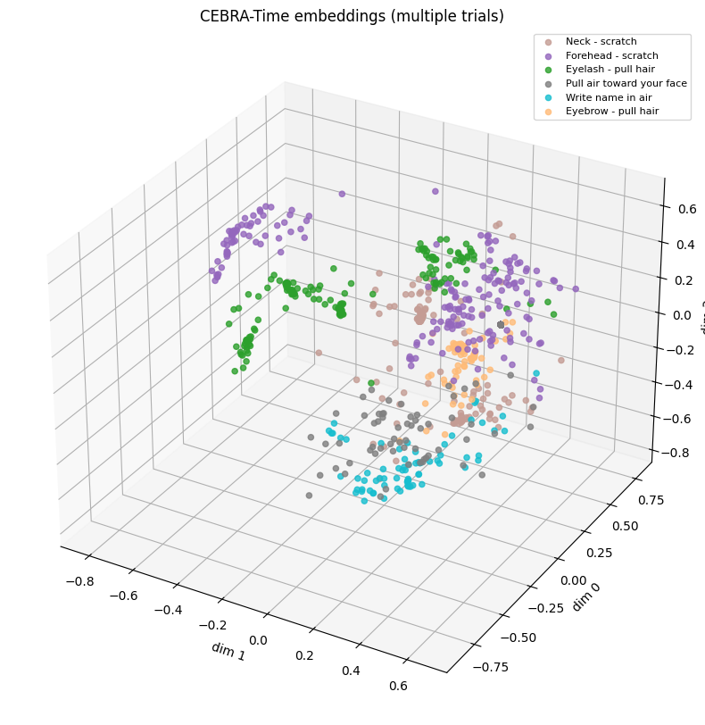
Some gestures in the latent space

Slide 5
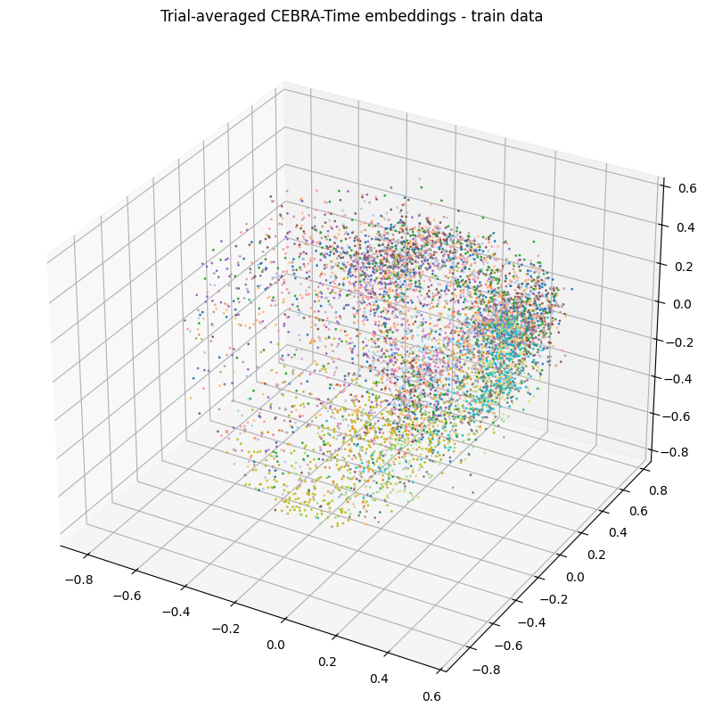
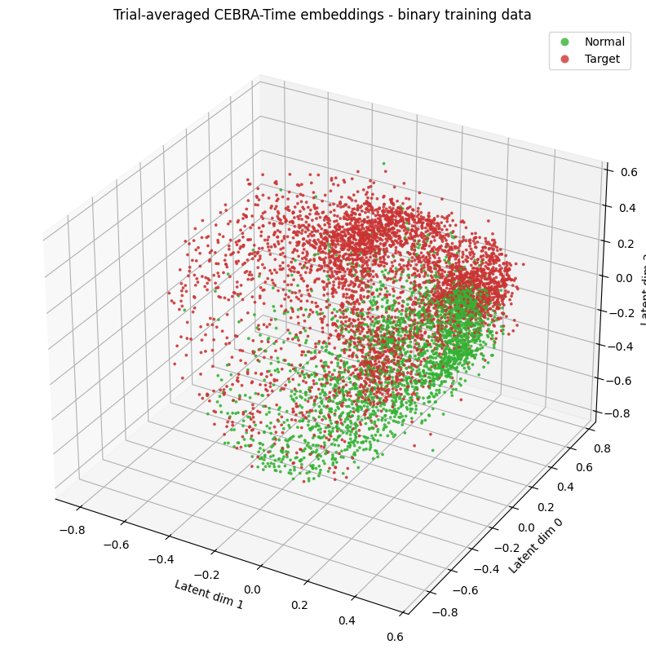
Average embedding vectors, grouped by type – Training data

Slide 6
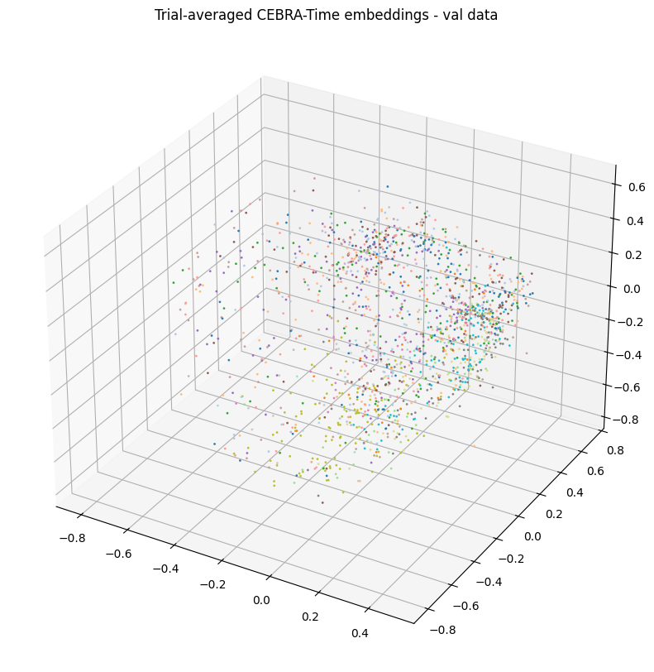
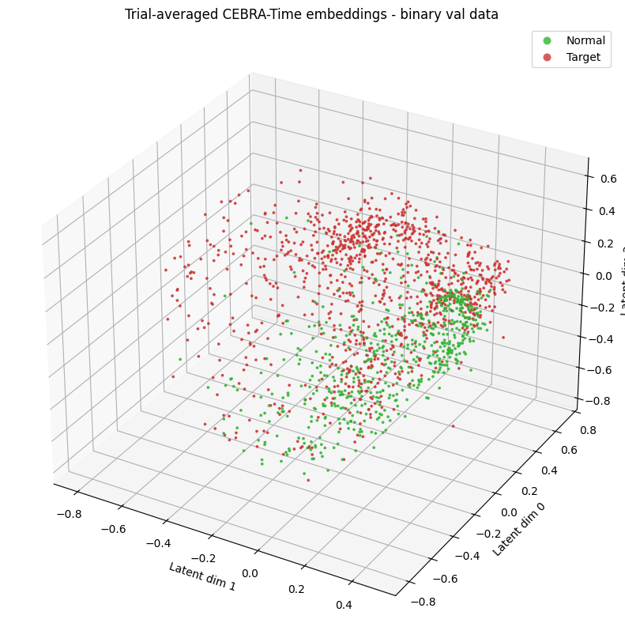
Average embedding vectors, grouped by type – Validation data

Slide 7
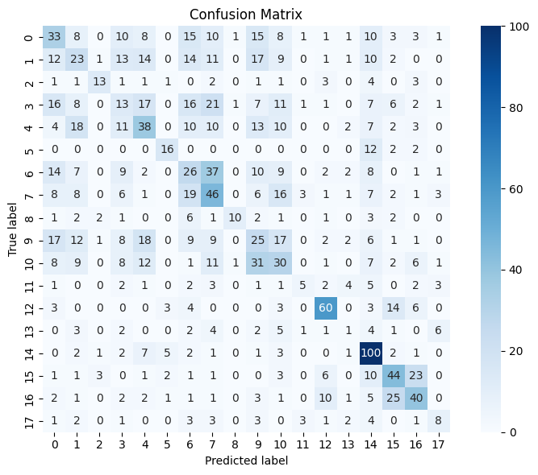
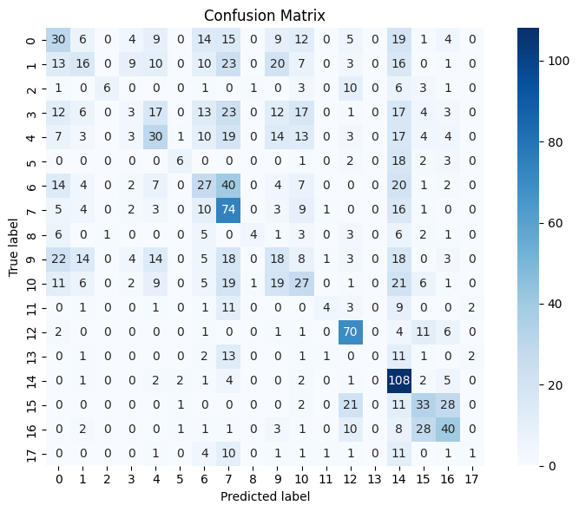
Confusion Matrix Comparison – Validation data
MiniRocket
Detach Rocket

Slide 8
#w With Physics based feature extraction - Exclude THF and TOF
Detailed Visualization and Comparison

Slide 9
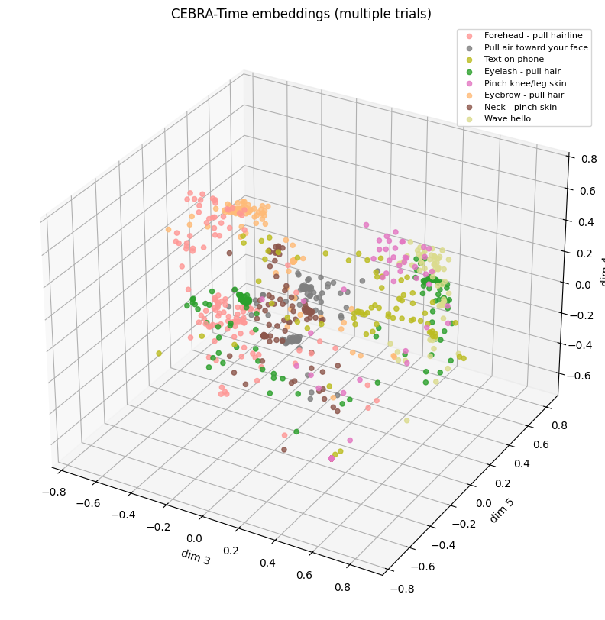
Some gestures in the latent space

Slide 10
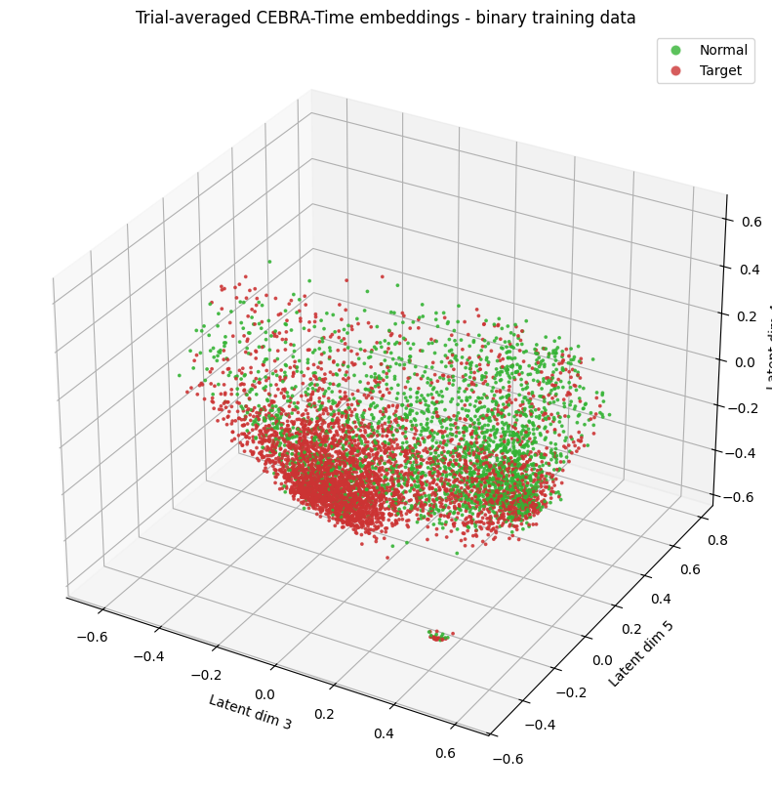
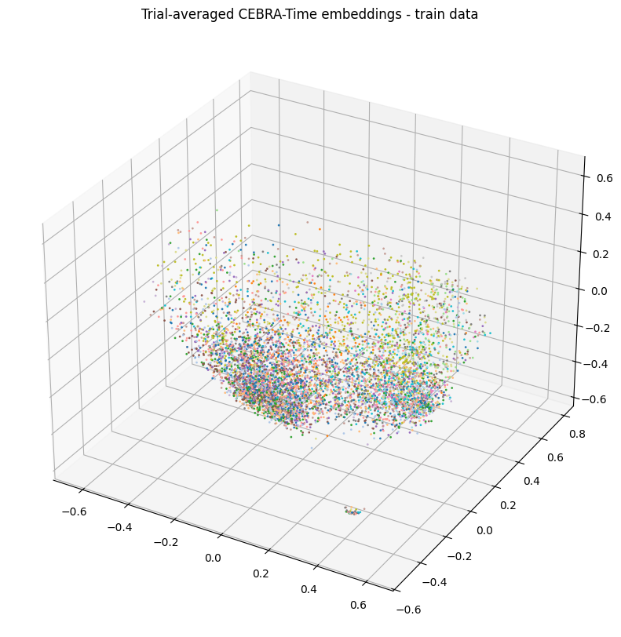
Average embedding vectors, grouped by type – Training data

Slide 11
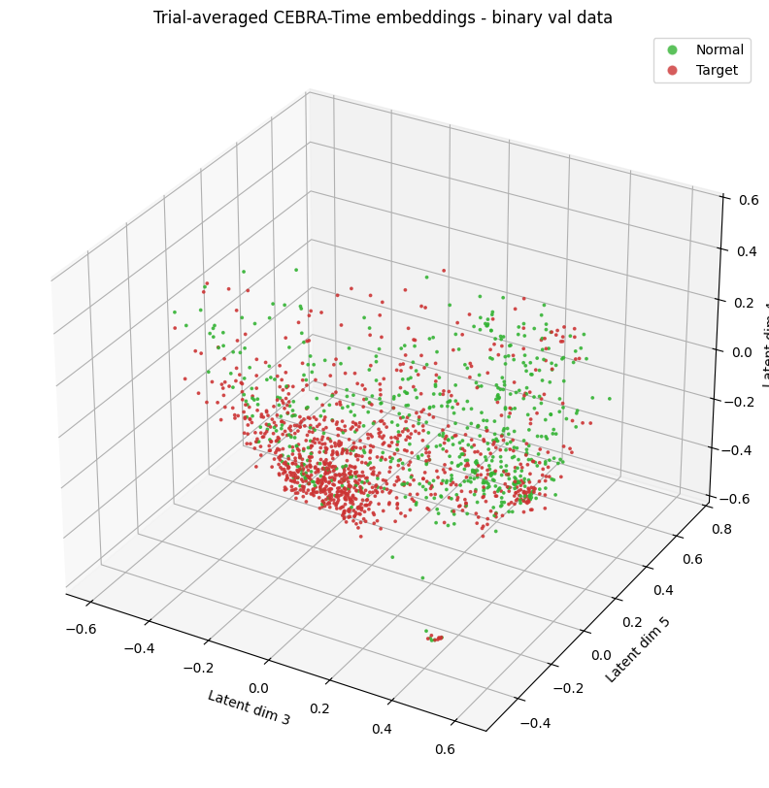
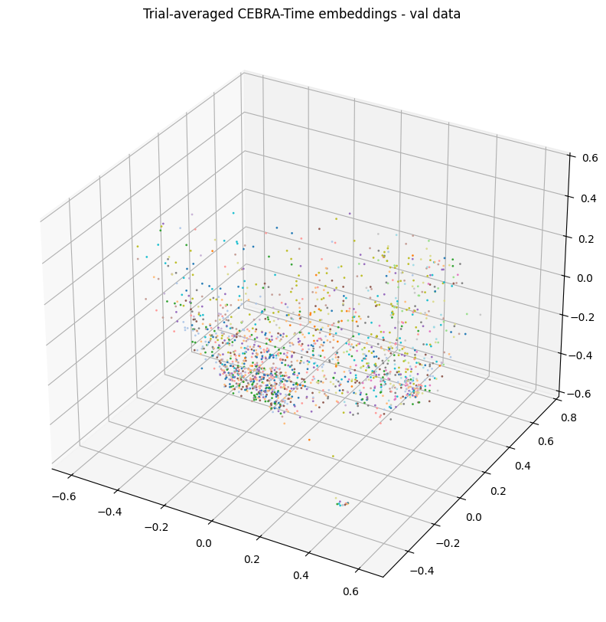
Average embedding vectors, grouped by type – Validation data

Slide 12
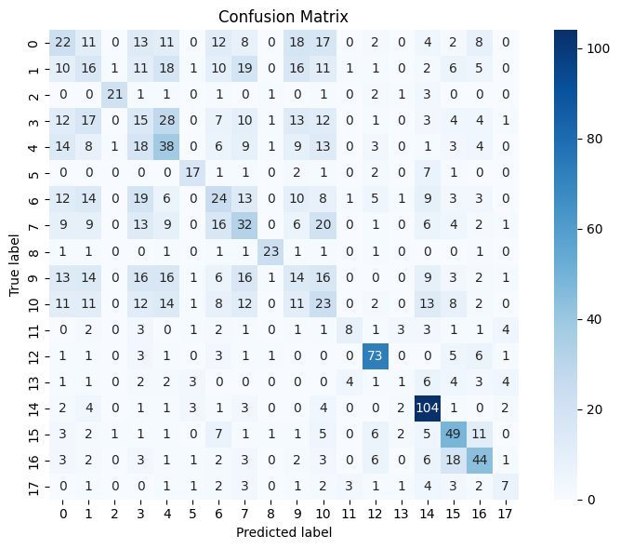
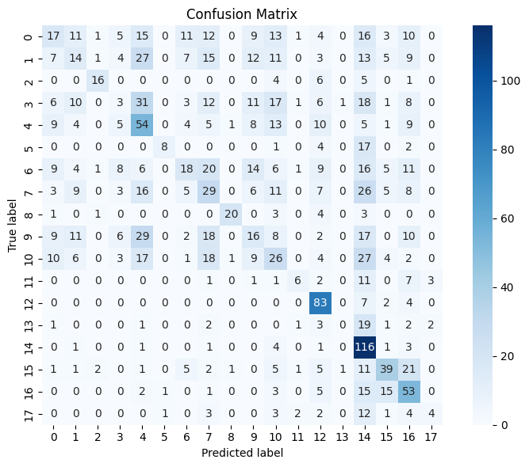
Confusion Matrix Comparison – Validation data
MiniRocket
Detach Rocket

