Slide 1
Time Series Forecasting
Overview and Discussion

Slide 2
Agenda
Data Preprocessing
Baselining
Machine Learning (Global Forecast Model)
Deployment

Slide 3
Data Preprocessing
Missing data
Visualization
Decomposition
Outlier handling

Slide 4
Handling missing data – few timepoints
Simpler techniques
  Last Observation Carried Forward or Forward Fill
  Next Observation Carried Backward of Backward Fill
  Nearest Interpolation
  Mean Value Fill
Interpolation
  Linear Interpolation
  Spline, Polynomial, and Other Interpolations

Slide 5
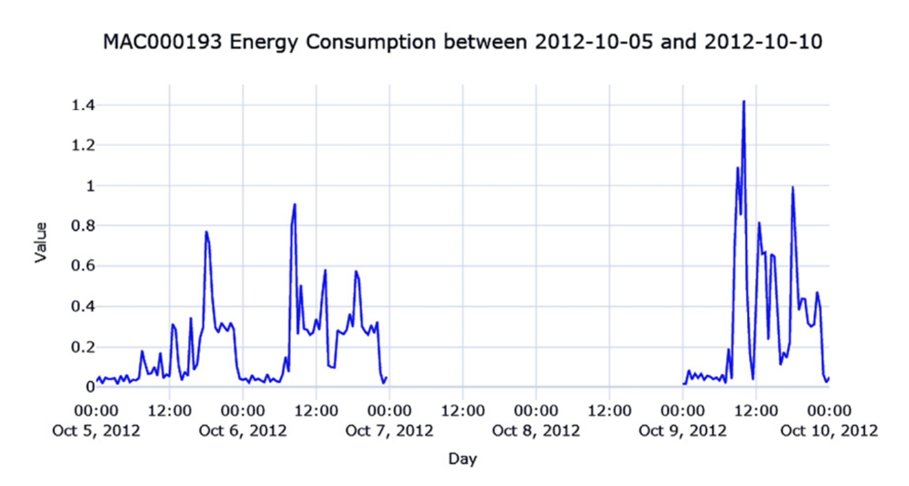
Handling bigger gaps
Ref: Modern Time Series Forecasting with Python, Second Edition, Manu Joseph, Jeffrey Tackes

Slide 6
Handling bigger gaps
Imputing with the previous day
Hourly average profile
The hourly average for each weekday
Seasonal interpolation
  Fills missing data by temporarily removing repeating patterns, filling gaps smoothly, and then restoring those patterns.

Slide 7
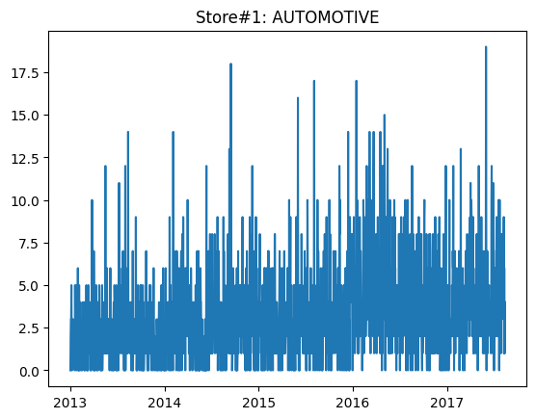
Visualization

Slide 8
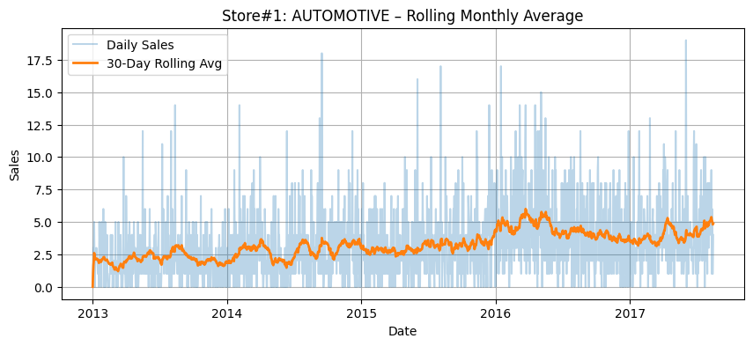
Visualization: Macro Patterns

Slide 9
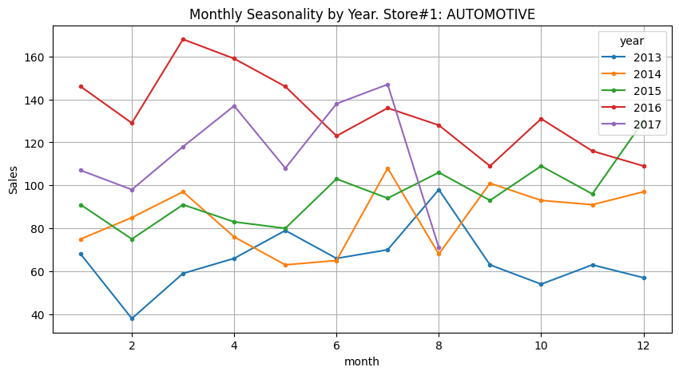
Visualization: Seasonality

Slide 10
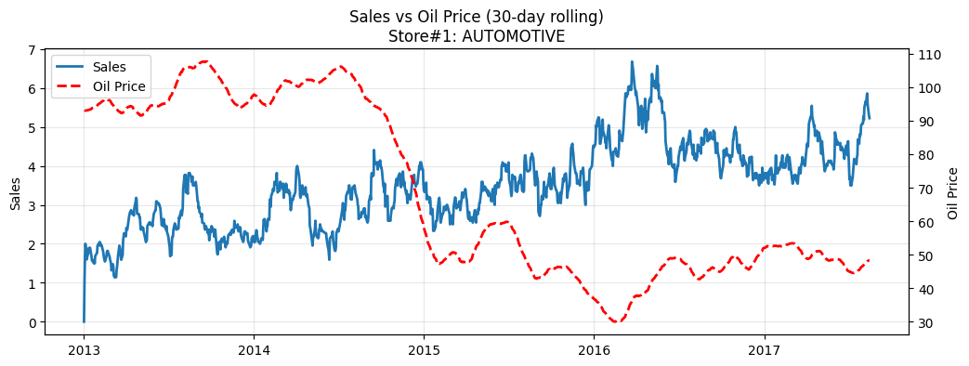
Visualization: Correlation

Slide 11
Decomposition
Time series data = trend + seasonality + residual
Remove trend
  diff(t) = x(t) − x(t−1)
Remove seasonality
  Weekly
    x(t) − x(t−7)
  Yearly
    x(t) − x(t−365)

Slide 12
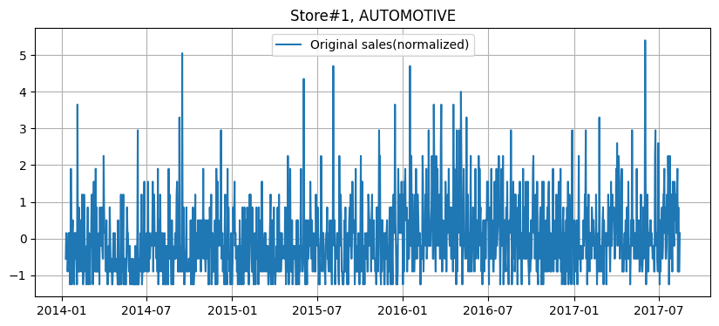
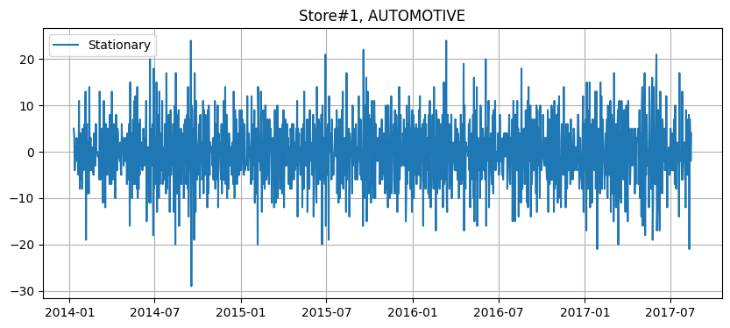
Decomposition

Slide 13
Outlier handling
Detection:
  Standard deviation
  IQR
  Isolation Forest
Removal:
  Do not blindly remove outliers as they may contain information
  Replace with a heuristic such as the maximum, minimum, and 75th percentile
  Consider the outliers as missing data
Modern algorithms are capable of handling outliers

Slide 14
Baselining
Setting up a test harness
Generating strong baseline forecasts (classical and statistical methods)
Assessing the forecastability of a time series

Slide 15
Setting up a test harness
Train, Validation and Test
Evaluation metric
  Mean Absolute Error (MAE)
  Mean Square Error (MSE)
  Mean Absolute Scaled Error (MASE)
  Forecast Bias (FB)

Slide 16
Generating strong baseline forecasts
Naïve Forecast
Seasonal Naïve Forecast

Slide 17
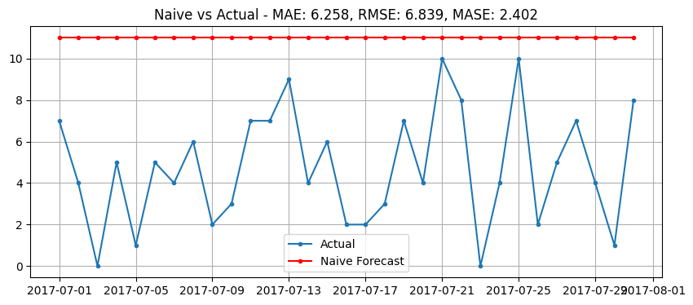
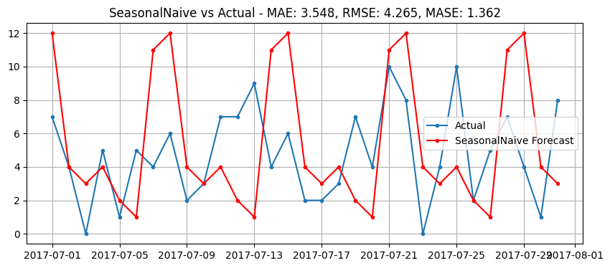
Generating strong baseline forecasts

Slide 18
Generating strong baseline forecasts
Naïve Forecast
Seasonal Naïve Forecast
Exponential smoothing
  Calculate rolling mean with decreasing weights as we look farther back
  Modeled around trend and seasonality

Slide 19
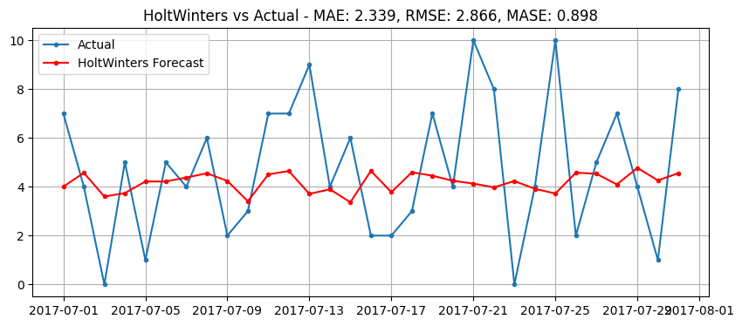
Generating strong baseline forecasts

Slide 20
Generating strong baseline forecasts
Naïve Forecast
Seasonal Naïve Forecast
Exponential smoothing
AutoRegressive Integrated Moving Average (ARIMA)
  relies on autocorrelation (the correlation of y(t) with y(t-1), y(t-2), and so on)

Slide 21
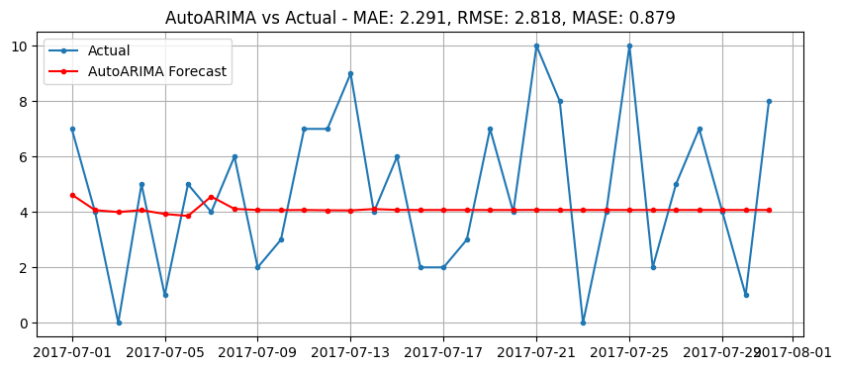
Generating strong baseline forecasts
Flat Predictions Because
AutoARIMA is not good for short spikes (daily sales)
Settles to seasonal mean

Slide 22
Generating strong baseline forecasts
Naïve Forecast
Seasonal Naïve Forecast
Exponential smoothing
AutoRegressive Integrated Moving Average (ARIMA)
Theta Forecast

Slide 23
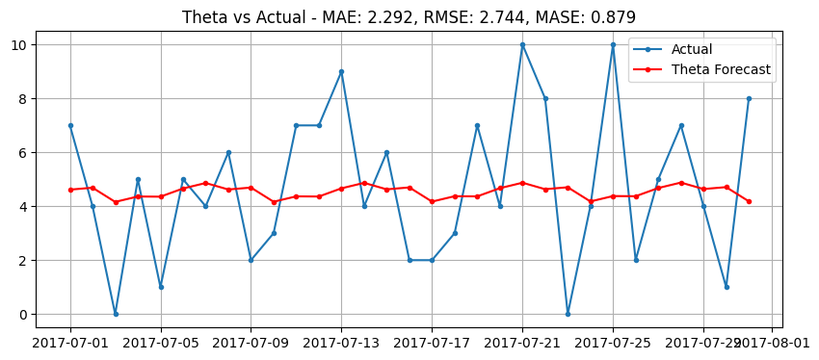
Generating strong baseline forecasts
Captures the pattern but not the peaks

Slide 24
Generating strong baseline forecasts
Naïve Forecast
Seasonal Naïve Forecast
Exponential smoothing
AutoRegressive Integrated Moving Average (ARIMA)
Theta Forecast
Multiple Seasonal-Trend decomposition using LOESS (MSTL)
  Use regression technique to extract Trends, Cycles, Seasonality and Irregularity
  Employs non seasonal model to forecast and then add the components

Slide 25
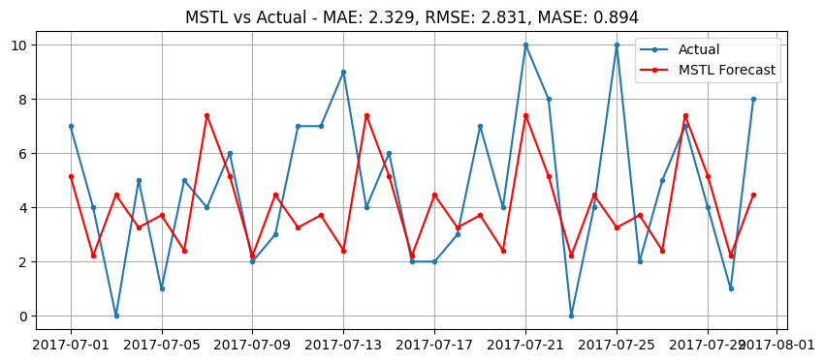
Generating strong baseline forecasts

Slide 26
Model Trials: for a specific product family
for store_nbr in list(df.store_nbr.unique()):
  df_store_nbr=df[df['store_nbr']==store_nbr]
  for model_name, model in models_dict.items():
    metrics = evaluate_model(
    model=model,
    model_name=model_name,
    ts_train=ts_train,
    ts_val=ts_val,
    _ts_train=_ts_train,
    _ts_val=_ts_val,
    freq='D',
    seasonality=7
    )

Slide 27
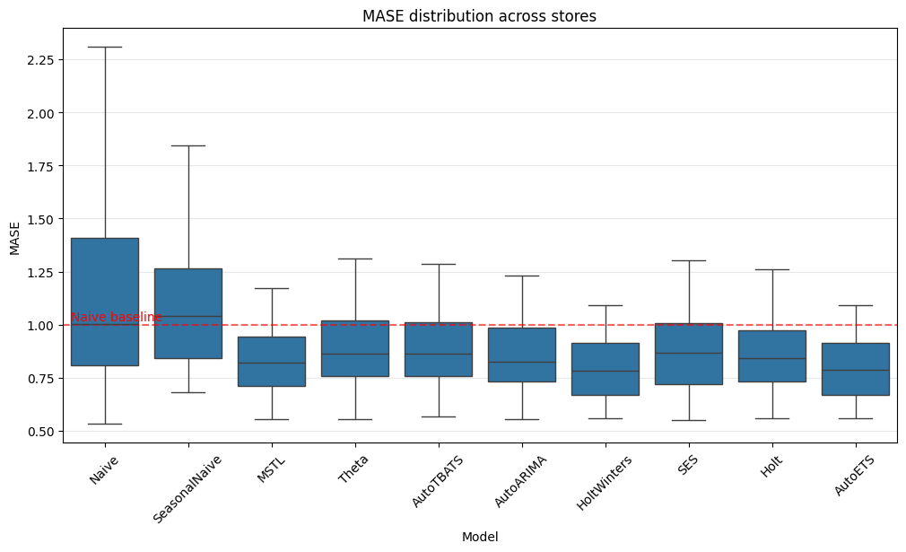
Model Trials: for a specific product family across all stores

Slide 28
Model Trials: for a specific product family across all stores
Model | Num_Wins
HoltWinters | 19
MSTL | 12
SES | 8
AutoETS | 5
Naive | 3
AutoTBATS | 2
Theta | 2
Holt | 1
AutoARIMA | 1
SeasonalNaive | 1

Slide 29
Forecastability
Coefficient of variation
  How variable the series is relative to its average level?
Residual variability
  How much randomness remains after removing trend and seasonality?
Spectral entropy
  How spread out the signal’s energy is across frequencies?
Kaboudan metric
  How much better a model forecasts the real series compared to a shuffled version?

Slide 30
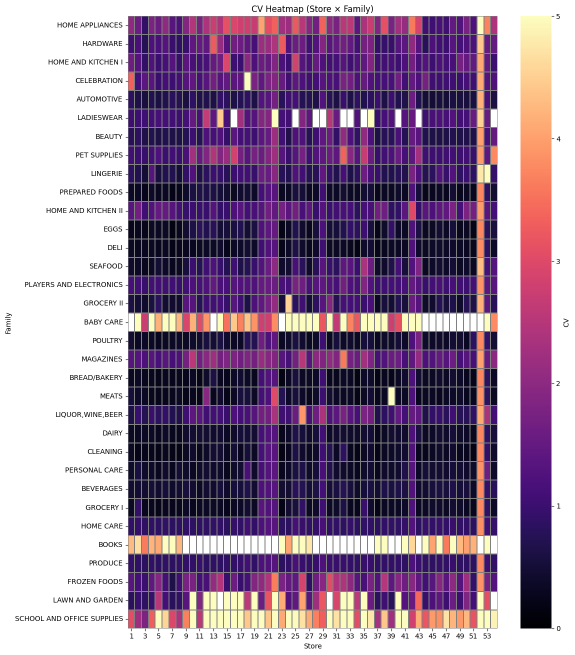
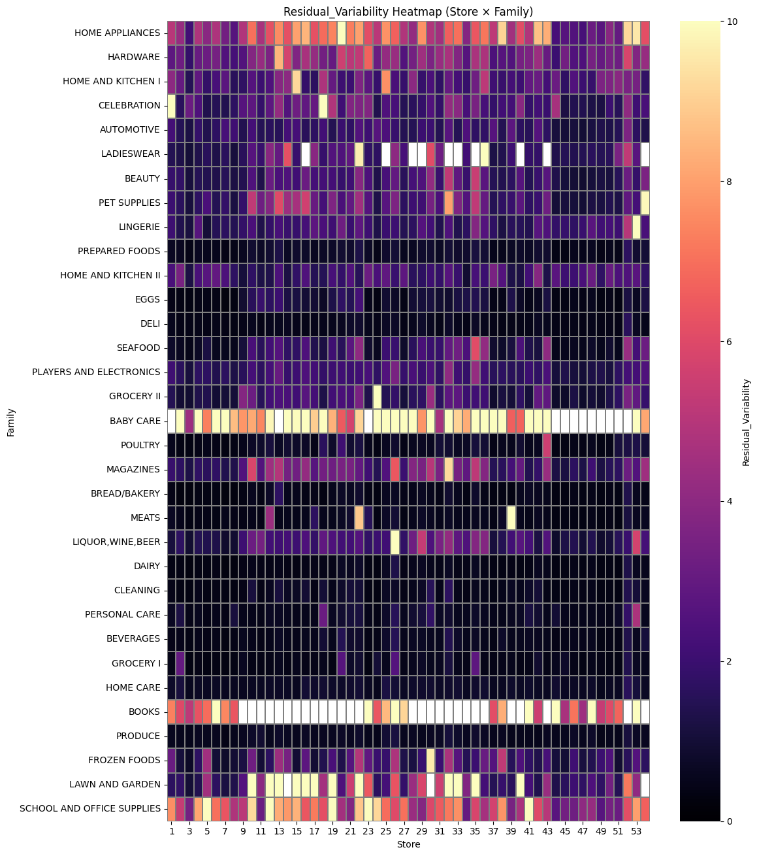
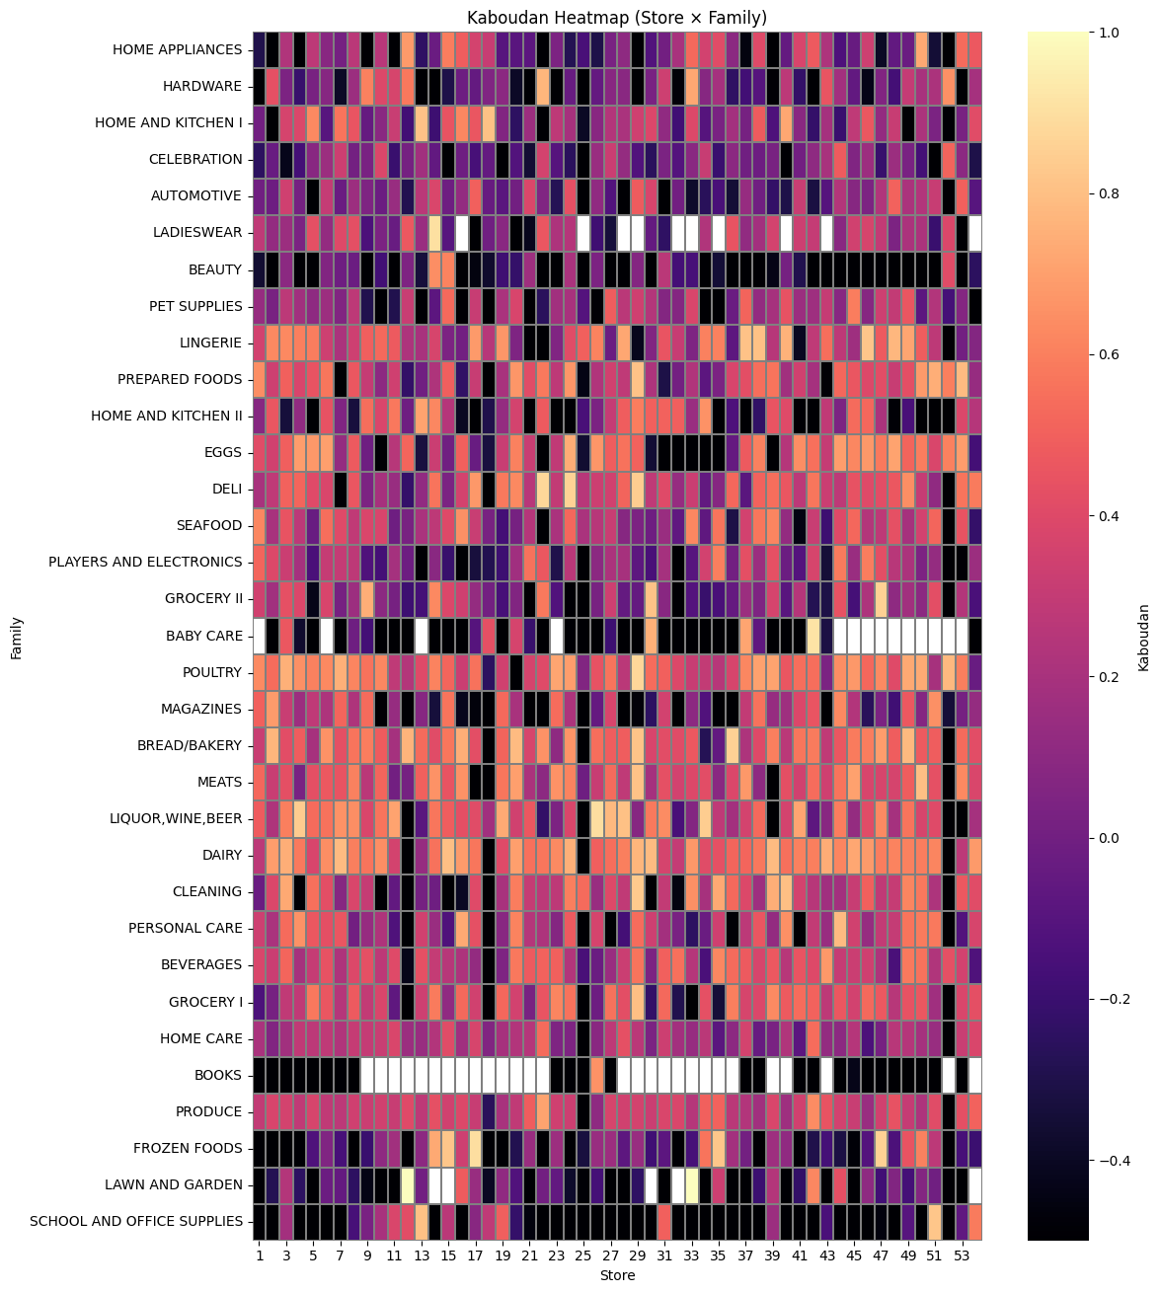
Forecastability

Slide 31
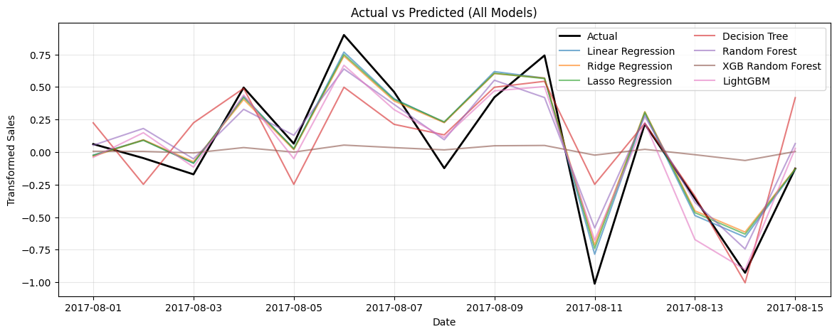
Machine Learning For Time Series
Target transformations (log, detrend, deseasonalize)
Time-delay features (lags, rolling stats)
Temporal features (calendar, Fourier)
Regression / ML models

Slide 32
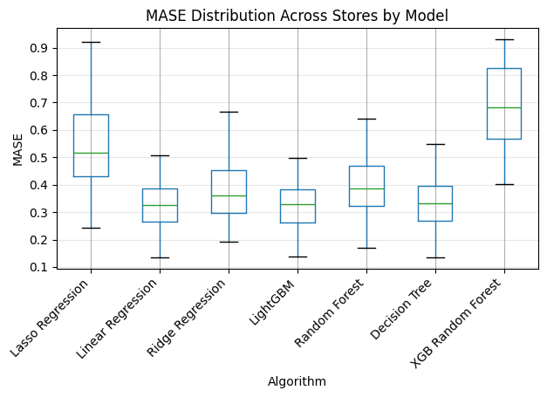
ML: for a specific product family across all stores

Slide 33
Statistical vs ML methods

Slide 34
Global Forecast Model
Training one model per store-product combination is inefficient
Not able to take advantage of the entire time series (data quantity)
All related time series share a common underlying structure, even if their levels differ.
Instead of fitting N models for N series, we fit one model across all series.

Slide 35
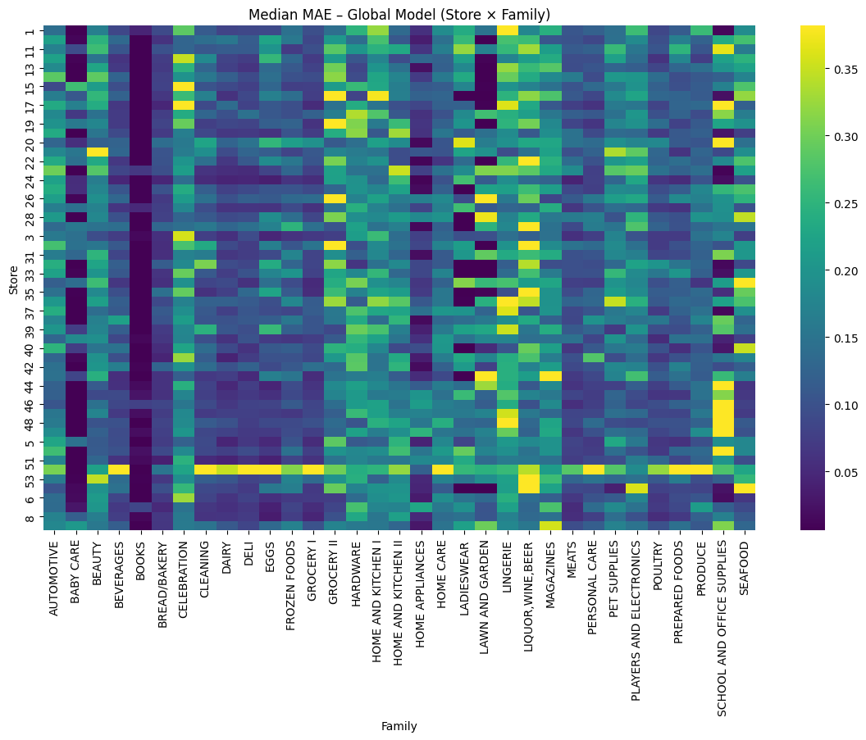
Global Forecast Model

Slide 36
Deployment
Training System
Builds / updates models
Runs offline (daily / weekly)
Inference system
Generates forecasts
Must be reliable, fast, reproducible
Monitoring & retraining system
Detects drift / degradation
Check model health and retrain
Often batch (not real-time)

Slide 37
Deployment: Retraining
Scheduled retraining
Rolling window retraining
Performance-triggered retraining

Slide 38
Reference Materials Used
Modern Time Series Forecasting with Python, Second Edition, Manu Joseph, Jeffrey Tackes
https://github.com/Nixtla/statsforecast
https://github.com/Nixtla/mlforecast

