Slide 1
DS-P_593 Product Recommendation app
By Group 3

Slide 2
Group 3 Team Members:
Mohammad Ashhar Farooqui | nazzfarooqui22@gmail.com
Trishnasree Das | tusti.1319@gmail.com
Dnyaneshwar Santosh Jadhav | dnyaneshwarjadhav1125@gmail.com

Slide 3
Project: Product Recommendation
The primary objective of this project is to develop and implement a recommendation system for an e-commerce platform that enhances customer experience by providing personalized product suggestions. The system will utilize item-item collaborative filtering to analyze user behavior and product ratings, identifying relationships between items based on user preferences.
By predicting the ratings or preferences a user might assign to unrated products, the system aims to:
Improve user engagement and customer satisfaction through relevant recommendations.
Increase sales conversion rates and average order value by encouraging product discovery.
Strengthen customer retention through a more tailored shopping experience.
UserId | Unique identifier for each user.
productId | Unique identifier for each product.
Rating | User’s rating for a given product, used to infer preference patterns.
timestamp | Time of the rating (excluded from analysis for this task).

Slide 4
Exploratory Data Analysis (EDA)
Data Loading
Load dataset from CSV
Preview data with head()
Brief: Shows how the data is imported and initially inspected for correctness.
Data Quality Checks
Check data info and missing values
Statistical summary of ratings
Brief: Ensures data integrity by checking for missing values and understanding basic statistics.

Slide 5
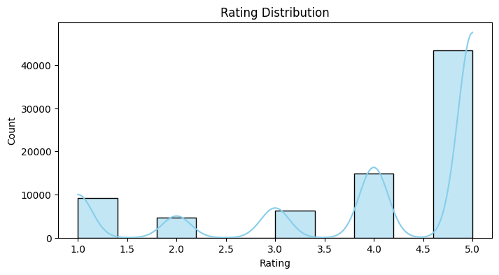
Data Visualization
Rating Distribution
Most ratings are positive (4 or 5)
Histogram visualizes distribution
Brief: Analyzes how users rate products, showing a tendency toward positive feedback.

Slide 6
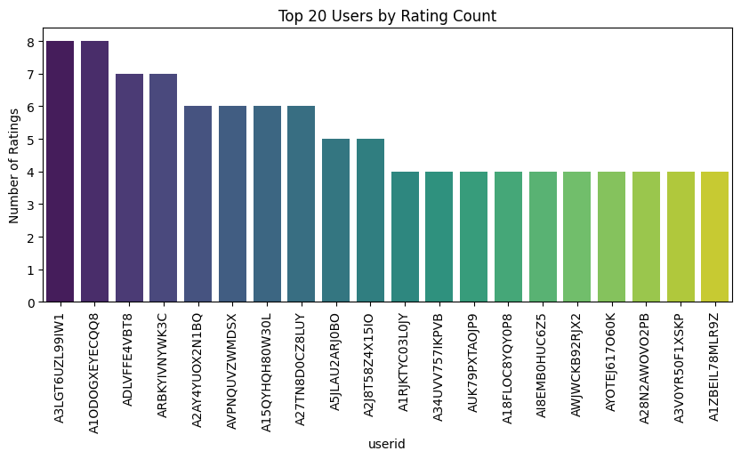
User Activity
Top 20 users by rating count
Bar plot shows user engagement
Brief: Identifies the most active users, which can influence recommendation strategies.

Slide 7
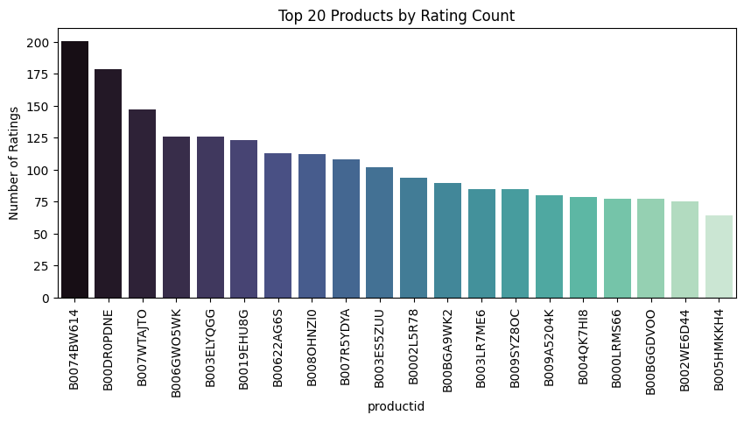
Product Activity
Top 20 products by rating count
Barplot shows popular products
Brief: Highlights products with the most ratings, indicating popularity and potential recommendation candidates.

Slide 8
Feature Engineering
The 'Date' column was converted to a numerical timestamp, allowing models to better capture time-based patterns.
Extract year and month features
Brief: Enhances the dataset by creating new time-based features for deeper analysis.

Slide 9
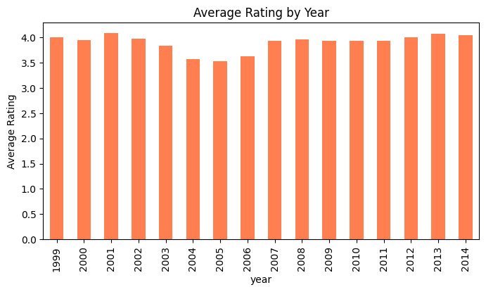
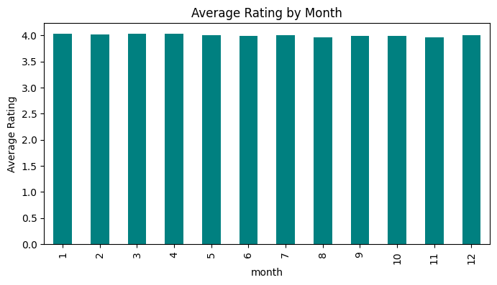
Ratings Over Time
Average rating by year
Average rating by month
Barplots show trends
Brief: Examines how ratings change over time, revealing seasonal or yearly patterns.

Slide 10
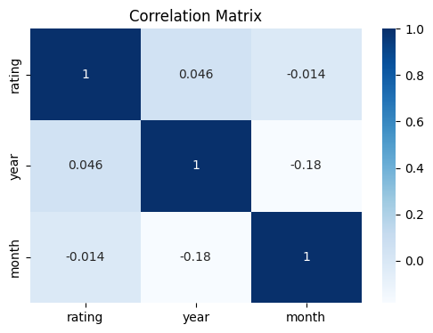
Correlation Analysis
Correlation matrix for rating, year, month
Heatmap visualization
Brief: Investigates relationships between features to inform model selection.

Slide 11
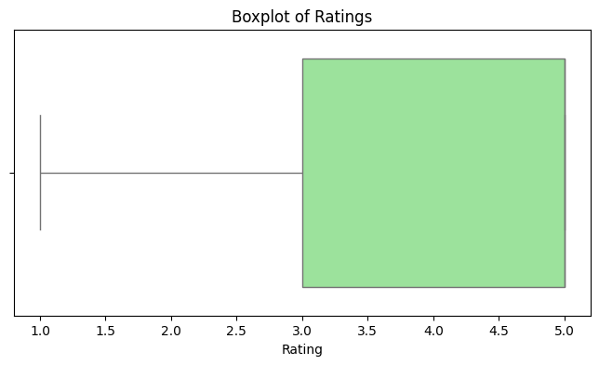
Outlier Detection
Boxplot for ratings
Identify outliers in user feedback
Brief: Detects unusual rating behavior that may affect model accuracy.

Slide 12
Key Insights
Ratings are mostly positive
Some users/products are highly active
Ratings consistent over time
Brief: Summarizes main findings from EDA, guiding model building.

Slide 13
Modeling Approaches
User-User Collaborative Filtering
Item-Item Collaborative Filtering
Content-Based Filtering
Matrix Factorization (SVD)
Random Forest Regression
Brief: Lists and briefly describes each modeling technique to be compared.

Slide 14
User-User Collaborative Filtering
Finds similar users
Recommends products rated by similar users
Memory-based, efficient
Brief: Explains how user similarity is leveraged for recommendations.

Slide 15
Item-Item Collaborative Filtering
Finds similar products
Recommends products similar to those rated by user
Memory-based, efficient
Brief: Focuses on product similarity for personalized suggestions.

Slide 16
Content-Based Filtering
Uses product features (average rating)
Recommends top-rated products not yet rated by user
Brief: Relies on product attributes for recommendations, useful for new users.

Slide 17
Matrix Factorization (SVD)
Decomposes user-item matrix
Handles sparsity, provides personalized recommendations
Brief: Uses latent features to predict ratings, effective for large datasets.

Slide 18
Model Comparison & Recommendation
SVD is best for large, sparse datasets
User/Item CF efficient but cold start issues
Content-Based is simple, limited personalization
Random Forest useful for regression, less collaborative effect
Proceed with SVD for production
Brief: Compares models, recommends SVD for deployment, and summarizes strengths/weaknesses.

Slide 19
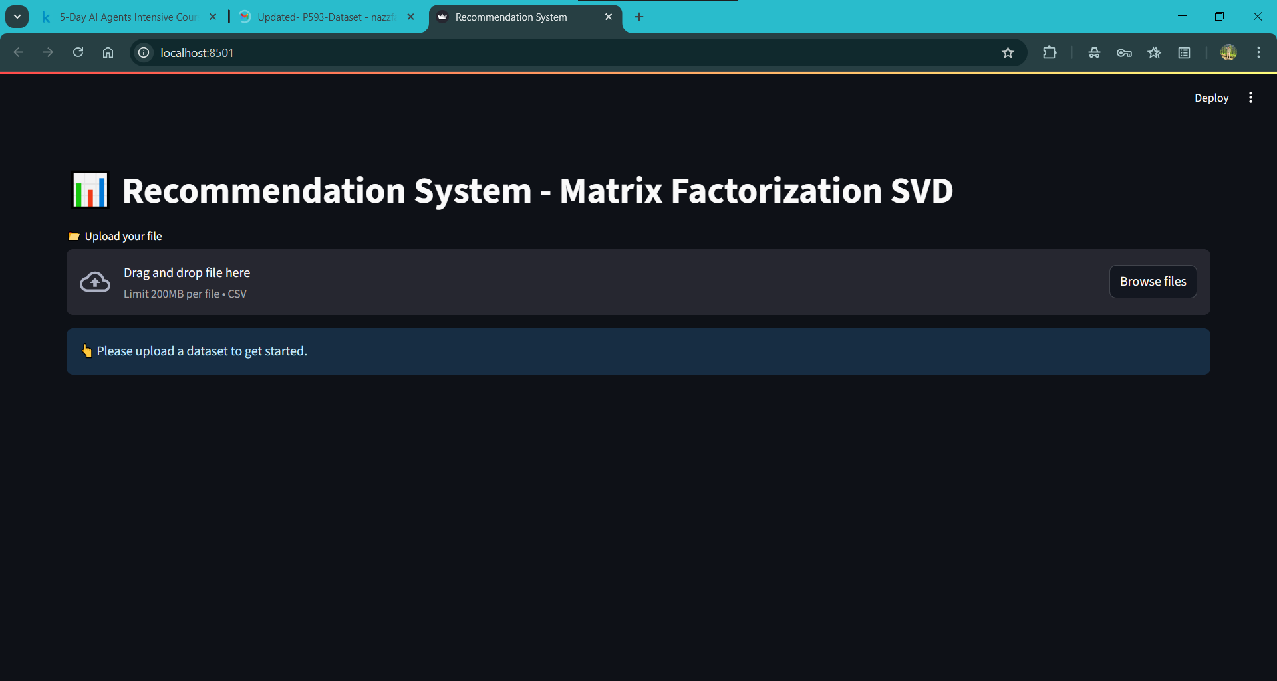
Screenshot of the Streamlit App Page

Slide 20
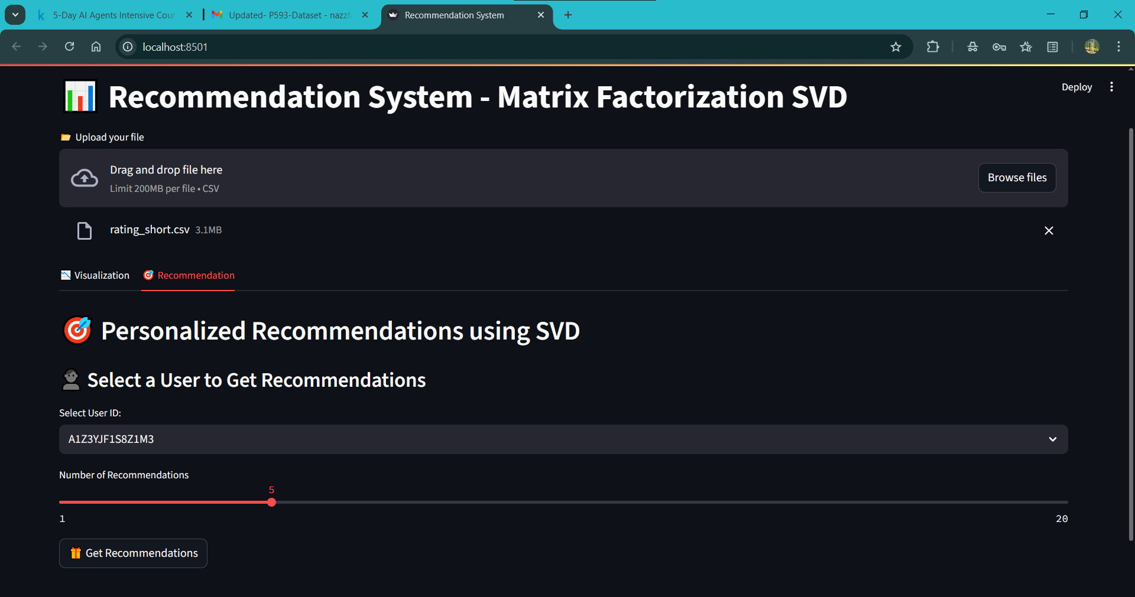

Slide 21
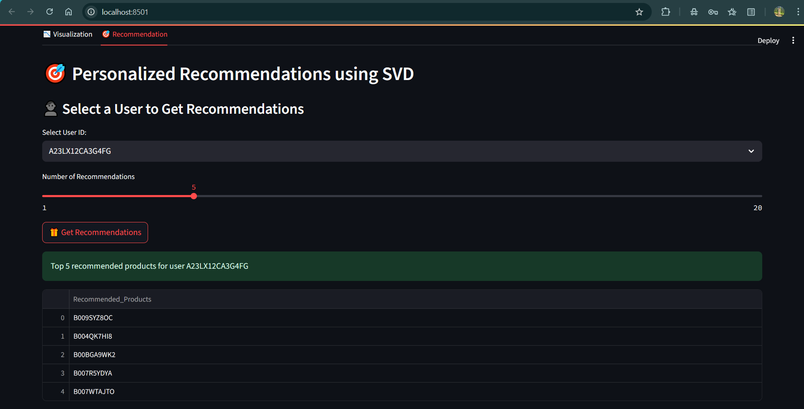

Slide 22
Challenges Faced During the Project
Data sparsity: Many users and products with few ratings, making collaborative filtering challenging.
Cold start problem: Difficulty recommending for new users or new products with little or no history.
Memory management: Large user-item matrices required efficient sparse matrix implementations to avoid memory errors.
Model selection: Comparing multiple approaches to find the best fit for the dataset and business requirements.
Feature engineering: Limited product/user features restricted the use of advanced content-based methods.
Evaluation: Ensuring fair and robust model comparison using appropriate metrics and validation techniques.

Slide 23
Thanks !

