Slide 1

Predictive Event Modeling - Propensity to watch a video
Team Alpha
Sankalp Mule
Ashhar Shaikh
Faraz Shaikh
Siddesh Thakre

Slide 2
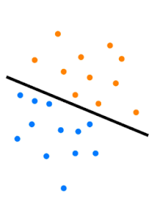
Problem Definition
Segment the audience of a content app based on its user’s propensity to watch a video in the next 2 days:
Classification Task
– Classify based on the user’s propensity to watch a video into:
‘0’ (Wont watch a video in next 2 days)
or
‘1’ (Will watch a video in next 2 days)

Slide 3
Problem Definition
Segment the audience of a content app based on its user’s propensity to watch a video in the next 2 days:
Classification Task
– Classify based on the user’s propensity to watch a video into:
‘0’ (Wont watch a video in next 2 days)
or
‘1’ (Will watch a video in next 2 days)

Slide 4
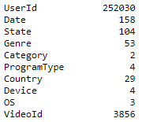
Dataset
df.nunique()
Number of Unique Users: 2,52,030
Number of Unique Videos: 3,856
Total Number of Genres: 53

Slide 5
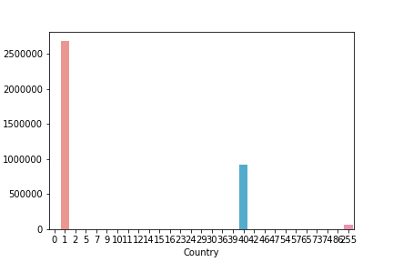
EDA
Country Count Plot based on Country Codes
26 L Records
with Country Code 1

Slide 6
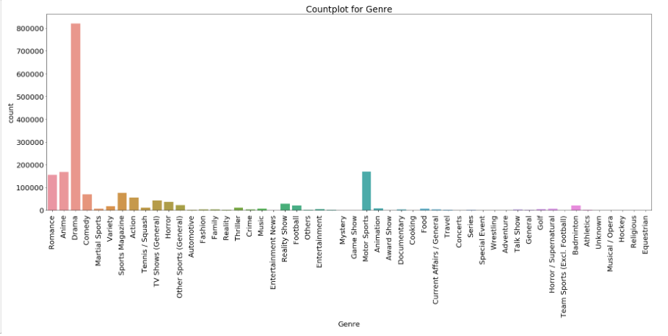
Drama:
Most watched Genre

Slide 7

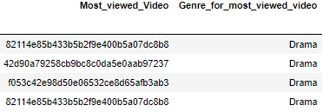
Country-wise Virality
Video Id and Genre of Most watched videos (Coutry-wise)

Slide 8
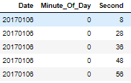

Feature Engineering
Creating Timestamp:
df['Start_Time_hr'] = df['Minute_Of_Day']//60
df['Start_Time_min'] = df['Minute_Of_Day']%60
df['Start_Time_sec'] = df['Second']
df['Start_Time_hr'] = df['Start_Time_hr'].apply(lambda x: str(x).zfill(2))
df['Start_Time_min'] = df['Start_Time_min'].apply(lambda x: str(x).zfill(2) )
df['Start_Time_sec'] =df['Start_Time_sec'].apply(lambda x: str(x).zfill(2))
df['time'] = df['Start_Time_hr'] + str(':') + df['Start_Time_min'] + str(':') +
df['Start_Time_sec']
df['date-time'] = df['Date'].apply(str) + ' ' + df['time'].apply(str)
df['date-time'] = pd.to_datetime(df['date-time'])

Slide 9
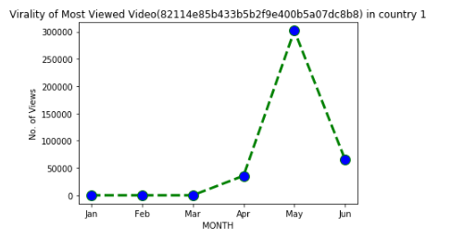
Virality of Most Viewed Video
(VideoId: 82114e85b433b5b2f9e400b5a07dc8b8)
Country 1

Slide 10
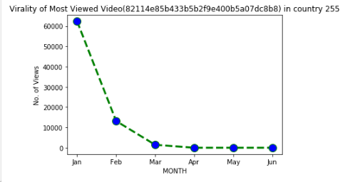
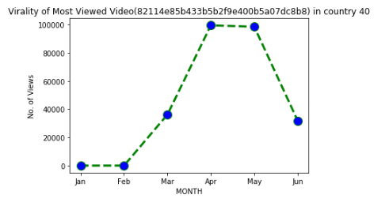
Country 40
Country 255

Slide 11
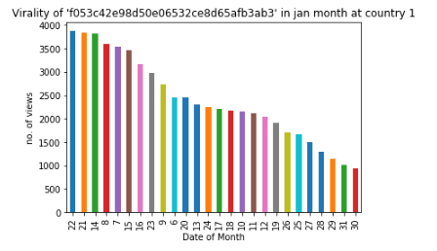
Virality of Most viewed video of Country 255 in January
VideoId: f053c42e98d50e06532ce8d65afb3ab3

Slide 12
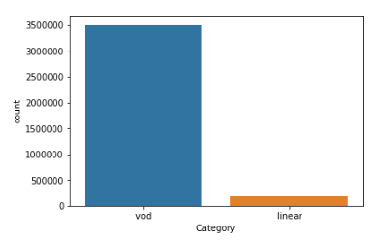
Category Countplot
1.7 L Linear
Category records

Slide 13
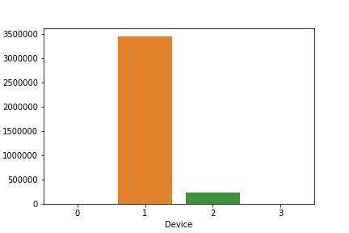
Countplot for Device
Labels:
0: Desktop
1: Mobile
2: Tablet
3: TV

Slide 14
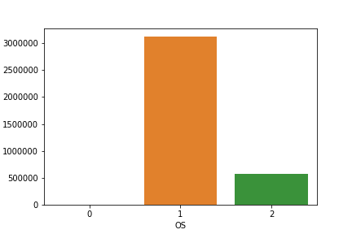
31L Android
User records
Countplot for Operating System used:
Label:
0: Others
1: Android
2: iOS

Slide 15
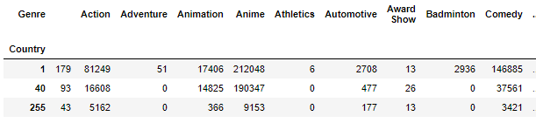
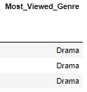
Most Viewed Genre (Country-wise)
3 rows × 54 columns

Slide 16
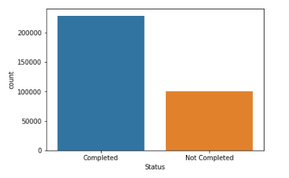
Count Plot for Status of Registration in Registration.csv

Slide 17
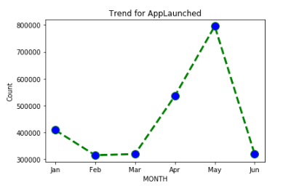
Trend of AppLaunched

Slide 18
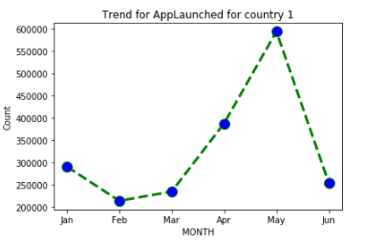
Trend of AppLaunched in Country 1

Slide 19
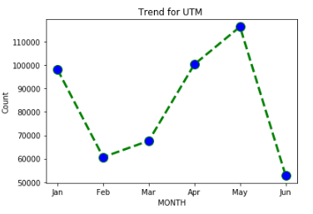
Trend for UTM Visited:

Slide 20
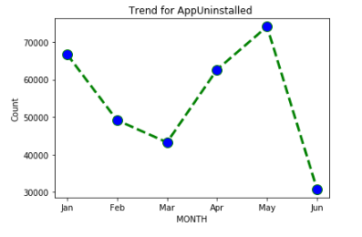
Trend for AppUninstalled

Slide 21
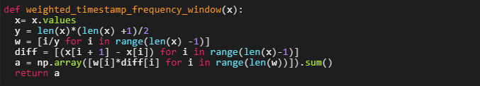
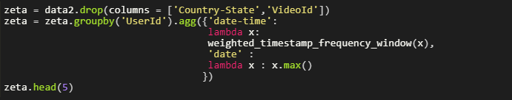
Model Building
Calculating Weighted Average Timestamp frequency:

Slide 22
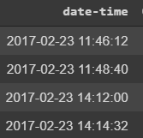
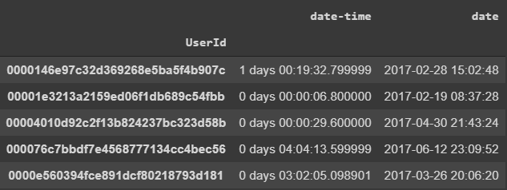
Difference x Weighted Average

Slide 23
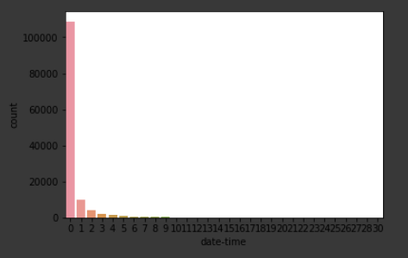

Slide 24
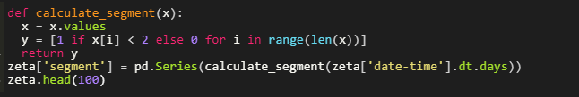
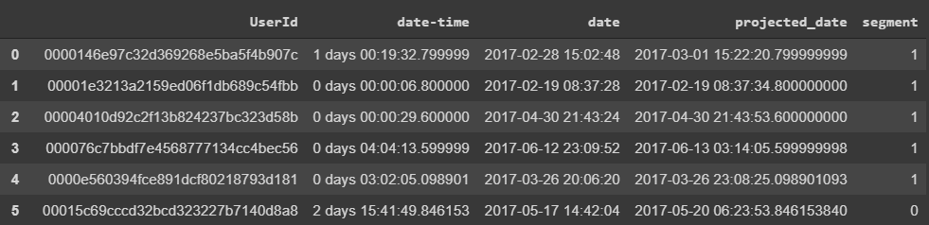
Calculating Segment for Each UserId

Slide 25
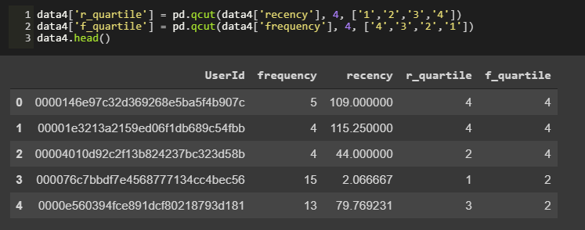

Slide 26
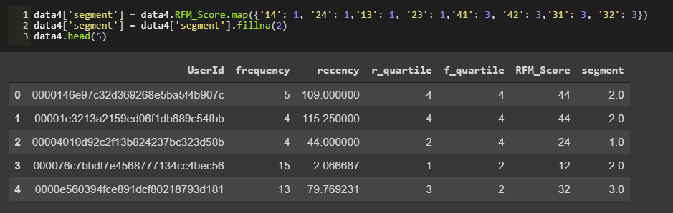

Slide 27
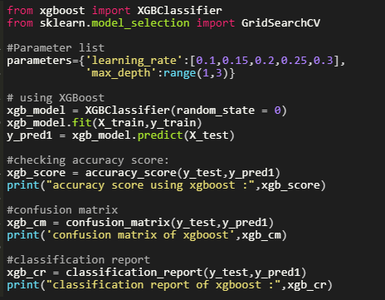

Slide 28
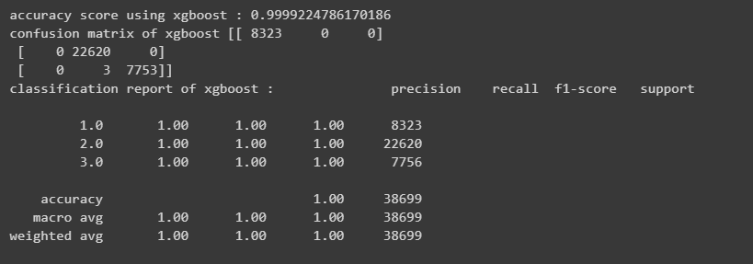
Xgboost Model

Slide 29
Inference
Calculating Weighted Timestamp frequency and then segmenting the Users was better than the XGBoost Model

