Slide 1

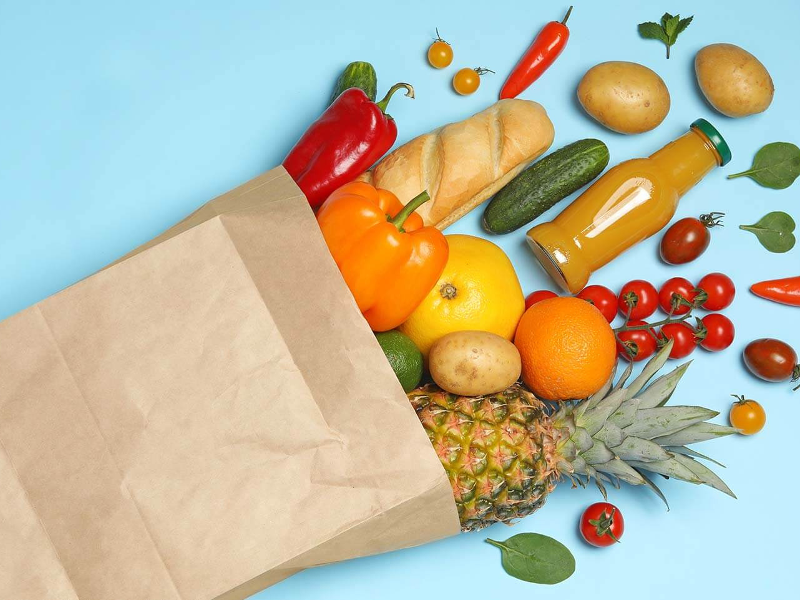
GO GROCERY
TEAM 20
Team Members
Ying Zhang
Yuhan Wang
Zoe Lin
Tyson Reed
Shane Johnson
Shriram Someshwar

Slide 2
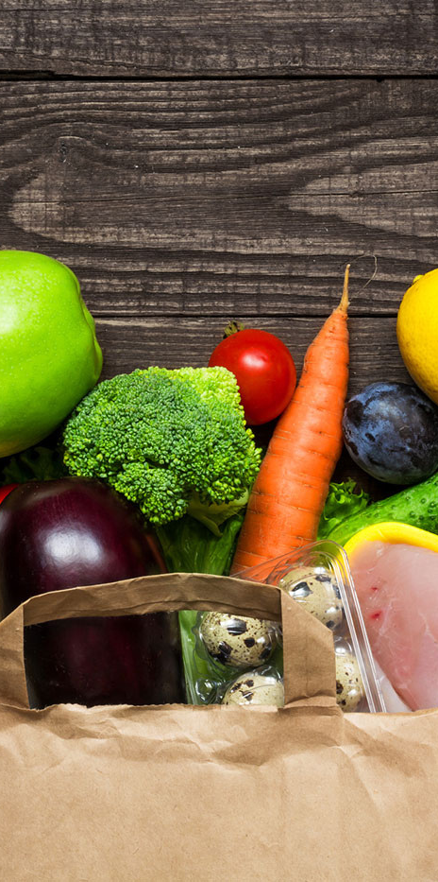
THEME
AND
VALUE PROPOSITION
Develop a price comparison app across grocery and retail stores, giving users the choice between time spent and money spent.
Save Customers 20% of their shopping time and 10% on the price of their groceries.

Slide 3

Marketing:
Place our app on multiple platforms and conduct marketing campaigns
Acquire a pool of influencers to promote the product.
Running ads through Google, FB and Twitter.
Recruit a pool of users and document their stories.
Reach out to multiple outlets.
Technical:
App store optimization and outreach
Building an App landing page to highlight the app’s usage.
Measure KPI’s
PRODUCT STRATEGY

Slide 4
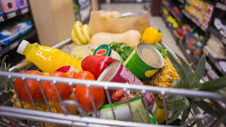
CUSTOMER SEGMENT
College students:
Grocery shop 2-3 times a month. Likely to grocery shop on the weekend
Price is a deciding factor
Use grocery-related apps such as instacart.
Post-college working-class:
Order on weekdays
More often to walk to the store, do not use grocery related apps
Will pay more instead of going traveling farther

Slide 5
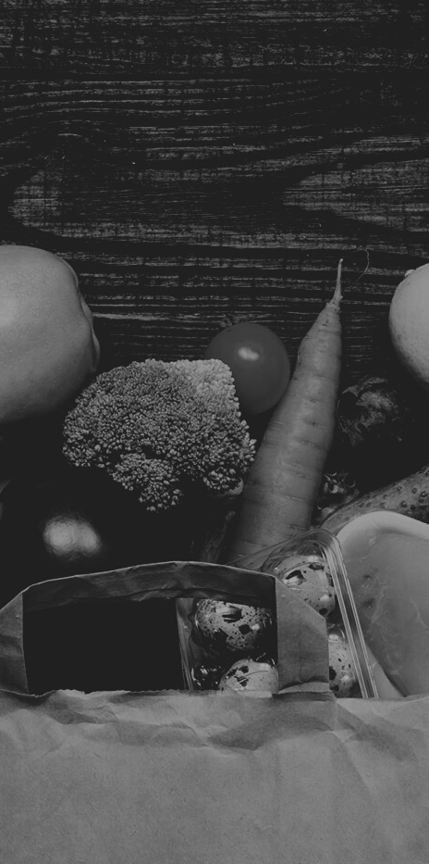
BUSINESS PLAN
Need for Product in college(save money) and post-college customer segment (save time).
Target both segments
Launch the app on App Stores by December 2022, and acquire 1000 sign-ups and 500 orders before February 2023

Slide 6

Technical Difficulties to develop
Software Development
Software Optimization
Customer Shortage
Supermarkets compliance with our service
Local market compliance with our service
Industry Entry Barriers are high（Industry Competition）
FEASIBILITY RISKS

Slide 7
WHAT QUESTIONS TO ASK
Current technology needs to support the lifestyles of time conscious, on the move individuals.
As Pandemic winds down, people will shift to in-person options moving GoGrocery to the forefront.

Slide 8
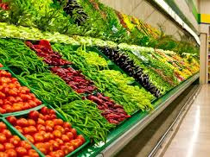
THANK YOU

