Slide 1
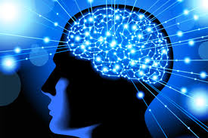
DMIA
Dermatoglyphics Multiple Intelligence Analysis

