Slide 1
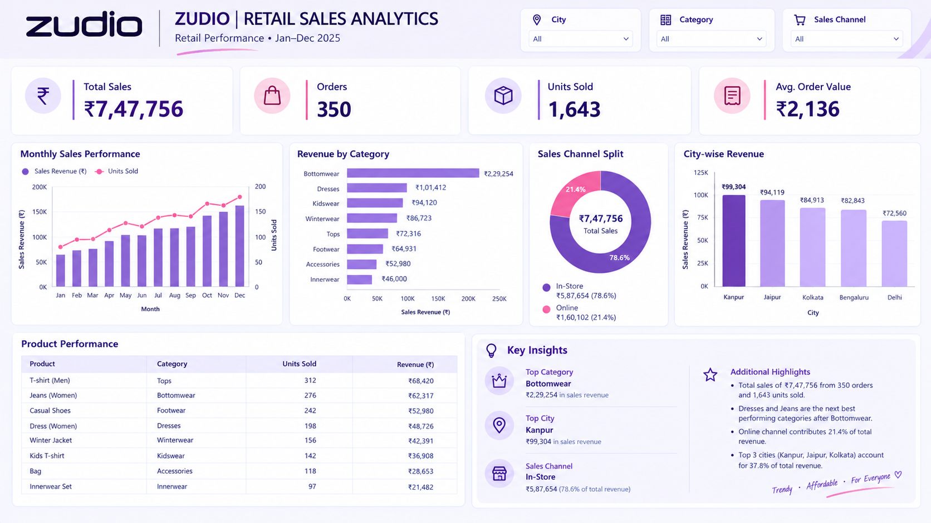
ZUDIO | RETAIL
SALES ANALYTICS
DASHBOARD
Understanding retail performance through data visualization
Presented by: Ashi
Class: BBABA22
Roll No.: 1250645037
University: BBDU
Retail Performance • Jan–Dec 2025

Slide 2
1. Introduction
What this dashboard is designed to do
Project overview
Purpose
This Power BI dashboard presents a retail sales overview for Zudio across January–December 2025. It brings sales, orders, units, product categories, channels and cities into one visual report.
• Track overall sales performance
• Compare categories, cities and sales channels
• Identify strong products and business patterns
• Support quicker, evidence-based decisions
2

Slide 3
2. KPI Cards: At-a-glance performance
Why we use cards at the top of the dashboard
Total Sales — ₹7,47,756
Orders — 350
Shows the total revenue generated in the selected period. It is the main measure of business performance and gives a quick financial overview.
Counts the number of orders. This helps understand transaction volume and compare demand across periods or filters.
Units Sold — 1,643
Average Order Value — ₹2,136
Shows the number of items sold. It helps measure product movement and inventory demand.
Shows average revenue per order (Total Sales ÷ Orders, approximately). It helps assess how much customers spend per transaction.
3

Slide 4
3. Interactive Filters (Slicers)
Why City, Category and Sales Channel are included
City slicer
Category slicer
Sales Channel slicer
Filters the report to one or more cities. Use it to compare local performance and explore where sales are strongest.
Focuses on a product category such as Bottomwear, Dresses or Footwear, helping users examine category-specific performance.
Filters results by In-Store or Online sales, making it easier to compare channel contribution and customer purchasing patterns.
4

Slide 5
4. Monthly Sales Performance
Visual used: Combo chart (columns + line)
Why this chart?
What it shows
Columns show monthly sales revenue, while the line shows units sold. A combo chart lets us compare two related measures over the same timeline without losing the trend in either measure.
• Sales generally rise toward the end of the year.
• December appears to be the strongest month in the displayed trend.
• Units sold also increase overall, suggesting higher product movement.
• Monthly patterns can help with stock planning and promotions.
5

Slide 6
5. Revenue by Category
Visual used: Horizontal bar chart
Why horizontal bars?
What it shows
Categories have long names, so horizontal bars keep labels readable. The bars make it easy to compare revenue and rank categories from highest to lowest.
Bottomwear is the top category at about ₹2,29,254. Dresses and Kidswear follow in the displayed report. Lower-revenue categories may need a closer look at demand, pricing, assortment or promotion.
6

Slide 7
6. Sales Channel Split & City-wise Revenue
Two visuals answer two different business questions
Donut chart — channel share
Column chart — city revenue
Why: a donut chart highlights each channel's proportion of total sales.
What it shows: In-Store contributes ₹5,87,654 (78.6%), while Online contributes ₹1,60,102 (21.4%). In-store is the larger revenue channel in this dataset.
Why: vertical bars compare revenue across cities quickly.
What it shows: Kanpur is highest among the displayed cities at ₹99,304, followed by Jaipur at ₹94,119 and Kolkata at ₹84,913. This helps compare regional performance.
7

Slide 8
7. Product Performance Table
Why a table is useful alongside charts
Why use a table?
How to interpret it
Charts reveal broad patterns, while a table gives exact values for individual products. Product, category, units sold and revenue can be checked together.
The table includes products such as T-shirt (Men), Jeans (Women), Casual Shoes and Dress (Women). It helps identify high-selling products, compare revenue and spot products that may need inventory or marketing attention.
8

Slide 9
8. Key Insights from the Dashboard
Turning visuals into practical business observations
Category and geography
Channel and overall scale
• Bottomwear is the largest revenue category in the displayed data.
• Kanpur leads the cities shown.
• Dresses and Jeans are highlighted as strong performers after Bottomwear.
• In-Store accounts for 78.6% of sales; Online accounts for 21.4%.
• The dashboard reports ₹7,47,756 sales from 350 orders and 1,643 units.
• These insights can guide stock allocation, city-level campaigns and online-channel improvement.
9

Slide 10
9. How to Use the Dashboard & Data Note
Good practice when presenting a Power BI report
How to explore
Data note
1. Select a City, Category or Sales Channel slicer.
2. Observe how KPI cards and charts update.
3. Compare trends and rankings before drawing conclusions.
4. Clear filters to return to the overall view.
The figures shown are taken from the supplied dashboard image. Before final submission, verify that all visuals use the same date range and that KPI totals reconcile with the source dataset. The report is a descriptive analysis, not proof of why a trend occurred.
10

Slide 11
10. Conclusion
Summary and business value
Conclusion
Final takeaway
The Zudio Retail Sales Analytics Dashboard converts sales data into an easy-to-read performance summary. KPI cards show the overall position, charts compare time, category, channel and city, and the product table provides detailed values.
The displayed data points to Bottomwear as the leading category, In-Store as the main sales channel, and Kanpur as the strongest city among those shown. Using these insights with regular data checks can support better inventory planning, targeted promotions and informed retail decisions.
11

Slide 12
THANK YOU
Questions & Discussion
Ashi | BBABA22 | Roll No. 1250645037
BBDU
Zudio Retail Sales Analytics • Jan–Dec 2025

