Slide 2
Project Title
Lossless Data Compression Algorithms and their Comparison
Project Guide
GL PRAKASH
Asst. Professor (S.G.),
Department of Virtualization | SoCS|UPES,
Dehradun, India

Slide 3
Team Members & Role
S.NO. | Name of the Student | Role of the Student
1. | Ashi Agarwal | Shannonfano Algorithm Implementation
2. | Arpit Bhardwaj | Huffmann Algorithm Implementation
3. | Ashish Bansal | Lempel-ziv Algorithm implementation
4. | Deepanshu Goyal | Comparison & Suggest improvements

Slide 4
Introduction
These days the exponential growth of data leads to high computation requirements which is not always available at user’s end, so compression basically reduces the redundancy in data representation thus decreasing the size of data which when transferred over network consumes less bandwidth and also decreases the cost of storing it.
Notes:
4

Slide 5
There are number of data compression algorithms which use different approaches, in our project we will examine lossless data compression algorithms like Huffman encoding algorithm, Lempel-Ziv-Welch algorithm, and Shannon-Fano algorithm and comparing their performance.

Slide 6
Problem Statement
Storage on the cloud is a limited resource. Even though more storage space can be purchased, it seems better to utilize the given space to the fullest. The solution to this problem is data compression. Compress data to save space and then store it on the cloud, also in doing so, we save the data transmission cost over the network and make our cloud storage even more efficient.

Slide 7
Motivation
Cloud computing has turned out be an excellent way to cope up with the data growth, but somewhere down the lane cloud computing also requires physical infrastructure.
Processing of large amount data requires time, so processing of redundant data wastes lot of time .So we need the Compression of Data.
According to the Google[ref10] Users of the Internet generate 2.5 quintillion bytes of data each day, on average, according to recent research cites by Domo .So to store this high amount of data we need a lot of Storage, So it is the need of hour to Compress the Data.
All these factors motivates us to study these compression algorithms.

Slide 8
Objectives
Implementation of :
Huffman's encoding Algorithm
Shannon – Fano Algorithm
Lempel – Zev Welch Algorithm
Comparison of all three algorithms on the basis of:
=> Degree of compression
=> Time
=> Code Efficiency
Implementation and deployment of compressed text on cloud.

Slide 9
Software/ Hardware Requirement
•Hardware Interface:
64 bits processor architecture supported by windows.
Minimum RAM requirement for proper functioning is 8 GB.
Required input as well as output devices.
•Software Interface:
C Compiler (GCC).
AWS CLOUD SERVICES.
Socket Programming Library in C.

Slide 10
Methodology
Huffman's encoding algorithm:
Huffman encoding-
There are 2 major parts of Huffman encoding
1) Creating The Huffman tree for given input Character (step 1-5)
2) Traversing the Huffman tree to assign code to Characters (step 6)
Step 1: Create a leaf node for all unique input Character and build a min heap for all leaf node
Step 2: Take 2 Node with minimum frequency from min heap

Slide 11
Step 3: Create a new internal node And assign frequency equal to sum of the 2 nodes frequency taken in step 2 And assign fist taken node as a left child and second taken node as a right child
Step 4: add internal node (Created in step 3) To the min heap
Step 5: Repeat step 2,3,4 Until Heap contain only one node. This Node is root Node and tree has been completed
Step 6: Traverse the Tree starting from the root Maintain an auxilary array While moving to the left child, write 0 to the array. While moving to the right child, write 1 to the array. Print the array when a leaf node is encountered.

Slide 12
Shannon – Fano Algorithm :
For a given list of symbols, develop a corresponding list of probabilities or frequency counts so that each symbol’s relative frequency of occurrence is known.
2. Sort the lists of symbols according to frequency, with the most frequently occurring symbols at the left and the least common at the right.
3. Divide the list into two parts, with the total frequency counts of the left part being as close to the total of the right as possible.
.
Notes:
12

Slide 13
4. The left part of the list is assigned the binary digit 0, and the right part is assigned the digit 1. This means that the codes for the symbols in the first part will all start with 0, and the codes in the second part will all start with 1.
5. Recursively apply the steps 3 and 4 to each of the two halves, subdividing groups and adding bits to the codes until each symbol has become a corresponding code leaf on the tree

Slide 14
Lempel – Zev Welch Algorithm:
LZW compression uses a code table, with 4096 as a common choice for the number of table entries. Codes 0-255 in the code table are always assigned to represent single bytes from the input file.
When encoding begins the code table contains only the first 256 entries, with the remainder of the table being blanks. Compression is achieved by using codes 256 through 4095 to represent sequences of bytes.
As the encoding continues, LZW identifies repeated sequences in the data, and adds them to the code table.
Decoding is achieved by taking each code from the compressed file and translating it through the code table to find what character or characters it represents.

Slide 15
Comparison:
Compression Ratio
Compression Factor
Time complexity
Saving Percentage
Code Efficiency

Slide 16
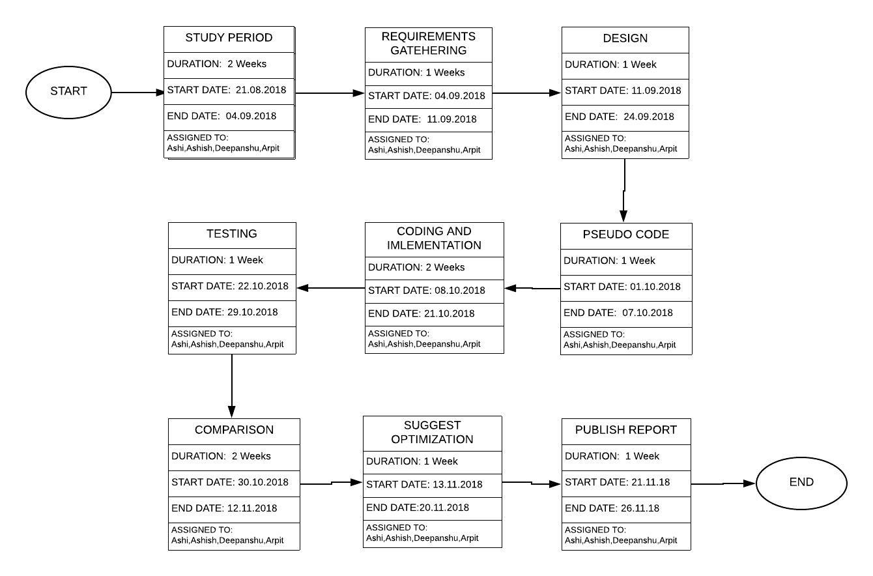
PERT Chart

Slide 17
References
Monika Soni , Dr Neeraj Shukla “Data Compression Techniques in Cloud Computing”
Mohammad Hosseini “A Survey of Data Compression Algorithms and their Applications”
Pu, I.M., 2006, Fundamental Data Compression, Elsevier, Britain.
Kesheng, W., J. Otoo and S. Arie, 2006. Optimizing bitmap indices with efficient compression, ACM Trans. Database Systems, 31: 1-38.
https://www.google.com/url?sa=t&rct=j&q=&esrc=s&source=web&cd=15&ved=2ahUKEwjW8piM_q_dAhVHyrwKHXE2DHoQFjAOegQIABAC&url=http%3A%2F%2Fecehithaldia.in%2Fteaching_material%2FShanon-Fano1586521731.pdf&usg=AOvVaw0MHM4foSS-sDhzqyRAVfaE
S.R. Kodituwakku ,U. S. Amarasinghe “Comparision of Lossless data compression algorithms for text data”
Highly Efficient Compression Algorithms for Multichannel EEG,Laxmi Shaw , Student Member, IEEE , Daleef Rahman, and Aurobinda Routray, Senior Member, IEEE
A Survey of Data Compression Algorithms and their Applications ,Mohammad Hosseini
Network Systems Lab, School of Computing Science, Simon Fraser University, BC, Canada,Email: mohammad hosseini@sfu.ca
ref10-https://www.marketingprofs.com/charts/2017/32531/the-incredible-amount-of-data-generated-online-every-minute-infographic

