Slide 1

IPL Match Winner Prediction
Machine Learning Project
Muhammed Ashif T| DA & DS
Trainee

Slide 2
Introduction
Problem overview
Importance of match outcome prediction
Machine learning approach

Slide 3
Dataset Overview
IPL match dataset
Season, teams, toss details, venue
Target variable: Winner

Slide 4
Data Cleaning
Removed missing values
Selected relevant features
Encoded categorical variables

Slide 5
Exploratory Data Analysis
Team-wise performance
Toss impact analysis
Venue-based match distribution

Slide 6
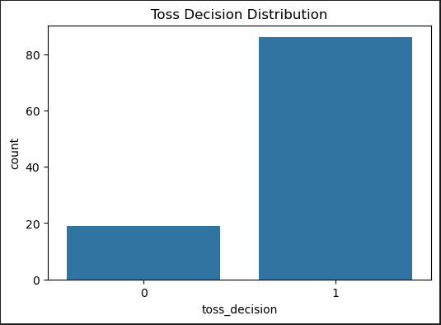

Slide 7
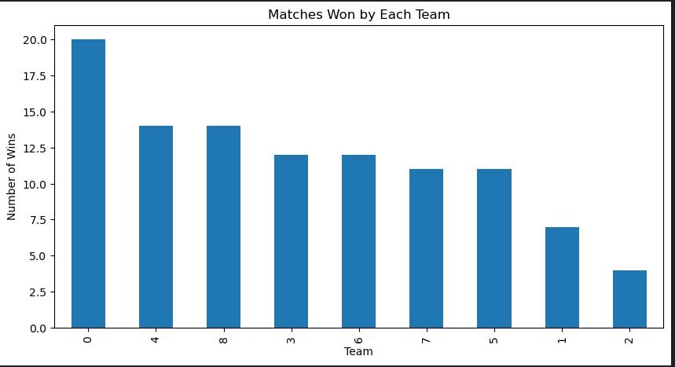

Slide 8
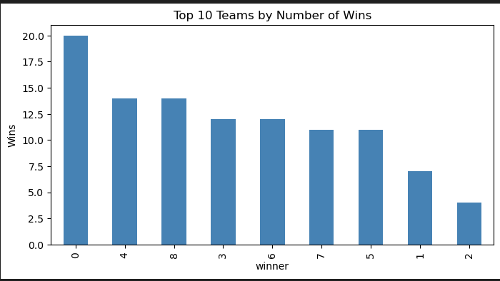

Slide 9
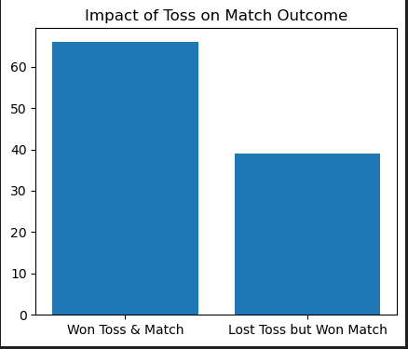

Slide 10
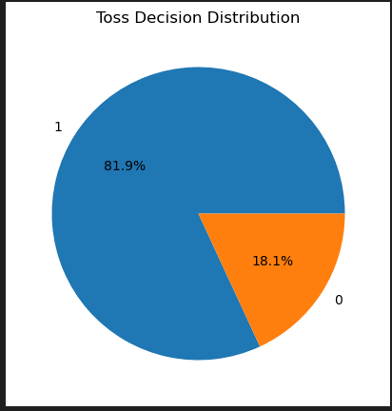

Slide 11
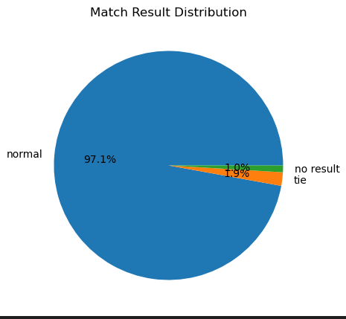

Slide 12
Modeling Process
Logistic Regression
SVM
KNN
Decision Tree
Random Forest
GridSearchCV

Slide 13
Model Comparison
Accuracy, Precision, Recall, F1-score
Random Forest performed best

Slide 14
Conclusion & Future Work
Random Forest selected as final model
Add player stats & team form
Model deployment

